Slide 1
Pain and pleasure: Greek deformations on the botanical terminology of the ms. Vat. Lat. 4418
Marta Punsola Munárriz (IMF-CSIC)
2n Congrés Internacional d’ARDIT
20 de maig de 2015

Slide 2
Codex Vat. Lat. 4418
Miscellaneous manuscript
Italy, s. XI
Caroline minuscule, several hands
Medical content
Personal use

Slide 3
Content of Vat. Lat. 4418
Galenus, Ad Glauconem de medendi methodo L. I-II (ff. 1r-8v, 25r-48v, 9r-24r)
Galenus, Liber tertius (ff. 24r-24v, 49r-67v)
<Aurelius, De acutis passionibus> (ff. 67v-79v)
<Aesculapius>, Liber quintus (ff. 80r-101v)
Galenus, De podagra (ff. 101v-107v)
<Sapientia artis medicinae> (ff. 107v-109r)
Vindicianus, Epistula ad Pentadium (ff. 109r-110r)

Slide 4
Content of Vat. Lat. 4418
Item alia prognostica Ypocratis designis tysicorum et pleureticorum sic probabis (f. 110v)
Pharmacopoeia (ff. 111r-143v)
Medical and botanical glossary (ff. 143v-148v)
Verses on the Egyptian days (f. 149r)
Non identified work (f. 149v)
Phlebotomy lunar calendar (f. 149v)
<Dynamidia L. I-III> (ff. 150r-171r)

Slide 5
Knowledge of Greek medicine
Latin medical and botanical terminology: Greek origin
s. XI: recuperation of Greek medicine through Arabic works
Importance of Latin translations, 2 neuralgic centres:
Salerno (Constantin the African)
Toledo (Gerard of Cremona)
Fixation of a Latin specialised terminology
Glossaries are not theoretical works, they are fundamentally practical tools

Slide 6
Vat. Lat. 4418: Medical and botanical glossary
576 glosses, 2 columns, alphabetical order
Work of reference, prescriptive nature
Content:
medicinal plants
minerals
animals and animal substances
Notable presence of Greek words

Slide 7
Types of glosses
atrafax (ἀτράφαξυς); iarim (ἰάριν); mirmix (μύρμηξ); ophis (ὄφις)
meconus onigru idest papauer ortense; origanu idest colena; tridax idest lactuca
hydor imbrion idest aqua pluuialis; stear idest ade[p]s porcinus
amilu idest tritici sucus quod in estiuo componitur tempore; quercus idest arbor ferens glandes

Slide 8
Greek deformations and alterations
Most common phenomena
- Iotacism
- Loss of aspiration
- Vocalic change
- Devoicing and sonorantisation
Paronymic attraction
Change of gender
Formation from the genitive
False etymologies
Palaeographical errors

Slide 9
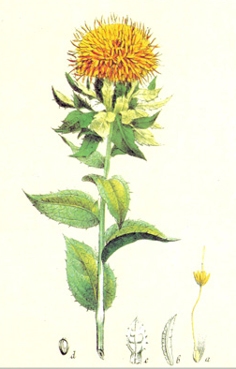
Anticrocu
Gloss 35: anticrocu idest
flos ambuci
Carthamus tinctorius L.
(‘safflower’)
Diosc. gr. 4, 188
(gr. κνῆκος, ‘yellow’)
ἄνθος κρόκῳ ὅμοιον
(κρόκος, ‘saffron’)

Slide 10
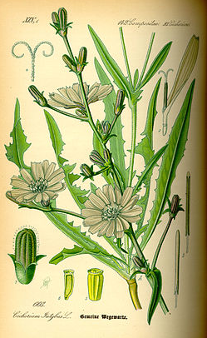
Concerion
Gloss 142: concerion
Cichorium intybus L. (‘chicory’)
gr. κιχόρεια (Diosc. gr. 2, 132)
cocurion .i. intuua
(Gloss. III 555, 27)
cocorion idest intuba agreste
(Gloss. III 538, 5; 621, 33)
cocerion .i. intiba agrestis
(Laud Herbal Gloss. 396)
concerion idest intiba agrestis
(Vat. Lat. 4418)

Slide 11
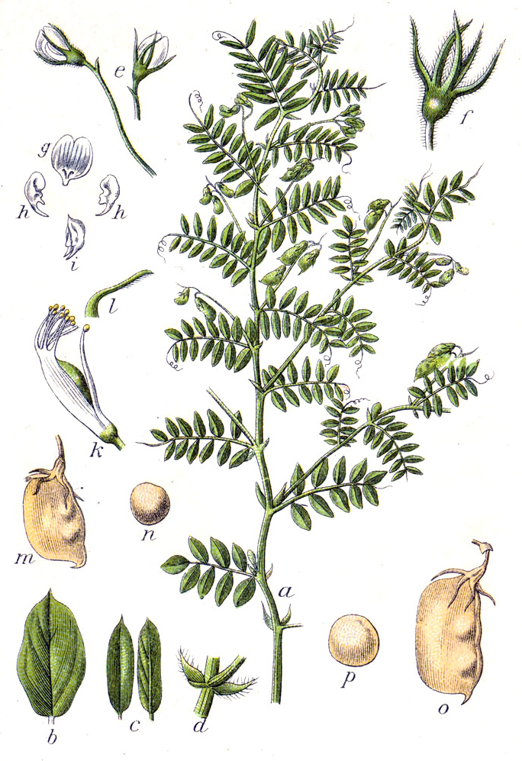
Agus
Gloss 81: agus idest lenticula
Lens culinaris Medik (‘lentil’)
gr. φακός (Diosc. gr. 2, 107)
Gloss 237: facus idest lencula
Correction:
[F]agus idest lenticula
Facus idest len[ti]cula

Slide 12
Examples of doublets
actis-hyctis (gr. ἀκτῆ) Sambucus nigra L. uel Sambucus ebulus L.
cimofabion-cynocefalion (gr. κυνοκεφάλιον) Antirrhinum orontium L.
eusenio-eozomon (gr. εὔζωμον) Eruca vesicaria L.
canibri-kambris (gr. κράμβη) Brassica L.
ediosmon-hydicismon (gr. ἡδύοσμον) Mentha silvestris L.
criidi-krite (gr. κριθή) Hordeum sativum L.
silomacar-xiloniacor (gr. ξυλόμακερ) Rheum officinale L.

Slide 13
Conclusions
Lack of knowledge → errors and deformations
Medical and botanical glossaries are a practical tool
Objective: better understanding of the theory, deciphering obscure medical texts and their terminology

Slide 14
Pain and pleasure: Greek deformations on the botanical terminology of the ms. Vat. Lat. 4418
Marta Punsola Munárriz (IMF-CSIC)
2n Congrés Internacional d’ARDIT
20 de maig de 2015

