Slide 1

Football League
Database Implementation

Slide 2
Content
Introduction
ER Diagram updates after feebback
Data dictionary
Data definition Language
Data Manipulaiton Language
Test database implementation
Conclusion

Slide 3
Football League
Development and implementation of a Database using PostgreSQL regarding a Football League
Implementation of the designed database according to the requirement
Validation of the implementation of the database

Slide 4
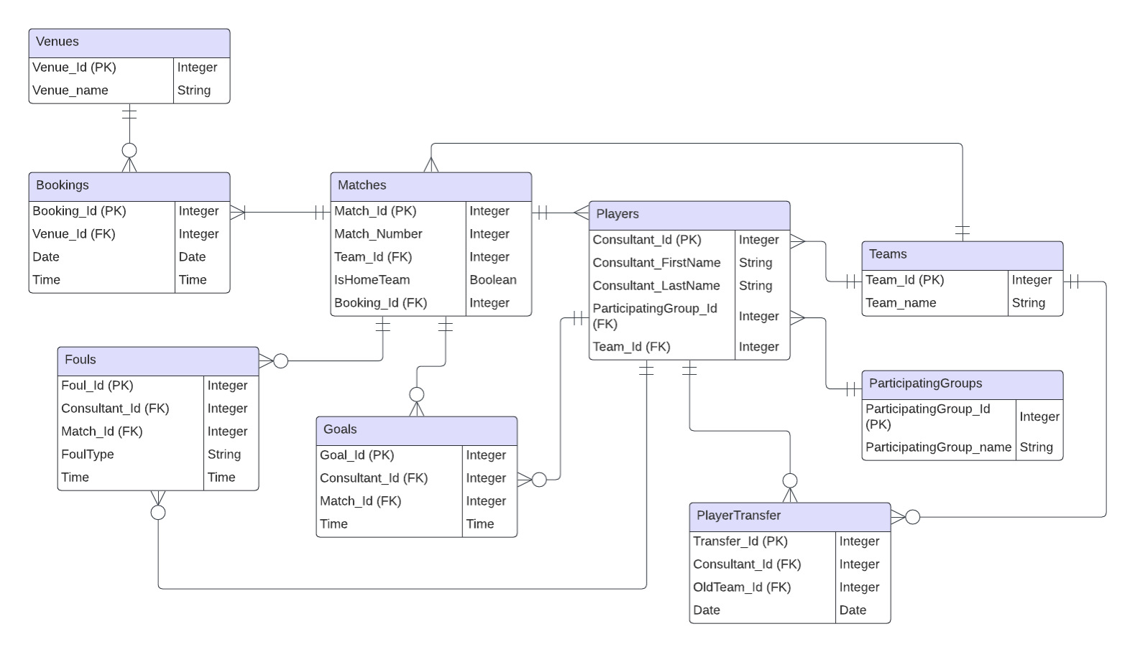
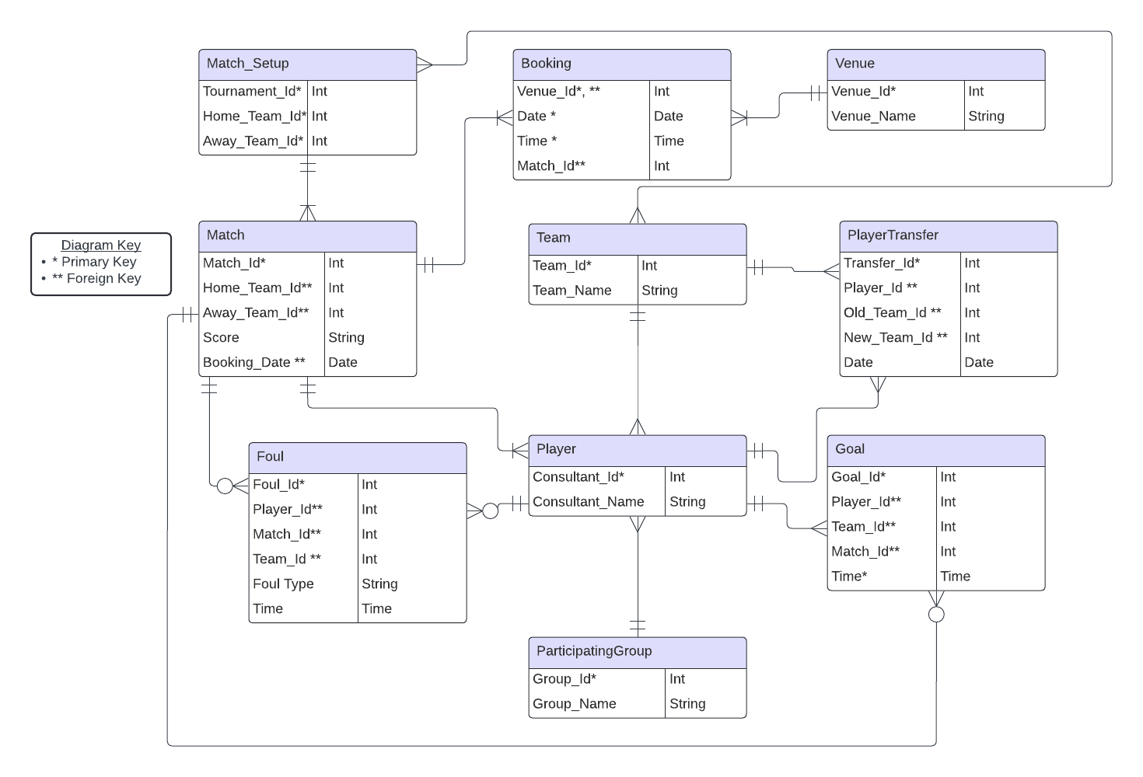
ER diagram

Slide 5
Data dictionary
Team
Description: Contains information about different teams (unique identifiable ID and corresponding name).
Fields:
Team_Id (Primary Key): Unique identifier for each team. Integer.
Team_Name: Name of the team. Varchar (50).
Bookings
Description: Stores booking details for matches at different venues.
Fields:
Booking_Id (Primary Key): Unique identifier for each booking. Integer.
Venue_ID (Foreign Key): References the Venues table to indicate the booked venue. Integer.
Date: Date of the booking. Date.
Time: Time of the booking. Time.
Relationships:
Many-to-One relationship with Venues table (each booking corresponds to one venue).

Slide 6
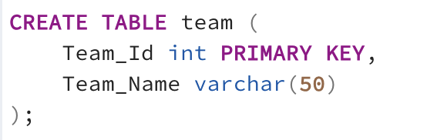
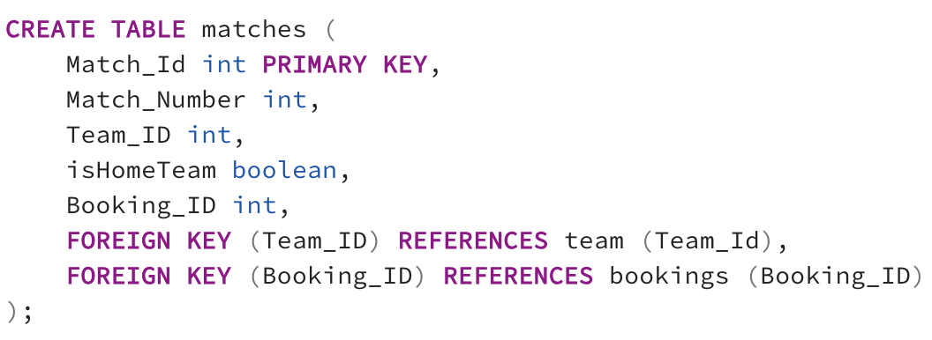
Data definition Language

Slide 7
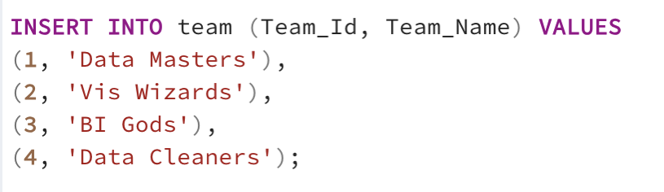
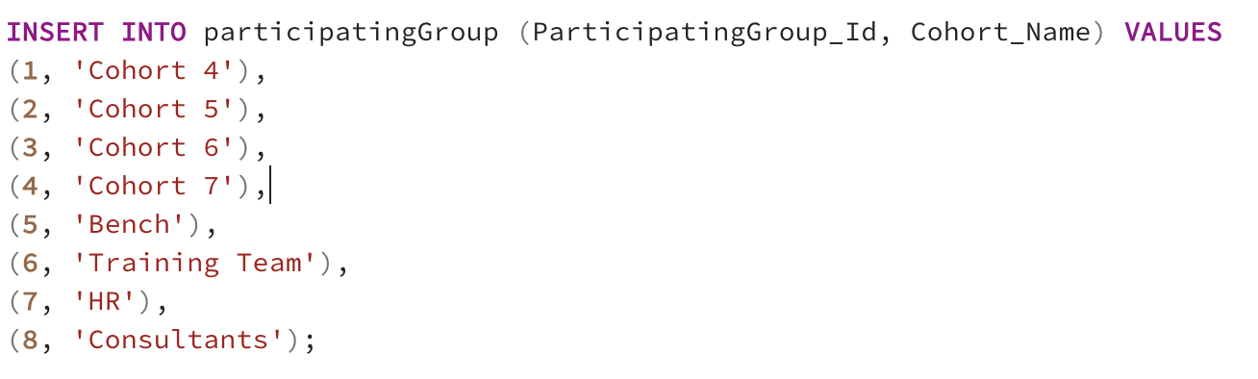
Data manipulation Language

Slide 8
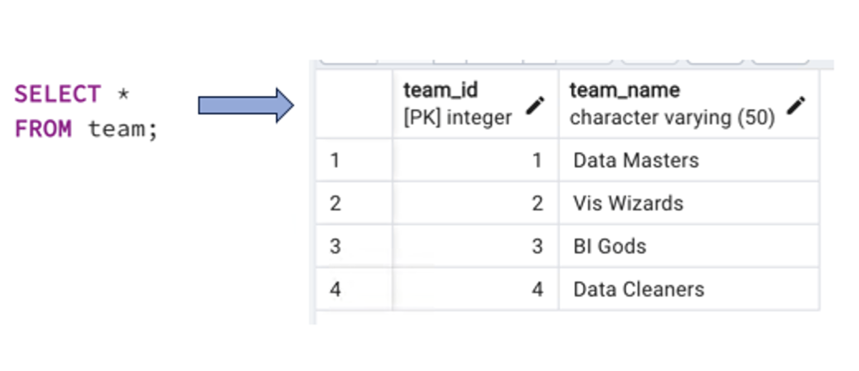
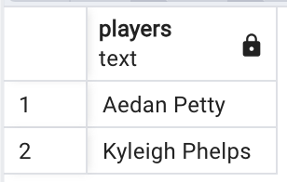
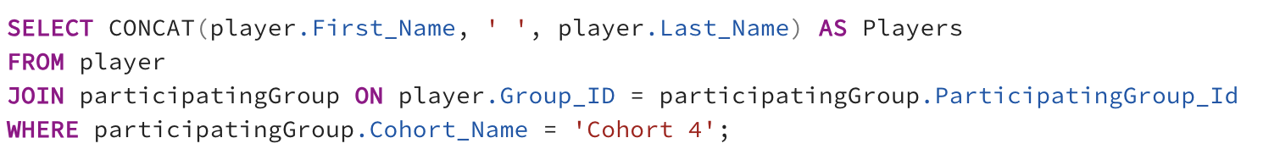
Test Database Implementation

Slide 9
Conclusion
01
First draft of the ER model needed improvement
Database was implemented successfully
Further improvement and testing should be done to optimise database

Slide 10
QUESTIONS?
Marta Moreira
MartaMoreira@rockborne.com
Please keep this slide for attribution

