Slide 1

Flight Status Predictor
Predicting if a flight will arrive at least 15 minutes later than scheduled.

Slide 2
Table of contents
Introduction
Overview
Data
Methodology
Results
Conclusion

Slide 3
PROBLEM
Goal: Predicting flight delay
Solution: Use ML classification methods
Independent variables –
Response variable:
Arr_Delay_Minutes– regression problem
Arrival_Delay_At_least_15_Minutes – classification problem

Slide 4
Overview
Dataset acquisition
Delay problem – predicting if a plane will land with at least 15 minutes of delay.
Feature engineering – choosing the best features
Choosing machine learning methods to be implemented
Choosing the best models

Slide 5
Process
Getting the right dataset
Data Cleaning
Model Selection
Confusion matrix
Accuracy
Precision
Recall
F1
ROC/AUC
Hyperparameter Tuning
Saving model as pickle file and deploying if using Streamlit
Removing irrelevant fields
Removing NULL values
Choosing best features for the model
Depending on the model
Choosing model with best testing results
Data
Feature Selection
Testing
Model deployment

Slide 6
data
Original Data Set :
6,777,978 rows and 43 columns (11 categorical and 32 continuous)
15 min delay probability 20.2 %
After transformation (removing certain features and rows )
2,742,902 rows, 27 columns
15 min delay probability 50 %
Columns with NULL values were removed.

Slide 7
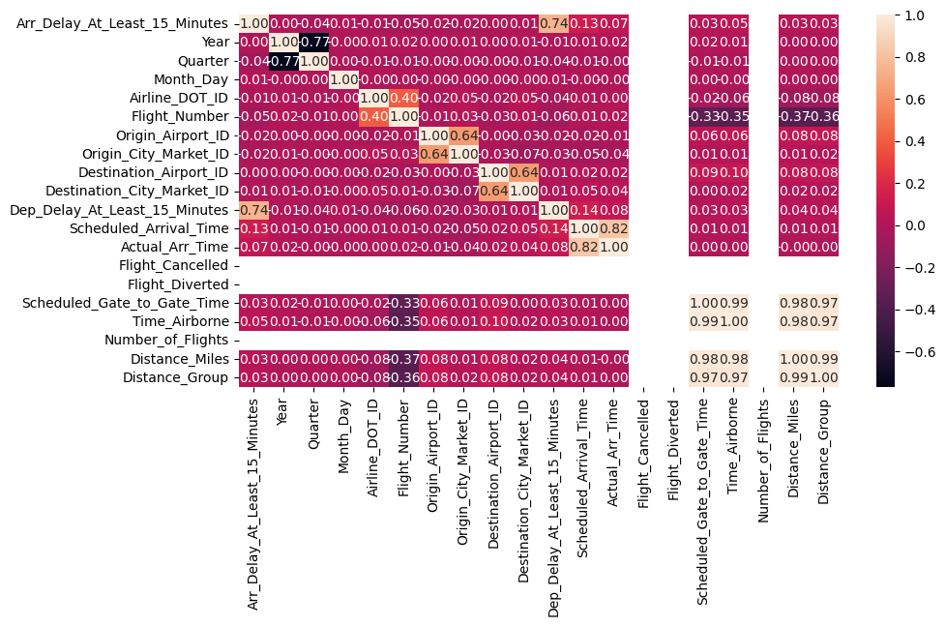
Data – correlations between features

Slide 8
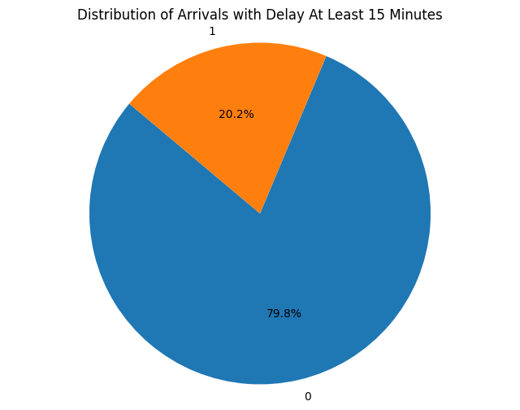
PRELIMINARY Data Analysis

Slide 9
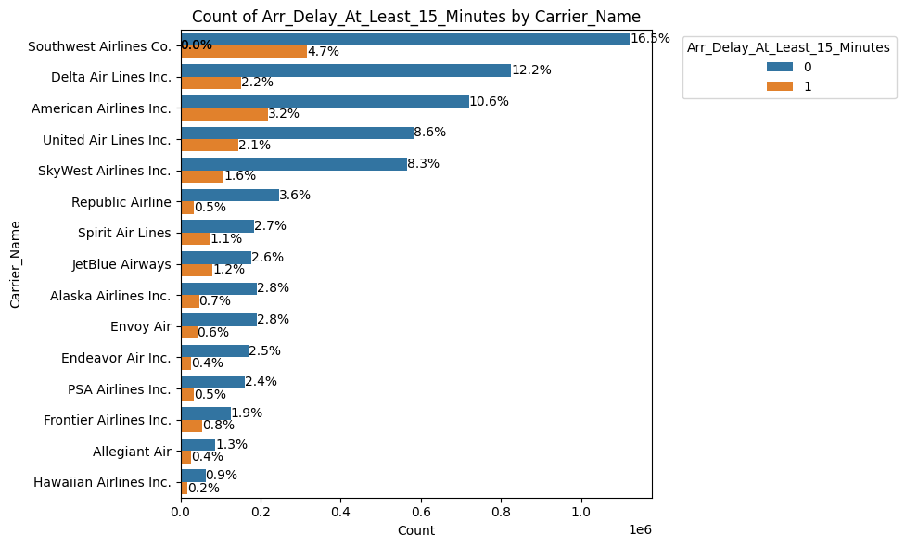
EXPLORATORY DATA ANALYSIS

Slide 10
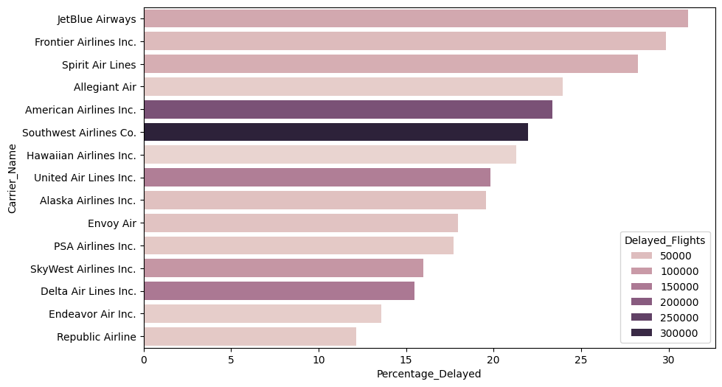
EXPLORATORY DATA ANALYSIS

Slide 11
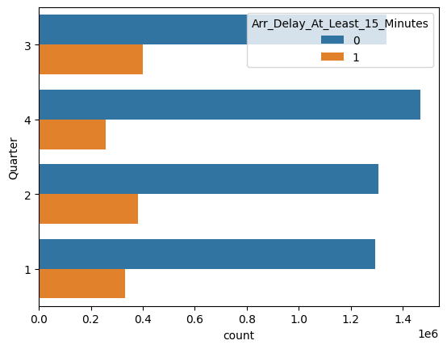
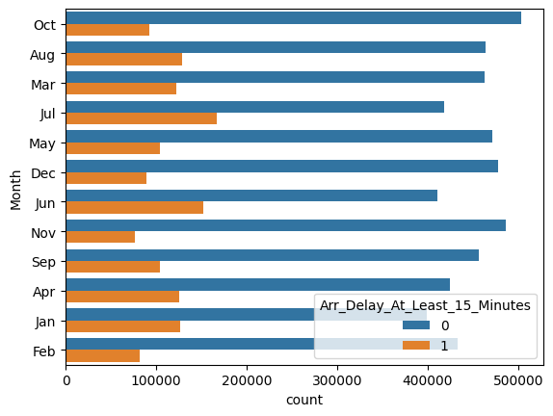
EXPLORATORY data ANALYSIS

Slide 12
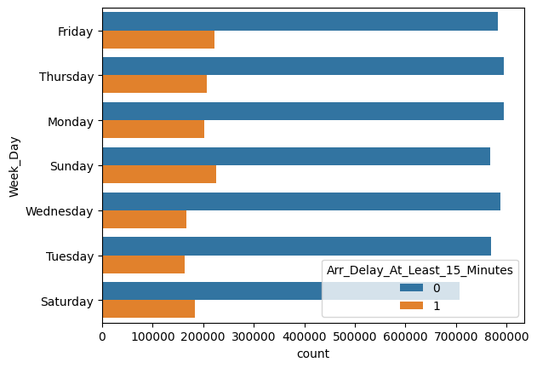
EXPLORATORY data ANALYSIS
Feature_class | Total_Flights | Delayed_Flights | Percentage_Delayed
Sunday | 993,917 | 225,513 | 22.69%
Friday | 1,006,397 | 222,892 | 22.15%
Thursday | 1,002,419 | 207,300 | 20.68%
Saturday | 890,364 | 183,081 | 20.56%
Monday | 996,731 | 201,586 | 20.22%
Tuesday | 934,067 | 164,199 | 17.58%
Wednesday | 954,083 | 166,880 | 17.49%

Slide 13
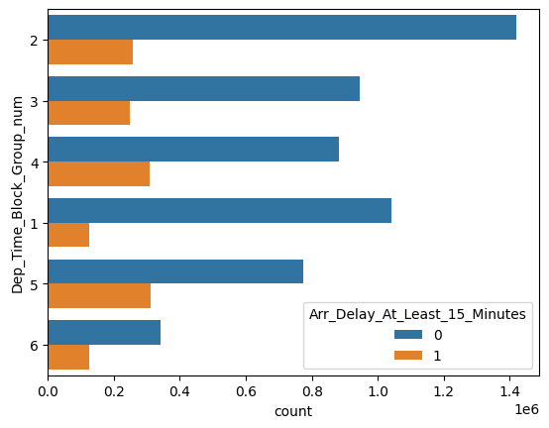
EXPLORATORY data ANALYSIS
 | Total_Flights | Delayed_Flights | Percentage_Delayed
Evening | 1,085,963 | 311,197 | 28.66%
Night | 467,796 | 125,100 | 26.74%
Afternoon | 1,190,516 | 307,259 | 25.81%
Early afternoon | 1,193,596 | 247,230 | 20.71%
Morning | 1,675,136 | 256,402 | 15.31%
Early morning | 1,164,971 | 124,263 | 10.67%

Slide 14
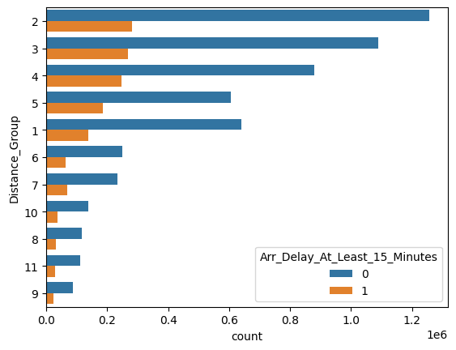
EXPLORATORY data ANALYSIS
Feature_class | Total_Flights | Delayed_Flights | Percentage_Delayed
5 | 790,573 | 185,827 | 23.51%
7 | 302,250 | 67,567 | 22.35%
4 | 1,125,895 | 245,562 | 21.81%
9 | 111,202 | 23,991 | 21.57%
11 | 140,112 | 30,029 | 21.43%
8 | 148,064 | 31,107 | 21.01%
10 | 173,193 | 36,356 | 20.99%
6 | 314,425 | 64,376 | 20.47%
3 | 1,357,844 | 267,365 | 19.69%
2 | 1,537,278 | 281,795 | 18.33%
1 | 777,142 | 137,476 | 17.69%

Slide 15
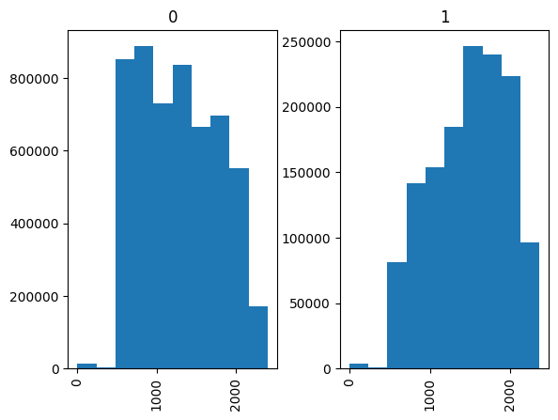
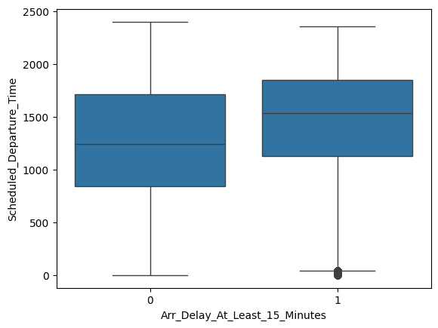
EXPLORATORY data ANALYSIS

Slide 16
EXPLORATORY data ANALYSIS

Slide 17
METHODOLOGY
Preliminary data analysis
Explanatory Data Analysis
Feature engineering
Fitting model
Choosing the best model
Hyper parameters tuning
Testing Model
Model Deployment

Slide 18
METHODOLOGY
Logistic Regression
Decision Trees
Random Forest
Gradient Boosting
Support Vector Machine
Naïve Bayes
K Nearest Neighbor

Slide 19
MODEL COMPARISON
Model | Measure | Downsampled l Dataset
Logistic Regression | Accuracy | 60.01%
 | Precision | 59.34%
 | Recall | 63.93%
 | F1 | 61.55%
 | ROC AUC | 66.55%
Decision Tree | Accuracy | 59.07%
 | Precision | 59.96%
 | Recall | 54.92%
 | F1 | 57.33%
 | ROC AUC | 59.08%
Random Forest | Accuracy | 59.18%
 | Precision | 59.17%
 | Recall | 59.57%
 | F1 | 59.37%
 | ROC AUC | 5918.00%
Gradient Boosting | Accuracy | 61.22%
 | Precision | 61.18%
 | Recall | 61.67%
 | F1 | 61.42%
 | ROC AUC | 61.22%
Naïve Guass | Accuracy | 60.20%
 | Precision | 60.21%
 | Recall | 60.43%
 | F1 | 60.32%
 | ROC AUC | 60.20%

Slide 20
MODEL COMPARISON
Model | Measure | Full Dataset | Downsampled l Dataset
Logistic Regression | Accuracy | 79.74% | 60.01%
 | Precision | 57.03% | 59.34%
 | Recall | 0.16% | 63.93%
 | F1 | 0.33% | 61.55%
 | ROC AUC | - | 66.55%

Slide 21
Confusion MATRIX
Original Data Set
 | TRUE
Predicted | 0 | 1 | All
0 | 2,161,242 | 702 | 2,161,944
1 | 54,316 | 932 | 55,248
All | 2,215,558 | 1,634 | 2,217,192
Downsampled Data Set
 | TRUE
Predicted | 0 | 1 | All
0 | 164,313 | 108,667 | 272,980
1 | 109,645 | 165,956 | 275,601
All | 273,958 | 274,623 | 548,581

Slide 22
NEXT STEPS
Feature engineering and hyperparameters tuning in more details
Creating more meaningful variables
Exploring different feature combinations and data subset

Slide 23

MODEL DEPLOYMENT

Slide 24

MODEL DEPLOYMENT

