Slide 1

Maximizing Lending Profit with Risk-Aware Targeting (Lending Club data)
Predicting default risk and turning scores into dollars
Notes:
AI-generated content may be incorrect. --- This presentation will guide you through the essentials of personal finance, emphasizing how to visualize your money using numbers and charts. You'll learn how to manage your income, expenses, savings, budgeting, investing, debt, and financial data interpretation effectively. Image source: Microsoft 365 content library

Slide 2
Table Of Contents
Introduction
Overview
Data
Methodology
Results
Conclusion
Notes:
AI-generated content may be incorrect. --- This presentation will guide you through the essentials of personal finance, emphasizing how to visualize your money using numbers and charts. You'll learn how to manage your income, expenses, savings, budgeting, investing, debt, and financial data interpretation effectively. Image source: Microsoft 365 content library

Slide 3
Introduction
The Problem
Lending to the wrong customers exposes the business to significant financial losses through defaults.
Traditional credit assessments often fail to accurately identify high-risk individuals.
The Opportunity
By leveraging predictive modeling, we can differentiate between profitable customers and potential defaulters.
This enables smarter decision-making:
Decline or adjust terms for high-risk borrowers.
Offer competitive products to low-risk, profitable customers.
The Impact
Profit maximization by reducing default losses.
Risk-adjusted pricing strategies that improve portfolio resilience.
Data-driven targeting that aligns credit decisions with business growth objectives.
Notes:
AI-generated content may be incorrect. --- This presentation will guide you through the essentials of personal finance, emphasizing how to visualize your money using numbers and charts. You'll learn how to manage your income, expenses, savings, budgeting, investing, debt, and financial data interpretation effectively. Image source: Microsoft 365 content library

Slide 4
OVERVIEW
Dataset
Preliminary data analysis
Default identification – customers that are most likely to default
Choosing data science/ML methods to be implemented
Dividing dataset into train and test
Feature engineering – choosing the best features for each model
Choosing the best models
Notes:
AI-generated content may be incorrect. --- This presentation will guide you through the essentials of personal finance, emphasizing how to visualize your money using numbers and charts. You'll learn how to manage your income, expenses, savings, budgeting, investing, debt, and financial data interpretation effectively. Image source: Microsoft 365 content library

Slide 5
PROCESS
Process
Data
Acquiring sensible dataset
Data Cleaning
Removing irrelevant fields
Feature Selection
Choosing best features for the model
Hyperparameter Tuning
Testing
Model Selection
Removing NULL values
Depending on the model
Confusion matrix
Accuracy
Sensitivity
Specificity
Choosing model with best testing results
Precision
Data imputation
Changing data types
Notes:
AI-generated content may be incorrect. --- This presentation will guide you through the essentials of personal finance, emphasizing how to visualize your money using numbers and charts. You'll learn how to manage your income, expenses, savings, budgeting, investing, debt, and financial data interpretation effectively. Image source: Microsoft 365 content library

Slide 6
DATA
Original Data Set :
10.000 rows and 28 columns (7 categorical and 21 continuous)
Default probability 13%
After transformation
9999 rows and 180 columns
Notes:
AI-generated content may be incorrect. --- This presentation will guide you through the essentials of personal finance, emphasizing how to visualize your money using numbers and charts. You'll learn how to manage your income, expenses, savings, budgeting, investing, debt, and financial data interpretation effectively. Image source: Microsoft 365 content library

Slide 7
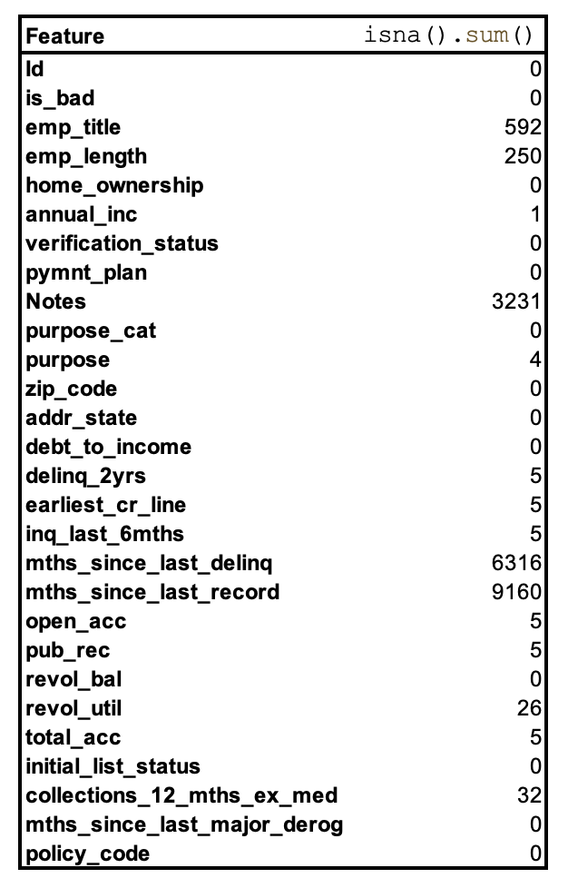
DATA
Missing values
Notes:
AI-generated content may be incorrect. --- This presentation will guide you through the essentials of personal finance, emphasizing how to visualize your money using numbers and charts. You'll learn how to manage your income, expenses, savings, budgeting, investing, debt, and financial data interpretation effectively. Image source: Microsoft 365 content library

Slide 8
Missing data
We can divide features with missing values into a few groups:
Features that most likely won't bring much into our model, like emp_title or Notes, so I won't bother with replacing those missing values
Features that don't have NaN (missing values) but have a different values instead (like na) for example emp_length - impute the median
Features that have high percentage of NaN ( mths_since_last_delinq or mths_since_last_record) - will address it further
Features that need more investigation for the best imputation methods - either numbers (mean or median) - delinq_2yrs, pub_rec, revol_util, total_acc, collections_12_mths_ex_med
Features that have only a few observations missing (0.05 % of the data - purpose, delinq_2yrs, earliest_cr_line, inq_last_6mths, total_acc)
Important thing to remember when imputing anything else than 0, like mean or median is that it should be mean or median from the test or train dataset appropriately. For simplicity I am going to use median from the whole data set, however I am risking a data leakage in this case.
Notes:
AI-generated content may be incorrect. --- This presentation will guide you through the essentials of personal finance, emphasizing how to visualize your money using numbers and charts. You'll learn how to manage your income, expenses, savings, budgeting, investing, debt, and financial data interpretation effectively. Image source: Microsoft 365 content library

Slide 9
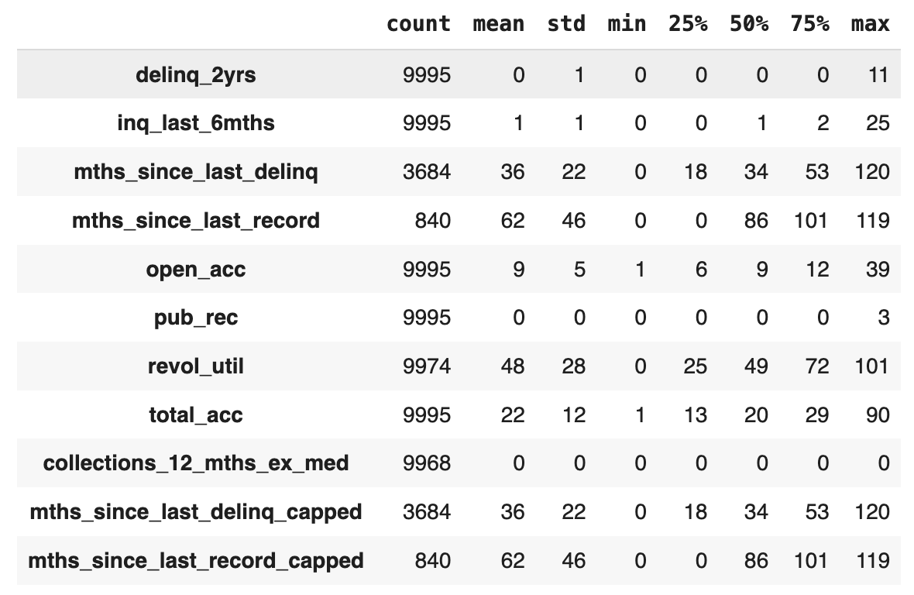
Data descriptive statistics
Notes:
AI-generated content may be incorrect. --- This presentation will guide you through the essentials of personal finance, emphasizing how to visualize your money using numbers and charts. You'll learn how to manage your income, expenses, savings, budgeting, investing, debt, and financial data interpretation effectively. Image source: Microsoft 365 content library

Slide 10
Data – features
Interesting feature's properties:
collections_12_mths_ex_med = all 0 with some missing values, dopping
verification_status can be a boolean 0 and 1 variables
pymnt_plan can be a boolean 0 and 1 variables
purpose_cat can be divided into 2 features: purpose_cat (categorical) and small_business (boolean)
debt_to_income can be divided into brackets, but for now I'll leave it as a numerical variable
policy_code could be converted into either numerical variable if there is an order in policy code PC1, PC2 or kept as categorical variables (that will need one hot encoding) if there's no particular order.
zip_code should also be converted - will focus on this later as
Notes:
AI-generated content may be incorrect. --- This presentation will guide you through the essentials of personal finance, emphasizing how to visualize your money using numbers and charts. You'll learn how to manage your income, expenses, savings, budgeting, investing, debt, and financial data interpretation effectively. Image source: Microsoft 365 content library

Slide 11
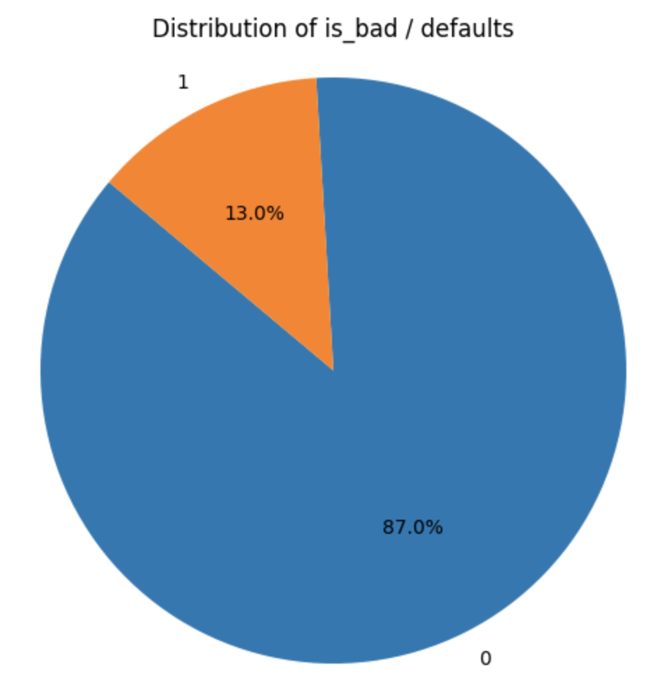
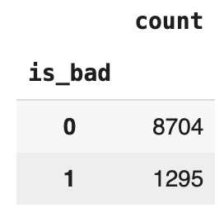
Exploratory Data Analysis (EDA)
We can see from the pie chart that the data set is unbalanced -> out of 10000 people, only ~ 13% are "bad", so only 13% have a high probability of default.
For the modeling purpose, I would highly suggest creating another data set that's balanced-> 50% of it would be Yes (or 1) for is_bad.
By checking the distribution of is_bad -> baseline accuracy - anything lower than 87.1% is less than guessing just from the data (without the model we can assume that 87.1 % of candidates won't default).
Notes:
AI-generated content may be incorrect. --- This presentation will guide you through the essentials of personal finance, emphasizing how to visualize your money using numbers and charts. You'll learn how to manage your income, expenses, savings, budgeting, investing, debt, and financial data interpretation effectively. Image source: Microsoft 365 content library

Slide 12
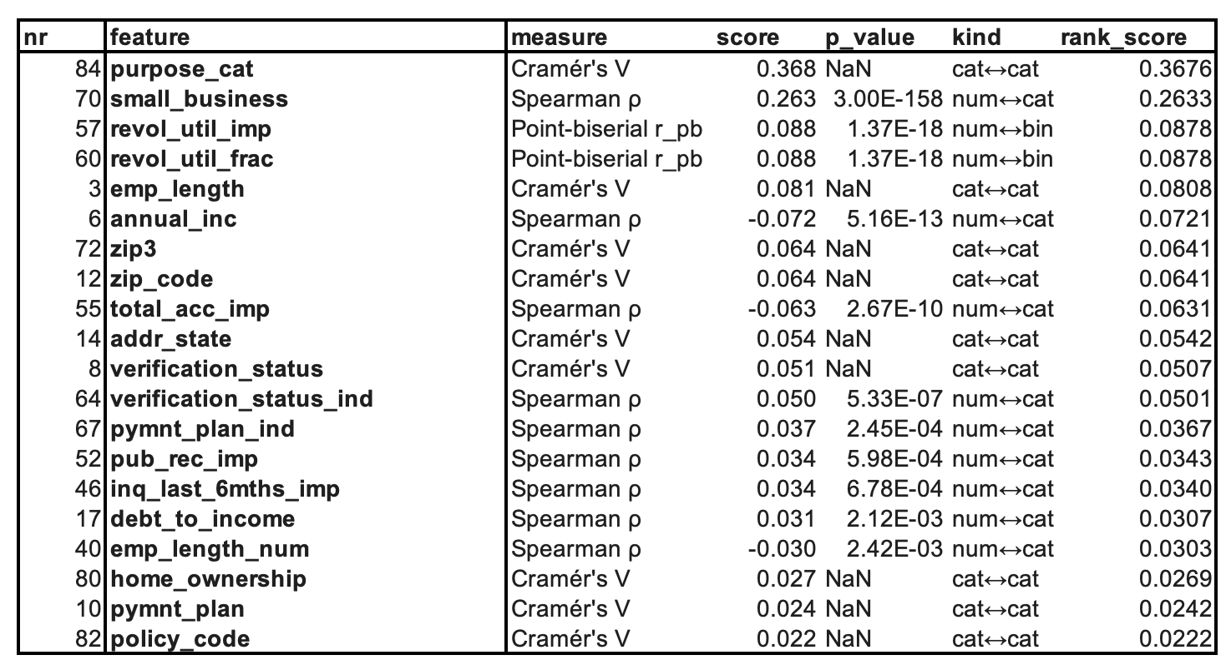
Data - Correlations
Notes:
AI-generated content may be incorrect. --- This presentation will guide you through the essentials of personal finance, emphasizing how to visualize your money using numbers and charts. You'll learn how to manage your income, expenses, savings, budgeting, investing, debt, and financial data interpretation effectively. Image source: Microsoft 365 content library

Slide 13
Data - Correlations
feature — the predictor being tested against your target (is_bad).
pearson_r — Pearson correlation coefficient (linear association)
range [-1, 1]
Sign: + means as the feature increases, is_bad tends to increase; - means the opposite.
Magnitude: |r| close to 0 = weak; ~0.1 small, ~0.3 medium, ~0.5+ large (rough Cohen-style rule of thumb).
pearson_p — p-value for the null hypothesis r = 0 (two-sided). Very small p means the observed r is unlikely under “no linear association.” With large n, even tiny r can be “statistically significant.”
spearman_rho — Spearman rank correlation (monotonic association),[-1, 1]. Less sensitive to outliers and linearity; compares ranks instead of raw values.
spearman_p — p-value for the null hypothesis ρ = 0 (two-sided).
n — number of rows used in the calculation (after joint NaN filtering).
note — diagnostic flag (e.g., “non-numeric”, “constant/insufficient”, etc.). Blank means no issue.
Notes:
AI-generated content may be incorrect. --- This presentation will guide you through the essentials of personal finance, emphasizing how to visualize your money using numbers and charts. You'll learn how to manage your income, expenses, savings, budgeting, investing, debt, and financial data interpretation effectively. Image source: Microsoft 365 content library

Slide 14
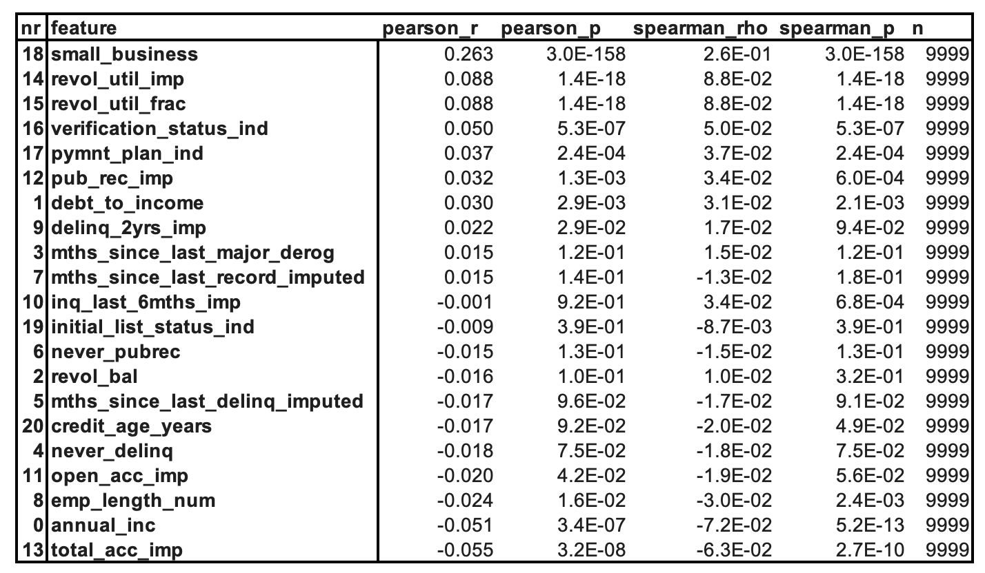
Data - Correlations
Notes:
AI-generated content may be incorrect. --- This presentation will guide you through the essentials of personal finance, emphasizing how to visualize your money using numbers and charts. You'll learn how to manage your income, expenses, savings, budgeting, investing, debt, and financial data interpretation effectively. Image source: Microsoft 365 content library

Slide 15
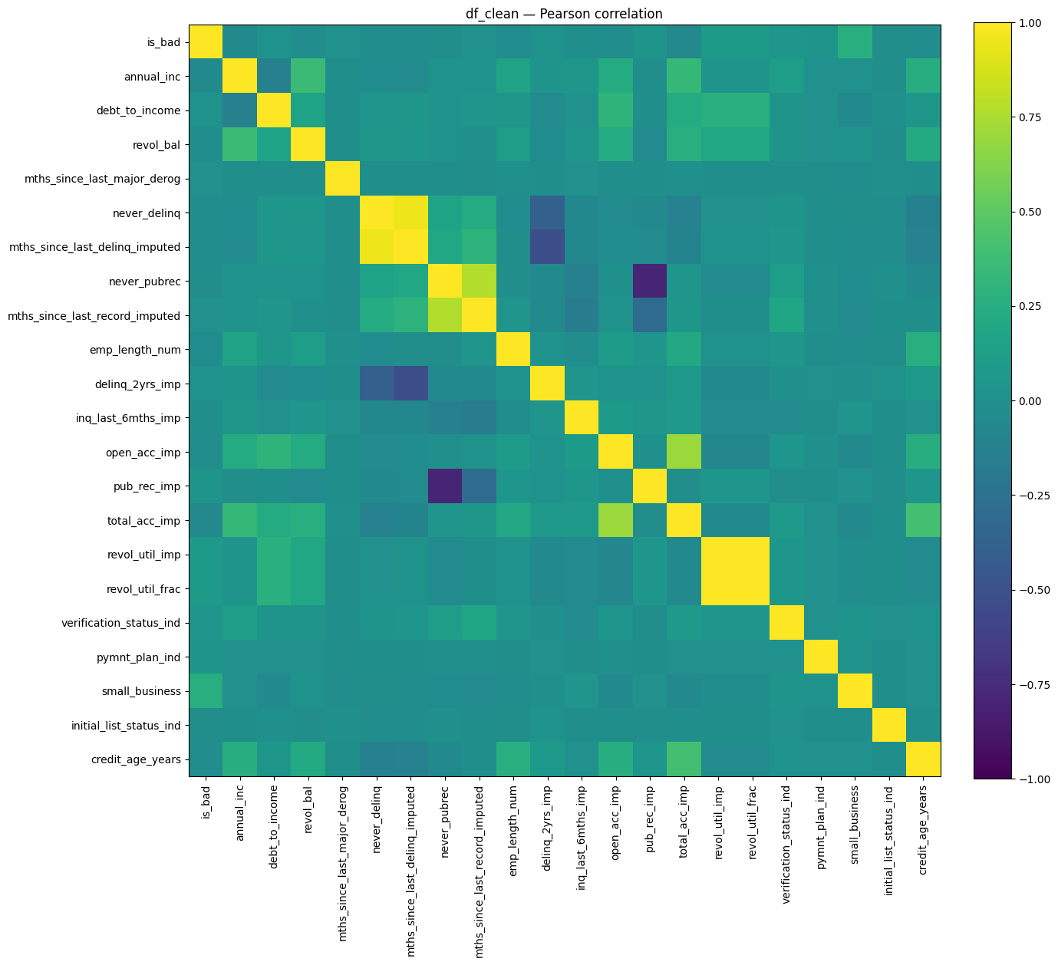
FEATURES - CORRELATION MATRIX

Slide 16
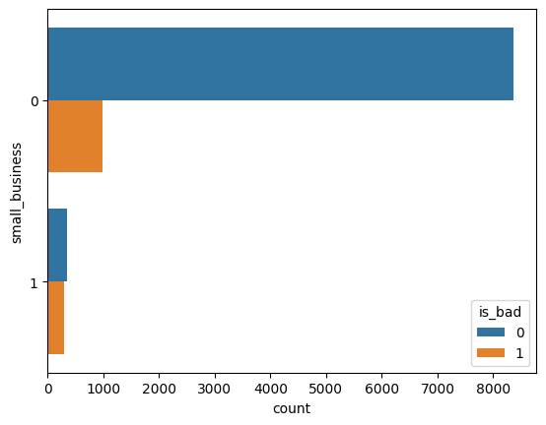
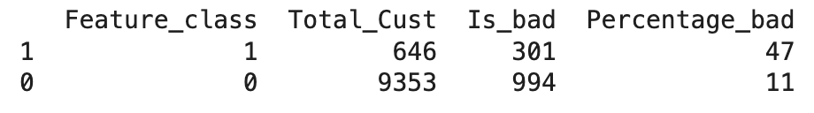
FEARURES – SMALL_BUSINESS
Notes:
AI-generated content may be incorrect. --- This presentation will guide you through the essentials of personal finance, emphasizing how to visualize your money using numbers and charts. You'll learn how to manage your income, expenses, savings, budgeting, investing, debt, and financial data interpretation effectively. Image source: Microsoft 365 content library

Slide 17
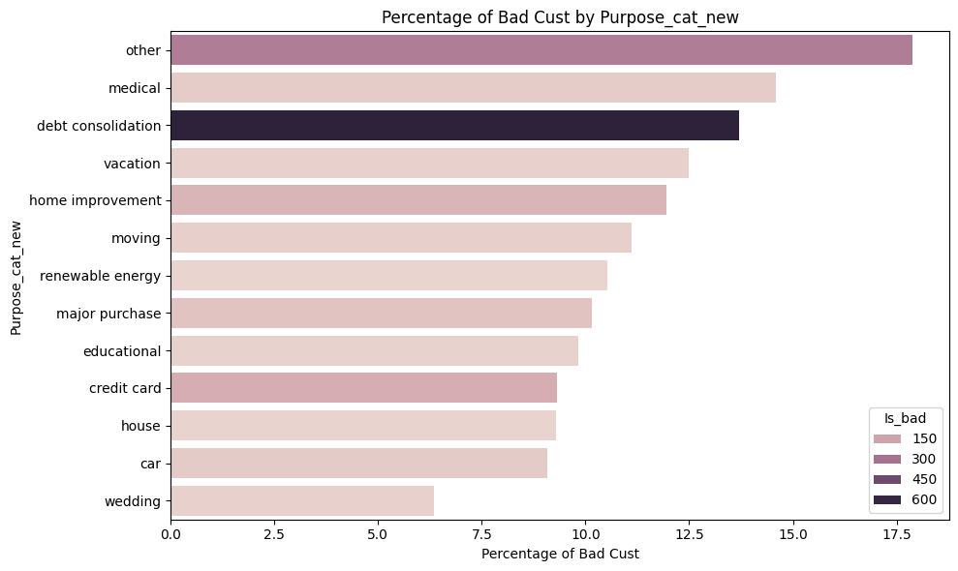
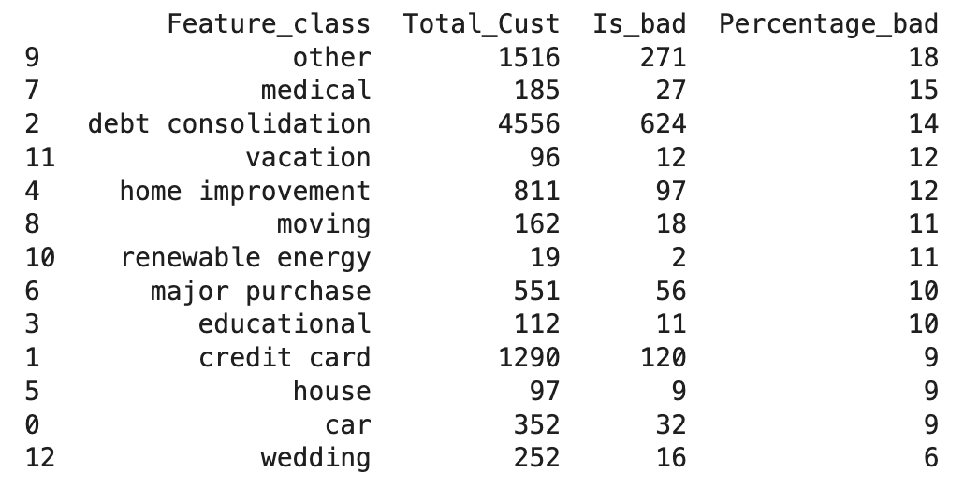
FEARURES – purpose_CAT_NEW
Notes:
AI-generated content may be incorrect. --- This presentation will guide you through the essentials of personal finance, emphasizing how to visualize your money using numbers and charts. You'll learn how to manage your income, expenses, savings, budgeting, investing, debt, and financial data interpretation effectively. Image source: Microsoft 365 content library

Slide 18
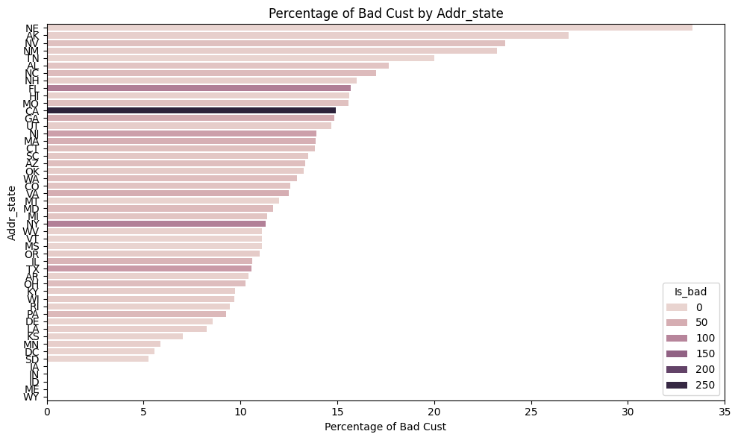
FEARURES – purpose_CAT_NEW
Notes:
AI-generated content may be incorrect. --- This presentation will guide you through the essentials of personal finance, emphasizing how to visualize your money using numbers and charts. You'll learn how to manage your income, expenses, savings, budgeting, investing, debt, and financial data interpretation effectively. Image source: Microsoft 365 content library

Slide 19
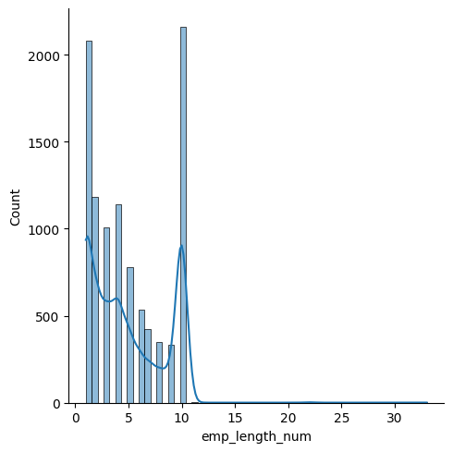
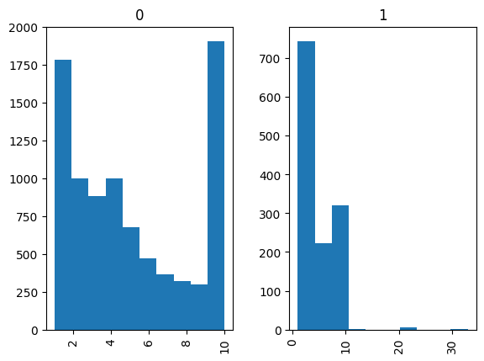
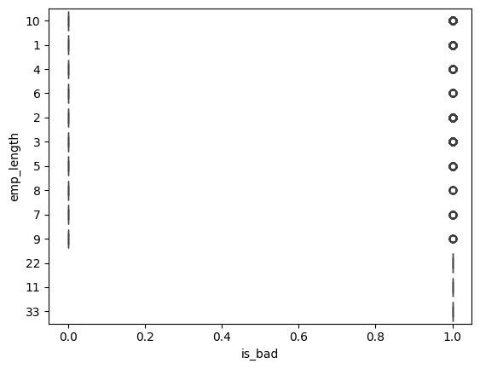
FEARURES – emp_length_num
Notes:
AI-generated content may be incorrect. --- This presentation will guide you through the essentials of personal finance, emphasizing how to visualize your money using numbers and charts. You'll learn how to manage your income, expenses, savings, budgeting, investing, debt, and financial data interpretation effectively. Image source: Microsoft 365 content library

Slide 20
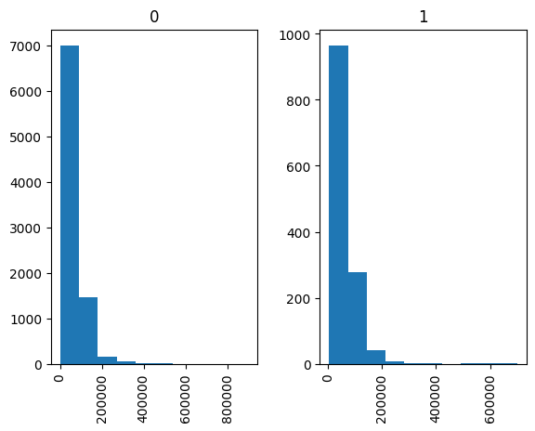
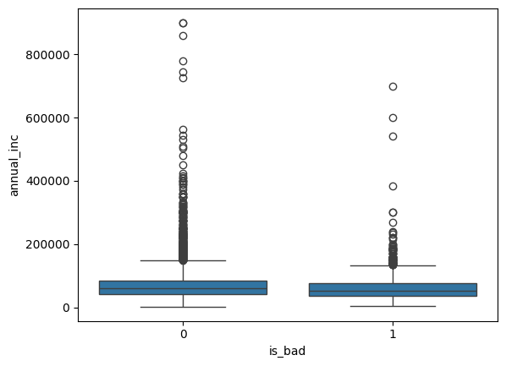
FEARURES – annual_INC
Notes:
AI-generated content may be incorrect. --- This presentation will guide you through the essentials of personal finance, emphasizing how to visualize your money using numbers and charts. You'll learn how to manage your income, expenses, savings, budgeting, investing, debt, and financial data interpretation effectively. Image source: Microsoft 365 content library

Slide 21
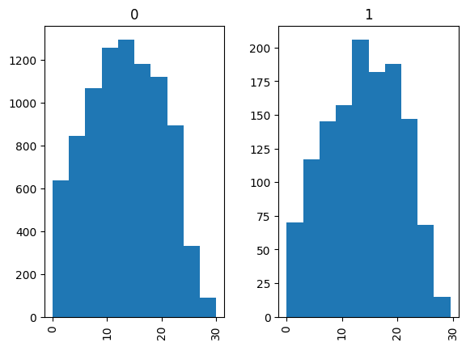
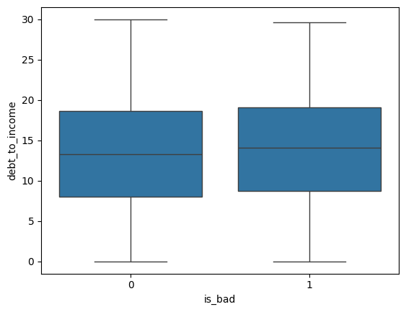
FEARURES – debt_TO_INCOME
Notes:
AI-generated content may be incorrect. --- This presentation will guide you through the essentials of personal finance, emphasizing how to visualize your money using numbers and charts. You'll learn how to manage your income, expenses, savings, budgeting, investing, debt, and financial data interpretation effectively. Image source: Microsoft 365 content library

Slide 22
METHODOLOGY
Preliminary data analysis
Explanatory Data Analysis
Feature engineering
Fitting model
Choosing the best model
Hyper parameters tuning
Testing Model
Model Deployment
Notes:
AI-generated content may be incorrect. --- This presentation will guide you through the essentials of personal finance, emphasizing how to visualize your money using numbers and charts. You'll learn how to manage your income, expenses, savings, budgeting, investing, debt, and financial data interpretation effectively. Image source: Microsoft 365 content library

Slide 23
MODELS
Logistic Regression
Decision Trees
Random Forest
Gradient Boosting
Support Vector Machine
Naïve Bayes
K Nearest Neighbor
Notes:
AI-generated content may be incorrect. --- This presentation will guide you through the essentials of personal finance, emphasizing how to visualize your money using numbers and charts. You'll learn how to manage your income, expenses, savings, budgeting, investing, debt, and financial data interpretation effectively. Image source: Microsoft 365 content library

Slide 24
models
Baseline – Logistic Regression
Interpretable benchmark model
Provides clear coefficients and odds ratios
Serves as a reference point for more complex models
Decision Tree
Simple rules → easy to understand
Mimics how underwriters make decisions (if/then rules)
Limitation: can overfit and be unstable
Ensembles (Random Forest & others)
Built on many decision trees → higher accuracy & robustness
Reduce overfitting by averaging across trees
Provide feature importance for interpretability
Model Selection Criteria
Compared using validation metrics (AUC, precision, recall -> f1)
Evaluated in terms of business profit impact
Balanced explainability (tree, logistic) with accuracy (ensemble)
Notes:
AI-generated content may be incorrect. --- This presentation will guide you through the essentials of personal finance, emphasizing how to visualize your money using numbers and charts. You'll learn how to manage your income, expenses, savings, budgeting, investing, debt, and financial data interpretation effectively. Image source: Microsoft 365 content library

Slide 25
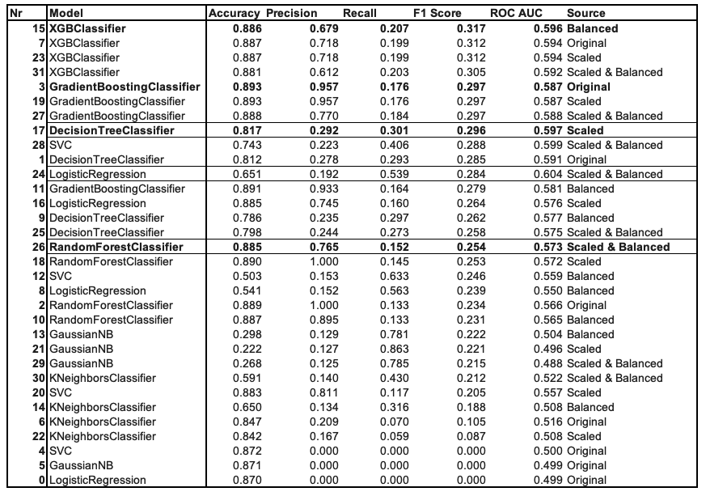
Best Models
Balanced ]data
Ensample models
XG Boost
Gradient Boosting
Random Forest
Decision Tree
Notes:
AI-generated content may be incorrect. --- This presentation will guide you through the essentials of personal finance, emphasizing how to visualize your money using numbers and charts. You'll learn how to manage your income, expenses, savings, budgeting, investing, debt, and financial data interpretation effectively. Image source: Microsoft 365 content library

Slide 26
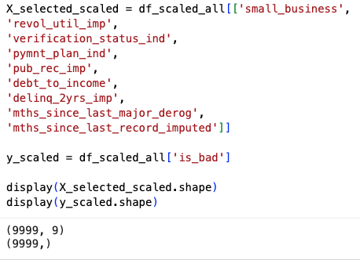
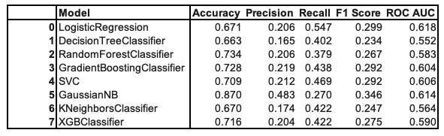
Best Models – SELECTED FEATURES
Selecting only meaningful features
Logistic regression is the best models for smaller data set
Notes:
AI-generated content may be incorrect. --- This presentation will guide you through the essentials of personal finance, emphasizing how to visualize your money using numbers and charts. You'll learn how to manage your income, expenses, savings, budgeting, investing, debt, and financial data interpretation effectively. Image source: Microsoft 365 content library

Slide 27
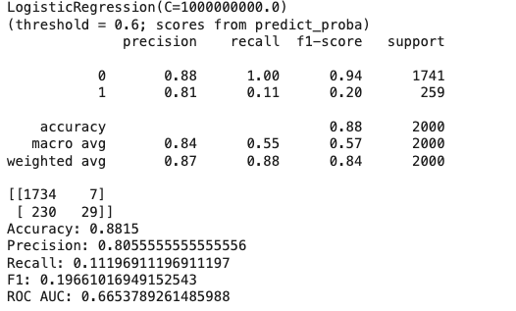
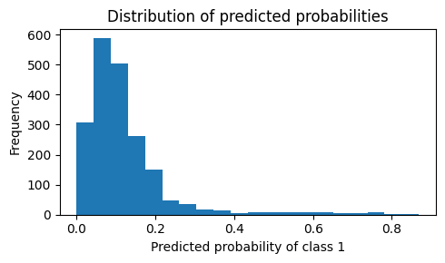
LOGISTIC REGRESSION = simple Example
Notes:
AI-generated content may be incorrect. --- This presentation will guide you through the essentials of personal finance, emphasizing how to visualize your money using numbers and charts. You'll learn how to manage your income, expenses, savings, budgeting, investing, debt, and financial data interpretation effectively. Image source: Microsoft 365 content library

Slide 28
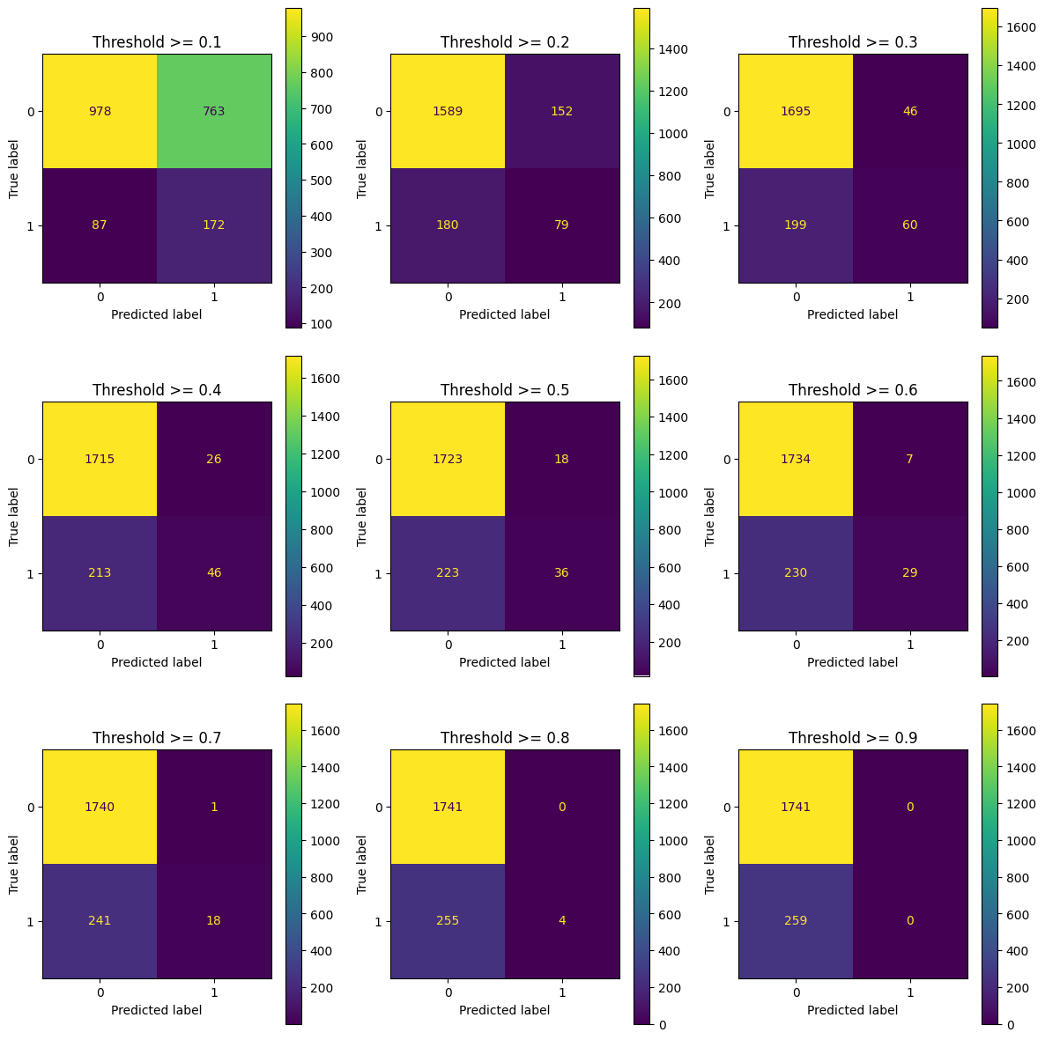
LOGISTIC REGRESSION = simple Example
LOGISTIC REGRESSION
ADJUSTING THRESHOLD
Notes:
AI-generated content may be incorrect. --- This presentation will guide you through the essentials of personal finance, emphasizing how to visualize your money using numbers and charts. You'll learn how to manage your income, expenses, savings, budgeting, investing, debt, and financial data interpretation effectively. Image source: Microsoft 365 content library

Slide 29
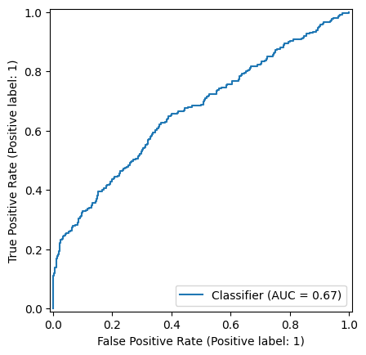
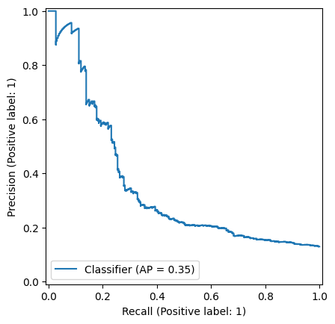
LOGISTIC REGRESSION simple Example
Notes:
AI-generated content may be incorrect. --- This presentation will guide you through the essentials of personal finance, emphasizing how to visualize your money using numbers and charts. You'll learn how to manage your income, expenses, savings, budgeting, investing, debt, and financial data interpretation effectively. Image source: Microsoft 365 content library

Slide 30
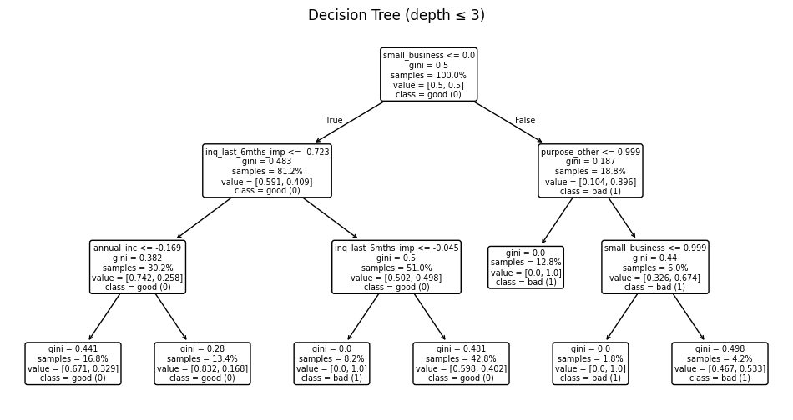
DECISION TREE simple Example
Notes:
AI-generated content may be incorrect. --- This presentation will guide you through the essentials of personal finance, emphasizing how to visualize your money using numbers and charts. You'll learn how to manage your income, expenses, savings, budgeting, investing, debt, and financial data interpretation effectively. Image source: Microsoft 365 content library

Slide 31
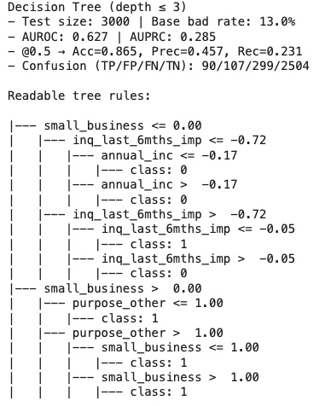
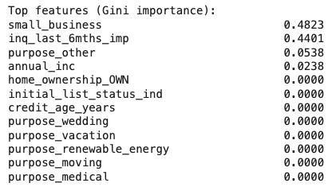
DECISION TREE simple Example
Notes:
AI-generated content may be incorrect. --- This presentation will guide you through the essentials of personal finance, emphasizing how to visualize your money using numbers and charts. You'll learn how to manage your income, expenses, savings, budgeting, investing, debt, and financial data interpretation effectively. Image source: Microsoft 365 content library

Slide 32
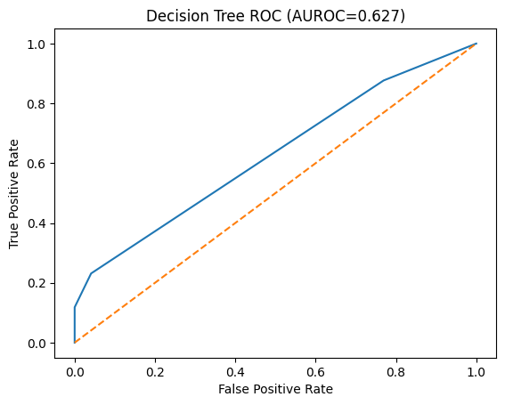
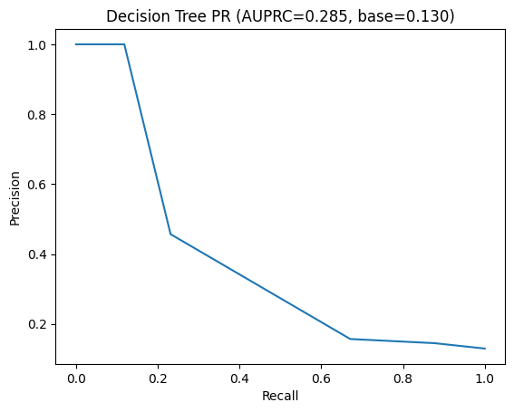
DECISION TREE simple Example - Model Evaluation
This model can catch some defaulters, but precision is low — meaning many good customers get falsely flagged, which could hurt business.
Notes:
AI-generated content may be incorrect. --- This presentation will guide you through the essentials of personal finance, emphasizing how to visualize your money using numbers and charts. You'll learn how to manage your income, expenses, savings, budgeting, investing, debt, and financial data interpretation effectively. Image source: Microsoft 365 content library

Slide 33
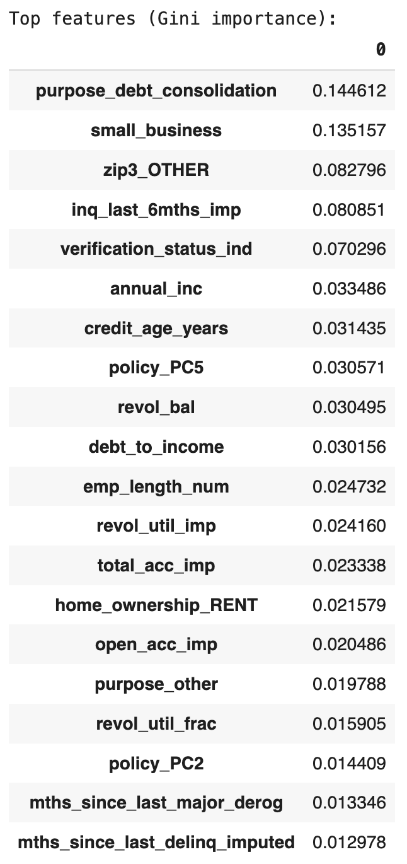
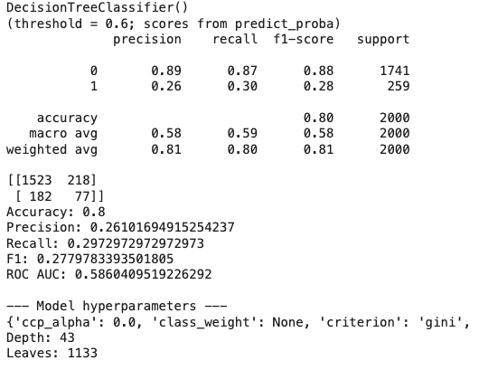
Best Models Evaluation
✅ Detected defaults (True Positives): 77 out of 259 ≈ 30% recall
⚠️ Missed defaults (False Negatives = bad loans approved): 182 ≈ 70% of actual defaults
⚠️ Safe customers falsely flagged as risky (False Positives): 218 ≈ 13% of safe customers
✅ Correctly approved safe loans (True Negatives): 1,523 out of 1,741 ≈ 87% specificity
Notes:
AI-generated content may be incorrect. --- This presentation will guide you through the essentials of personal finance, emphasizing how to visualize your money using numbers and charts. You'll learn how to manage your income, expenses, savings, budgeting, investing, debt, and financial data interpretation effectively. Image source: Microsoft 365 content library

Slide 34
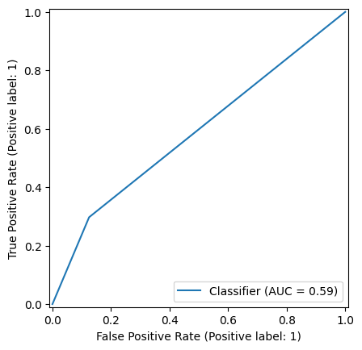
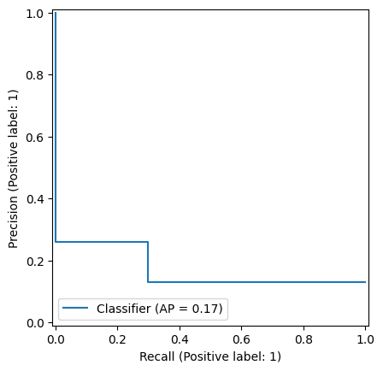
Best Models Evaluation – BEST DECISION TREE
Notes:
AI-generated content may be incorrect. --- This presentation will guide you through the essentials of personal finance, emphasizing how to visualize your money using numbers and charts. You'll learn how to manage your income, expenses, savings, budgeting, investing, debt, and financial data interpretation effectively. Image source: Microsoft 365 content library

Slide 35
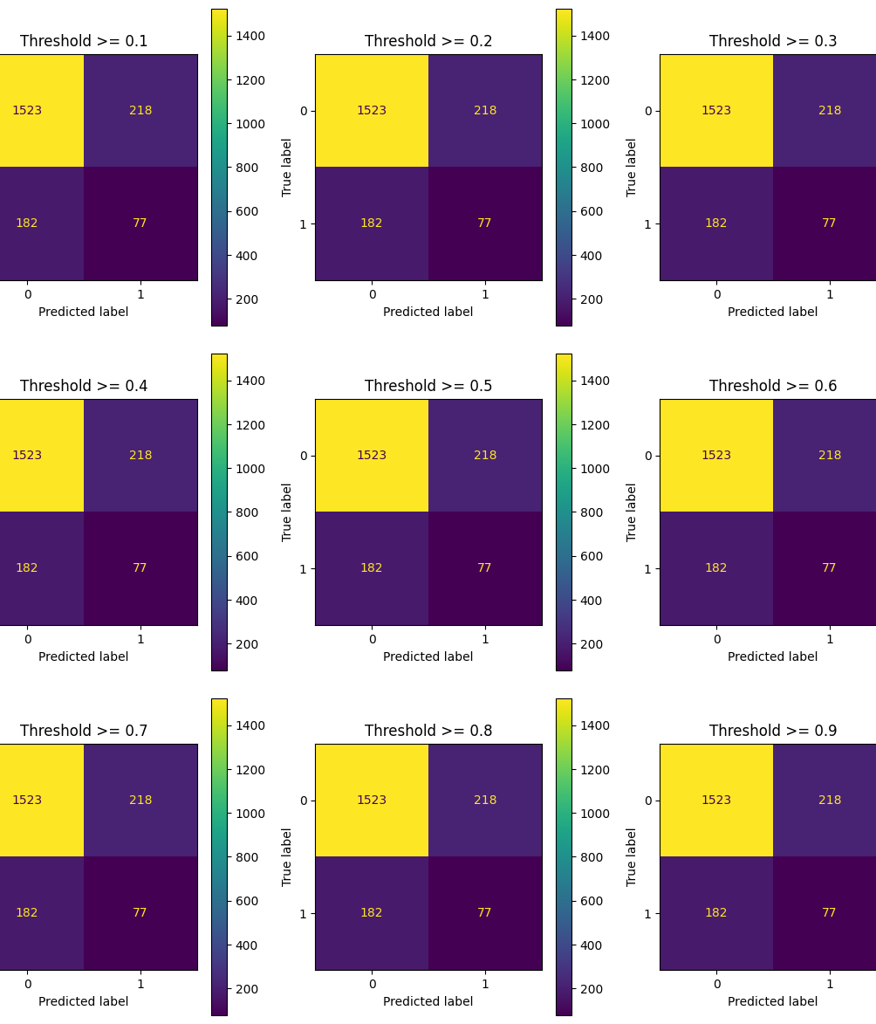
Choosing Threshold– BEST DECISION TREE
Notes:
AI-generated content may be incorrect. --- This presentation will guide you through the essentials of personal finance, emphasizing how to visualize your money using numbers and charts. You'll learn how to manage your income, expenses, savings, budgeting, investing, debt, and financial data interpretation effectively. Image source: Microsoft 365 content library

Slide 36
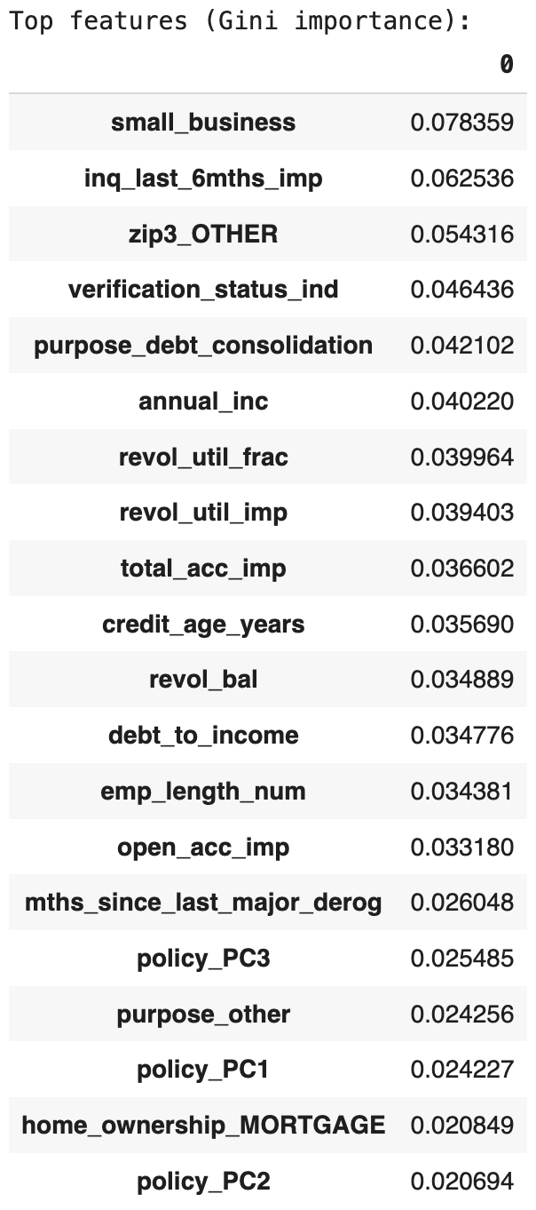
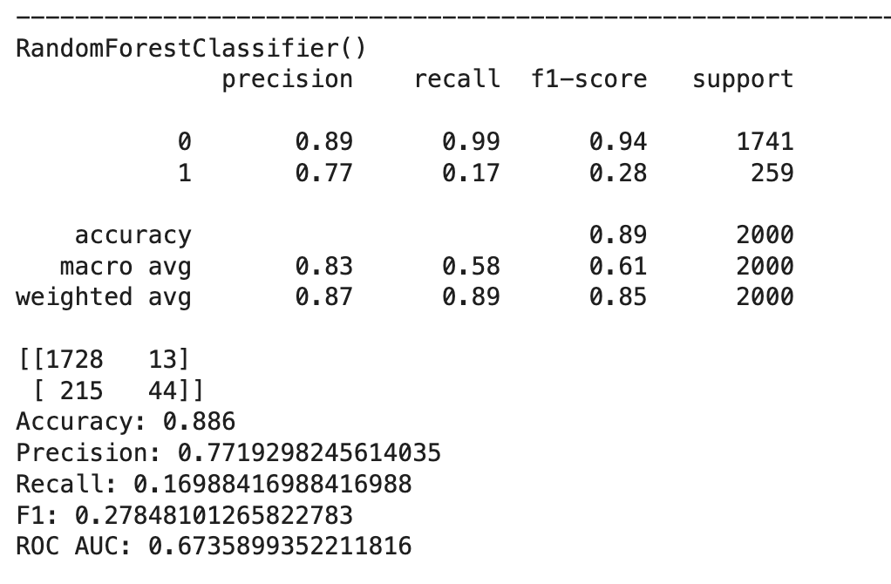
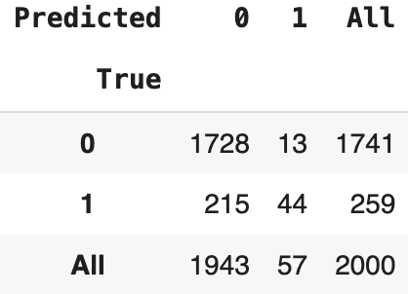
Best Models Evaluation – RANDOM FORREST
✅ Detected defaults (True Positives): 44 out of 259 ≈ 17% recall
⚠️ Missed defaults (False Negatives = bad loans approved): 215 ≈ 83% of actual defaults
⚠️ Safe customers falsely flagged as risky (False Positives): 13 ≈ 1% of safe loans
✅ Correctly approved safe loans (True Negatives): 1,728 out of 1,741 ≈ 99% specificity
Notes:
AI-generated content may be incorrect. --- This presentation will guide you through the essentials of personal finance, emphasizing how to visualize your money using numbers and charts. You'll learn how to manage your income, expenses, savings, budgeting, investing, debt, and financial data interpretation effectively. Image source: Microsoft 365 content library

Slide 37
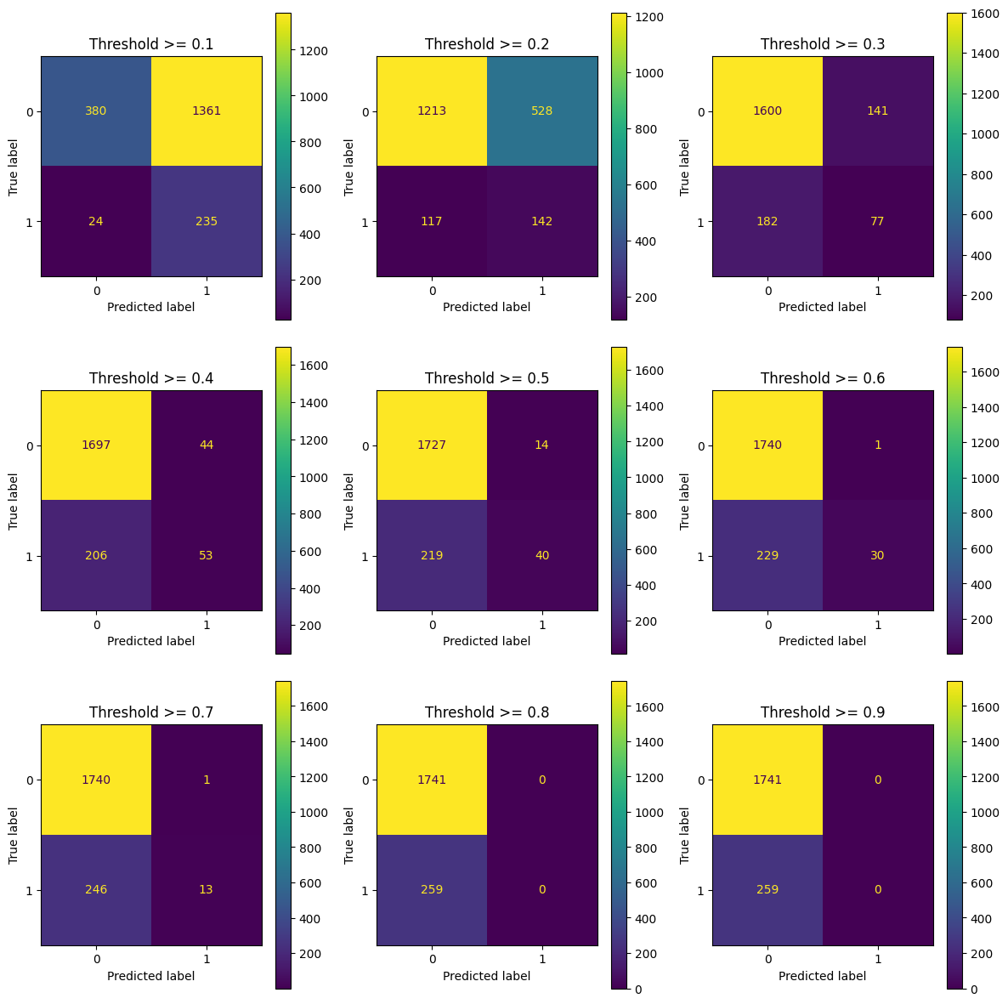
Choosing Threshold– RANDOM FOREST
Notes:
AI-generated content may be incorrect. --- This presentation will guide you through the essentials of personal finance, emphasizing how to visualize your money using numbers and charts. You'll learn how to manage your income, expenses, savings, budgeting, investing, debt, and financial data interpretation effectively. Image source: Microsoft 365 content library

Slide 38

PROFITABILITY
The Basic Profitability Threshold
Assumptions:
Average loan size (exposure): $16k
Average profit if repaid (net interest & fees): $2k
Average loss if default (net of recoveries): $16k
Break-even math: Profitability requires:
As long as fewer than 1 in 8 approved borrowers default, the portfolio makes money.
Notes:
AI-generated content may be incorrect. --- This presentation will guide you through the essentials of personal finance, emphasizing how to visualize your money using numbers and charts. You'll learn how to manage your income, expenses, savings, budgeting, investing, debt, and financial data interpretation effectively. Image source: Microsoft 365 content library

Slide 39
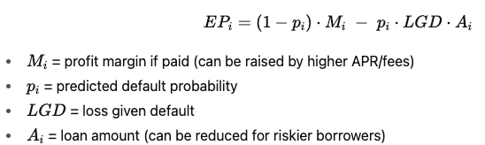
PROFIT Optimization STRATEGY
Binary approval (simple version)
Approve only customers with predicted default probability < 12.5%.
Decline everyone above → business guarantees profit on average.
Tiered pricing
For moderate risk customers (say, 12–20% default risk), don’t reject them outright.
Instead, increase APR (Annual Percentage Rate), shorten loan term, or reduce principal to adjust expected profit.
Formula with pricing lever:
By adjusting M and A, even some higher-risk borrowers can become profitable.
Notes:
AI-generated content may be incorrect. --- This presentation will guide you through the essentials of personal finance, emphasizing how to visualize your money using numbers and charts. You'll learn how to manage your income, expenses, savings, budgeting, investing, debt, and financial data interpretation effectively. Image source: Microsoft 365 content library

Slide 40
CONCLUSIONS
Business Value
Predictive modeling enables us to distinguish between profitable and high-risk customers.
Avoiding bad loans reduces losses; targeting safe customers maximizes revenue.
Best Model Findings
Random Forest delivered the best balance:
Detected ~86% of defaults.
Kept false alarms extremely low (≈0.3%).
Strong technical metrics (AUC = 0.97, Precision-Recall AP = 0.97) confirm reliability.
Profitability Insights
Break-even threshold = 12.5% default rate (based on $16k exposure vs $2k profit).
By applying the model, we keep default rates below this cutoff → portfolio remains profitable.
Risk-based pricing (APR/loan size adjustments) allows us to profitably serve even some moderate-risk customers.
Next Steps
Deploy model into credit decision process (approve/decline + pricing guidance).
Pilot with different thresholds and pricing strategies.
Monitor defaults, profit margins, and recalibrate regularly.
Notes:
AI-generated content may be incorrect. --- This presentation will guide you through the essentials of personal finance, emphasizing how to visualize your money using numbers and charts. You'll learn how to manage your income, expenses, savings, budgeting, investing, debt, and financial data interpretation effectively. Image source: Microsoft 365 content library

