Slide 1
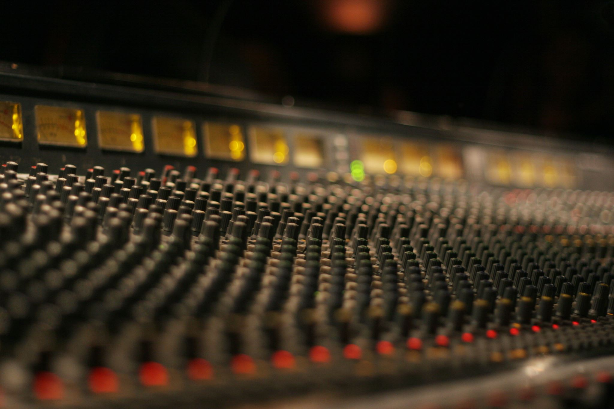
Music Recommendation System
Marta Wheeler

Slide 2
Problem definition
Recommendations Systems are one of the most profitable applications of data science in today’s world.
Market size value in 2022 -> $34.53 billion
Revenue forecast in 2030 -> $103.07 billion
Growth rate CAGR of 14.7% from 2022 to 2030
Spotify, YouTube Music, Pandora, SoundCloud, iHeartRadio, Tidal, Tidal, Apple Music, Bandcamp
Spotify’s market cap is estimated at $24.08 billion

Slide 3
Problem to solve
Increased customer satisfaction
Increased revenue
Find out how to measure customer happiness
Engagements & retention
Recommend top 10 songs for a user of music recommendation system

Slide 4
Unique characteristics of music recommendation:
Duration of items – short
Magnitude of items – large
Sequential consumption
Recommendation of previously recommended items
Consumption behavior – passive
Listening intent and purpose
Emotions
Listening context

Slide 5
Solution Approach
Choosing only subset of the data - Taste Profile Subset released by the Echo Nest as part of the Million Song Dataset
only users who listened to at least 90 or more songs
songs that have been listened by 120 or more users
only songs with max play count 5
Play count as a proxy for rating
Threshold = 1.5
Building several different models and comparing its evaluation metrics

Slide 6
Investigated models:
Popularity based
User-User Similarity-based collaborative filtering
Item-item Similarity-based collaborative filtering
Matrix factorization – model based
Cluster based
Content based

Slide 7
Solution Approach - Recommendation System Pipeline
Data Extraction
Data Preprocessing
Find similarity of users/items
Recommendation
Summarize features
Define Threshold
Dataset Download
Metadata:
TF-IDF
Text: sentiment analysis
Find cosine Similarity between users/items
Dataset Reshaping
PART I
PART II

Slide 8
More details on solution approach
 |  | Perf eval measures | Similarity Based Collaborative Filtering |  |  |  | Model Based Collaborative Filtering |  | Cluster based Recommendation System
 |  |  | User - user |  | Item - item |  | Matrix Factorization
 |  |  | Baseline | Optimized | Baseline | Optimized | Baseline | Optimized | Baseline | Optimized
 |  | RMSE | 1.0878 | 1.0521 | 1.0394 | 1.0328 | 1.0252 | 1.0141 | 1.0691 | 1.0487
 |  | Precision | 0.396 | 0.413 | 0.307 | 0.408 | 0.41 | 0.415 | 0.398 | 0.397
 |  | Recall | 0.692 | 0.721 | 0.562 | 0.665 | 0.633 | 0.635 | 0.56 | 0.582
 |  | F1 | 0.504 | 0.525 | 0.397 | 0.506 | 0.498 | 0.502 | 0.465 | 0.472
User_id | Song_id
6958 | 1671 | Pred1 | 1.801 | 1.963 | 1.361 | 1.963 | 1.267 | 1.343 | 1.294 | 1.294
6958 | 3232 | Pred2 | 1.639 | 1.452 | 1.378 | 1.492 | 1.556 | 1.804 | 1.479 | 1.479
27018 | 1671 | Pred3 | 1.275 | 1.286 | 2.551 | 2.337 | 2.217 | 2.264 | 2.403 | 2.403

Slide 9
Final Model solution existing users and songs
Optimized user-user similarity based collaborative filtering model.
Optimized by tuning values of the hyperparameters using grid search cross-validation
k = 30
min_k = 9
sim_options
name = 'pearson_baseline’
user_based = True
min_support 2
Test size = 40%
Threshold = 1.5

Slide 10
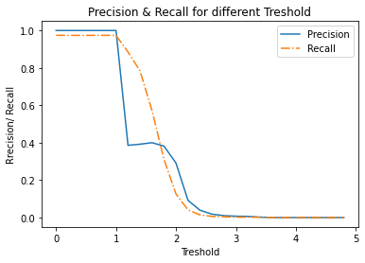
Model solution – threshold

Slide 11
Model solution
Existing users and songs vs new ones.
Optimized User-user similarity based collaborative filtering for established users and songs.
Popularity based model to introduce new songs to existing users ( item cold start problem).
Content based models for brand new songs and artist (user cold start problem).

Slide 12
Proposed business solution
Hybrid model user and song segmentation
Content
New song?
YES
New user?
YES
NO
Popularity
NO
YES
New song?
NO
User-user

Slide 13
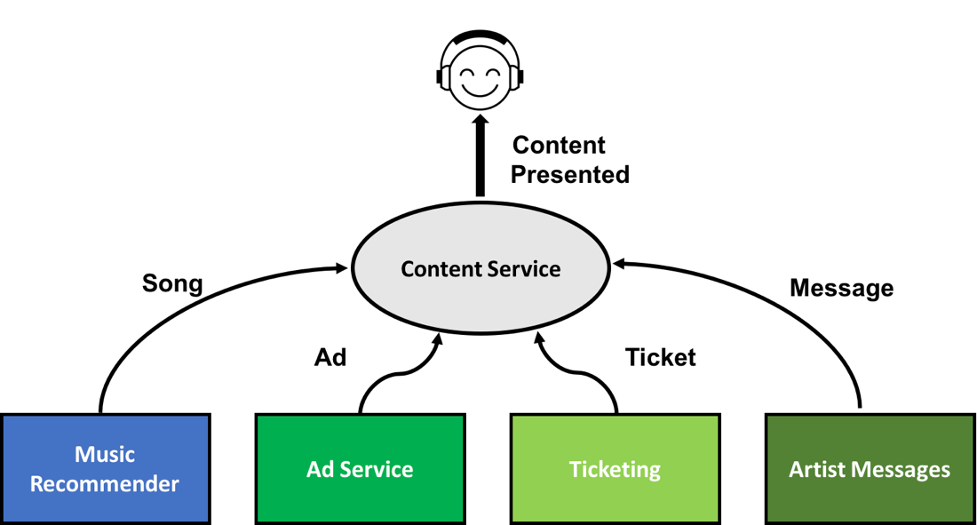
Key Actionable for stakeholders
Customer satisfaction
Engagement vs Retention
How to measure user happiness?
How to generate max profit?
How to reduce cost?

Slide 14
Executive Summary
Using hybrid model to recommend 10 songs for a user
User-user similarity-based model for existing users
Content based model for new songs and new users
Popularity based model to suggest new songs for existing users
User-user model exhibits best evaluation measures (high Precision@k and Recall@k and low RMSE)
Low precision yields in high cost (60% of recommended songs aren’t relevant)
Having richer data set can help with better prediction and lower cost
Measuring customer satisfaction is an important aspect

Slide 15
Risk and Challenges
Finding the right song for the right user
New song vs repeated
User satisfaction evaluation
Cold start & sparsity problem
Content based recommendation
Hybridization (CB + CF)
Cross-domain recommendation
Active learning
Automatic playlist continuation
High cost of recommendations compared to return

Slide 16
Cold Start Problem
Sparsity Problem
Cold Start Challenge &
User Happiness
More data need for better models
Users – typical demographical data (age, geo location, education level, income, ethnicity), new user vs established user, free or paid membership.
Songs – genre, type, sonic info (acoustic features including spectral properties, timbre, rhythm, and pitch).
Interactions – seasonality (time of the year, time of the weekday), place (gym, plane, home- living room, entertainment, kitchen, bedroom, car, work), activity- can be tight to the place (resting/relaxing, working out, work, travel, cooking), time spent listening to the song (if the song was listened to till the end, stopped at 10%, 30%, skipped and how many times).

Slide 17
Further analysis
Further analysis would consist of acquiring additional data mentioned previously (user, song and interaction data) and finding any dependencies (for example seasonality, time and place for an interaction, more context analysis for the songs and users).
Having richer data, different models could be applied like time series (seasonality) or neural networks (CRNN – combination of CNN & RNN)

Slide 18
Thank you!

Slide 19
Bibliography
[1] Schedl Markus, Zamani Hamed, Chen Ching-Wei, Daldjoo Yashar, Elahi Medhi (2018) Current challenges and vision in music recommender system research.
[2] Abdollahpouri Himan ,Esisnger Steve (2017) Multiple Stakeholders in Music Recommender Systems.
[3] Adiyansjah, Gunawan Alexander, Suhartono Derwin (2019) Music Recomemndaer System Based on Genre unising Convolutional Recurrent Neural Networks
[4] Grand View Research (2021) Music Streaming Market.

Slide 20
Appendix

Slide 21
Appendix
Hyperparameters for the KNNBasic algorithms
k (int) – The (max) number of neighbors to take into account for aggregation (see this note). Default is 40.
min_k (int) – The minimum number of neighbors to take into account for aggregation. If there are not enough neighbors, the prediction is set to the global mean of all ratings. Default is 1.
sim_options (dict) – A dictionary of options for the similarity measure. And there are four similarity measures available in surprise -
cosine
msd (default)
pearson
pearson baseline

Slide 22
Appendix
10 most recommended songs to the user number 6958 (user-user similarity based collaborative filtering model ):
2.55 5531 “Secrets” Waking Up by OneRepublic from 2009
2.52 317 “Undo” Vespertine Live by Björk from 2001
2.41 4954 “The Maestro” Check Your Head by Beastie Boys from 1992
2.4 8635 “Una Confusion” All Access by LU from 2006
2.39 5943 “You've Got The Love” Lungs by Florence + The Machine from 2009
2.39 1664 “Horn Concerto No. 4 in E flat K495: II. Romanc...” Mozart - Eine kleine Nachtmusik by Barry Tuckwell/Academy of St Martin-in-the-Fie...
2.35 6246 “Canada” The End Is Here by Five Iron Frenzy
2.32 1348 “Mia” First Love by Emmy The Great from 2007
2.27 7496 “The Gift” We Don't Need To Whisper by Angels and Airwaves from 2006
2.26 2852 “West One (Shine On Me)” The Crack/Grin And Bear It by The Ruts from 1980

Slide 23
Final Model Solution- Appendix
Popularity based model with min 50 interactions:
7224 “Victoria (LP Version)” Hit By A Train: The Best Of Old 97's by Old 97's from 2006
8324 “The Big Gundown” Invaders Must Die Remixes and Bonus Tracks by The Prodigy from 2009
6450 “Brave The Elements” Brave The Elements - EP by Colossal
9942 “Greece 2000” Greece 2000 by Three Drives from 1997
5531 “Secrets” Waking Up by OneRepublic from 2009
5653 “Transparency” Workout Holiday by White Denim from 2008
8483 “Video Killed The Radio Star” Friends Reunited: Music Of The Year 1979 by The Buggles from 1979
2220 “Sehr kosmisch” Musik von Harmonia by Harmonia
657 “Luvstruck” Hard House Anthems by Southside Spinners from 1999
614 “You're The One” If There Was A Way by Dwight Yoakam from 1990

Slide 24
Final Model Solution- Appendix
10 most recommended songs to the user number 6958 (content-based model, because user listened to the “'The Bachelor and the Bride” 5 times)
447 “Daisy And Prudence” Distillation by Erin McKeown from 2000
1674 “I Need A Dollar” I Need A Dollar by Aloe Blacc from 2010
1936 “Feel The Love” In Ghost Colours by Cut Copy from 2008
2716 “All The Pretty Faces” When You Were Young by The Killers from 2006
3534 “Who Let You Go?” Sawdust by The Killers from 2007
5095 “Bones” Bones by The Killers from 2006
5715 “Sam's Town” Sam's Town by The Killers from 2006
8624 “Hearts On Fire” Hearts On Fire by Cut Copy from 2007
2914 “Billy Liar” Billy Liar (CD-Single) by The Decemberists from 2003
6084 “Red Right Ankle” Her Majesty The Decemberists by The Decemberists from 2003

