Slide 1
Inference in first-order logic

Slide 2
Outline
Reducing first-order inference to propositional inference
Unification
Generalized Modus Ponens
Forward chaining
Backward chaining
Resolution

Slide 3
Universal instantiation (UI)
Every instantiation of a universally quantified sentence is entailed by it:
∀v α Subst({v/g}, α)
for any variable v and ground term g
E.g., ∀x King(x) ∧ Greedy(x) ⇒ Evil(x) yields: King(John) ∧ Greedy(John) ⇒ Evil(John)
King(Richard) ∧ Greedy(Richard) ⇒ Evil(Richard)
King(Father(John)) ∧ Greedy(Father(John)) ⇒ Evil(Father(John))

Slide 4
Existential instantiation (EI)
For any sentence α, variable v, and constant symbol k that does not appear elsewhere in the knowledge base:
∃v α
Subst({v/k}, α)
E.g., ∃x Crown(x) ∧ OnHead(x,John) yields:
Crown(C₁) ∧ OnHead(C₁,John)
provided C₁ is a new constant symbol, called a Skolem constant.

Slide 5
Reduction to propositional inference
Suppose the KB contains just the following:
∀x King(x) ∧ Greedy(x) ⇒ Evil(x)
King(John)
Greedy(John)
Brother(Richard,John)
Instantiating the universal sentence in all possible ways, we have:
King(John) ∧ Greedy(John) ⇒ Evil(John)
King(Richard) ∧ Greedy(Richard) ⇒ Evil(Richard)
King(John)
Greedy(John)
Brother(Richard,John)
The new KB is propositionalized: proposition symbols are
King(John), Greedy(John), Evil(John), King(Richard), etc.

Slide 6
Unification
We can get the inference immediately if we can find a substitution θ such that King(x) and Greedy(x) match King(John) and Greedy(y)
θ = {x/John,y/John} works
Unify(α,β) = θ if αθ = βθ
p q θ
Knows(John,x) Knows(John,Jane)
Knows(John,x) Knows(y,OJ)
Knows(John,x) Knows(y,Mother(y))
Knows(John,x) Knows(x,OJ)
Standardizing apart eliminates overlap of variables, e.g., Knows(z₁₇,OJ)

Slide 7
Unification
We can get the inference immediately if we can find a substitution θ such that King(x) and Greedy(x) match King(John) and Greedy(y)
θ = {x/John,y/John} works
Unify(α,β) = θ if αθ = βθ
p q θ
Knows(John,x) Knows(John,Jane) {x/Jane}}
Knows(John,x) Knows(y,OJ)
Knows(John,x) Knows(y,Mother(y))
Knows(John,x) Knows(x,OJ)
Standardizing apart eliminates overlap of variables, e.g., Knows(z₁₇,OJ)

Slide 8
Unification
We can get the inference immediately if we can find a substitution θ such that King(x) and Greedy(x) match King(John) and Greedy(y)
θ = {x/John,y/John} works
Unify(α,β) = θ if αθ = βθ
p q θ
Knows(John,x) Knows(John,Jane) {x/Jane}}
Knows(John,x) Knows(y,OJ) {x/OJ,y/John}}
Knows(John,x) Knows(y,Mother(y))
Knows(John,x) Knows(x,OJ)
Standardizing apart eliminates overlap of variables, e.g., Knows(z₁₇,OJ)

Slide 9
Unification
We can get the inference immediately if we can find a substitution θ such that King(x) and Greedy(x) match King(John) and Greedy(y)
θ = {x/John,y/John} works
Unify(α,β) = θ if αθ = βθ
p q θ
Knows(John,x) Knows(John,Jane) {x/Jane}}
Knows(John,x) Knows(y,OJ) {x/OJ,y/John}}
Knows(John,x) Knows(y,Mother(y)) {y/John,x/Mother(John)}}
Knows(John,x) Knows(x,OJ)
Standardizing apart eliminates overlap of variables, e.g., Knows(z₁₇,OJ)

Slide 10
Unification
We can get the inference immediately if we can find a substitution θ such that King(x) and Greedy(x) match King(John) and Greedy(y)
θ = {x/John,y/John} works
Unify(α,β) = θ if αθ = βθ
p q θ
Knows(John,x) Knows(John,Jane) {x/Jane}}
Knows(John,x) Knows(y,OJ) {x/OJ,y/John}}
Knows(John,x) Knows(y,Mother(y)) {y/John,x/Mother(John)}}
Knows(John,x) Knows(x,OJ) {fail}
Standardizing apart eliminates overlap of variables, e.g., Knows(z₁₇,OJ)

Slide 11
Unification
To unify Knows(John,x) and Knows(y,z), θ = {y/John, x/z } or θ = {y/John, x/John, z/John}
The first unifier is more general than the second.
There is a single most general unifier (MGU) that is unique up to renaming of variables
MGU = { y/John, x/z }

Slide 12
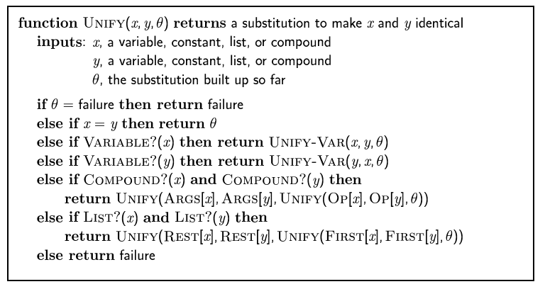
The unification algorithm

Slide 13
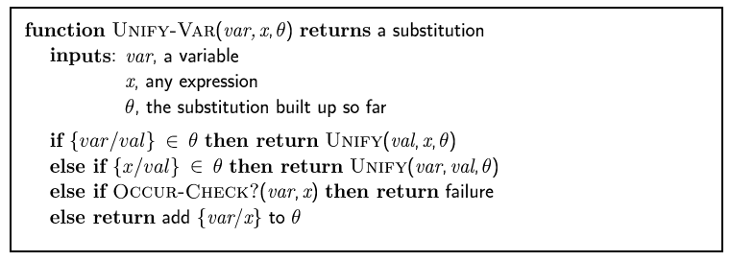
The unification algorithm

Slide 14
Generalized Modus Ponens (GMP)
p₁', p₂', … , p_{n}', ( p₁ ∧ p₂ ∧ … ∧ p_{n} ⇒ q)
qθ
p₁' is King(John) p₁ is King(x)
p₂' is Greedy(y) p₂ is Greedy(x)
q is Evil(x)
θ is {x/John,y/John}
q θ is Evil(John)
GMP used with KB of definite clauses (exactly one positive literal)
All variables assumed universally quantified
where p_{i}'θ = p_{i} θ for all i

Slide 15
Example knowledge base
The law says that it is a crime for an American to sell weapons to hostile nations. The country Nono, an enemy of America, has some missiles, and all of its missiles were sold to it by Colonel West, who is American.
Prove that Col. West is a criminal

Slide 16
Example knowledge base
... it is a crime for an American to sell weapons to hostile nations:
American(x) ∧ Weapon(y) ∧ Sells(x,y,z) ∧ Hostile(z) ⇒ Criminal(x)
Nono has some missiles, i.e., ∃x Owns(Nono,x) ∧ Missile(x): Owns(Nono,M₁) and Missile(M₁)
… all of its missiles were sold to it by Colonel West
Missile(x) ∧ Owns(Nono,x) ⇒ Sells(West,x,Nono)
Missiles are weapons: Missile(x) ⇒ Weapon(x)
An enemy of America counts as "hostile“:
Enemy(x,America) ⇒ Hostile(x)
West, who is American …
American(West)
The country Nono, an enemy of America …
Enemy(Nono,America)

Slide 17
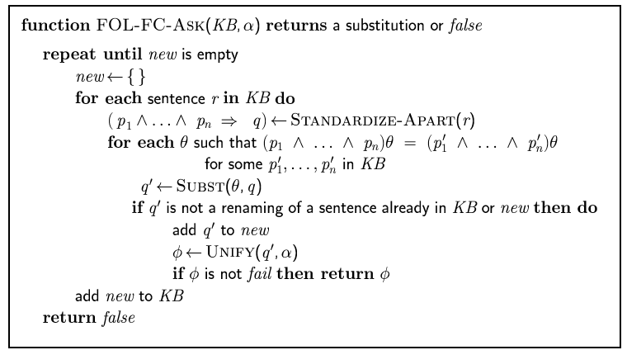
Forward chaining algorithm

Slide 18
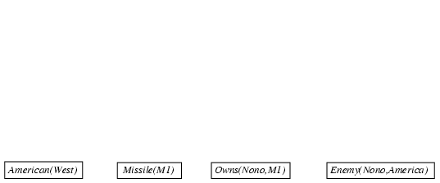
Forward chaining proof

Slide 19
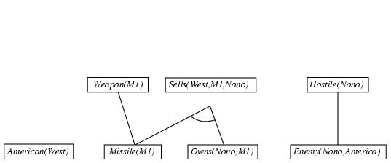
Forward chaining proof

Slide 20
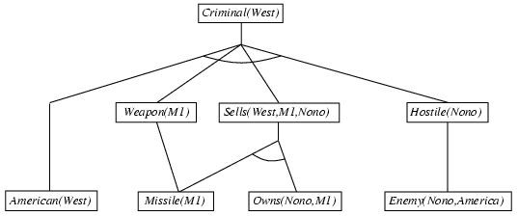
Forward chaining proof

Slide 21
Properties of forward chaining
Sound and complete for first-order definite clauses
Datalog = first-order definite clauses + no functions
FC terminates for Datalog in finite number of iterations
May not terminate in general if α is not entailed
This is unavoidable: entailment with definite clauses is semidecidable

Slide 22
Efficiency of forward chaining
Incremental forward chaining: no need to match a rule on iteration k if a premise wasn't added on iteration k-1
⇒ match each rule whose premise contains a newly added positive literal
Matching itself can be expensive:
Database indexing allows O(1) retrieval of known facts
e.g., query Missile(x) retrieves Missile(M₁)
Forward chaining is widely used in deductive databases

Slide 23
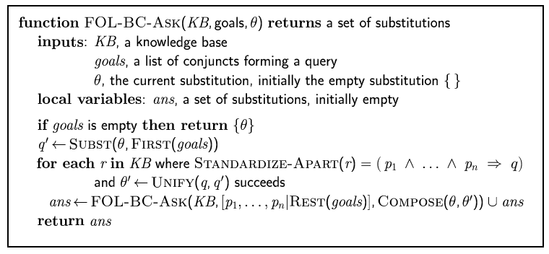
Backward chaining algorithm

Slide 24

Backward chaining example

Slide 25
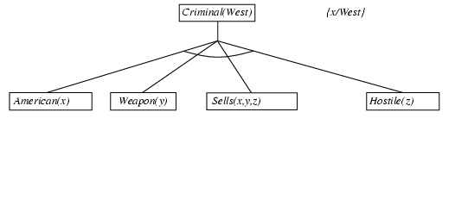
Backward chaining example

Slide 26
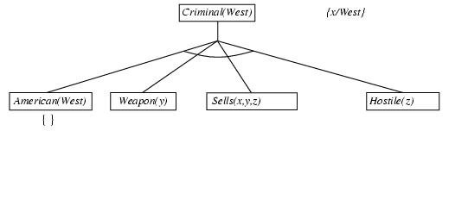
Backward chaining example

Slide 27
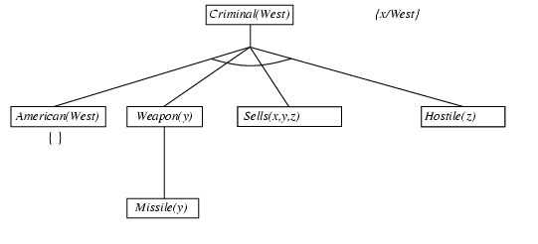
Backward chaining example

Slide 28
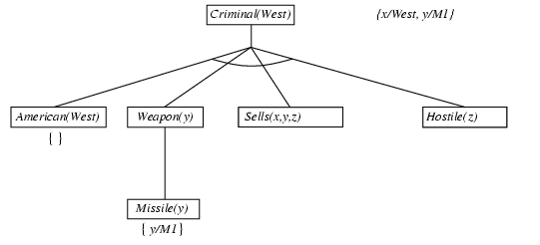
Backward chaining example

Slide 29
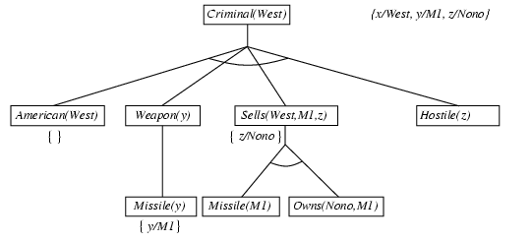
Backward chaining example

Slide 30
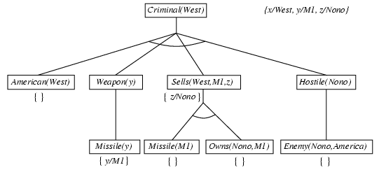
Backward chaining example
American(x) ∧ Weapon(y) ∧ Sells(x,y,z) ∧ Hostile(z) ⇒ Criminal(x)
Owns(Nono,M₁) and Missile(M₁)
Missile(x) ∧ Owns(Nono,x) ⇒ Sells(West,x,Nono)
Missile(x) ⇒ Weapon(x)
Enemy(x,America) ⇒ Hostile(x)
American(West)
Enemy(Nono,America)

Slide 31
Properties of backward chaining
Depth-first recursive proof search: space is linear in size of proof
Incomplete due to infinite loops
⇒ fix by checking current goal against every goal on stack
Inefficient due to repeated subgoals (both success and failure)
⇒ fix using caching of previous results (extra space)
Widely used for logic programming

Slide 32
Resolution: brief summary
Full first-order version:
l₁ ∨ ··· ∨ l_{k}, m₁ ∨ ··· ∨ m_{n}
(l₁ ∨ ··· ∨ l_{i-1} ∨ l_{i+1} ∨ ··· ∨ l_{k} ∨ m₁ ∨ ··· ∨ m_{j-1} ∨ m_{j+1} ∨ ··· ∨ m_{n})θ
where Unify(l_{i}, ¬m_{j}) = θ.
The two clauses are assumed to be standardized apart so that they share no variables.
For example,
¬Rich(x) ∨ Unhappy(x)
Rich(Ken)
Unhappy(Ken)
with θ = {x/Ken}
Apply resolution steps to CNF(KB ∧ ¬α); complete for FOL

Slide 33
Conversion to CNF
Everyone who loves all animals is loved by someone:
∀x [∀y Animal(y) ⇒ Loves(x,y)] ⇒ [∃y Loves(y,x)]
Eliminate biconditionals and implications
∀x [¬∀y ¬Animal(y) ∨ Loves(x,y)] ∨ [∃y Loves(y,x)]
Move ¬ inwards: ¬∀x p ≡ ∃x ¬p, ¬ ∃x p ≡ ∀x ¬p
∀x [∃y ¬(¬Animal(y) ∨ Loves(x,y))] ∨ [∃y Loves(y,x)]
∀x [∃y ¬¬Animal(y) ∧ ¬Loves(x,y)] ∨ [∃y Loves(y,x)]
∀x [∃y Animal(y) ∧ ¬Loves(x,y)] ∨ [∃y Loves(y,x)]

Slide 34
Conversion to CNF contd.
Standardize variables: each quantifier should use a different one
∀x [∃y Animal(y) ∧ ¬Loves(x,y)] ∨ [∃z Loves(z,x)]
Skolemize: a more general form of existential instantiation.
Each existential variable is replaced by a Skolem function of the enclosing universally quantified variables:
∀x [Animal(F(x)) ∧ ¬Loves(x,F(x))] ∨ Loves(G(x),x)
Drop universal quantifiers:
[Animal(F(x)) ∧ ¬Loves(x,F(x))] ∨ Loves(G(x),x)
Distribute ∨ over ∧ :
[Animal(F(x)) ∨ Loves(G(x),x)] ∧ [¬Loves(x,F(x)) ∨ Loves(G(x),x)]

Slide 35
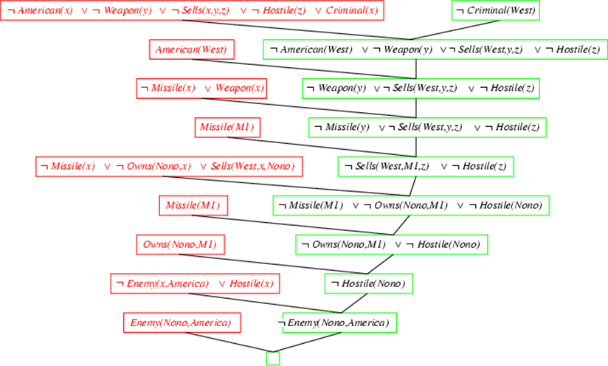
Resolution proof: definite clauses

Slide 36
Representing Facts in First-Order Logic
Example:
Lucy* is a professor
All professors are people
John is the dean.
Deans are professors.
All professors consider the dean a friend or don’t know him.
Everyone is a friend of someone.
People only criticize people that are not their friends.
Lucy criticized John.

