Slide 1
CSG2A3 ALGORITMA dan STRUKTUR DATA
Graph Data Structure

Slide 2
Graph Definition
A representation of a set of objects where some pairs of objects are connected by links
A graph data structure consists of a finite set of nodes or vertices, together with a set of ordered pairs of these nodes known as edges or arcs
G = ( V , E )
V = { v1, v2, …, vn }
E = { e1, e2, …, em }

Slide 3
Graph Example
V = {v1, v2, v3}
E = {e1, e2, e3, e4, e5}
= { (v1,v2), (v1,v2), (v1,v3), (v2,v3),
(v3,v3)
}

Slide 4
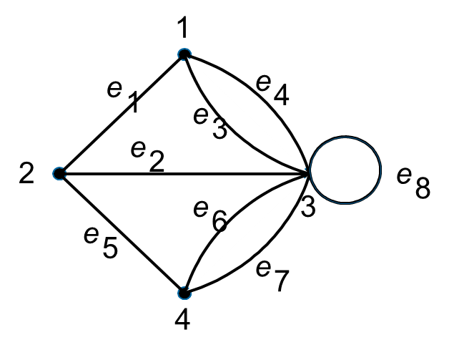
Graph Example
V = { 1, 2, 3, 4 }
E = {e1, e2, e3, e4, e5, e6, e7, e8}
= { (1, 2), (2, 3), (1, 3), (1, 3),
(2, 4), (3, 4), (3, 4), (3, 3)
}
Edge e₃ = (1, 3) and e₄ = (1, 3) are called multiple edges or paralel edges
Edge e₈ = (3, 3) is called loop

Slide 5
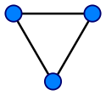
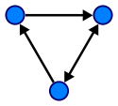
Types of Graph
Undirected graph
Simple Graph
Multigraph
Directed graph
Directed multigraph
Weighted graph
2
1
6

Slide 6
Undirected Graph
The edges have no orientation
Edge (a, b) and (b, a) are identical
Simple graph
Undirected graph with no loop and multiple edges
Multigraph
Undirected or directed graph that allow any multiple edges and loops
1
2
3
4

Slide 7
Directed Graph
Digraph
D = ( V, A )
The edges have orientation
Sometimes called arcs
Arc a = (x, y) is considered to be directed from x to y
y : head, successor
x : tail, predecessor

Slide 8
Properties of Graph
Two vertices u and v are called adjacent if an edge exists between them
From example: v1 and v2 are adjacent, while v1 and v4 are not
Two edges of a graph are called adjacent if they share a common vertex
From example: e1 and e5 are adjacent

Slide 9
Properties of Graph
If an edge connects two vertices; these two vertices are said to be incident to that edge, or,
equivalently, that edge incident to those two vertices
From example: e1 is incident to v1 and v2

Slide 10
Properties of Graph
The set of neighbors of v is a set of vertices adjacent to v not including v itself
From example : neighbors of 1 = { 2, 3 }
The degree of a vertex v in a graph G is the number of edges incident to v,
d(v)
loops being counted twice
From example : d(v1) = 3 d(v3) = 7

Slide 11
Properties of Graph
In digraph there are 2 more degrees to count
In degree to count the number of head endpoints adjacent to a node
Out degree to count the number of tail endpoints adjacent to a node
From example: d(v4) = 4 din(v4) = 2 dout(v4) = 2

Slide 12
Path in Graph
sequence of edges which connect a sequence of vertices
by most definitions, are all distinct from one another.
In digraph, the sequence of edges must be on the same direction (directed path)
From example: path = 1-2-3-4 {e1,e2,e6} length of path = 3
In weighted graph the length of path is total of value of traveled edge

Slide 13
Cycle in Graph
A closed walk consists of a sequence of vertices starting and ending at the same vertex,
with each two consecutive vertices in the sequence adjacent to each other in the graph
In digraph, the sequence of edges must be on the same direction (directed cycle)
From example: cycle = 1-2-3-2 {e1,e2,e4} length of cycle = 3
In weighted graph the length of cycle is total value of traveled edge

Slide 14
Exercise
Graf G = (V, E)
V = { ……………….}
E = {…………………}
Write down any path and circuit that exists in that graph!
Write the length
Write the degree of each vertex!

Slide 15
Question?

Slide 16
Graph Representation
Adjacency matrix
Incidence matrix
Adjacency list

Slide 17
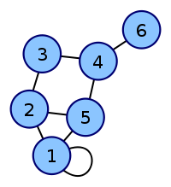
Adjacency Matrix
n x n matrix, n = number of vertices
M[x,y] = 1 if x and y are adjacent
In multigraph M[x,y] = number of edges from x to y
In undirected graph M[x,y] = M[y,x]
 | 1 | 2 | 3 | 4 | 5 | 6
1 | 1 | 1 | 0 | 0 | 1 | 0
2 | 1 | 0 | 1 | 0 | 1 | 0
3 | 0 | 1 | 0 | 1 | 0 | 0
4 | 0 | 0 | 1 | 0 | 1 | 1
5 | 1 | 1 | 0 | 1 | 0 | 0
6 | 0 | 0 | 0 | 1 | 0 | 0

Slide 18
Adjacency Matrix
In digraph
M[x,y] = 1 if there is an arc from x to y
M[x,y] may not the same as M[y,x]
 | 1 | 2 | 3 | 4 | 5 | 6
1 | 1 | 1 | 0 | 0 | 1 | 0
2 | 1 | 0 | 1 | 0 | 1 | 0
3 | 0 | 1 | 0 | 1 | 0 | 0
4 | 0 | 0 | 1 | 0 | 1 | 1
5 | 1 | 1 | 0 | 1 | 0 | 0
6 | 0 | 0 | 0 | 1 | 0 | 0
 | 1 | 2 | 3 | 4 | 5 | 6
1 | 1 | 0 | 0 | 0 | 0 | 0
2 | 1 | 0 | 0 | 0 | 0 | 0
3 | 0 | 1 | 0 | 1 | 0 | 0
4 | 0 | 0 | 0 | 0 | 1 | 0
5 | 1 | 1 | 0 | 0 | 0 | 0
6 | 0 | 0 | 0 | 1 | 0 | 0

Slide 19
Adjacency Matrix
In weighted graph
M[x,y] = value/weight of edge from x to y
M[x,y] = ~, if x and y are not adjacent
 | 1 | 2 | 3 | 4 | 5 | 6
1 | 1 | 1 | 0 | 0 | 1 | 0
2 | 1 | 0 | 1 | 0 | 1 | 0
3 | 0 | 1 | 0 | 1 | 0 | 0
4 | 0 | 0 | 1 | 0 | 1 | 1
5 | 1 | 1 | 0 | 1 | 0 | 0
6 | 0 | 0 | 0 | 1 | 0 | 0
 | 1 | 2 | 3 | 4 | 5 | 6
1 | 3 | 2 | ~ | ~ | 4 | ~
2 | 2 | ~ | 7 | ~ | 0 | ~
3 | ~ | 7 | ~ | 2 | ~ | ~
4 | ~ | ~ | 2 | ~ | 6 | 2
5 | 4 | 0 | ~ | 6 | ~ | ~
6 | ~ | ~ | ~ | 2 | ~ | ~
2
2
7
6
0
2
4
3

Slide 20
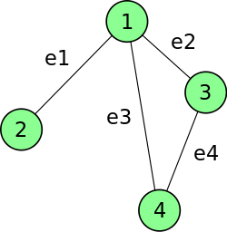
Incidence Matrix
n x m matrix,
n = number of vertices, m = number of edges
B[i, j] = 1 if vertex i and edge j are incident
 | e1 | e2 | e3 | e4
v1 | 1 | 1 | 1 | 0
v2 | 1 | 0 | 0 | 0
v3 | 0 | 1 | 0 | 1
v4 | 0 | 0 | 1 | 1

Slide 21
Incidence Matrix
In digraph
B[i, j] = 1 if the edge enters the vertex
B[i, j] = -1 if the edge leaves the vertex
 | e1 | e2 | e3 | e4
v1 | 1 | 1 | 1 | 0
v2 | 1 | 0 | 0 | 0
v3 | 0 | 1 | 0 | 1
v4 | 0 | 0 | 1 | 1
 | e1 | e2 | e3 | e4
v1 | 1 | -1 | -1 | 0
v2 | -1 | 0 | 0 | 0
v3 | 0 | 1 | 0 | 1
v4 | 0 | 0 | 1 | -1

Slide 22






Adjacency List
n x 1 array of linked list
n = number of vertices
may also be formed in multi linked list
1
2
3
4
5
6

Slide 23
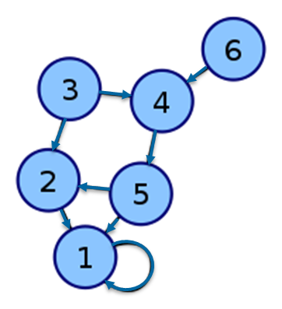



Adjacency List
Adjacency matrix in form of linked list
No wasted space
1
2
3
4
5
6

Slide 24
Exercise
Write the adjacency matrix, incidence matrix, and adjacency list

Slide 25
Question?

Slide 26
Traversal on Graph
Depth First Search
Breadth First Search
Start from 1 :
DFS : 1 2 4 8 5 6 3 7
BFS : 1 2 3 4 5 6 7 8

Slide 27
Graph Searching Algorithm
Procedure graphSearch( G : graph, v : vertex )
Dictionary
C : Container
x, w : vertex
Algorithm
insert( C, v )
while ( not isEmpty( C ) ) do
x ← remove( x )
if( not isVisited( x ) ) then
visit( x )
for each vertex w Є Vx
if( not isVisited( w ) then insert( C, w )

Slide 28
The Container - Stack
Depth First Search
 | Stack Container C |  | X visited
{bottom stack} | 1
 | 3 2 |  | 1
 | 3 5 4 |  | 1 2
 | 3 5 8 |  | 1 2 4
 | 3 5 7 6 5 |  | 1 2 4 8
 | 3 5 7 6 |  | 1 2 4 8 5
 | 3 5 7 3 |  | 1 2 4 8 5 6
 | 3 5 7 7 |  | 1 2 4 8 5 6 3
 | 3 5 7 |  | 1 2 4 8 5 6 3 7
 | 3 5 |  | 1 2 4 8 5 6 3 7
 | 3 |  | 1 2 4 8 5 6 3 7
 | empty |  | 1 2 4 8 5 6 3 7

Slide 29
The Container - Queue
Breadth First Search
 | Queue Container C |  | X visited
{head} | 1
 | 2 3 |  | 1
 | 3 4 5 |  | 1 2
 | 4 5 6 7 |  | 1 2 3
 | 5 6 7 8 |  | 1 2 3 4
 | 6 7 8 |  | 1 2 3 4 5
 | 7 8 8 |  | 1 2 3 4 5 6
 | 8 8 8 |  | 1 2 3 4 5 6 7
 | 8 8 |  | 1 2 3 4 5 6 7 8
 | 8 |  | 1 2 3 4 5 6 7 8
 | empty |  | 1 2 3 4 5 6 7 8

Slide 30
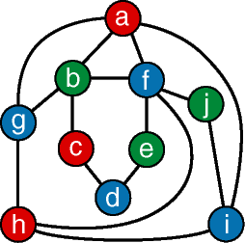
Exercise
Implement the graph searching algorithm to this graph

Slide 31
Topological Sorting
Toposort or topological ordering
linear ordering of vertices in directed acyclic graph
Example application:
the vertices of the graph may represent tasks to be performed,
the edges may represent constraints that one task must be performed before another;
in this application, a topological ordering is just a valid sequence for the tasks

Slide 32
Topological Sorting
Toposort result for the graph are:
v1, v2, v5, v4, v3, v7, v6
and
v1, v2, v5, v4, v7, v3, v6

Slide 33
Topological Sorting
Logic :
List all vertices, sort by degree of incoming edges (indegree)
If a vertex v has no incoming edges
Print vertex v
Remove vertex v
Repeat until no vertex remains
Or no more vertex with 0 in degree (cycle graph)

Slide 34
Topological Sorting
Calculate the inDegree
 | 1 | 2 | 3 | 4 | 5 | 6 | 7
1 |  | 1 | 1 | 1
2 |  |  |  | 1 | 1
3 |  |  |  |  |  | 1
4 |  |  | 1 |  |  | 1 | 1
5 |  |  |  | 1 |  |  | 1
6
7 |  |  |  |  |  | 1
1 | 2 | 3 | 4 | 5 | 6 | 7
0 | 1 | 2 | 3 | 1 | 3 | 2

Slide 35
Topological Sorting
Dictionary
v : vertex
Algorithm
for counter ← 1 to nVertex do
v ← getNewVertexZeroIndegree( G )
if ( v = Null ) then
output(‘graph has a cycle’)
else
result[ counter ] ← v
visit( v )
for ( each w adjacent to v ) do
indegree[w] ← indegree[w] - 1

Slide 36
Topological Sort
 | 1 | 2 | 3 | 4 | 5 | 6 | 7
1 |  | 1 | 1 | 1
2 |  |  |  | 1 | 1
3 |  |  |  |  |  | 1
4 |  |  | 1 |  |  | 1 | 1
5 |  |  |  | 1 |  |  | 1
6
7 |  |  |  |  |  | 1
 | Counter | 1 | 2 | 3 | 4 | 5 | 6 | 7
indegree | v1 | 0 | x
 | v2 | 1 | 0 | x
 | v3 | 2 | 1 | 1 | 1 | 0 | x
 | v4 | 3 | 2 | 1 | 0 | x
 | v5 | 1 | 1 | 0 | x
 | v6 | 3 | 3 | 3 | 3 | 2 | 1 | 0
 | v7 | 2 | 2 | 2 | 1 | 0 | 0 | x
 | zeroInDegree | v1 | v2 | v5 | v4 | v3 | v7 | v6

Slide 37
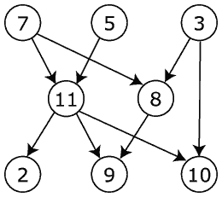
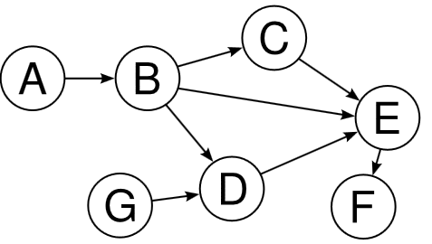
Exercise
Write the possible topological sort of these graphs

