Slide 1
CSG2A3 ALGORITMA dan STRUKTUR DATA
Tree Data Structure

Slide 2

Definition
The data structure consists of a root, and sub trees in a hierarchical arrangement.
A form of non-linear data structures

Slide 3
Definition
Usually used to describe, hierarchical data relationships, such as :
organizational structure
classification tree / genealogy
syntax tree / tree expression

Slide 4

Example
Organization Structure
Family tree
Tournament tree

Slide 5
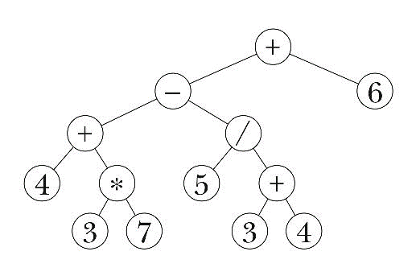
Example
Organization Structure
Arithmetic expression
Example : (4+3*7)-(5/(3+4)+6

Slide 6
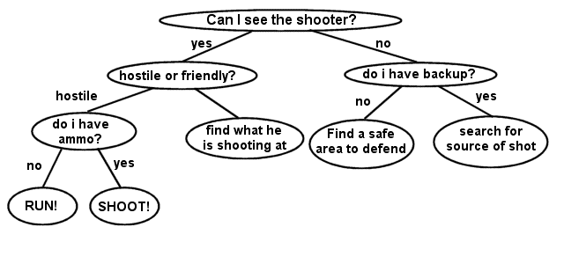
Example
Organization Structure
Arithmetic expression
Decision Tree

Slide 7
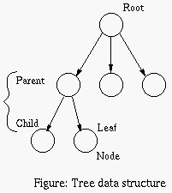
Tree Terminology
Leaf
Connection between nodes
(parent, child, sibling)
Level
Degree
Height and depth
Ancestor and Descendant
Forest

Slide 8
Tree Terminology
Tree is a collection of many nodes
Each node may have 0 or more successor
Each node has precisely one predecessor
except the peak node (root)
Root is the top node in a tree
Links that connect a node to its successors are called branches / edges

Slide 9
Tree Terminology
Successors of a node are called children (child)
Predecessor of a node is called parent
Nodes with the same parent are called siblings
Nodes with no children are called leaf/external node
Number of children / sub trees of a node is called degree

Slide 10
Tree Terminology
Descendant is a list of all child / successor to the leaf
Ancestor is a list of predecessor / from parent to root
The level of a node is defined by 1 + the number of connections between the node and the root.

Slide 11
Tree Terminology
The height of a tree is the number of edges on the longest downward path between the root and a leaf.
The height of a node is the number of edges on the longest downward path between that node and a leaf.
The depth of a node is the number of edges from the node to the tree's root node

Slide 12
Terminology
Degree = 2
Root
Degree = 3
Node / Vertex
Degree = 0

Slide 13
Exercise on Tree Terminology
Root =
Sibling C =
Parent F =
Child B =
Leaf =
Internal Node =
Level E =
Tree height =
Degree B =
Ancestor I =
Descendant B =

Slide 14
Exercise on Tree Terminology
Create the tree
Dataset: {A, X, W, H, B, E, S}
Root: A
Ancestor of S: {E, A}
{X, W, E} are siblings
{H, B} are descendant and both are children of W

Slide 15
Question?

Slide 16
Tree Notations / Representing Tree
Tree Diagram Notation
Classical node-link diagrams
Venn Diagram Notation
Nested sets / Tree Maps
Bracket Notation
Nested Parentheses
Level Notation
Outlines / tree views

Slide 17
Tree Diagram Notation

Slide 18
Venn Diagram Notation

Slide 19
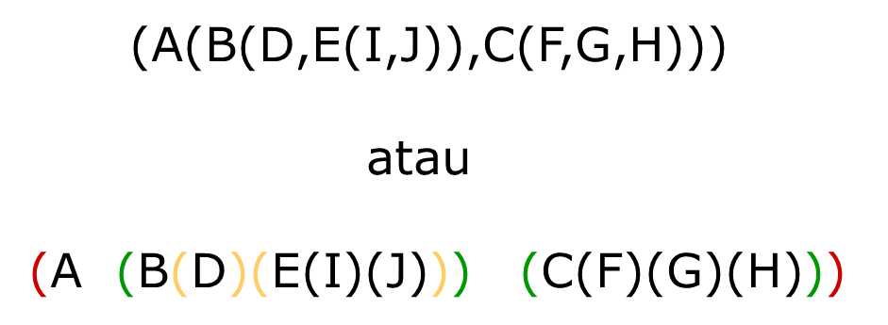
Bracket Notation

Slide 20
Level Notation

Slide 21
Exercise on Tree Notation
Create the tree in Venn Diagram, Bracket, and level notation
X
Y
R
S
Q
T
U
W
Z
P
M
N

Slide 22
Question?

