Slide 1
CSG2A3 ALGORITMA dan STRUKTUR DATA
Tree Data Structure

Slide 2

Binary Tree Data Structure

Slide 3
Binary Tree
Tree Data Structure with maximum child (degree) of 2, which are referred to as the left child and the right child.

Slide 4
Properties of Binary Tree
The number of nodes n a full binary tree is
At least :
At most :
Where h is the height of the tree
Maximum Node for each level = 2^{n}

Slide 5
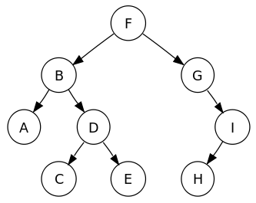
Types of Binary Tree
Full Binary Tree
Complete Binary Tree
Skewed Binary Tree

Slide 6
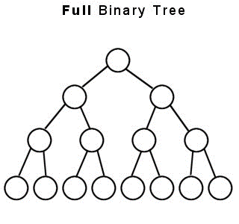
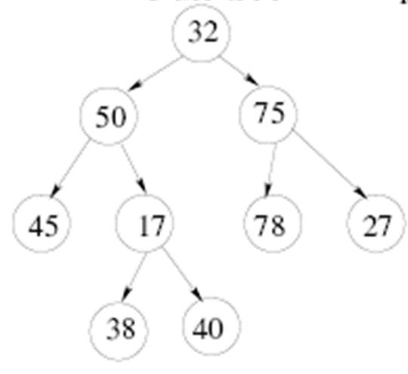
Full Binary Tree
A tree in which every node other than the leaves has two children
sometimes called proper binary tree or 2-tree

Slide 7
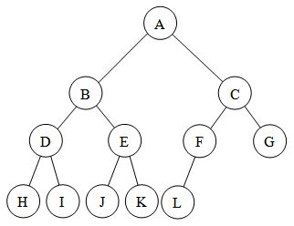
Complete Binary Tree
a binary tree in which every level, except possibly the last, is completely filled, and all nodes are as far left as possible
A
A
A
A
A
B
B
C
B
C
B
C
D
D
E

Slide 8
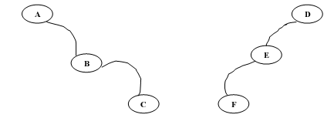
Skewed Tree
Binary Tree with an unbalanced branch between left and right branch

Slide 9
ADT Binary Tree
Array Representation
Linked list representation
id | value
1 | A
2 | B
3 | C
4 | D
5 | E
6 | F
7 | G

Slide 10

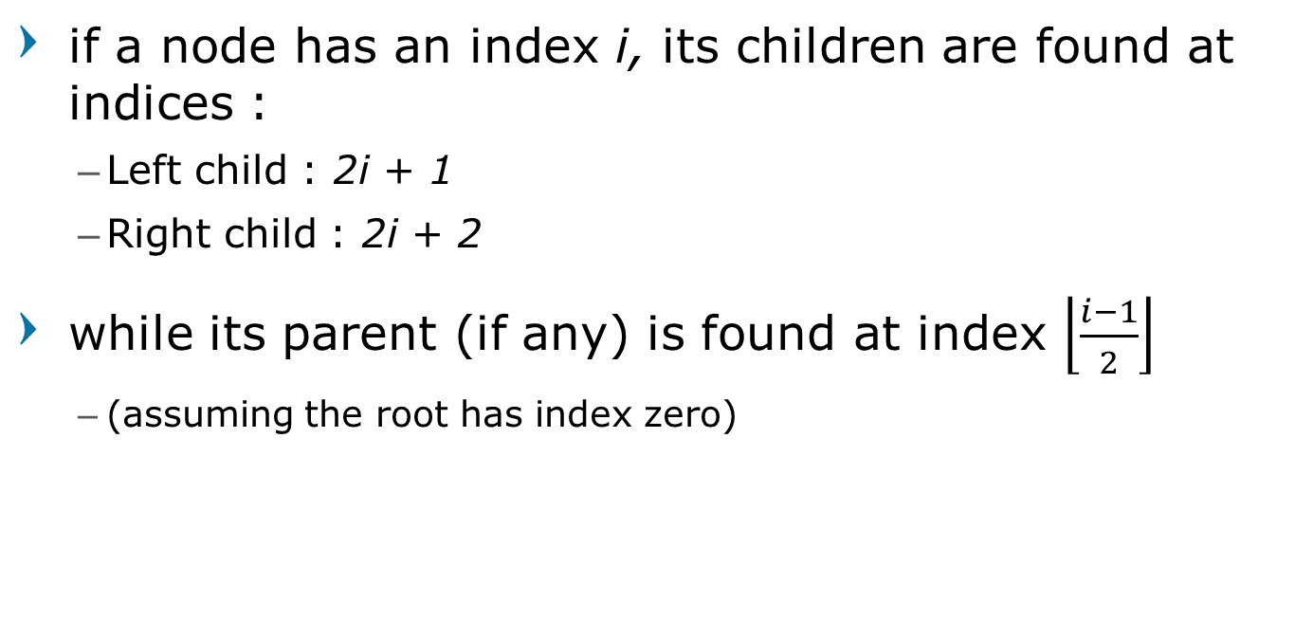
Array Representation
if a node has an index i, its children are found at indices :
Left child : 2i + 1
Right child : 2i + 2
while its parent (if any) is found at index $\left\lfloor \frac{i−1}{2}\right\rfloor$
(assuming the root has index zero)

Slide 11
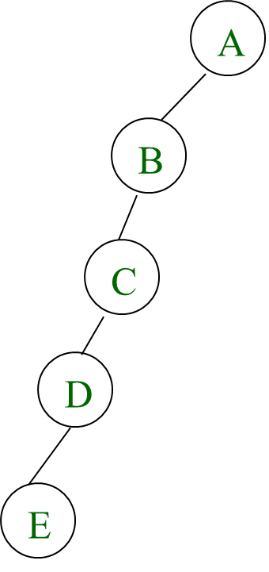
Array Representation
Problem :
Waste space
Insertion / deletion problem
Array Representation is good for Complete Binary Tree types
Binary Heap Tree
1 | 2 | 3 | 4 | 5 | 6 | 7 | 8 | … | 16
A | B | - | C | - | - | - | D | … | E

Slide 12
Linked List Representation
Type infotype : integer
Type address : pointer to Node
Type Node <
info : infotype
left : address
right : address
>
left | Info | right
Type BinTree : address
Dictionary
root : BinTree

Slide 13
Binary Tree : Create New Node
function createNode( x : infotype ) : address
Algorithm
allocate( N )
info( N ) ← x
left( N ) ← Null
right( N ) ← Null
→ N

Slide 14
Example Application of Binary Tree
Arithmetic Expression Tree
Binary Search Tree
Decision Tree
AVL Tree
Priority Queue
Binary Heap Tree

Slide 15
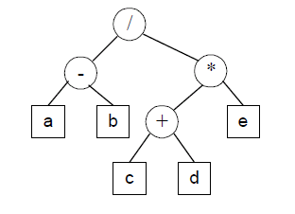
Arithmetic Expression Tree
A specific application of a binary tree to evaluate certain expressions
Example :
(a-b) / ((c+d) * e)

Slide 16
Exercise – create the tree
( a + b ) / ( c – d * e ) + f + g * h / i
(( A + B ) * ( C + D )) / ( E + F * H )
(6 - (12 - (3 + 7))) / ((1 + 0) + 2) * (2 *(3 + 1))

Slide 17
Binary Search Tree
Ordered / sorted binary tree
Internal nodes each store a key
two distinguished sub-trees
the key in each node must be:
greater than all keys stored in the left sub-tree
and smaller than all keys in right sub-tree

Slide 18
Binary Search Tree : Insert new Node
Procedure insertBST( i: x: infotype, i/o: N: BinTree )
Algorithm
if ( N = Nil ) then
N ← createNode( x )
else
if ( info( N ) > x ) then
insertBST( x , left( N ) )
else if ( info( N ) < x ) then
insertBST( x , right( N ) )
else
output(‘duplicate’)

Slide 19
Binary Search Tree : Search Node
Function findNode( i: x: infotype, i/o: N: BinTree ) : address
Algorithm
if ( info( N ) = x ) or ( N = Nil ) then
→ N
else
if ( info( N ) > x ) then
findNode( x , left( N ) )
else if ( info( N ) < x ) then
findNode( x , right( N ) )

Slide 20
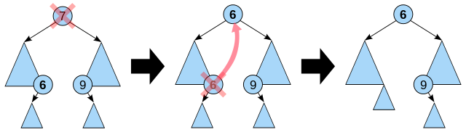
Binary Search Tree : Delete Node
Delete node P - Logic:
P has no children : remove P
P has 1 child : replace P with its child
P has 2 children :
Find Q where Q is either:
The leftmost child from the right sub-tree (successor of P) or
The rightmost child from the left sub-tree (predecessor of P)
Replace P with Q

Slide 21

Binary Search Tree : Delete Node
Procedure delMostRight( i/o : P , Q : BinTree )
Algorithm
if ( right( Q ) <> Nil ) then
delMostRight( P, right(Q) )
if( info( P ) = info( right( Q ) ) ) then
free( right( Q ) )
right( Q ) = Nil
else
info( P ) ← info( Q )
deleteBST( Q )
Procedure delMostLeft( i/o : P , Q : BinTree )
Algorithm
if ( left( Q ) <> Nil ) then
delMostLeft( P, left(Q) )
if( info( P ) = info( left( Q ) ) ) then
free( left( Q ) )
left( Q ) = Nil
else
info( P ) ← info( Q )
deleteBST( Q )

Slide 22
Binary Search Tree : Delete Node
Procedure deleteBST( i/o : P : BinTree )
Dictionary
Q : address
procedure delMostRight( i/o : P , Q : BinTree )
procedure delMostLeft( i/o : P , Q : BinTree )
Algorithm
if( left( P ) <> Nil ) then
Q ← left( P )
delMostRight( P , Q )
else
Q ← right( P )
delMostLeft( P , Q )

Slide 23
Question?

Slide 24
Traversal on Binary Tree
DFS traversal
Pre-order
In-order
Post-order
BFS traversal
Level-order

Slide 25
Pre-order Traversal
Deep First Search
Root → Left → Right
Prefix notation
Result :
FBADCEGIH

Slide 26
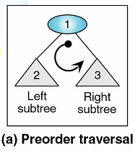
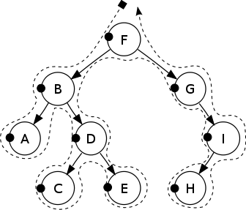
Pre-order Traversal
Procedure preOrder( i/o root : tree )
Algorithm
if ( root != null ) then
output( info( root ) )
preOrder( left( root ) )
preOrder( right( root ) )

Slide 27
In-order Traversal
Left → Root → Right
Infix notation
Result :
ABCDEFGHI

Slide 28
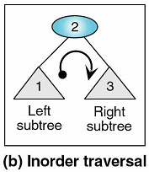
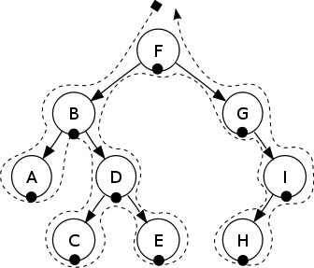
In-order Traversal
Procedure inOrder( i/o root : tree )
Algorithm
if ( root != null ) then
inOrder( left( root ) )
output( info( root ) )
inOrder( right( root ) )

Slide 29
Post-order Traversal
Left → right → Root
Postfix notation
Result :
ACEDBHIGF

Slide 30
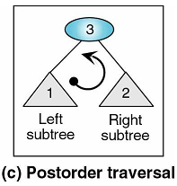

Post-order Traversal
Procedure postOrder( i/o root : tree )
Algorithm
if ( root != null ) then
postOrder( left( root ) )
postOrder( right( root ) )
output( info( root ) )

Slide 31
Level-order Traversal
Breadth First Search
recursively at each node
Result :
FBGADICEH

Slide 32
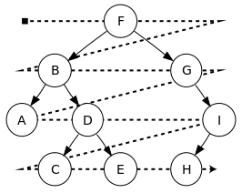
Level-order Traversal
Procedure levelOrder( root : tree )
Dictionary
Q : Queue
Algorithm
enqueue( Q, root )
while ( not isEmpty(Q) )
n ← dequeue( Q )
output( n )
enqueue( child ( n ) )

Slide 33
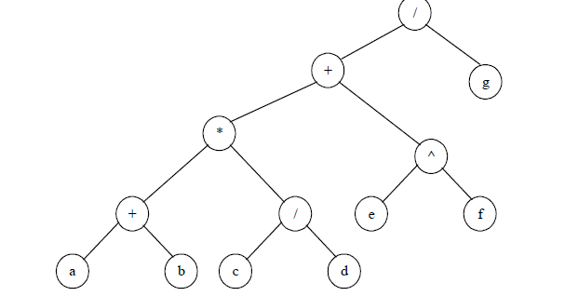
Exercise – write the traversal - 1

Slide 34
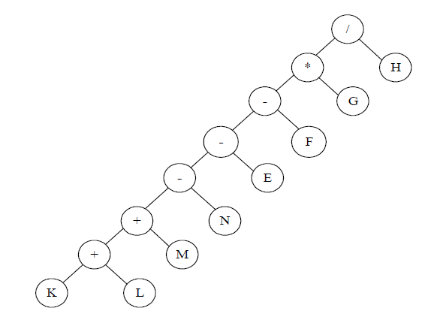
Exercise – write the traversal - 2

Slide 35
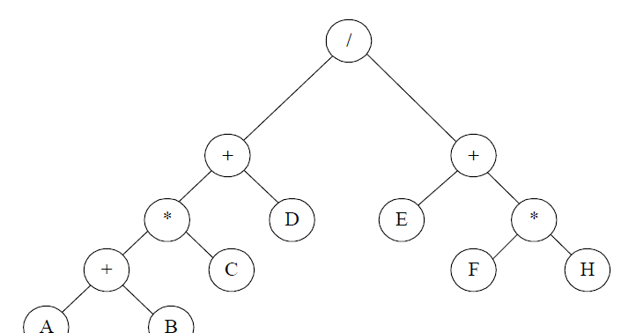
Exercise – write the traversal - 3

Slide 36
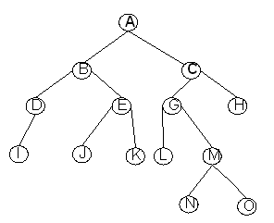
Exercise – write the traversal - 4

Slide 37
Exercise – Create the Tree
Assume there is ONE tree, which if traversed by Inorder resulting : EACKFHDBG, and when traversed by Preorder resulting : FAEKCDHGB
Draw the tree that satisfy the condition above

Slide 38
Question?

