Slide 1
CSG2A3 ALGORITMA dan STRUKTUR DATA
Recursive Algorithm

Slide 2
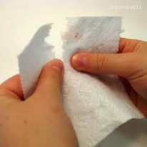
What is recursion?
Sometimes, the best way to solve a problem is by solving a smaller version of the exact same problem first
Example problem:
Try to tear a sheet of paper into the same 8 pieces

Slide 3
Tear paper into the same 8 pieces
To solve this, one solution is that we can just tear it 7 times as follows:
That was an example of the application of looping
1 | 2 | 3 | 4 | 5 | 6 | 7 | 8

Slide 4
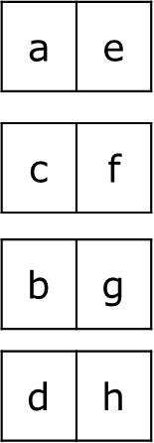
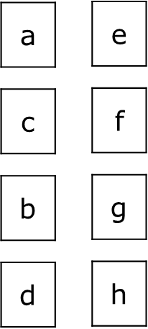
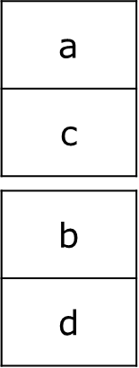
Tear paper into the same 8 pieces
Or we can tear it into 2, and repeat the process for each pieces 2 times
That is an example of the application of recursive
a | b

Slide 5
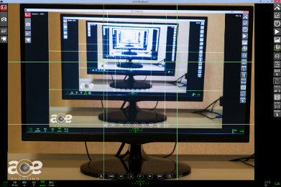
Recursive Function
Function that calls itself within the program text

Slide 6
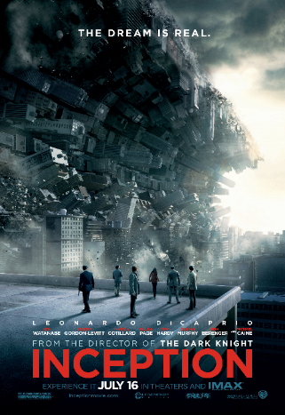
Have you seen this movie?
The movie tells about someone who can dream inside a dream
If you think that the “dream” in the movie is a function, then you’ll find it really similar concept to the recursive function

Slide 7
Some Definitions
Recursion is a technique that solves a problem by solving a smaller problem of the same type
Recursion is a principle closely related to mathematical induction.
F(0) = 0
F(x) = F(x-1) + 2
0
F(x) =
F(x-1) + 2

Slide 8
Example
Power of two
2^{n} = 2 * 2^{n-1}
2⁰ = 1
Factorial
X! = X * (X-1)!
0! = 1

Slide 9
Careful when writing
If we use iteration, we must be careful not to create an infinite loop by accident:
While ( result > 0 ) do
result ++
Oops!

Slide 10
Careful when writing
Similarly, if we use recursion we must be careful not to create an infinite chain of function calls

Slide 11

Remember the Rule!
An Algorithm must stop!
Define a rule that will stop the recursion
(initial set / base case)
X! = X * (X-1)!
0! = 1
Define a rule to reach the next iteration
(construct new element / step)

Slide 12
Algorithm of the factorial function
Function Factorial(input : n : integer)
if (n == 0) then // base case
→ 1
else
→ n * Factorial(n-1)

Slide 13
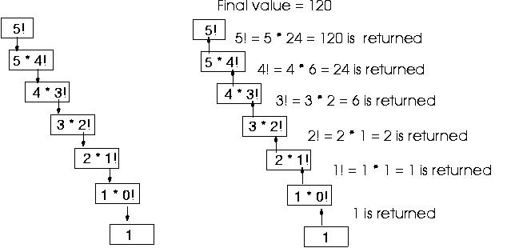

Slide 14

A famous example: The Fibonacci numbers
f(0) = 0, f(1) = 1
f(n) = f(n – 1) + f(n - 2)
f(0) = 0
f(1) = 1
f(2) = f(1) + f(0) = 1 + 0 = 1
f(3) = f(2) + f(1) = 1 + 1 = 2
f(4) = f(3) + f(2) = 2 + 1 = 3
f(5) = f(4) + f(3) = 3 + 2 = 5
f(6) = f(5) + f(4) = 5 + 3 = 8

Slide 15
Recursive Algorithm
An algorithm is called recursive if it solves a problem by reducing it to an instance of the same problem with smaller input
A recursive function must contain at least one non-recursive branch.
The recursive calls must eventually lead to a non-recursive branch

Slide 16
Recursion vs. iteration
For every recursive algorithm, there is an equivalent iterative algorithm
Iteration can be used in place of recursion
An iterative algorithm uses a looping construct
A recursive algorithm uses a branching structure

Slide 17
Recursion vs. iteration
Recursive solutions are often less efficient, in terms of both time and space, than iterative solutions
Recursion can simplify the solution of a problem, often resulting in shorter, more easily understood source code

Slide 18
How do I write a recursive function?
Determine the size factor
Determine the base case(s)
(the one for which you know the answer)
Determine the general case(s)
(the one where the problem is expressed as a smaller version of itself)
Verify the algorithm
(use the "Three-Question-Method")

Slide 19
Three-Question Verification Method
The Base-Case Question:
Is there a non-recursive way out of the function, and does the routine work correctly for this "base" case?
The Smaller-Caller Question:
Does each recursive call to the function involve a smaller case of the original problem, leading inescapably to the base case?
The General-Case Question:
Assuming that the recursive call(s) work correctly, does the whole function work correctly?

Slide 20
Question?

Slide 21
Write a recursive Algorithm
Binary Search
Reverse an Array
Counts number of zero
Checking a Palindrome
Drawing a triangle
Example :
*
**
***
****

