Slide 1
CSG2A3 ALGORITMA dan STRUKTUR DATA
Stack
Exercise

Slide 2
Exercise
Create an algorithm to push a value into a sorted stack so that the stack remains sorted
Only use push and pop
You can use multiple stack to do it

Slide 3
Exercise
Create an algorithm to check whether a word inputted from user is a palindrome or not
Example
Input : 10011001
Output : palindrome
Input : Was it a car or a cat I saw
Output : palindrome

Slide 4
Algebraic Expression
An algebraic expression is a legal combination of operands and the operators.
Operand is the quantity (unit of data) on which a mathematical operation is performed.
Operand may be a variable like x, y, z or a constant like 5, 4,0,9,1 etc.
Operator is a symbol which signifies a mathematical or logical operation between the operands. Example of familiar operators include +,-,*, /, ^
Considering these definitions of operands and operators now we can write an example of expression as x+y*z.

Slide 5
Infix, Postfix and Prefix Expressions
INFIX:
operands surround the operator,
x+y, 6*3 etc.
POSTFIX:
Reverse Polish Notation (RPN).
operator comes after the operands,
xy+, xyz+* etc.
PREFIX:
Polish notation.
operator comes before the operands,
+xy, *+xyz etc.

Slide 6
Properties
Operator Priorities
priority(*) = priority(/) > priority(+) = priority(-)
Tie Breaker
When an operand lies between two operators that have the same priority, the operand associates with the operator on the left.

Slide 7
Why use Prefix or Postfix
INFIX notations are not as simple as they seem specially while evaluating them.
To evaluate an infix expression we need to consider Operators’ Priority and Associative property
For example expression 3+5*4 evaluate to 32 i.e. (3+5)*4 or to 23 i.e. 3+(5*4).

Slide 8
Infix Expression Is Hard To Parse
Need operator priorities, tie breaker, and delimiters.
This makes computer evaluation more difficult than is necessary.
Postfix and prefix expression forms do not rely on operator priorities, a tie breaker, or delimiters.
So it is easier to evaluate expressions that are in these forms.

Slide 9
Examples of infix to prefix and post fix
Infix | PostFix | Prefix
A+B | AB+ | +AB
(A+B) * (C + D) | AB+CD+* | *+AB+CD
A-B/(C*D^E) | ABCDE^*/- | -A/B*C^DE
No brackets necessary

Slide 10
Example : Infix to Postfix
Expression
 | Stack
(bottom stack)
Output
Suppose we want to convert 2*3/(2-1)+5*3 into Postfix form,
2
*
3
/
(
- /(- 23*2
1 /(- 23*21
) / 23*21-
+ + 23*21-/
5 + 23*21-/5
* +* 23*21-/5
3 +* 23*21-/53
Empty 23*21-/53*+
Empty
*
*
/
/(
2
2
23
23*
23*

Slide 11
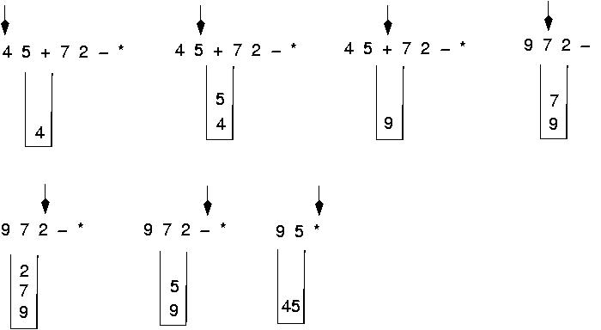
Evaluating a postfix Expression
Use a stack to evaluate an expression in postfix notation

Slide 12
Home Task
Write an algorithm to convert an infix expression to postfix and infix to prefix
Write an algorithm to evaluate a postfix and a prefix expression

