Slide 1
Mars frontier
Mars Rover Simulation Game.
Made by: Dhruv Middha, Omar Koraim, Mohammed Iftikhar Alam, Marwan Hamed.

Slide 2

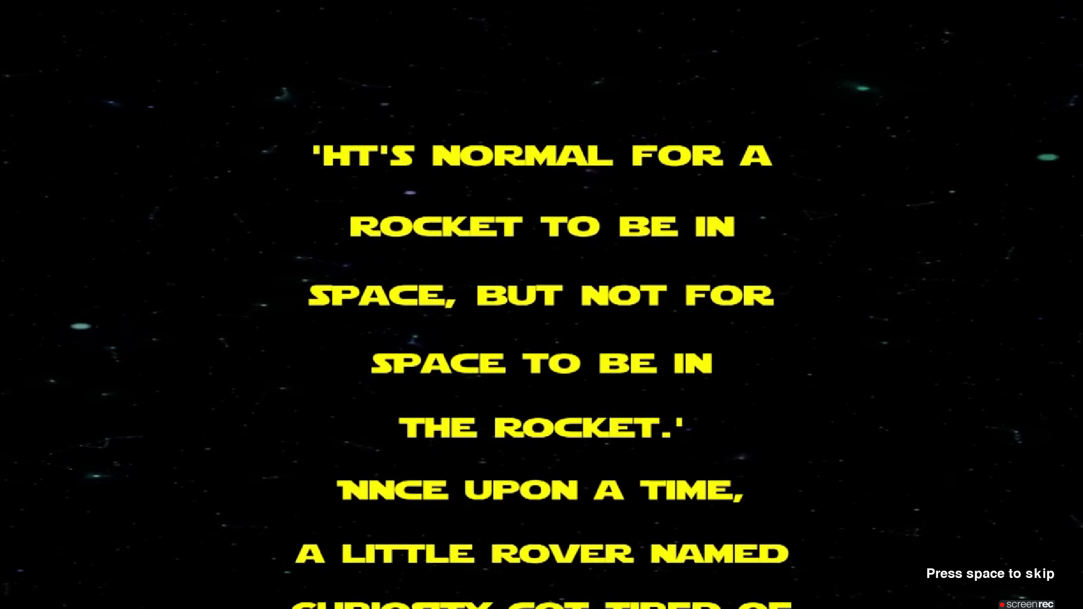

Background story
Press “Space Bar” to skip the background story if you want.

Slide 3
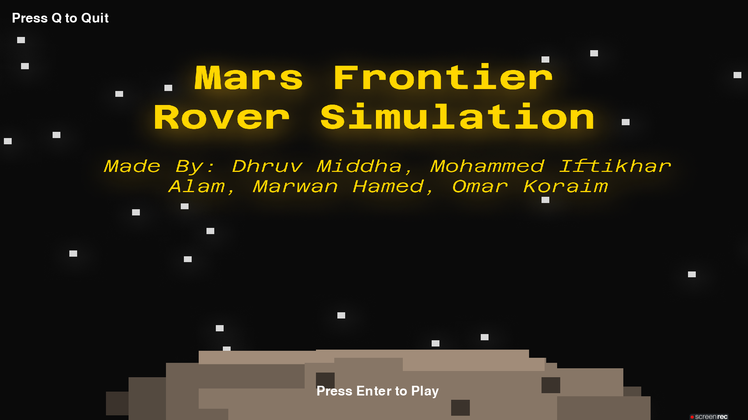
Press “Enter” to play the game.

Slide 4
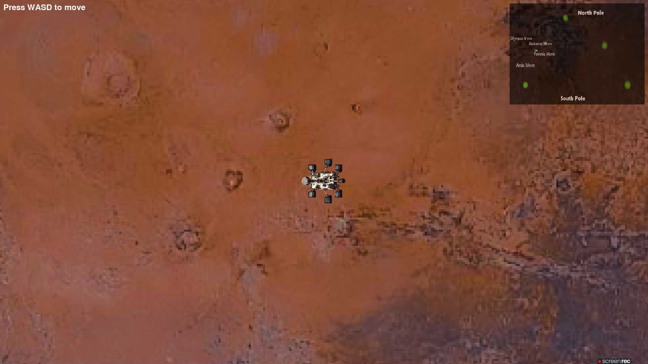
Name of the 4 destinations.
Press WASD to move the rover around the map.
The green spots on the mini map are the destinations you can travel to.

Slide 5
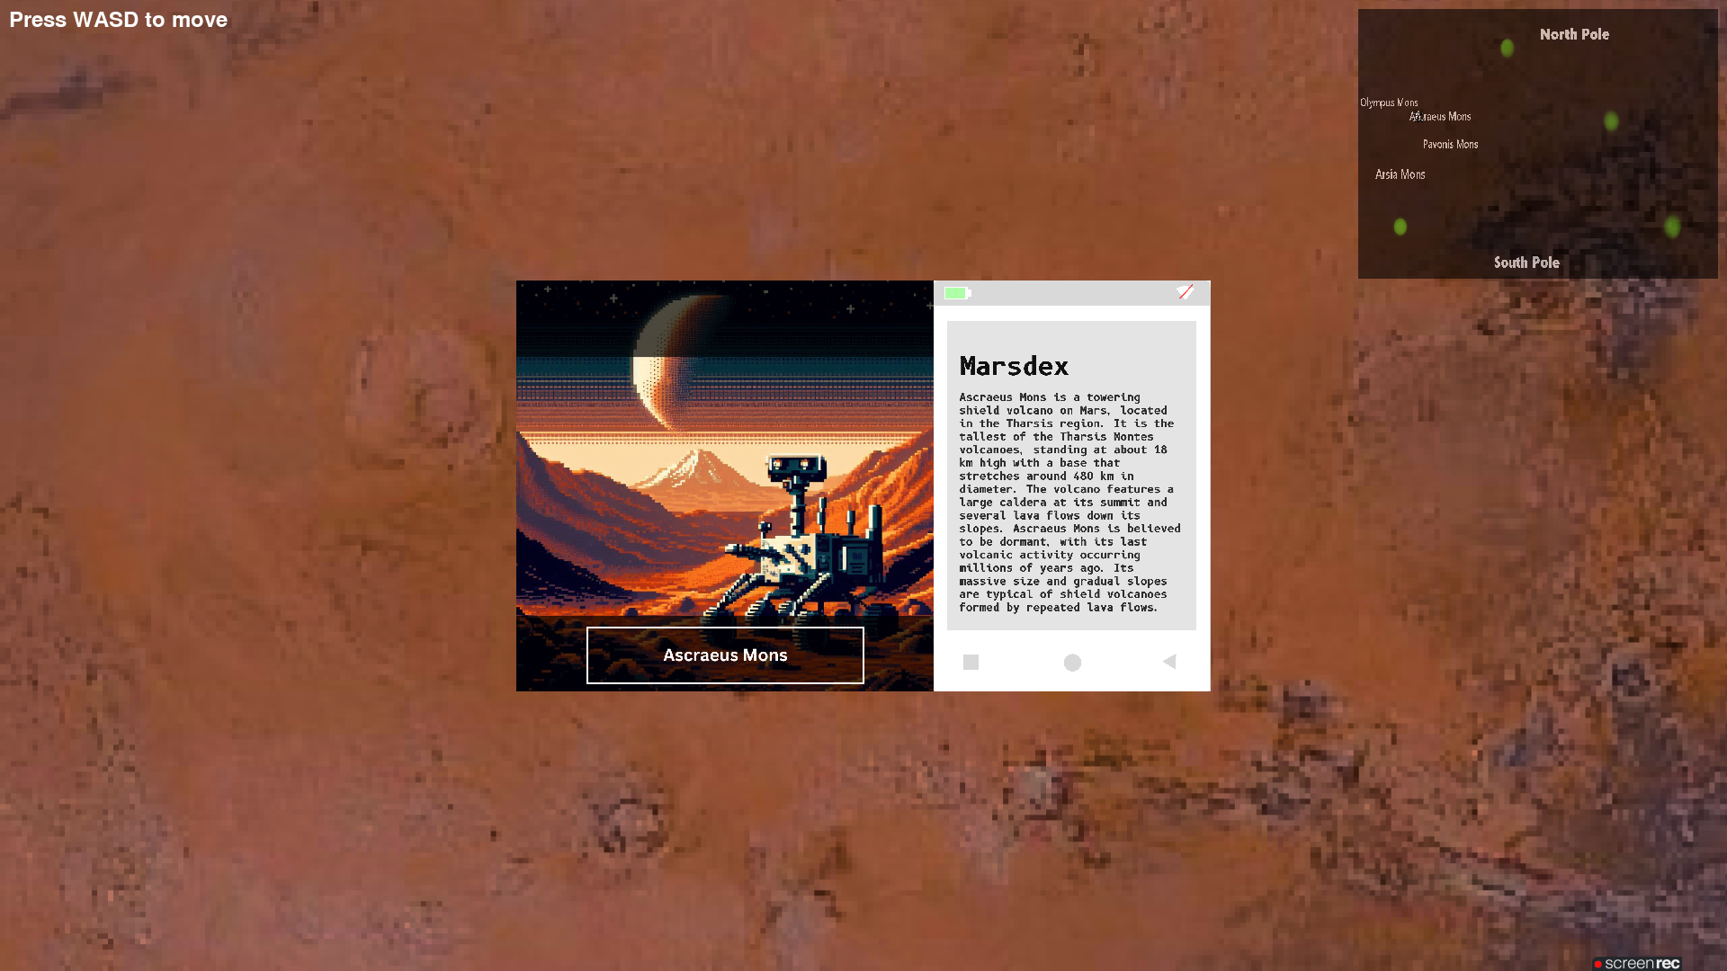
When you are around the ‘green spot’, press “E” to take a selfie in front of the destination. You will also be provided with some information about the place.
Information about the destination.
Selfie

Slide 6
Video demonstration
YouTube video link of the game demonstration: https://youtu.be/MAr0Y28MMcM?si=XczkP5Pnw-XLA34Y

