Slide 1
The escape problem
Anish Narkhede (012417769)
Neeraj Kulkarni (012413739)

Slide 2
Problem Statement
Given a set of m sources in a 2-dimensional grid, determine if it is possible to connect all sources to m points on the grid boundary using a set of vertex-disjoint paths.

Slide 3
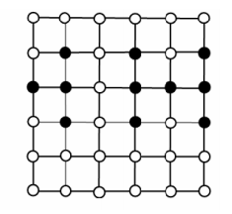
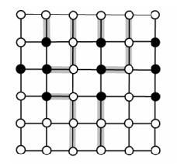
Escape Problem
Determine if it is possible to connect each of the starting vertices to any of the boundary vertex

Slide 4
Inception and Timeline // Check
Max-flow Ford-Fulkerson with DFS
Max-flow Edmonds-Karp
Capacity Scaling
Max-Flow Dinitz Algorithm
Escape Problem

Slide 5
Vertex Disjoint Paths Two paths from vertex u to vertex v are said to be internally disjoint / vertex disjoint if they do not contain any common internal vertex in them.
S
T

Slide 6
Vertex Disjoint Paths
S
T

Slide 7
Common Internal Vertex
S
T

Slide 8
Algorithm
Converting Escape problem to Single Source – Single Sink Maximum flow path.
Add two artificial vertices : super-source and super-sink.
Converting simple undirected graph G into directed graph for vertex disjoint paths G’ and applying max-flow algorithm
Split each vertex v in the graph into two vertices: v_{in} and v_{out} (except source s & sink t)
For each vertex u in the set of starting vertices for escape problem, add an edge from s to u_{in} with unit capacity of 1.
For each vertex v, add an edge of unit capacity of 1 from v_{in} to v_{out}

Slide 9
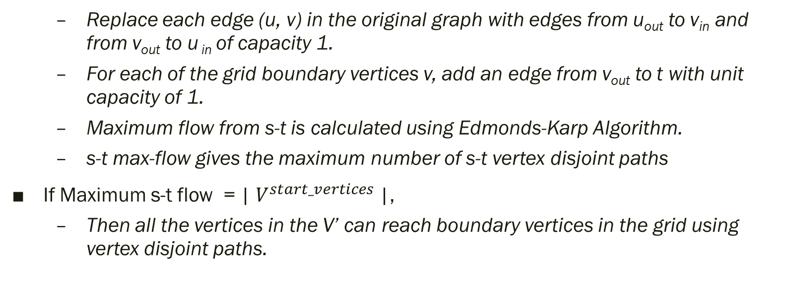
Algorithm (contd..)
Replace each edge (u, v) in the original graph with edges from u_{out} to v_{in} and from v_{out} to u _{in} of capacity 1.
For each of the grid boundary vertices v, add an edge from v_{out} to t with unit capacity of 1.
Maximum flow from s-t is calculated using Edmonds-Karp Algorithm.
s-t max-flow gives the maximum number of s-t vertex disjoint paths
If Maximum s-t flow = | $V^{start_vertices}$|,
Then all the vertices in the V’ can reach boundary vertices in the grid using vertex disjoint paths.

Slide 10

Analysis
Cost of splitting vertex V into two vertices v_{in} and v_{out} is O(V).
| $V^{′}$| = 2 .|V|
Cost of adding extra edges is |V| which is addition of edges between v_{in} and v_{out}
| $E^{′}$| = |E| + |V|
Cost of implementing Edmonds-Karp algorithm for maximum-flow = O($VE^{2})$
$O\left(V^{′}E^{′2}\right)=O(2.V.{(E+V)}^{2})$
Example: For 3x3 Grid:
| $V^{new}$| = (2 * 3 * 3) + 2
| $E^{new}$| = 33 + 8 + (Source-to Starting vertices edge)
O($3^{5})$ = O($9^{3})$ = O($n^{3})$

Slide 11
Funny Instance! Escape after Bank Robbery

Slide 12
Questions and Answers Thank You!

