Slide 1
Exploring the Tidyverse
R for DATA SCIENCE
Marten van den Berg
April 25, 2019

Slide 2
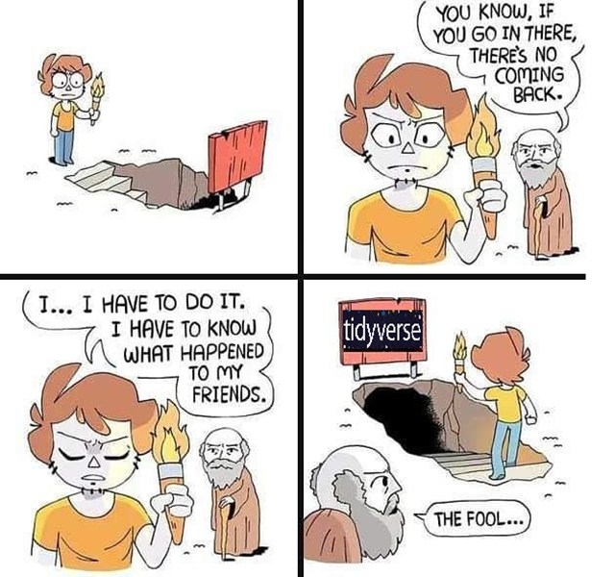

Slide 3
Introduction
In this club we will explore the Tidyverse
Some base R knowledge is required
If you join you have to present
Working from the book R for data science
  Available for free at: https://r4ds.had.co.nz/
Setting up the Tidyverse:
  install.packages("tidyverse")
  library(tidyverse)
30 minutes presentation, 30 minutes working on code

Slide 4

The Tidyverse
The tidyverse is an opinionated collection of R packages designed for data science.
Introduced by Hadley Wickham
All packages share an underlying design philosophy, grammar, and data structures.
Hadley Wickham is also chief scientist at Rstudio
The core packages are
  ggplot2 => Plotting graphs
  dplyr => Data manipulation
  tidyr => Data tidying
  readr => Read data (.csv etc.)
  purrr => Toolset for functions and vectors
  tibble => Re-imagining of the data frame
  stringr => Set of functions to work with strings
  forcats => Tools to work with factors

Slide 5
Tidy Data
Each variable you measure should be in one column.
Each different observation of that variable should be in a different row.
There should be one table for each "kind" of variable.
If you have multiple tables, they should include a column in the table that allows them to be linked.

Slide 6
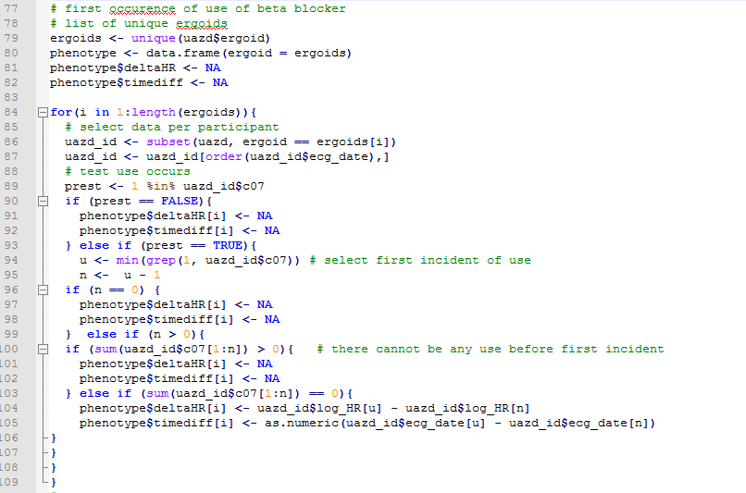
Why use the Tidyverse
Goal: calculate difference in heart rate between
last ECG without Beta-blocker use and
first ECG with Beta-blocker use
The script on the right works...

Slide 7
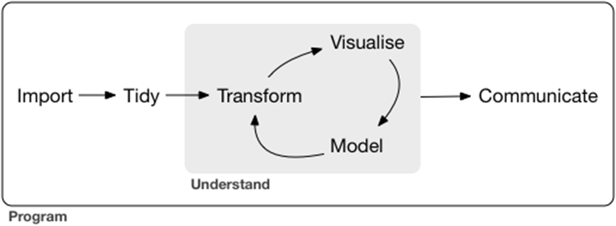
Import
Tidy
Transform (wrangle)
Visualize
Model
Communicate

Slide 8
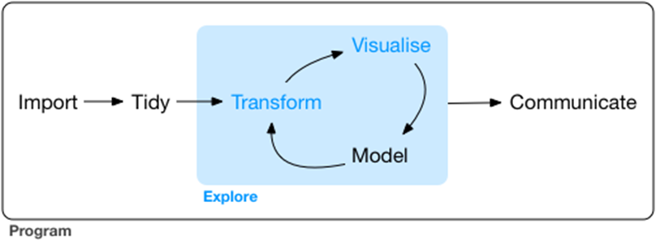
(I) Exploring the Data
We start with visualization – ggplot2
Then transformation:
  select important variables, filter out key observations, create new variables, and compute summaries.
Then exploratory data analysis: combine visualization with transformation and curiosity with skepticism

Slide 9
ggplot 2
Question: Do cars with big engines use more fuel than cars with small engines?
The mpg data frame ggplot2:mpg
  displ, a car’s engine size, in litres.
  hwy, a car’s fuel efficiency on the highway, in miles per gallon (mpg).
  To learn more about mpg, open its help page by running ?mpg.
ggplot(data = mpg) + geom_point(mapping = aes(x = displ, y = hwy))
ggplot(data = <DATA>) + <GEOM_FUNCTION>(mapping = aes(<MAPPINGS>))

Slide 10
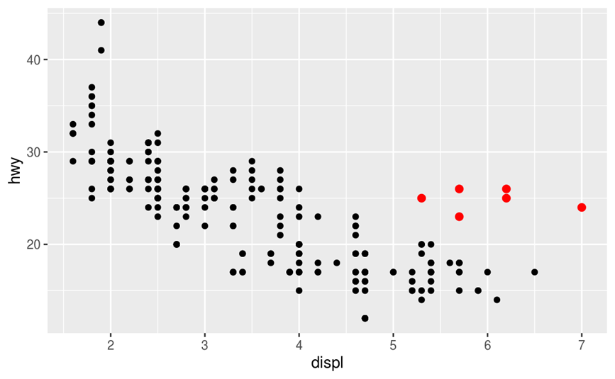
Are these Hybrids?

Slide 11
ggplot 2 (2)
To show a third variable in a two-axis plot, we can use aesthetics
An aesthetic is a visual property of the objects in your plot.
Aesthetics include things like the size, the shape, or the color of your points.
ggplot(data = mpg) + geom_point(mapping = aes(x = displ, y = hwy, color = class))
ggplot(data = mpg) + geom_point(mapping = aes(x = displ, y = hwy, size = class))
ggplot(data = mpg) + geom_point(mapping = aes(x = displ, y = hwy, alpha = class))

Slide 12
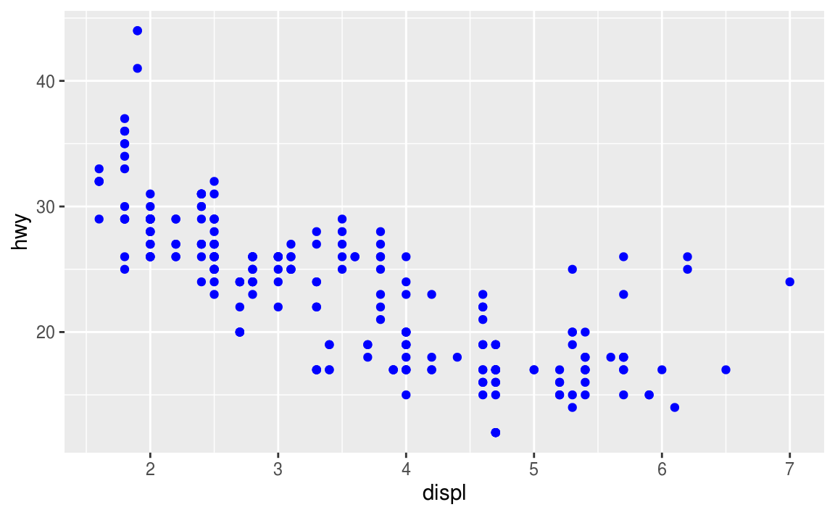
ggplot 2 (2)
You can also set the aesthetic properties of your geom manually.
Make all points blue
ggplot(data = mpg) + geom_point(mapping = aes(x = displ, y = hwy), color = "blue")
*note it is outside of aes()

Slide 13
Common problems & help
R is very picky with code. Check for typo’s!
Don’t put the + at the beginning of the line, but at the end
Carefully read error messages
use the R help ?function_name
Search the internet (stackexchange)

