Slide 1

R for data science
recap

Slide 2
Chapter 1 & 2

Slide 3
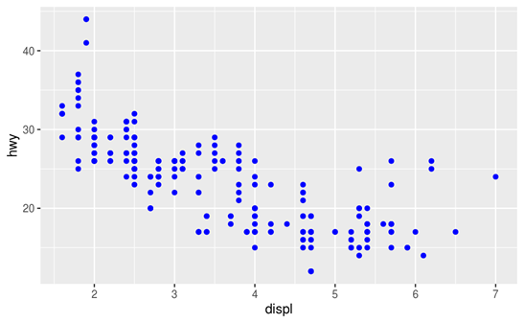
Recap Chapter 3
ggplot(data = <DATA>) +
<GEOM_FUNCTION>(mapping = aes(<MAPPINGS>))
ggplot(data = mpg) +
geom_point(mapping = aes(x = displ, y = hwy), color = "blue")

Slide 4
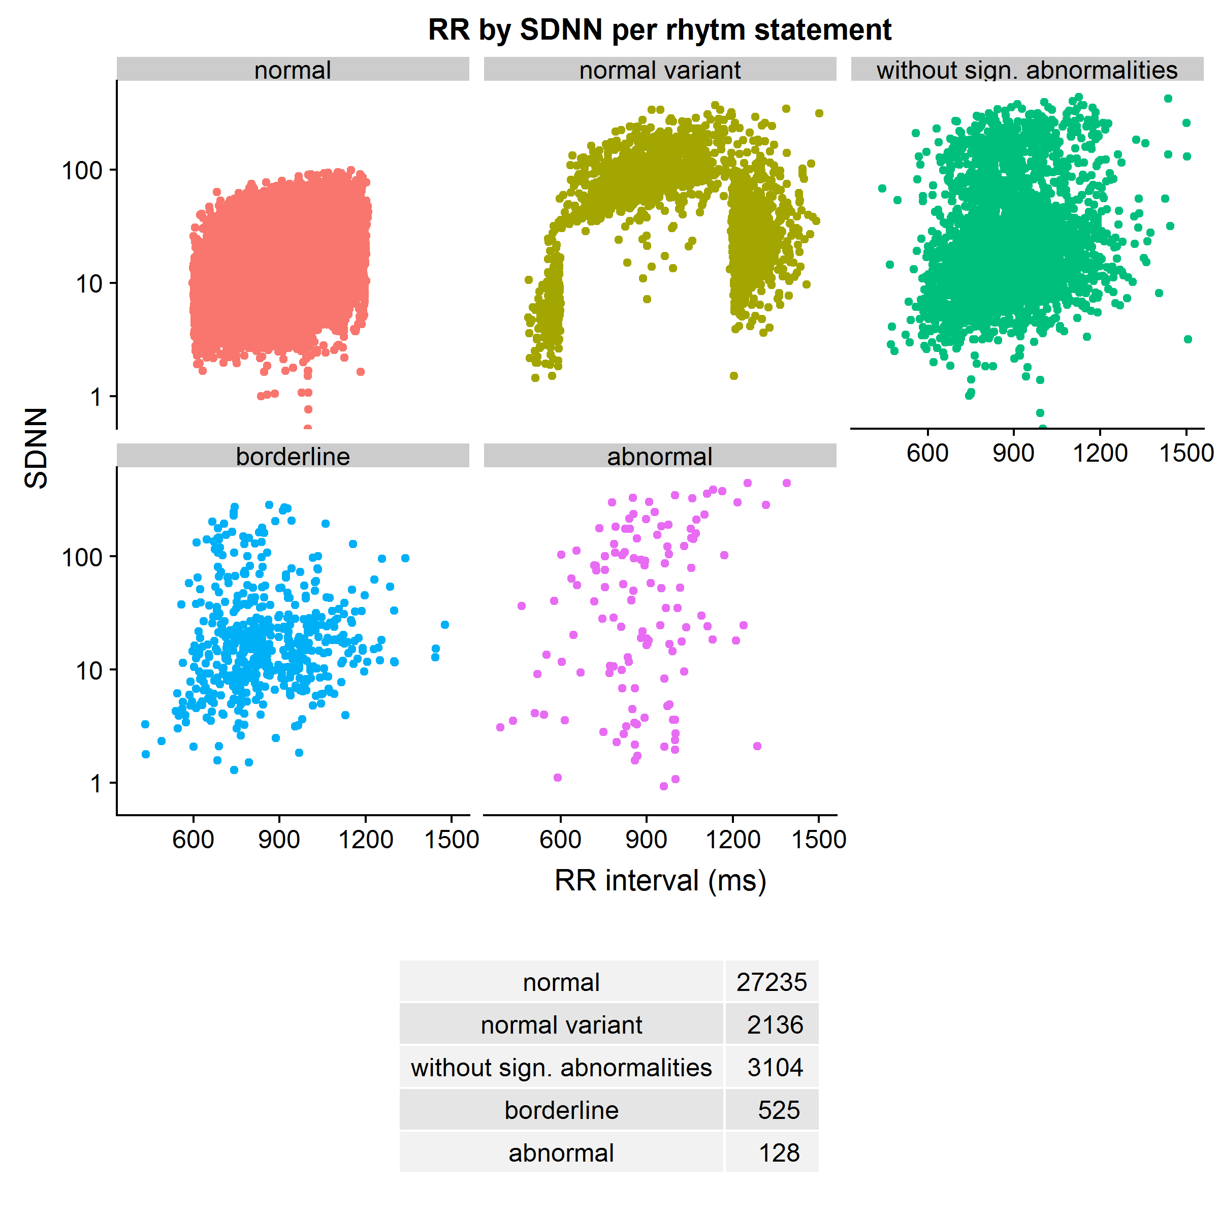
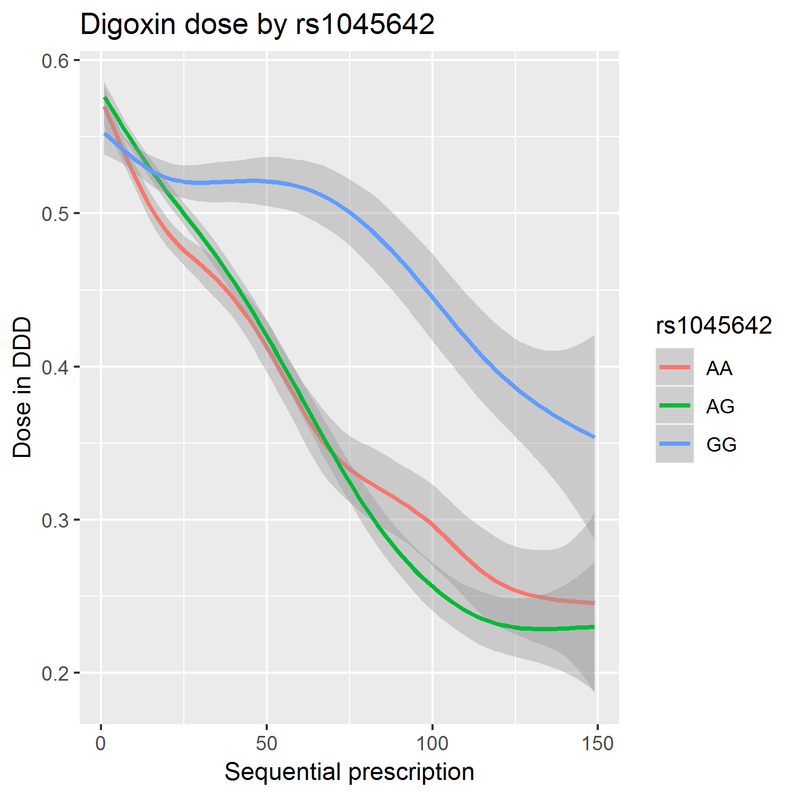
Examples

Slide 5
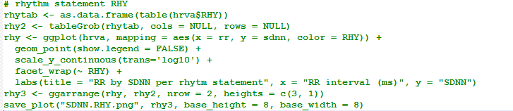
facet_wrap()
scale_y_continuous()
labs()
ggarrange()
tableGrob() – tables as grid table

Slide 6
Recap Chapter 4
Use R as calculator
Assign values
object_name <- value
R is case sensitive!
Call functions
Function_name(arg1 = val1, arg2 = val2, ...)

Slide 7
Chapter 5: dplyr basics
Pick observations by their values (filter()).
Reorder the rows (arrange()).
Pick variables by their names (select()).
Create new variables with functions of existing variables (mutate()).
Collapse many values down to a single summary (summarise()).

Slide 8
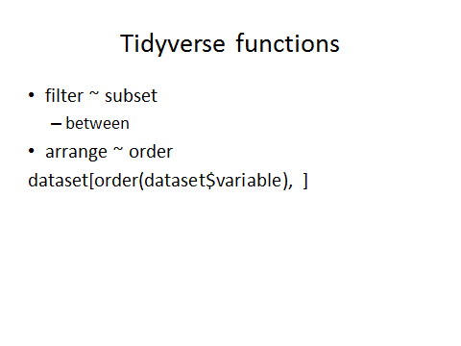
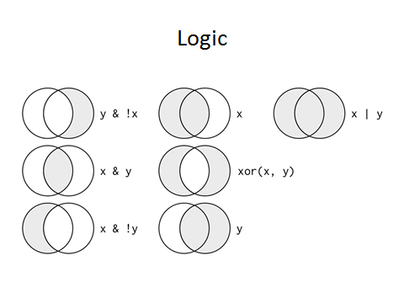

Slide 9
Filter examples
E1<- filter(flights, arr_delay >= 120)
E2<- filter(flights, dest %in% c("IAH", "HOU"))
E3<- filter(flights, carrier %in% c("UA", "AA", "DL"))
E4<- filter(flights, month %in% 6:8)
E5<- filter(flights, arr_delay > 120 & dep_delay <= 0)
E6<- filter(flights, dep_delay > 60 & arr_delay <= dep_delay - 30)
E7a<- filter(flights, dep_time >= 0 & dep_time <= 600)
E7b <- filter(flights, between(dep_time, 0, 600))

Slide 10
Arrange
arrange(flights, !is.na(dep_time))
arrange(flights, dep_delay)
arrange(flights, desc(dep_delay))
arrange(flights, air_time)
arrange(flights, distance)
arrange(flights, desc(distance))

Slide 11
An example of code used
A dataset with multiple prescriptions per person
Calculate differences between subsequent prescriptions, and prescripton first vs. fifth, first vs. last etc.
Create a variable of starting/stopping digoxin use
Ergoid | Prescripiton | Digoxin dose | QT
1 | 1 | 1 | 420
1 | 2 | 0.5 | 400
2 | 1 | 0 | 425
2 | 2 | 0 | 425
2 | 3 | 0.25 | 450

Slide 12
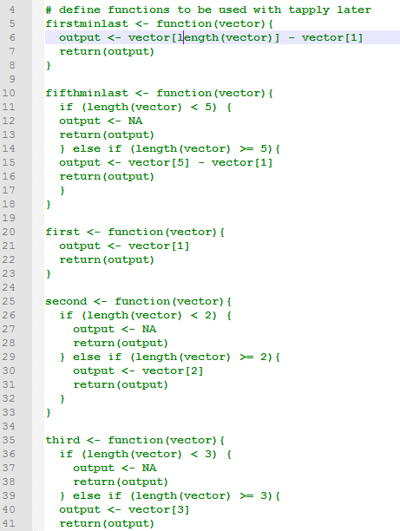
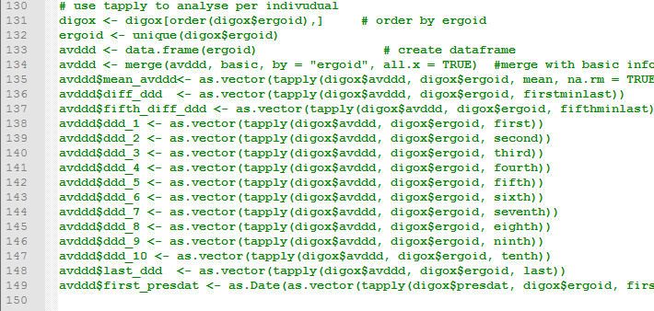
Old solution: functions and tapply
This goes on for 8 more functions!

Slide 13
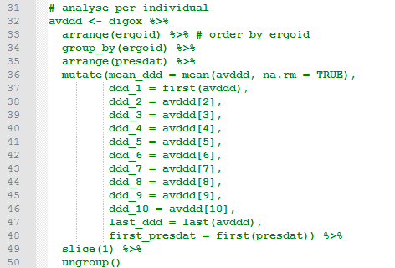
New Solution: group_by()

