Slide 1

Programming High Integrity Systems - EVA
Final Presentation

Slide 2
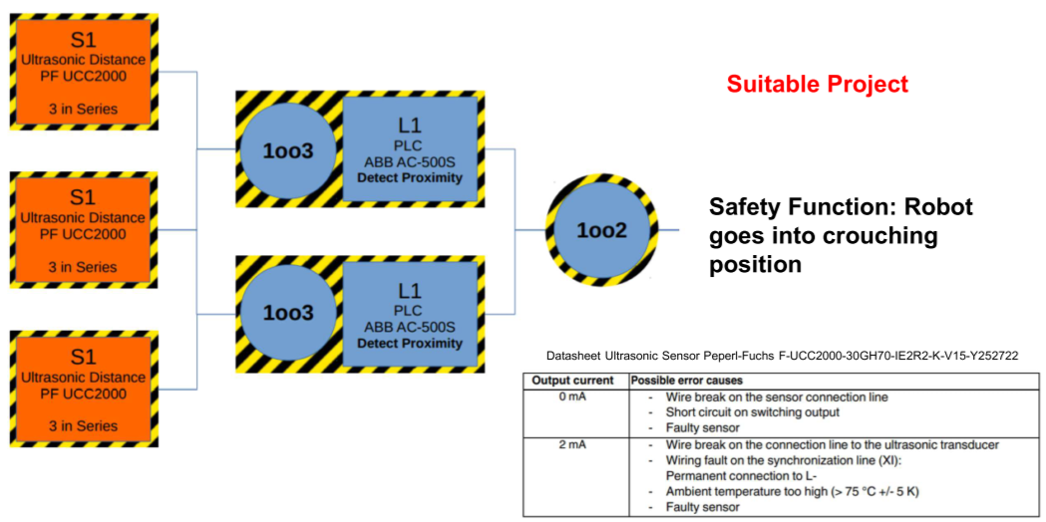
Project scope
Implementation of a safety system according to the following architecture
The development must take into considerations all safety aspects
Notes:
M

Slide 3
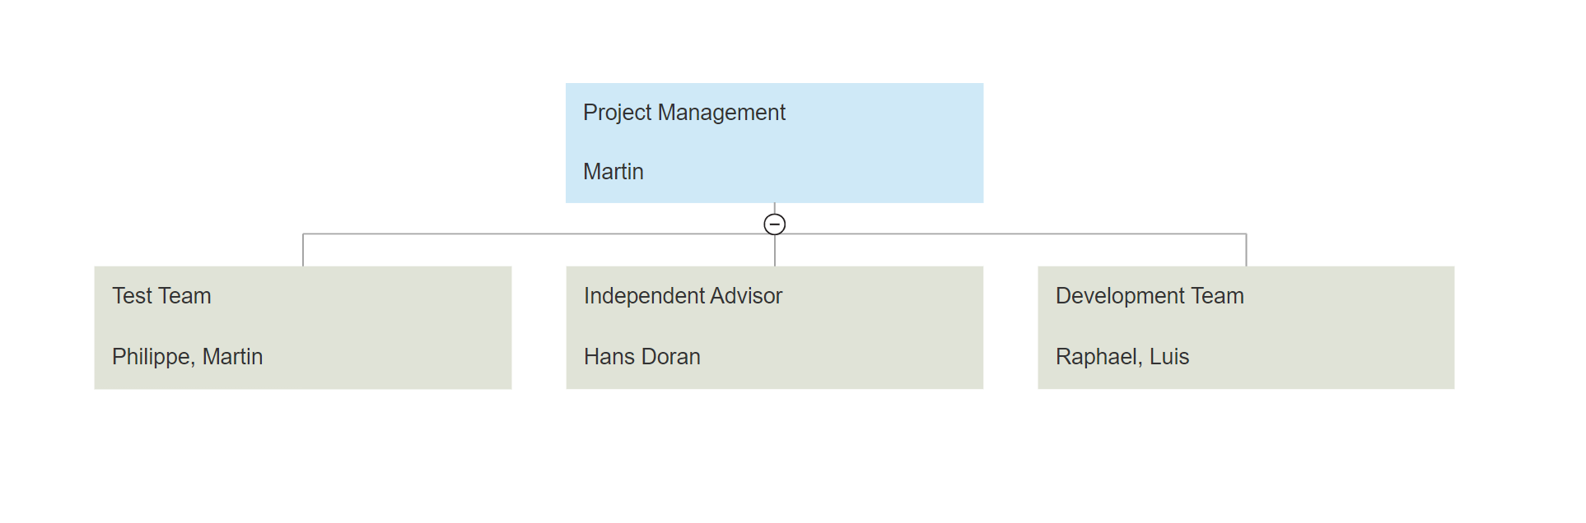
Management structure
Notes:
M

Slide 4
Requirements Safety function
SF1: If a person is in proximity (2m), the robot shall go into the safe state
Notes:
P

Slide 5
Requirements Sensors
R1.2: The sensors give as an output a current value between 0 mA and 20 mA
R1.3: The sensor has the following input to output characteristics, which is linear:
R1.4: If the sensor has a failure, it outputs a value between 0 mA and 4 mA (excluding 4 mA)
R1.7: The sensor output values must be refreshed every 100 ms
0 m | 20 mA
>= 20 m | 4 mA
Notes:
P

Slide 6
Requirements Logic
R2.0: The logic part consists of 2 independent voters A and B
R2.1: Both voter A and B implement following 1oo3 behaviour:
If any sensor returns a current smaller than 4 mA (< 4 mA) or greater than 18.4 mA (> 18.4 mA) return isDistanceSafe = False (0)
If any 2 sensor current values differ by more than 0.2 mA (> 0.2 mA) return isDistanceSafe = False (0)
Otherwise return isDistanceSafe = True (1)
R2.4: If any of voter A or B returns isDistanceSafe = False (0), Stage2Voter shall return enterSafeState = True(1), otherwise it shall return enterSafeState = False(0). 0 means the system stays operational, 1 means go to safe state
R2.5: The system shall have a single outlier filter, to smooth the output behavior
Notes:
P

Slide 7
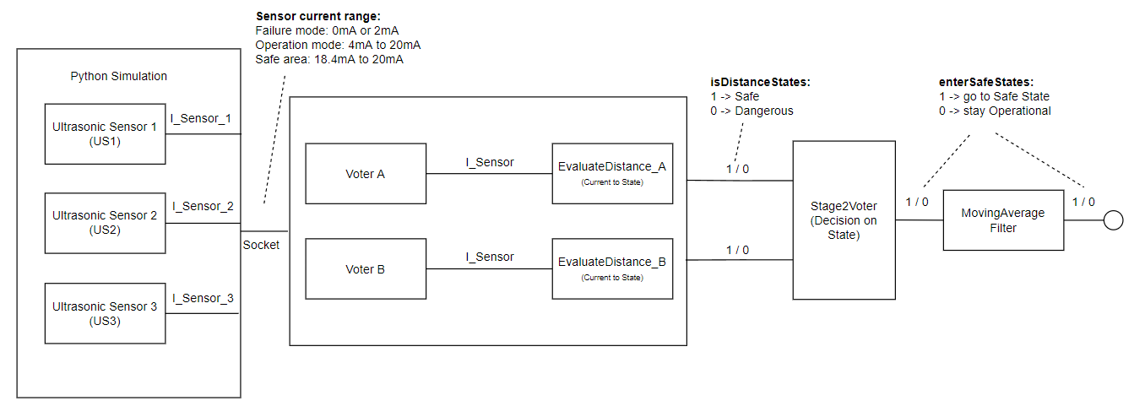
Functional Architecture
Notes:
R

Slide 8
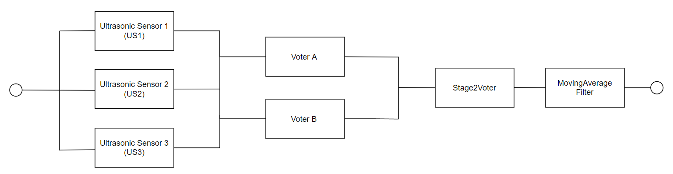
Safety Architecture
Notes:
R

Slide 9
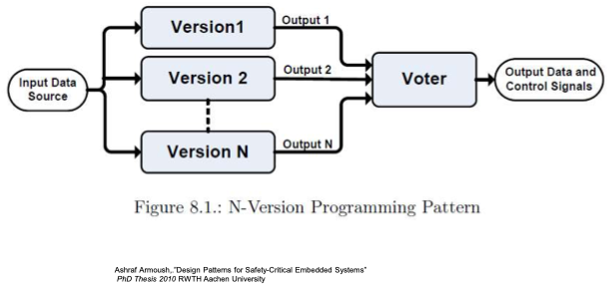
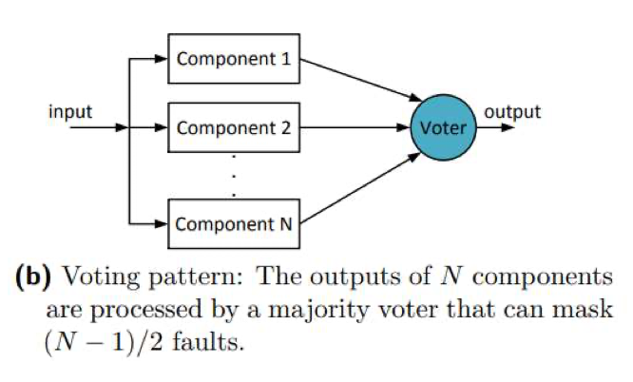
Voters
Notes:
R

Slide 10
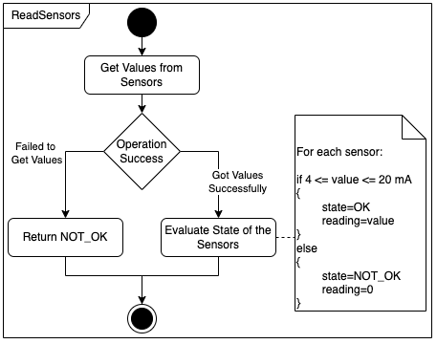
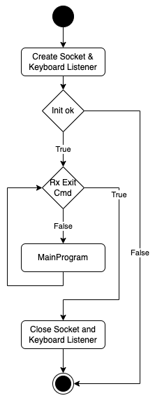
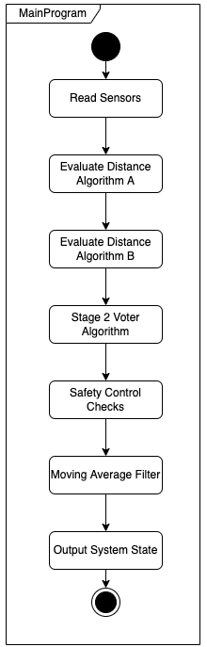
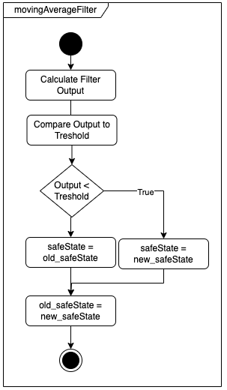
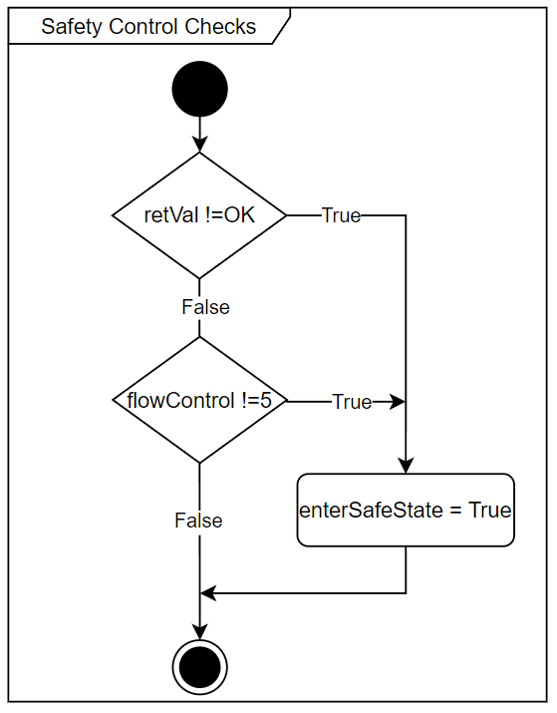
Common Implementation
Notes:
L

Slide 11
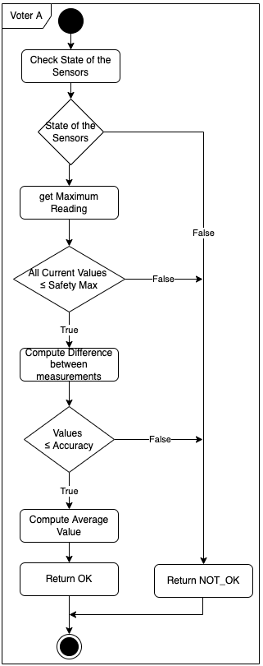
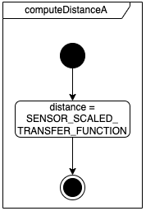
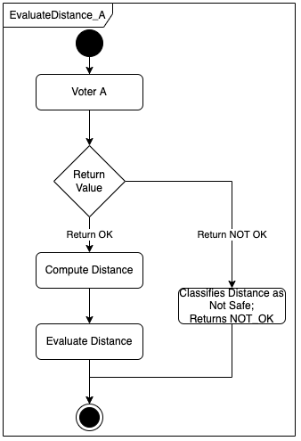
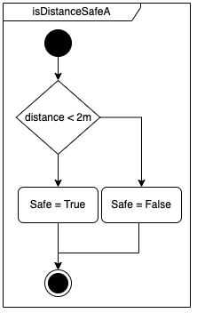
Version A Implementation
Notes:
L

Slide 12
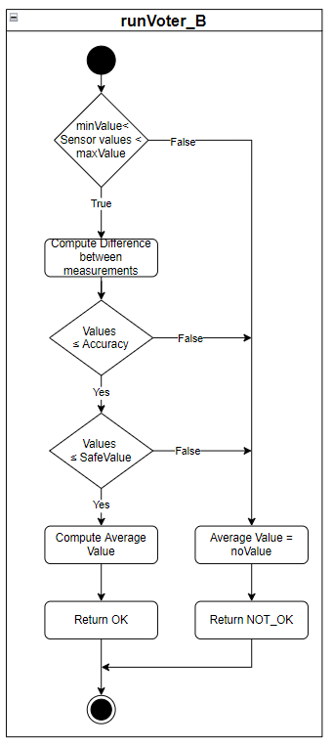
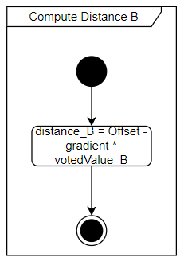
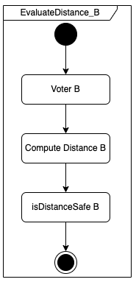
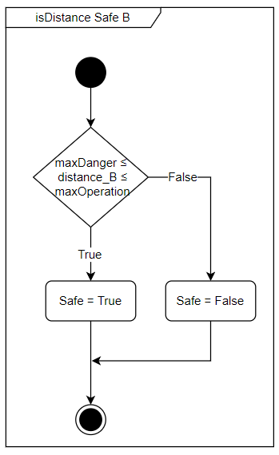
Version B Implementation
Notes:
R

Slide 13
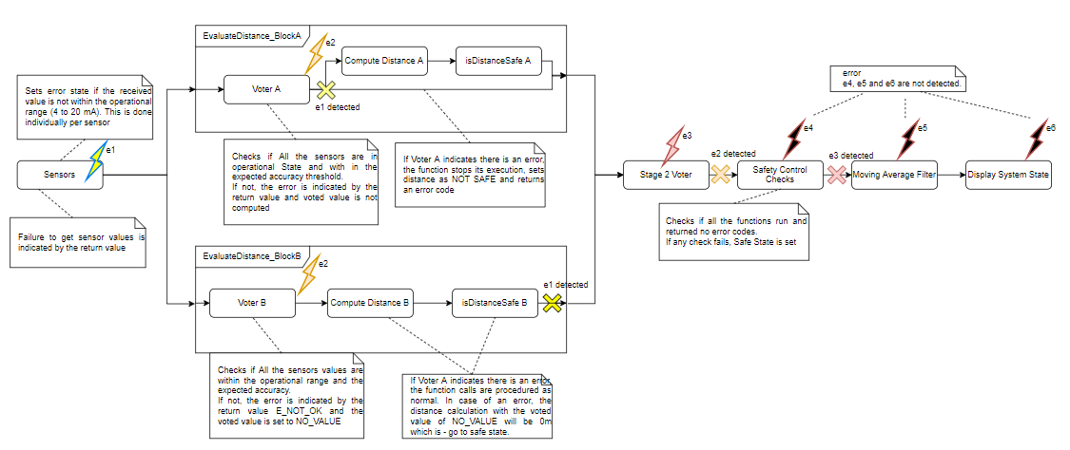
Error Propagation
Notes:
R

Slide 14
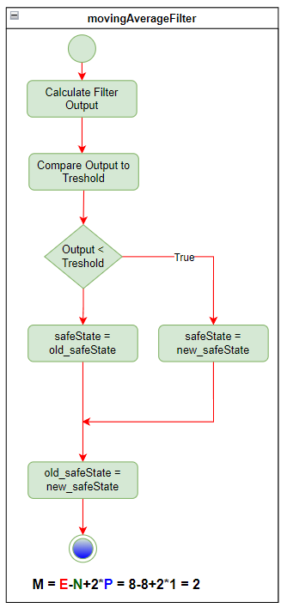
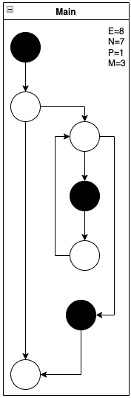
Cyclomatic complexity
Notes:
R

Slide 15
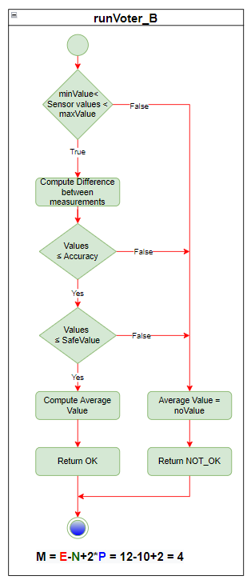
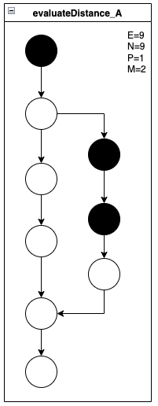
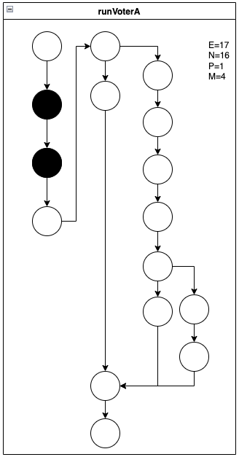
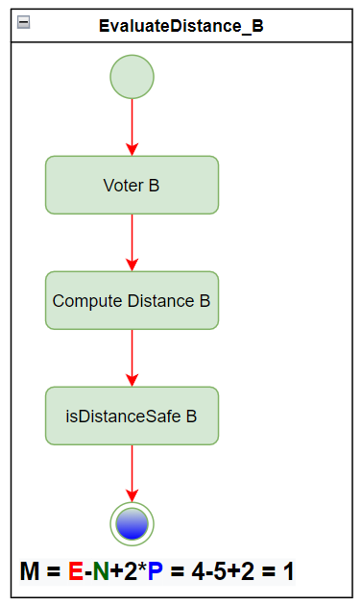
Cyclomatic complexity
All the functions have a C.C. ≤ 4
Notes:
L

Slide 16
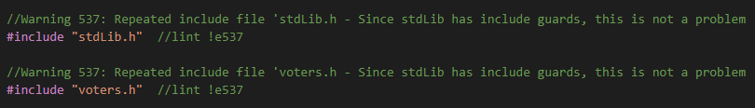
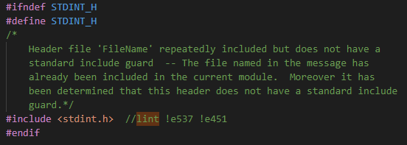
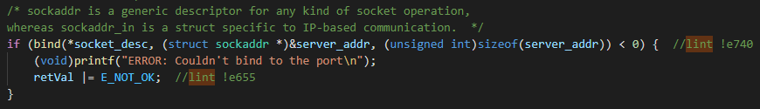
Linter errors
Notes:
L

Slide 17
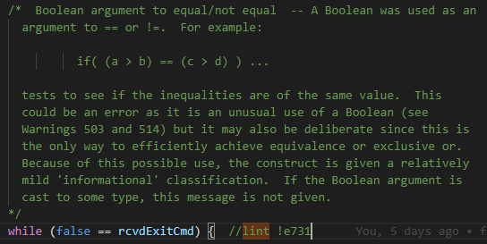
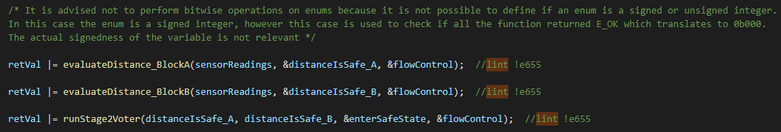
Linter Errors
Notes:
L

Slide 18
Testing strategy
Static analysis with Linter
Validation/ Verification Plan according to V-Model
Dynamic testing with golden model (branch, expression, statements)
Unit testing voterA, voterB and voter 1oo2
Integration testing of all components
Testing language: Python
Validation testing with simulation
Notes:
M

Slide 19
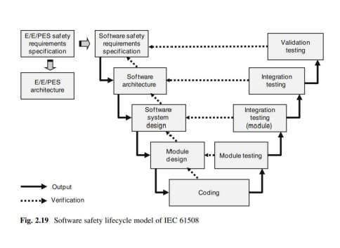
Testing Plan
Notes:
M

Slide 20
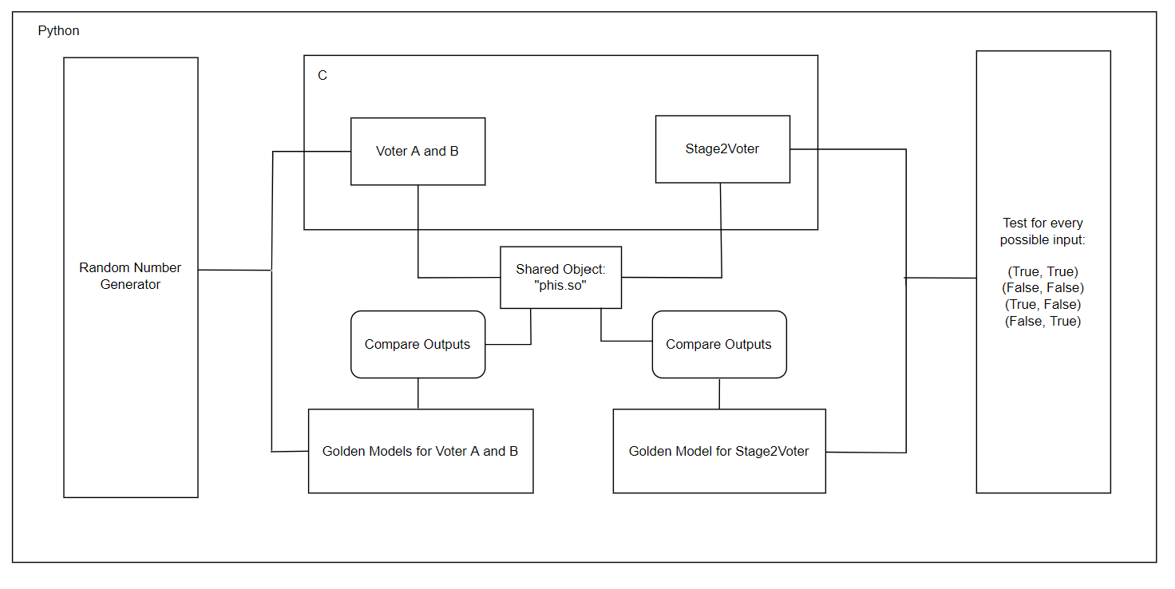
Unit Testing
Notes:
M

Slide 21
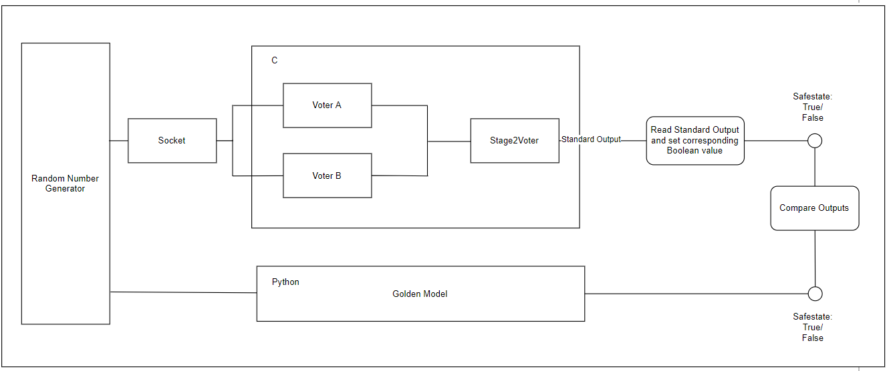
Integration Testing
Notes:
M

Slide 22
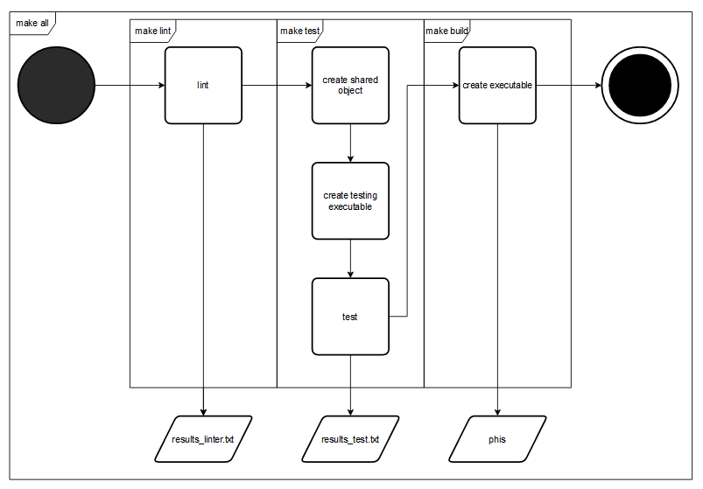
Build System
Notes:
P

Slide 23
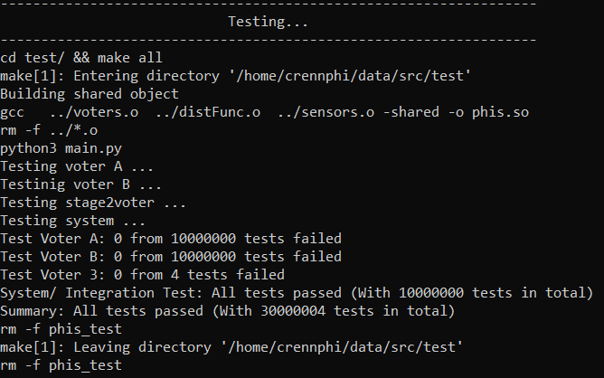
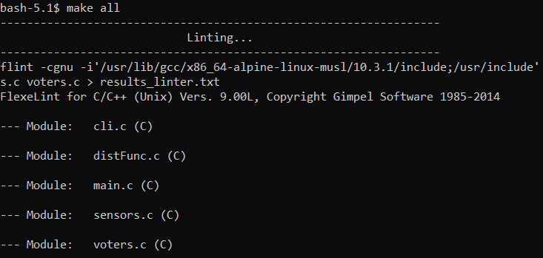
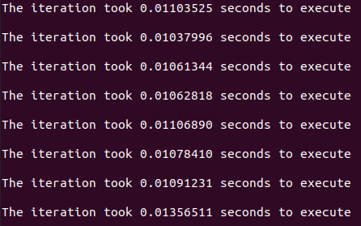
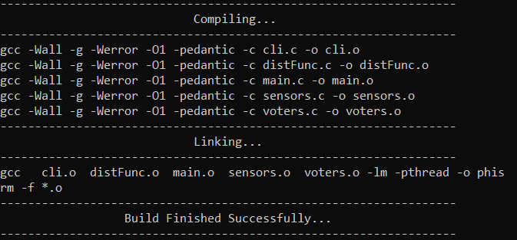
Build System
Notes:
P

Slide 24
Validation Plan
ID | Description | Type of validation | Responsibility
Va1 | Acceptance test with stakeholder | Demonstration | PO, Stakeholder
Validation ID | Requirement | Description
Va1 | SF1 | Purpose: We test, if the system goes into safe state when an object is in proximity of 2m. Precondition: System is commissioned and powered up. Procedure: Bring system into normal operating state Put system on a reference point Place Object in a distance of 10m in front of the system Approach the system with the object in a speed of 1m/min Test parameter: Object with the dimensions of (10x10x10) cm Evaluation: Check when the system goes into safe state memorize the distance Test passed: System goes and remains into safe state, when object closer than 2m in front of the system Test failed: Any other behavior
Notes:
M

Slide 25
Demo

Slide 26
Questions

Slide 27
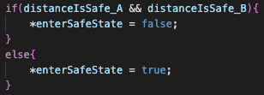
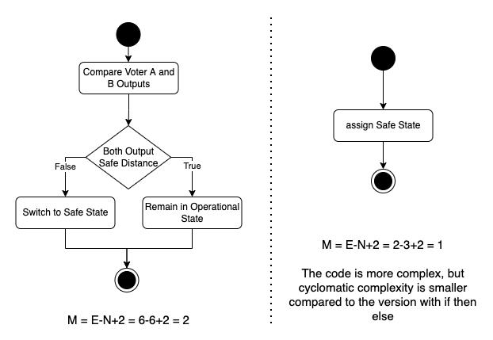

Cyclomatic Complexity - Stage 2 Voter Implementation

