Slide 1
FitClassMaster
Martin Hristov 0MI0600343
Live Demo: https://fitclass-app.onrender.com/

Slide 2
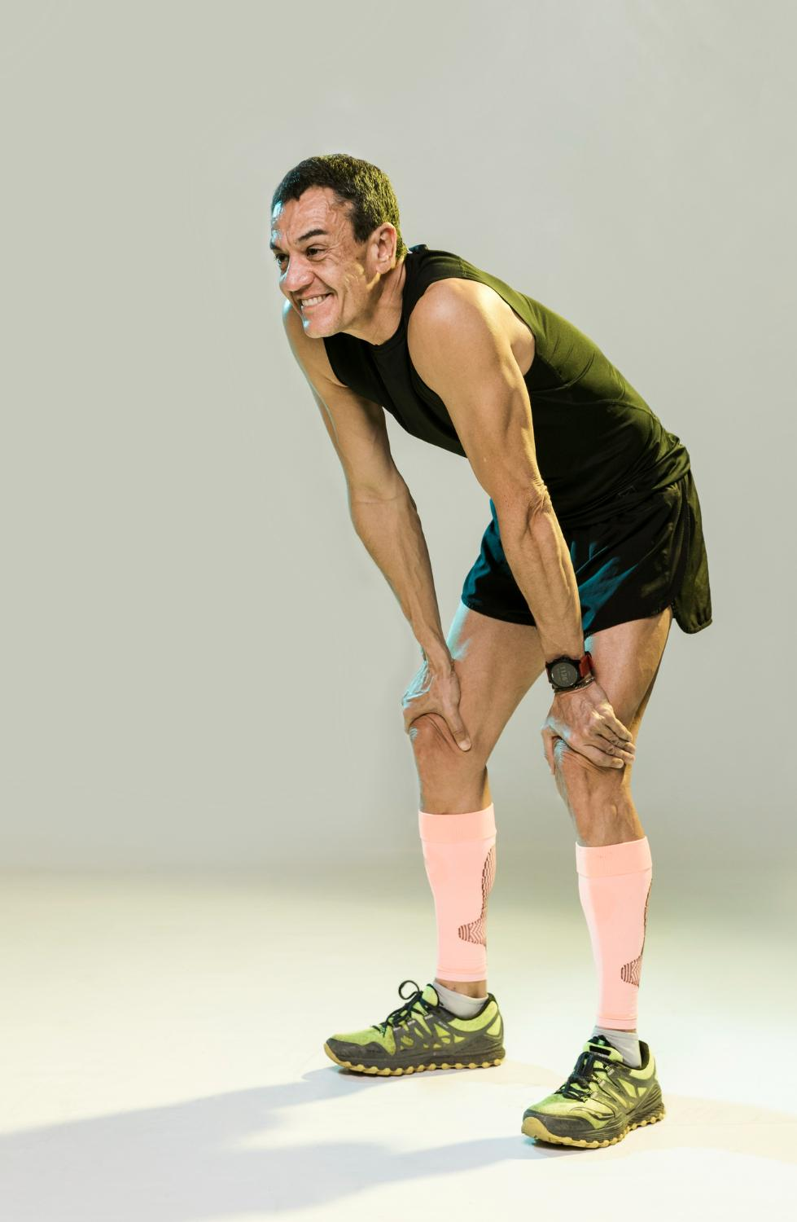
The Problem Context
Currently, gym management is fragmented. Trainers rely on paper logs or spreadsheets, while members track progress in isolated apps. This results in delayed feedback and a lack of centralized data, making it impossible to adjust training in real-time.

Slide 3
The Solution
FitClassMaster replaces scattered tools with a single, synchronized platform that connects Gyms, Trainers, and Members instanty.

Slide 4
Key Capabilities
1. Management: Seamless class scheduling and member enrollment via personalized dashboards.
2. Live Performance: Real-time workout tracking where trainers see client reps and sets the moment they happen via WebSockets.
3. Communication: Integrated chat system for instant feedback and coaching.

Slide 5
Layered Architecture
Top Layer (Presentation): Go Templates + HTMX (Server-Side Rendering for SPA feel).
Middle Layer (Business Logic): Service-based architecture isolating rules from the database.
Bottom Layer (Data): MSSQL/PostgreSQL via GORM (Object-Relational Mapping).

Slide 6
DEMO
https://fitclass-app.onrender.com/

Slide 7
THANKS!
Please keep this slide for attribution

