Slide 1


Home
Service
About Us
Contact
Presented by :
Bouric Enos
Oct 4, 2026
www.reallygreatsite.com

Slide 2
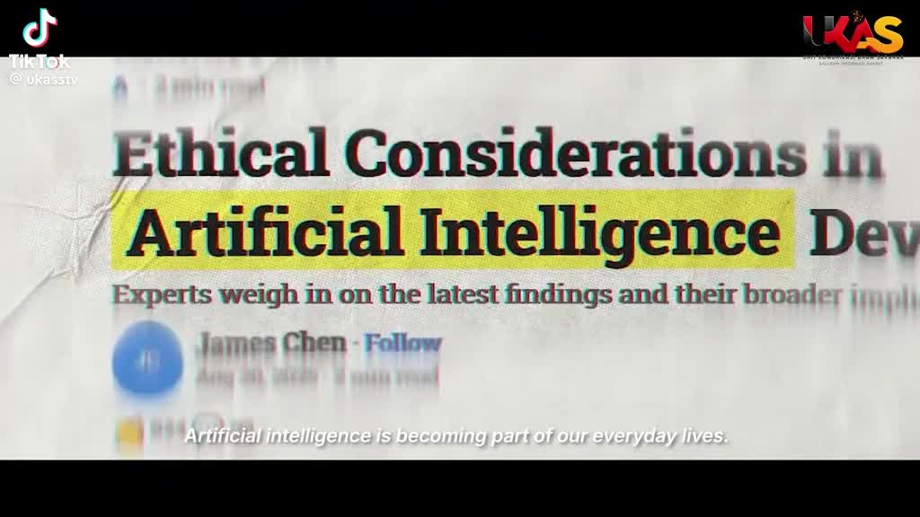
Introduction
Information moves faster than verification.
Claims, screenshots and images can spread before they are confirmed.
Sources can be difficult to trace.
Repeated information may still originate from one unverified source.

Slide 3
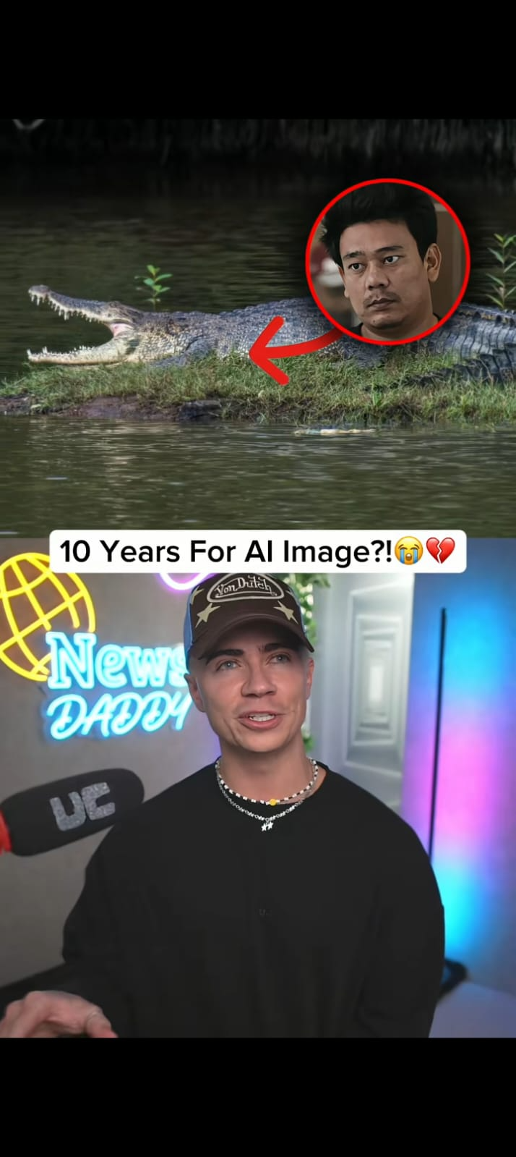
Problem Statement
Verification is fragmented
01 — Sources are difficult to trace
02 — Context gets lost
03 — Information overload
The problem isn't access to information. It's knowing what the evidence actually supports.

Slide 4
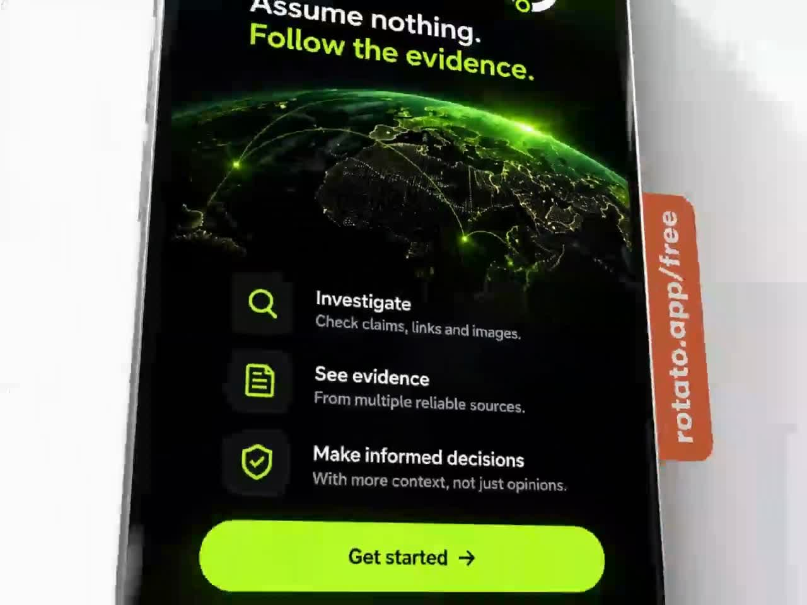
Meet
Agent 0.
An AI-assisted verification workspace that helps journalists investigate questionable claims, links and images before they publish.
It brings the evidence together.
You make the call.

Slide 5

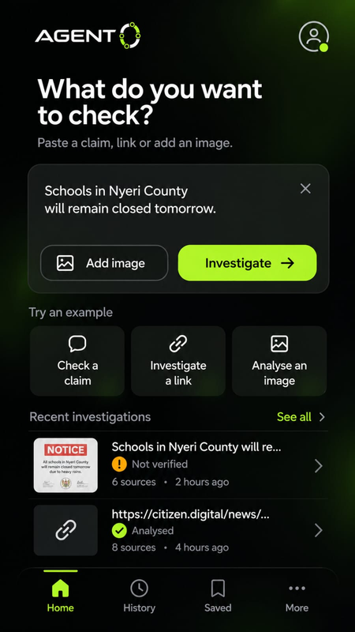
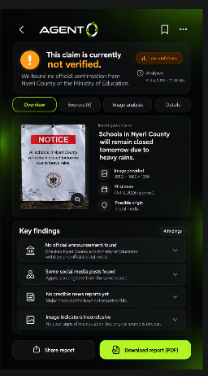
One workspace.
Three ways to investigate.
Different inputs. One evidence trail.
Claims
Check questionable statements against available reporting, official information and other evidence.
Links
Examine what an article or webpage claims and compare it with independent sources.
Images
Investigate visible context, file information and available origin or Content Credentials.

Slide 6
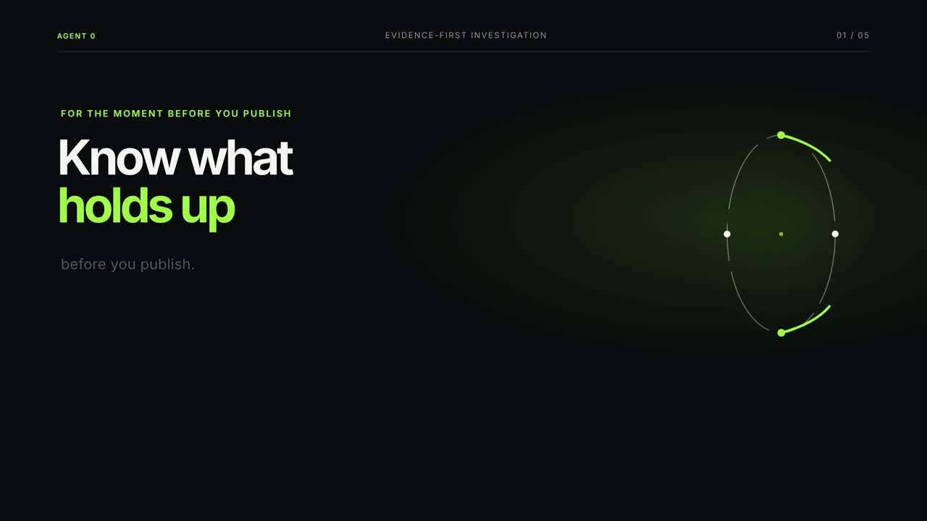
WHY AGENT 0
Agent 0 doesn't tell journalists what to believe. It shows them what the evidence can establish.
Evidence you can inspect
Every important finding traces back to the evidence behind it.
Uncertainty stays visible
If something cannot be established, Agent 0 says so.
You make the final call
AI assists the investigation. Editorial judgment stays with the journalist

Slide 7
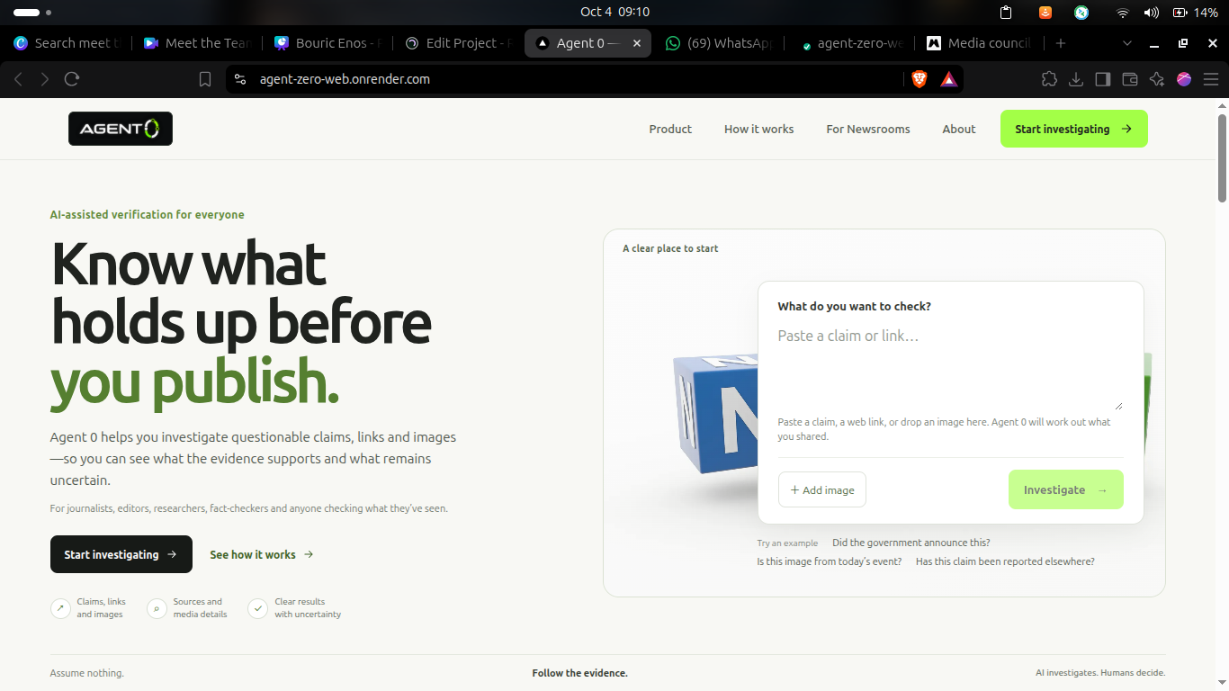
Business Model
01 — Journalists
Accessible individual investigations build adoption, trust and real-world feedback.
02 — Newsrooms
Paid team plans for higher investigation volumes, shared workflows and editorial oversight.
03 — Institutions & Platforms
Enterprise integrations, API access and verification infrastructure for organizations operating at scale.
04 --- Individuals
People checking suspicious news, forwarded messages, links or images before believing or sharing them.
Pay as you investigate → Subscriptions → Institutional plans

Slide 8
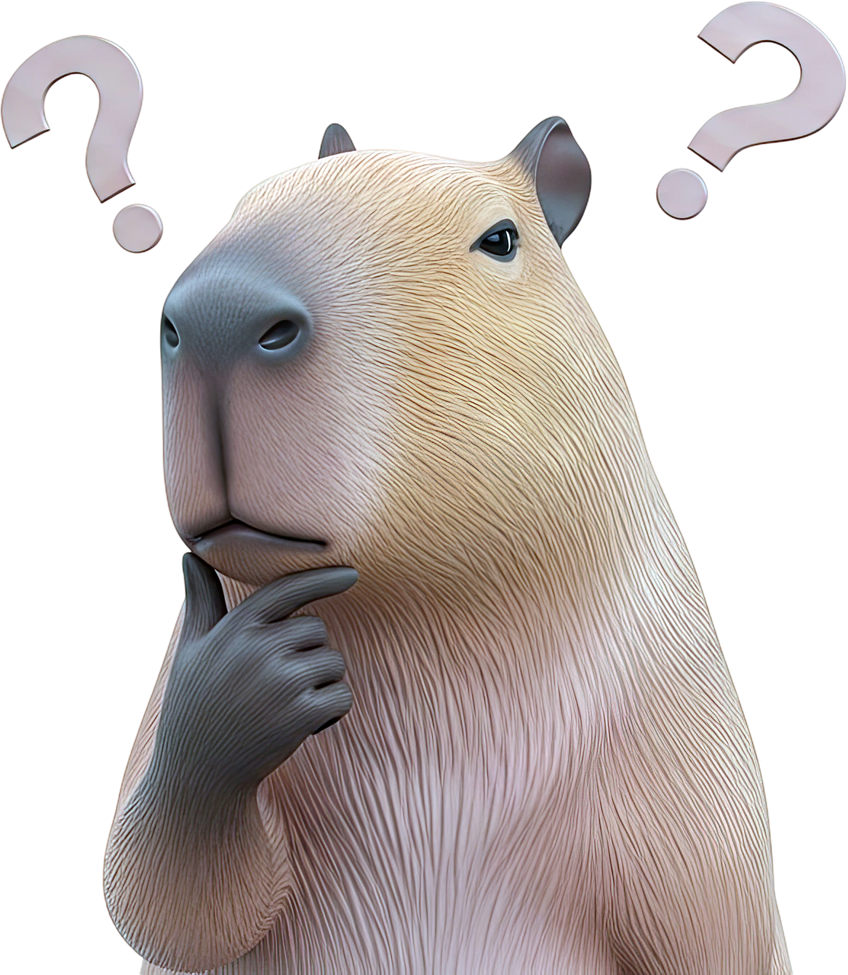
Why now?
The verification gap is getting harder.
Synthetic media is becoming easier to create.
Images, audio and content can be generated or manipulated faster and more convincingly.
Distribution is instant.
A screenshot or forwarded message can reach thousands before verification catches up.
Journalists face the same deadline.
Verification has to become faster without lowering editorial standards.
The answer isn't less human judgment. It's better tools for human judgment.

Slide 9
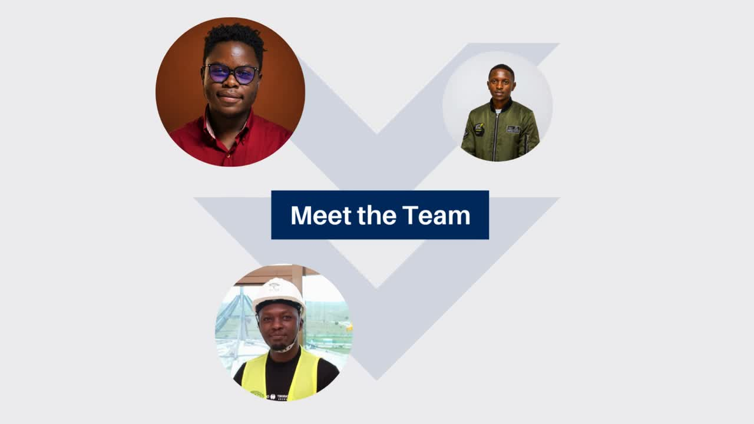

Slide 10
Thank You So Much!

