Slide 1
Data Science Toolset
(Formerly known as Advanced Ads Toolset)
(Formerly known as Data Science Suite)

Slide 2

What is Data Science
A process of using scientific methods, algorithms, statistics, probability, and data systems to extract knowledge and insights from structured and unstructured data. Simplified, data science analyzes large sets of data to provide meaningful information that can be used in decision making.

Slide 3

What is Data Science at Xandr
Data science at Xandr is used primarily to:
Enhance bidding strategies with precise targeting.
Improve measurement and testing capabilities.
Create in-depth outcome analysis.
To achieve this our clients, with and without data scientist on their staff, can create Custom Models, utilize the Incrementality Feed, and access the User Group Pattern Service.
This presentation will focus on Custom Models.

Slide 4
What are Custom Models
Custom Models enable Xandr’s UI, API, and Data Science Toolset users to add decision making logic for Bid Valuation, Creative Delivery and Non-Valuation purposes to their Augmented Line Items (ALI) or campaigns.

Slide 5
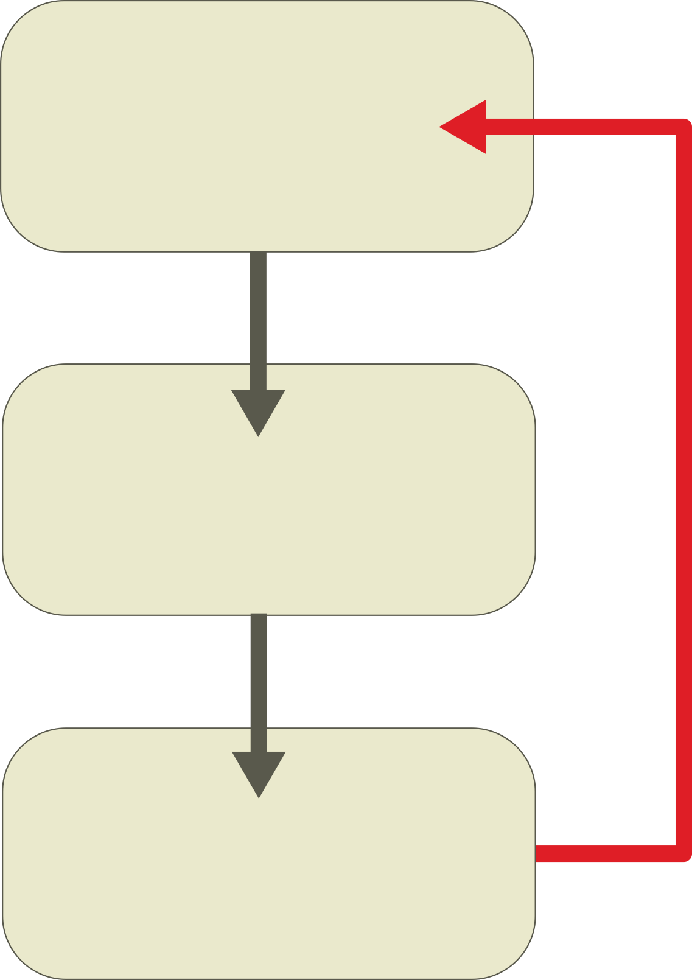
How Custom Models are used
Custom Models can be created by:
Using the UI to create a split on the ALI.
Using Xandr’s API’s Split Service.
Creating a decision tree using the Bonsai language.
Creating a logistic regression model.

Slide 6
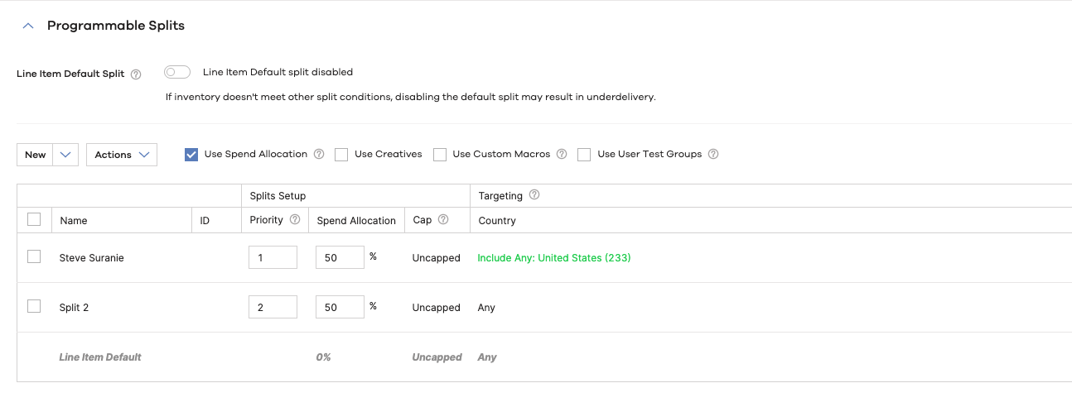
Splits in Invest
Users can create splits on Line Items by logging into Invest, opening a Line Item and going to the Programmable Splits section.

Slide 7
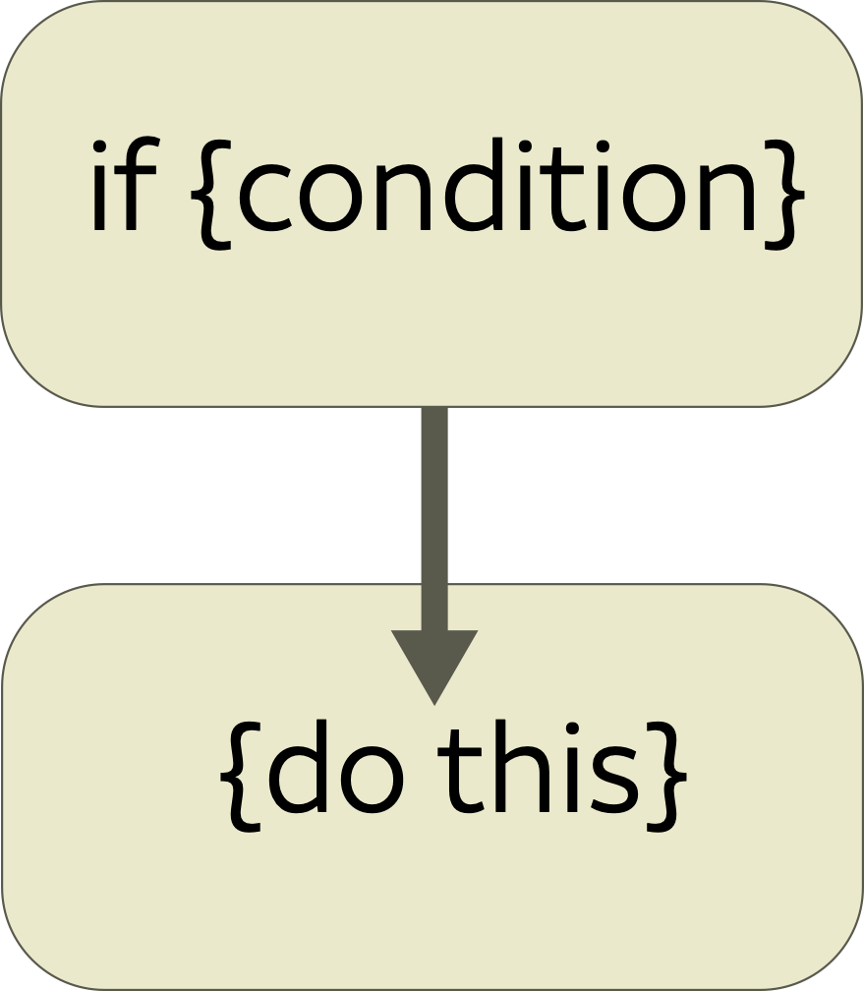
Split Service
Users can also utilize the Xandr API split service. This service enables users to create, update and delete splits on an ALI by passing a JSON file with the split data to the Xandr API.
The same process occurs in the background of the UI. When submitted, the data is collected and an API call is made for the splits. Both the UI and Split Service have a limit of 100 conditions.
…"bid_modifier": 0.5,
”conditions”: [
{
"field": "browser",
"operator": "in",
"value": [
8
]
}
], …

Slide 8
Why Use The Data Science Toolkit (DST)
DST provides tools for users to expand Custom Models beyond the 100 condition limit and to incorporate probability and predictability on end user actions.
DST provides two options:
Bonsai decision trees
Logistic regression models

Slide 9

Bonsai Decision Trees
Bonsai is a proprietary computing language developed by Xandr. Its simplicity enables non-programmers to write conditions and the code can be outputted from scripts.
A decision tree written in Bonsai is structured as a branch or a series of branches written as if/elif/else and/or switch expressions. The outcome of a branch is known as a leaf or leaf value.

Slide 10
Bonsai Decision Trees
A Bonsai if/elif/else example:
if country = "US":
1
elif user_hour range (8, 12):
if domain = "news.com":
0.85
else:
0.2
else:
0.1
The decision path of this example is as follows:
Is the user located in the U.S.?
If yes, bid 1
If no, go to step 2
Is it between 8:00AM and 12:00PM in the user’s time zone?
If yes, go to step 3
If no, bid 0.1
Are they viewing news.com?
If yes, bid 0.85
If no, bid 0.2

Slide 11
Bonsai Decision Trees
A Bonsai switch example:
switch user_hour:
case (1 .. 3):
0.4
case (4, 6, 8):
if country present:
0.8
else:
0.4
default: 0.1
The decision path of this example is as follows:
Is the user’s timezone between 1:00 and 3:00 AM?
If yes, bid 0.4
If no, go to step 2
Is it 4, 6 or 8 AM in the user’s time zone?
If yes, go to step 3
If no, bid 0.1
Can we determine the user’s country?
If yes, bid 0.8
If no, bid 0.4

Slide 12
Bonsai trees = Splits
Bonsai trees and Splits are similar in that they:
Are attached to an ALI.
Programmatically change line item configurations based on conditional input.

Slide 13
Bonsai trees ≠ Splits
Bonsai trees and Splits differ:
Splits have limited conditions. Bonsai trees do not and can have nested conditions.
There can only be 100 splits associated with an ALI.* Bonsai trees can have thousand of branches and leaves.
Bonsai trees require some basic coding skills.

Slide 14

Logistic Regression Models
Logistic Regression models are the data science part of DST. A logistic regression model is the basic approach to predict the probability of a binary response (click or don't click; buy or don't buy) from a combination of multiple signals. By utilizing logistic regression data scientists can run expressive models that produce more accurate predictions and that can quickly be trained at a high scale. By building tailored algorithms, clients with sophisticated data science tools can achieve better performance than our built-in optimization and can run complex offline models in real time.

Slide 15
Logistic Regression Models
The formula for Logistic Regression starts with determining the probability of an event (user click, a pixel fired, etc.)
The probability (p) the above model is looking to prove is whether an event will occur (event = 1), if we want to prove an event would not occur the event would equal 0.
The probability is also conditional on predictors (χ1 etc), variables that represent the features in a bid request and beta coefficients (β), weights that the model applies to the predictors.

Slide 16
Logistic Regression Models
Categorical Predictors (χn):
Ad bidding has a lot of categorical predictors, such as browser, domain (cnn.com, msnbc.com, etc.), day of the week and so on.
These are assigned a value of 1 or 0 (this process is called one-hot encoding). So let’s say we are using browsers as a categorical predictor, χ11 would be 1 if "browser = safari" and 0 if not, χ22 would be 1 if "browser = firefox", and so on…

Slide 17
Logistic Regression Models
Beta Coefficients (β)
The beta coefficients are the weights that the model assigns to the different predictors.
Browser | Coefficient
Safari | 1.2
Firefox | 0.8
So if χ11 is Safari then the value would be 1x1.2

Slide 18
Logistic Regression Models
Other factors:
There are other factors used in determining probability which increases the complexity of the equation but also improves the accuracy of the answer, such as one-hot encoding, higher-order predictors, hashed predictors, weight vectors, etc.

Slide 19
Translating Probability to Goal Value
The probability of an event happening is then used to determine the expected value (v) of that event, for example, the effective cost per click (eCPC). This is determined by multiplying the probability by the goal value.
The formula for deriving an expected value for an impression from the probability of an event happening is:

Slide 20
What Happens At Auction Time
Once the line item passes targeting, Xandr uses the line item’s
logistic regression model to determine a bid price. This is a simplified explanation.
Xandr determines if there are categorical predictors in the bid that the logistic regression model requires.
Xandr checks for attached Bonsai trees, parses their features and adds them to the model.
Xandr then sums the components and passes that to the logistic function to compute the estimated probability of a click.
Xandr then uses the expected value and the amount of inventory available to compute a bid.

