Slide 1

Project Wheels
Source: 1

Slide 2

Thank you
Getting Git to work with JupyterHub

Slide 3

Change the work structure
Hard deadlines
Individual user story’s

Slide 4

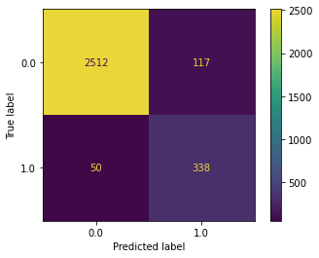
Machine learning

Slide 5

Question for the class

Slide 6
Sources
https://www.insidethegames.biz/articles/1112596/netherlands-wheelchair-basketball-tokyo (24-10-21)
https://www.kaartje2go.nl/bedankt-kaarten/kaart/bedankkaart-internationaal-a-big-thank-you (24-10-21)

