Slide 1
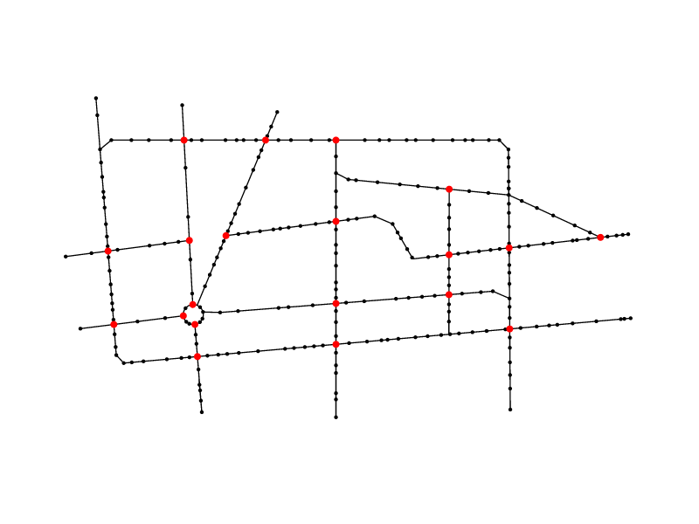
Network reconstruction

Slide 2
Network reconstruction steps
Create a MST from the set of given points
Connect endpoints
Remove divergent segments
Add new segments and points where necessary

Slide 3
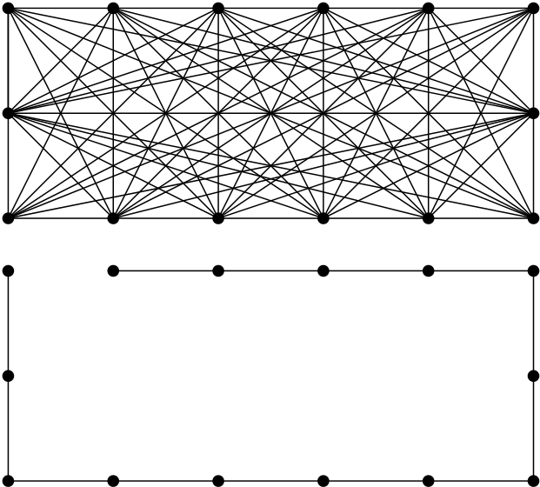
Create the MST
Kruskal's Algorithm

Slide 4
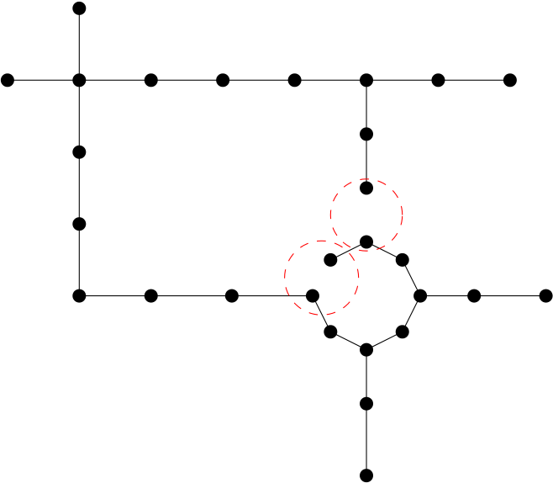
Connect endpoints
Construct adjacency matrix
Look for nearby nodes and check direction

Slide 5
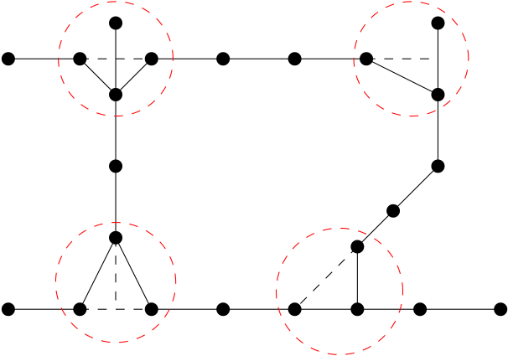
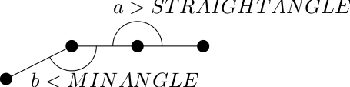
Remove divergent segments
Locate divergent segments
Remove if needed

Slide 6
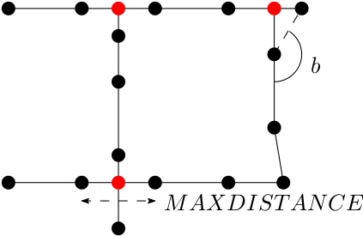
Add new segments
Find endpoints
Look for nearby point or intersecting segment
Create new Segment and/or point

Slide 7
Running time analysis
Create a MST O(n² log n)
Connect endpoints O(n)
Remove divergent segments O(n)
Add new segments and points O(n)
O(n² log n)

Slide 8
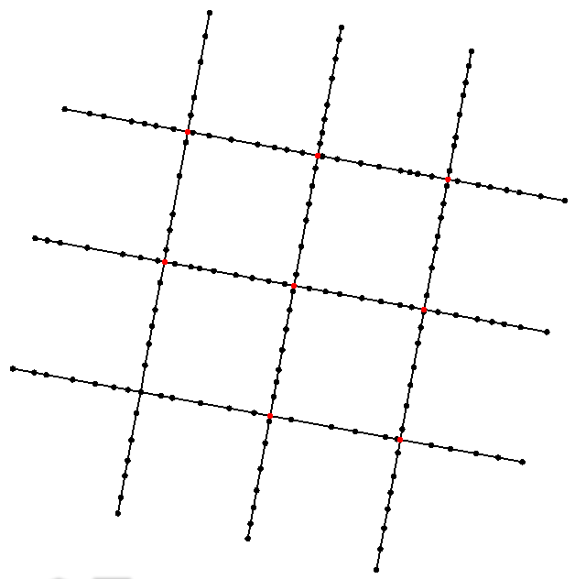
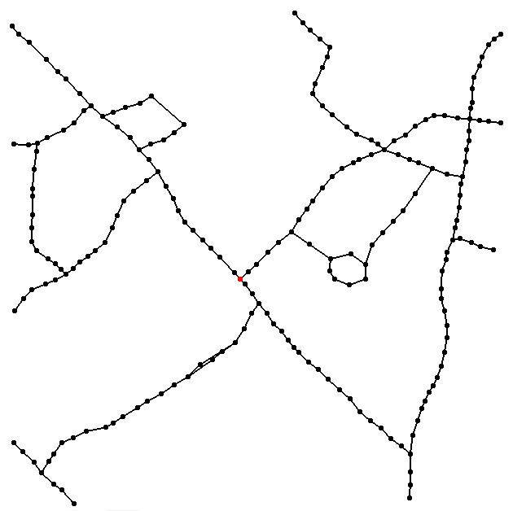
Experimental evaluation
MAXDISTANCE = 0.1f
MINANGLE = 160
STRAIGHTANGLE = 165

Slide 9
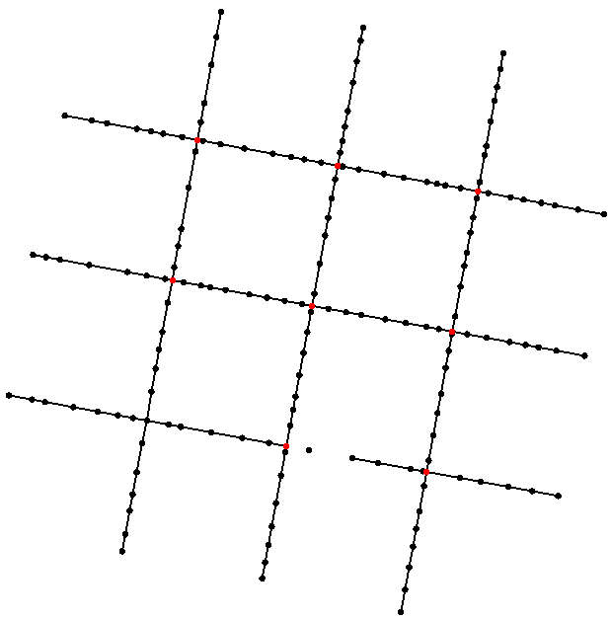
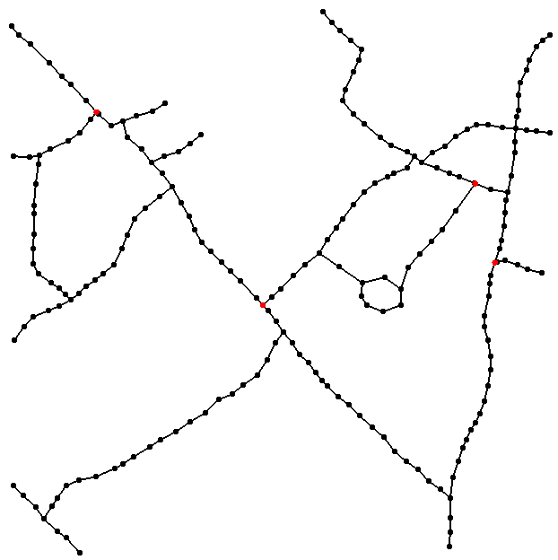
Experimental evaluation
MAXDISTANCE = 0.07f
MINANGLE = 165
STRAIGHTANGLE = 170

