Slide 1
2D Curve reconstruction
Authors
A. van den Boogaart
W. Brouwer
C. Mens
M. Muijsers
R. Wu

Slide 2


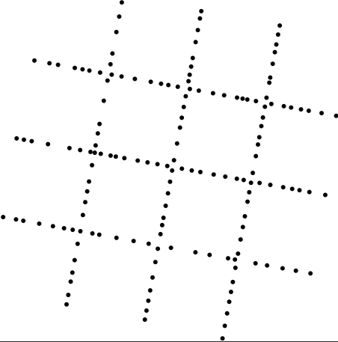
Problem Description
Single curve reconstruction
Multiple curve reconstruction
Network reconstruction

Slide 3
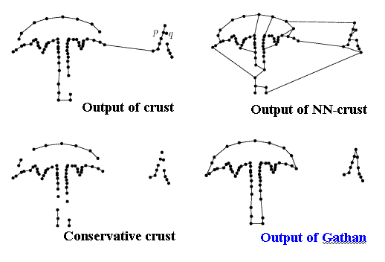
Previous work on curve reconstruction
Crust
Gathan

Slide 4
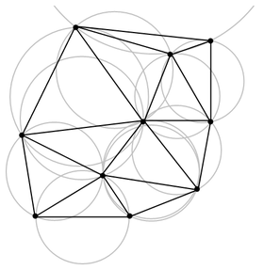
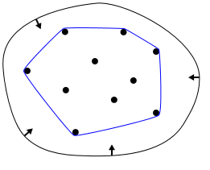
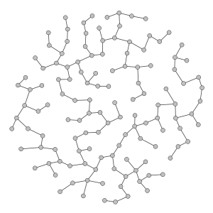
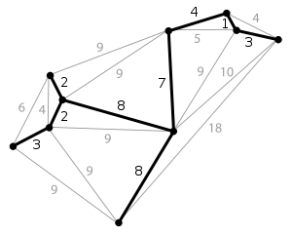
Common techniques
Delaunay triangulation / voronoi diagrams
Convex hull
  Rubber band around all points
Spanning graph
  Minimum spanning tree / rectalinear spanning tree

Slide 5
Common techniques: analysis
Delaunay triangulation / voronoi diagrams
  Hard to produce, verify and document
Convex hull
  Hard to extract meaningful information
Spanning graph
  Hard to identify incorrect results

Slide 6
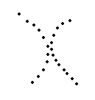
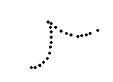

Curve reconstruction challenges
Almost touching curves
Sharp corners
To take a turn, or not to take a turn?

Slide 7
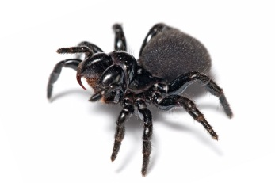
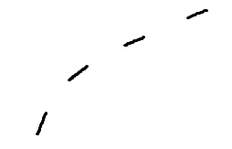
Solving the curve reconstruction
‘Spider’-type algorithm
  Start somewhere
  Look for the next best point at every point
  Go there and continue
  Use adjacency lists to improve efficiency and distinguish different curves

Slide 8
Solving the curve reconstruction
How to decide which point is best?
  Make sure you do not completely exclude future points from being added
  Take into account the curve up to that moment: curvature and distances
  Avoid intersections
?

Slide 9
Solving the curve reconstruction
How to decide where to start?
  Make sure you can easily find the first one (or better: two) segments
Method 1: take an edge with small length of the convex hull
  Takes time to compute and is inaccurate
Method 2: take a node where you can ‘see’ the boundary
  Where you are sure the node will be a good boundary point for the curve

Slide 10
Solving the curve reconstruction
Taking a node where you can see the boundary
  Maximize the angle without any other nodes
  Start connecting to the closest nodes and optimize the resulting triangle

Slide 11
Solving the curve reconstruction
Taking a node where you can see the boundary

Slide 12
Solving the curve reconstruction
Is the curve open or closed?
  Find if there is an extreme ‘odd one out’
  If so, remove it from the set of segments

Slide 13
Multiple curves
Same!

Slide 14
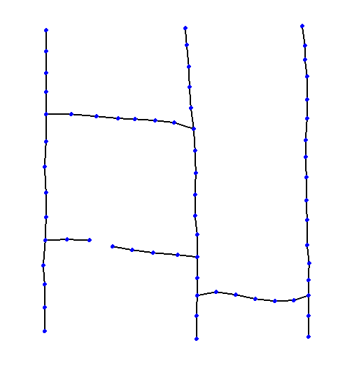
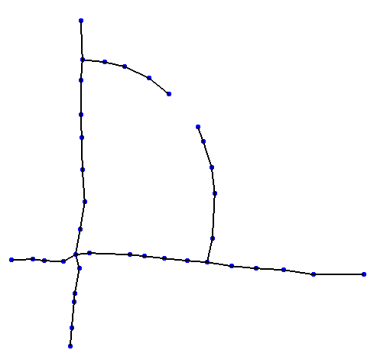
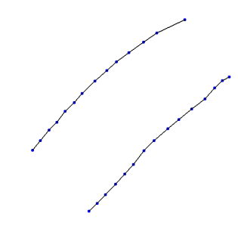
Network reconstruction challenges
Straight lines
    Must not contain gaps
Curves
    Must be connected
Parallel lines

Slide 15
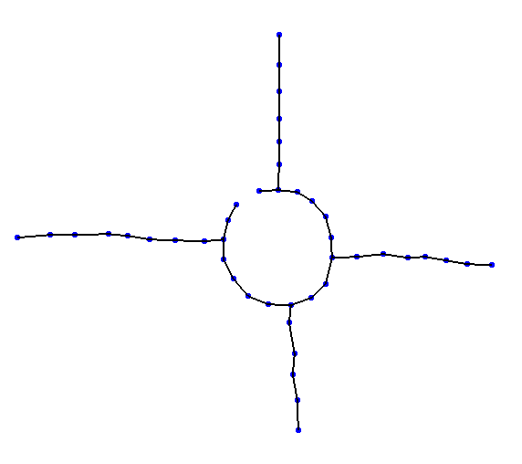
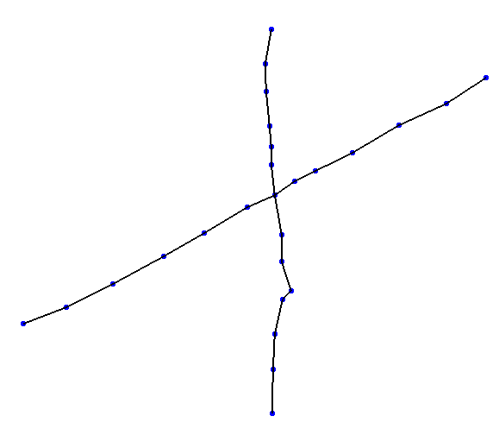
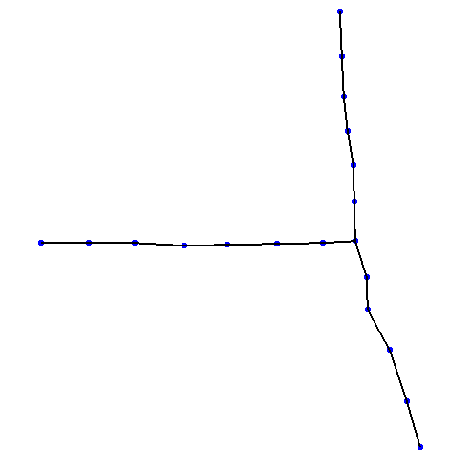
Network reconstruction challenges
Circles
  Hard to detect
Crossings
  Points can be
  added
T-junctions
  Hard if there is no
  point in the center

Slide 16
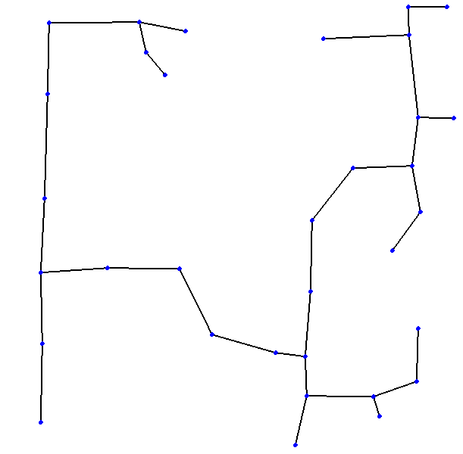
Reconstructing a network
Create a spanning graph
  Uses Kruskal’s Algorithm to get a minimum spanning tree
  Extend lines to find intersections

Slide 17
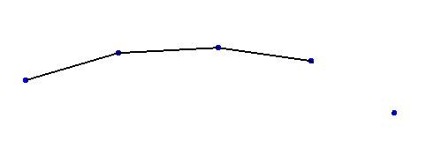
Set of straight segments: extend
When finding a set of straight segments
  Try to extend by adding fitting segments

Slide 18
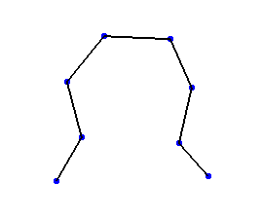
Avoid connecting ‘closely connected’ nodes
When evaluating creating a segment between nodes
  Check whether they are already connected by only a few edges

Slide 19
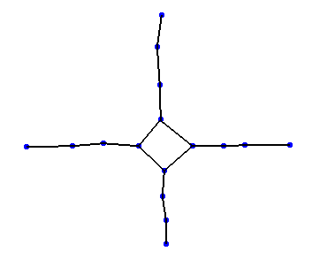
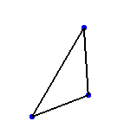
Avoid connecting ‘closely connected’ nodes
This avoids small triangles or quadrilaterals at intersections

