Slide 1

Querying the Hebrew Bible with Text-Fabric
A short introduction
By
Martijn Naaijer
March/April 2026

Slide 2
Goal
Make queries in Biblia Hebraica Stuttgartensia Amstelodamensis (BHSA = ETCBC dataset of the MT).
Analyze the results.
Software: Text-Fabric. Python package for processing texts with annotations.

Slide 3
Plan
3 afternoons
1. Introduction, word level queries in TF Browser.
2. Syntactic queries, queries in Jupyter Notebook, other datasets.
3. Data visualisations.

Slide 4
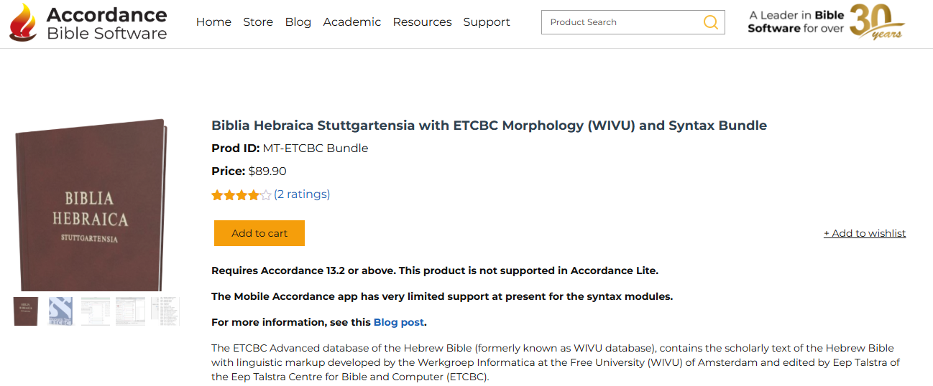
Open Source vs Closed Source

Slide 5
Open Source vs Closed Source
Or: Text-Fabric vs Accordance
Pros of open source
Free, community-driven innovation, customizable.
Pros of closed source
User-friendly interfaces, high stability, and easy to install/use.

Slide 6
Open Source vs Closed Source
Cons of Open Source
Requires technical skills, lacks official, guaranteed support, and documentation can be sparse.
Cons of Closed Source
Expensive licensing, limited customization, dependence on vendor for updates, and less transparency.

Slide 7
Open Source vs Closed Source: my opinion
Text Fabric is more flexible and transparent than Accordance:
-integration with Python scripts.
-export query results.
-integration with other datasets (e.g. DSS, SP).
-> Reproducible and controllable.
-> It is better suited as a research tool.

Slide 8
Queries
Query language: “Search”.
A Search query has a template structure:
object-type feature=value
Examples:
word nu=pl
phrase function=Subj

Slide 9
Search for objects with specific characteristics
Object types:
word
phrase
clause
sentence
verse
chapter
book

Slide 10
Features
The BHSA is annotated with many features, e.g.
Word level features:
Lexeme
Person/number/gender
Verbal stem/verbal tense
Syntactic features
Phrase types/functions

Slide 11
Time to make queries!

