Slide 1
Researching player development in Football Manager 2024 with Machine Learning

Slide 2
Index
Previous Work
Data Extraction and Handling
Modelling
Results
Results by age group
Conclusions

Slide 3
Previous work
I’ve previously done some research on FM21 that was featured on Zealand’s channel that showed that Prof > Det >> Amb
This challenged the current perspective that determination was the single most important attribute
Other work on this area was also performed by others, but just like my original research it had several shortcomings

Slide 4
The problem with current research
The size of the sample is often not big enough
The environment is too controlled in order to isolate the variables
Often models are too simplistic
To address this, I ran a new experiment in an unedited FM save, and trained a robust model using over 30000 data points, testing a variety of different variables, namely:
Professionalism
Determination
Ambition
Training Facilities
Minutes played
And more

Slide 5
Limitations
Coaching attributes are not controlled
Getting more data would be time consuming unless I learn to automate a few things
Inability to separate by position (except for goalkeeper)
There may be variables that affect player development that I am not considering
The fact we're only going forward 1 year stops us from analyzing regens

Slide 6
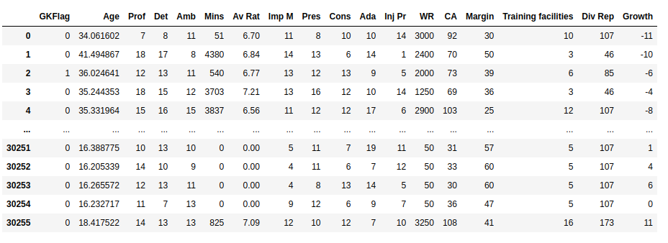
Data Extraction and Handling

Slide 7
Modelling
Three different types of models were experimented with:
Linear Regression: Achieved an MSE of 13.77
Neural Networks: Achieved an MSE of 7.98
XGBoost: Achieved an MSE of 7.20 (MAE of 1.81)
We use XGBoost for its better predicting ability but also ease of interpretation
We will interpret the model using SHAP values and PDP's

Slide 8

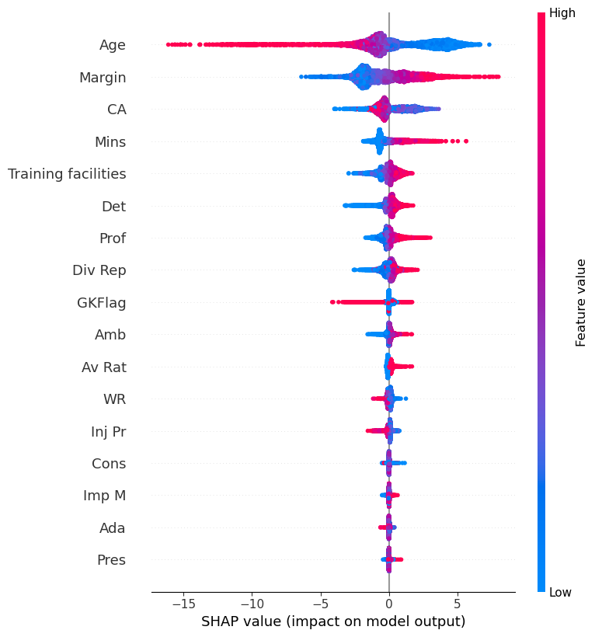
Results

Slide 9
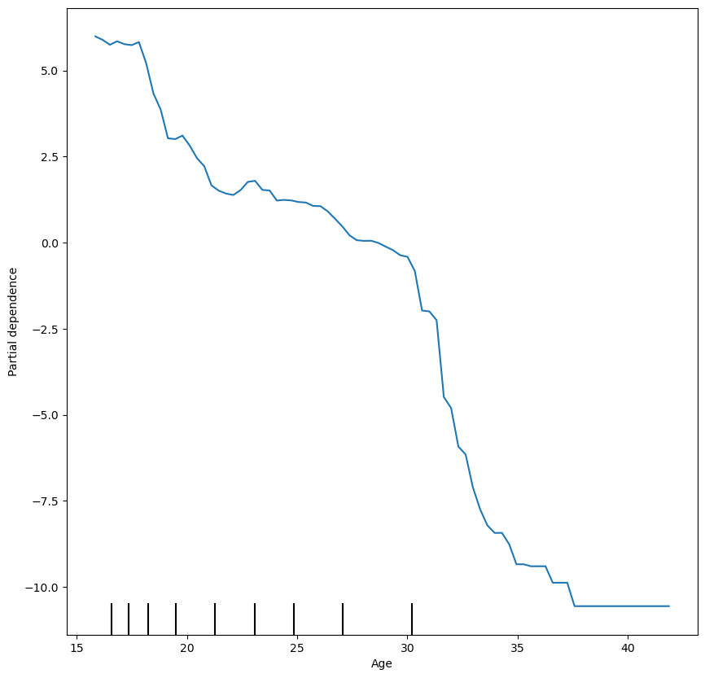
Age

Slide 10
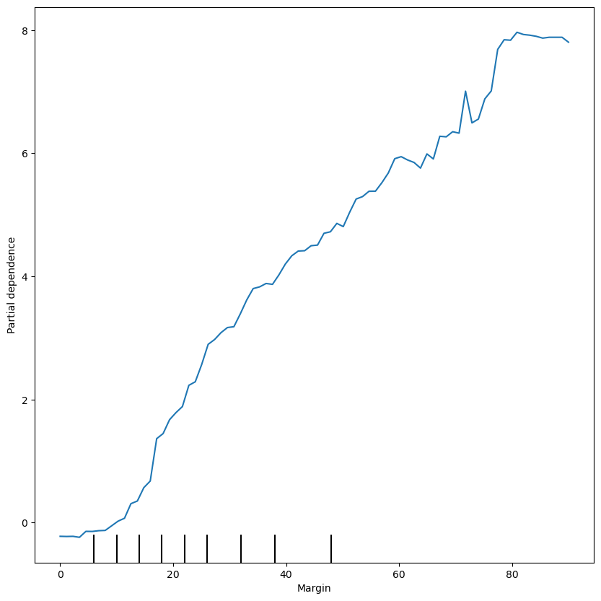
Margin

Slide 11
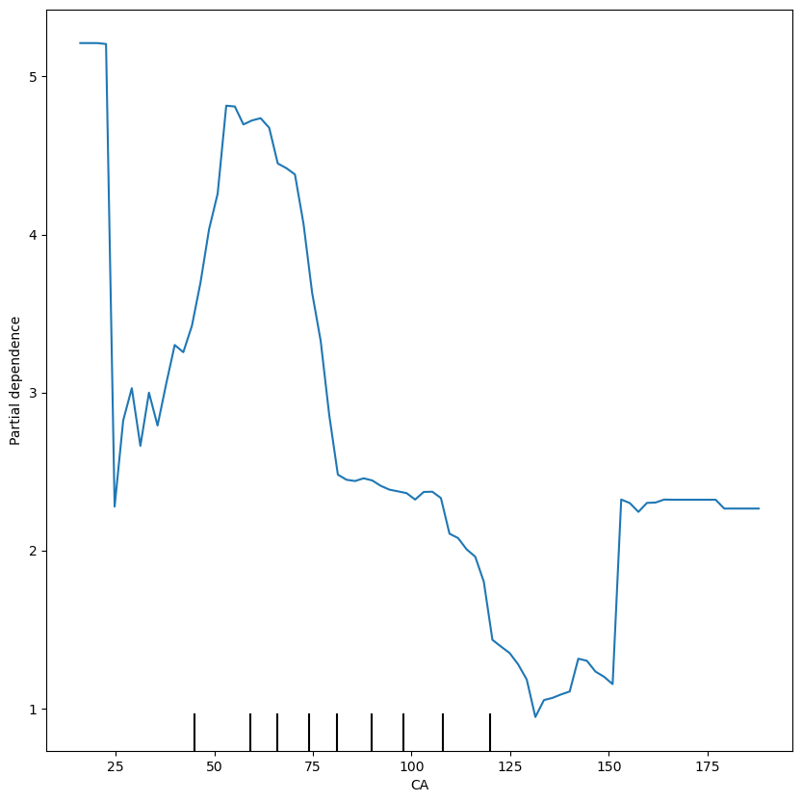
CA

Slide 12
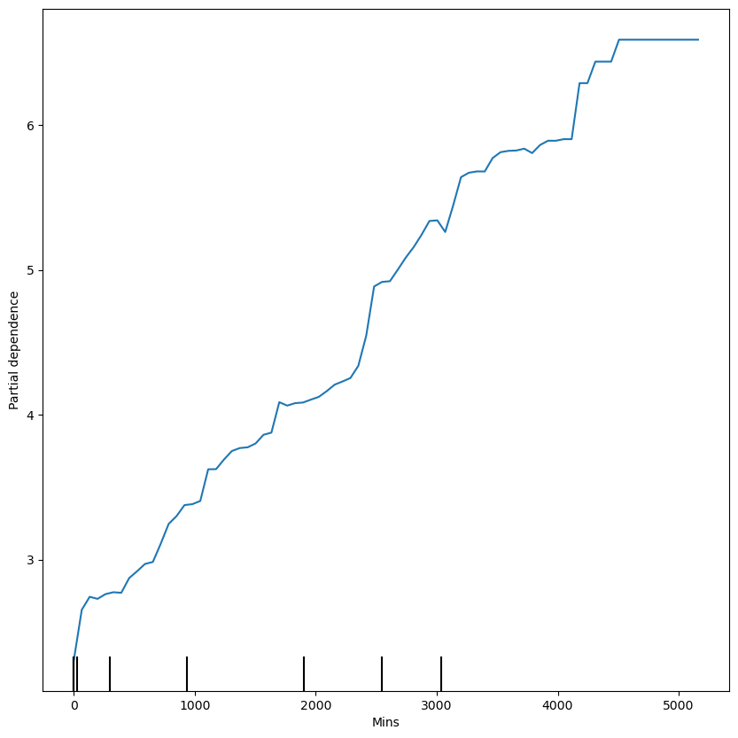
Mins

Slide 13
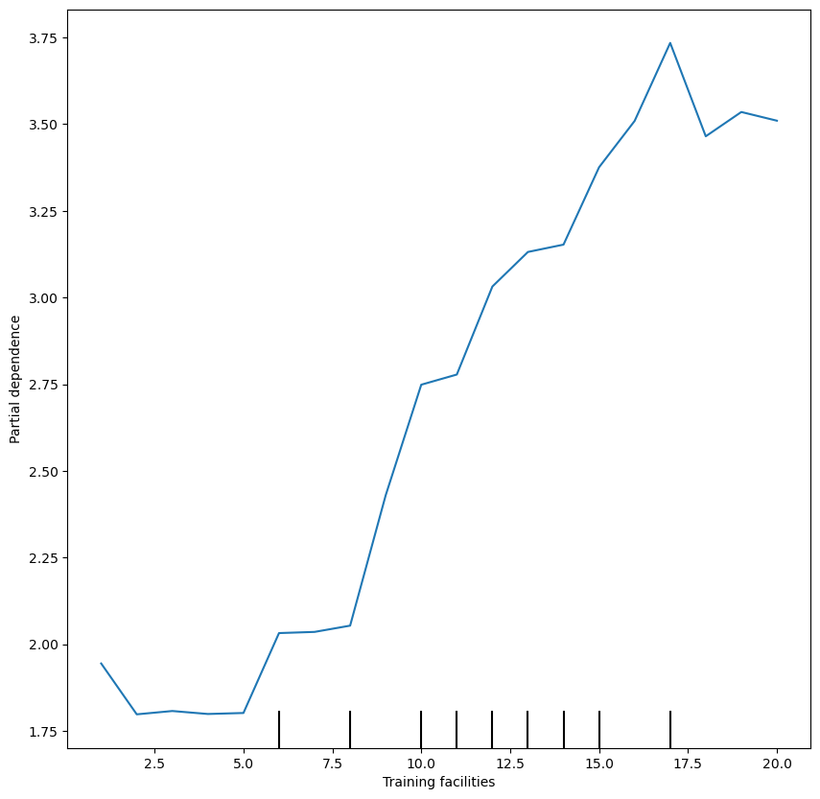
Training Facilities

Slide 14
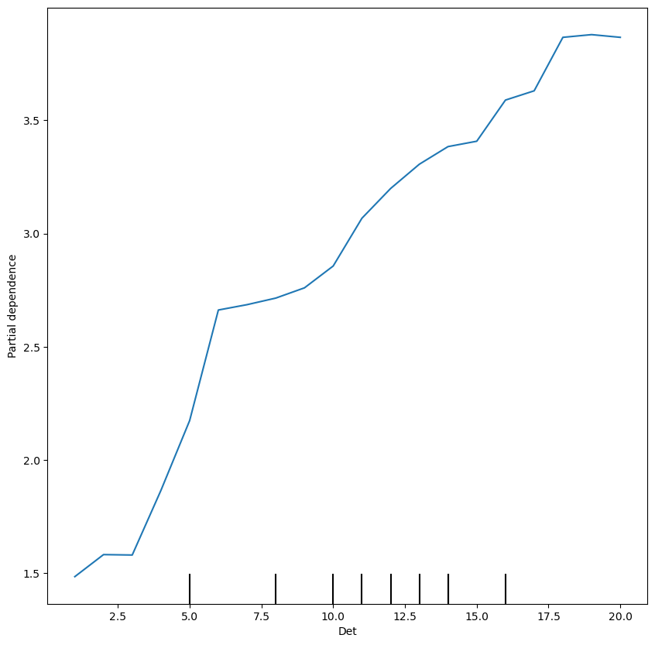
Det

Slide 15
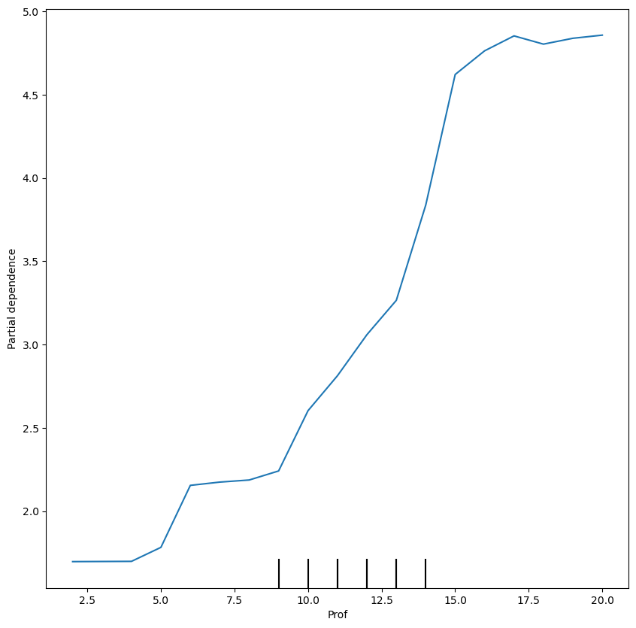
Prof

Slide 16
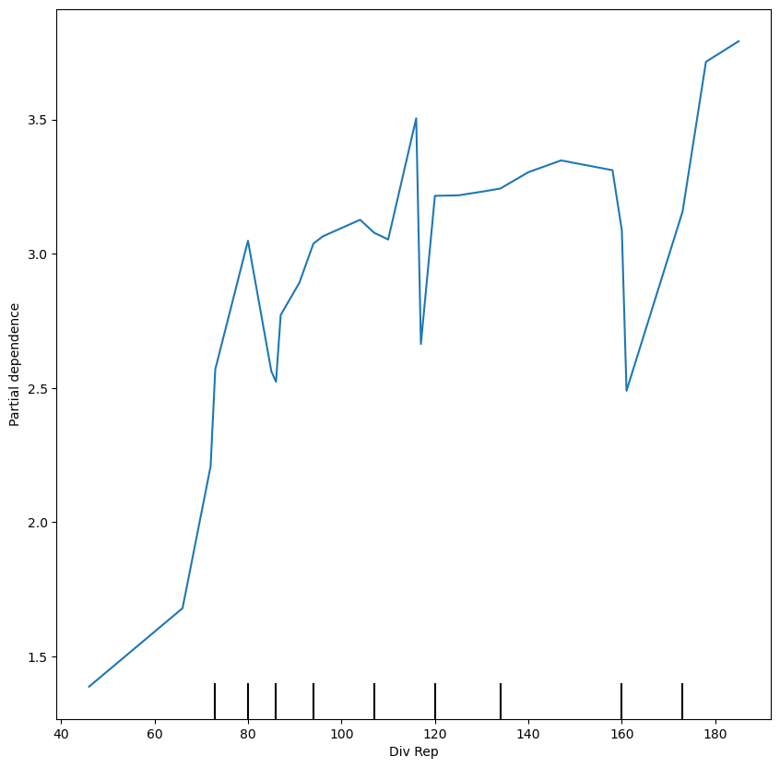
Div Rep

Slide 17
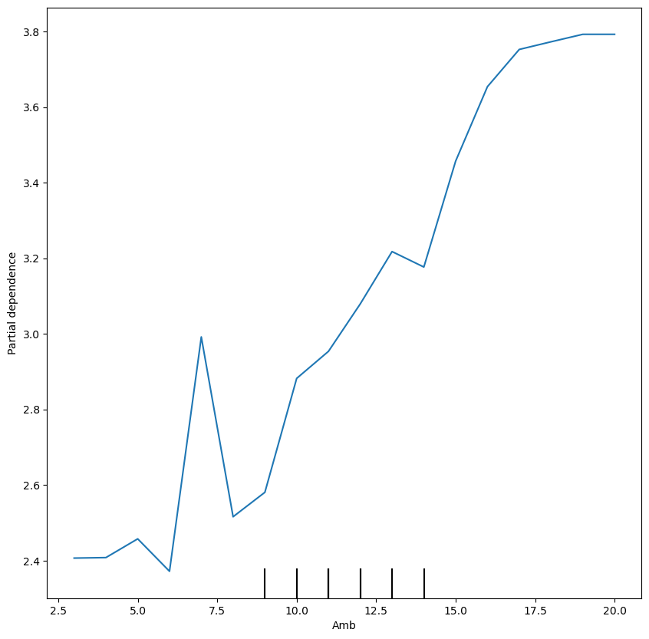
Amb

Slide 18
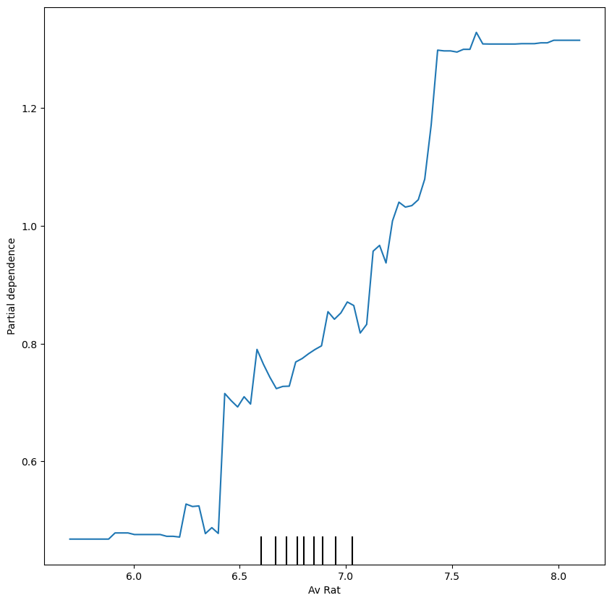
Avg Rat

Slide 19
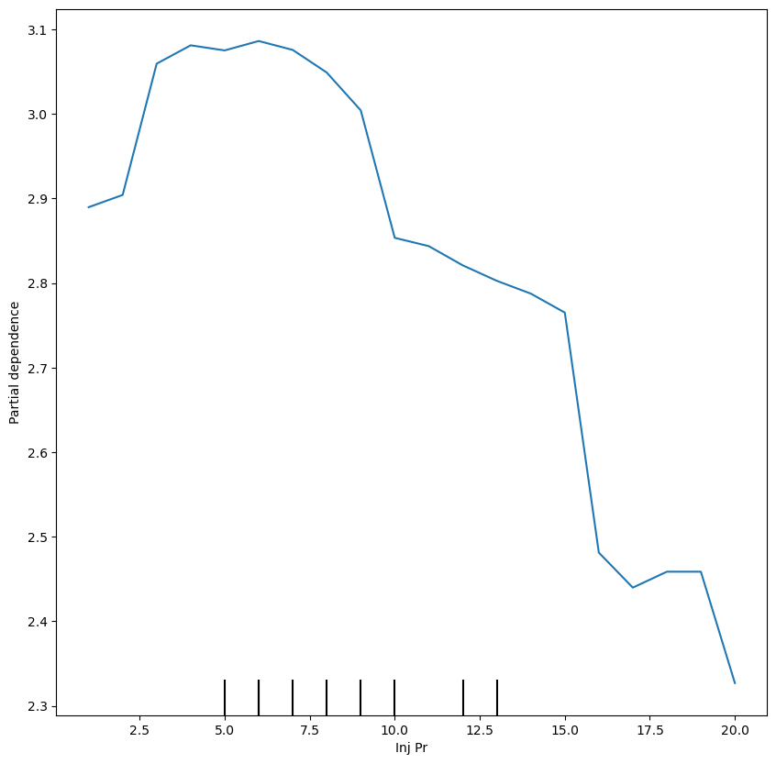
Inj Pr

Slide 20
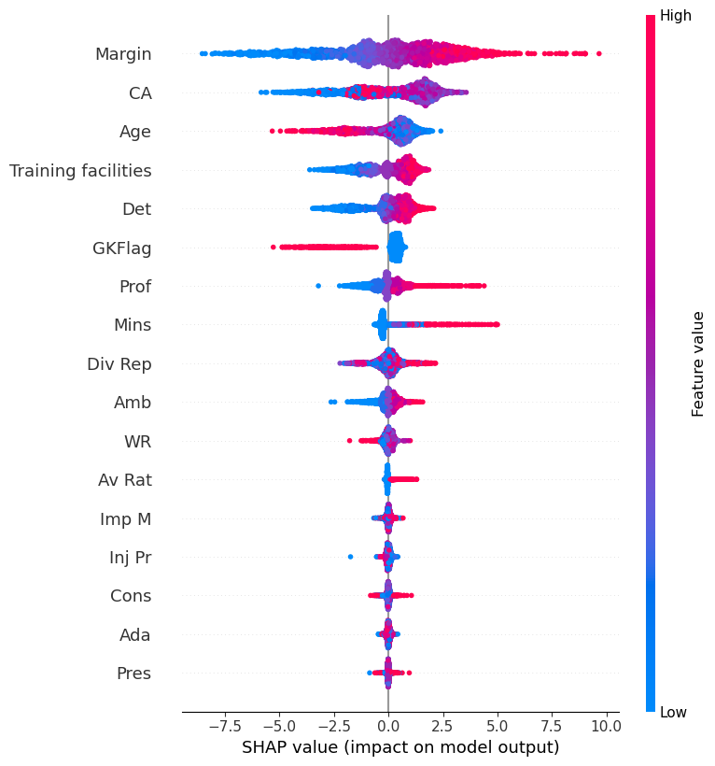
<20

Slide 21
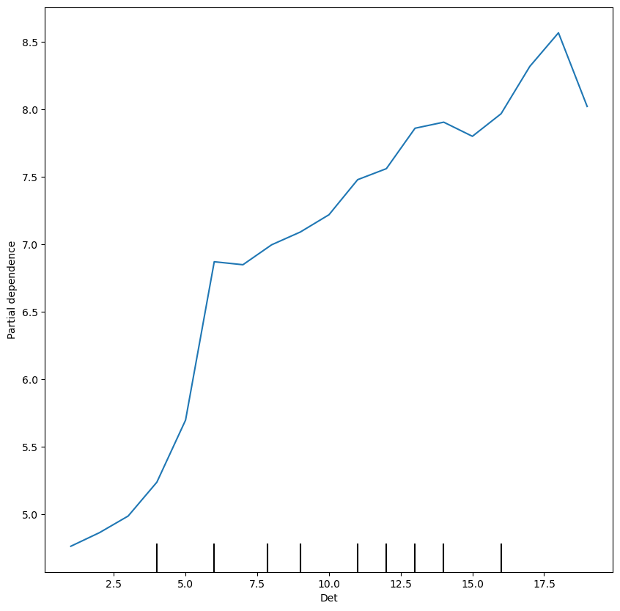
Det <20

Slide 22
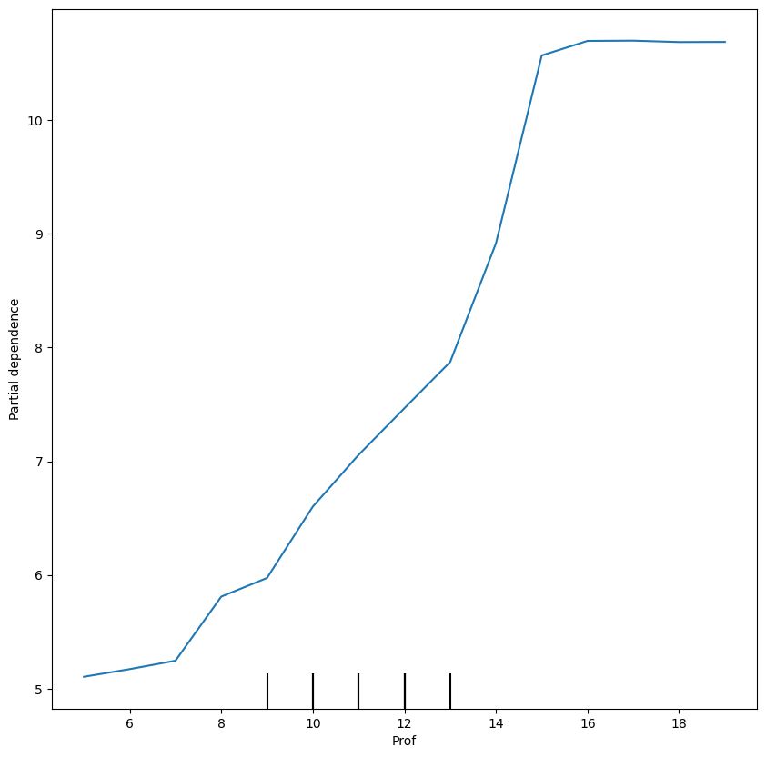
Prof <20

Slide 23
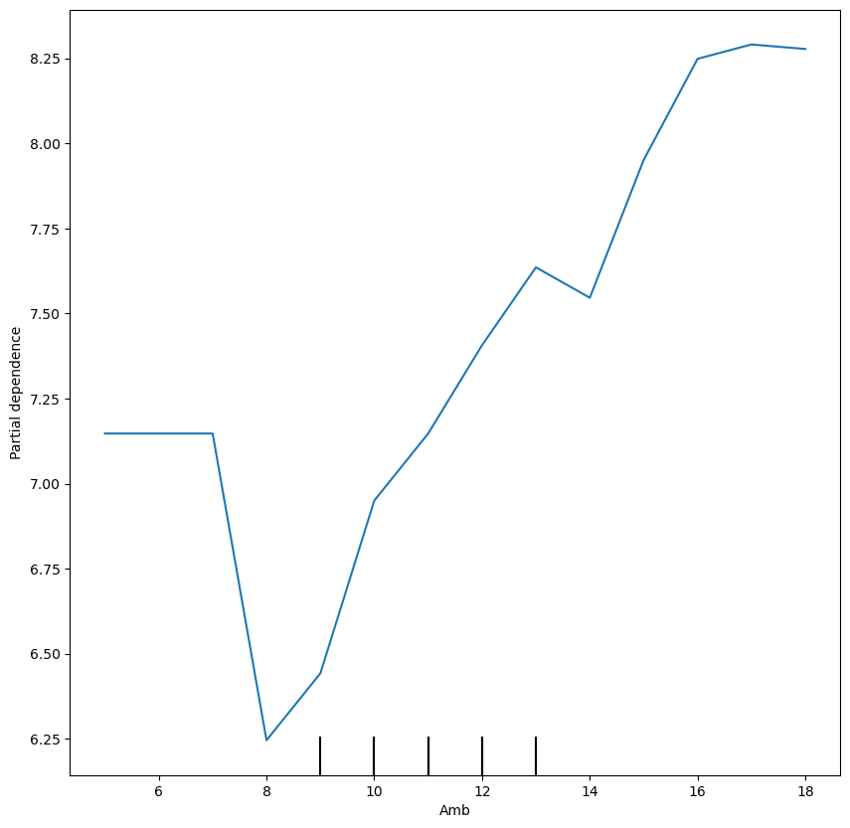
Amb <20

Slide 24
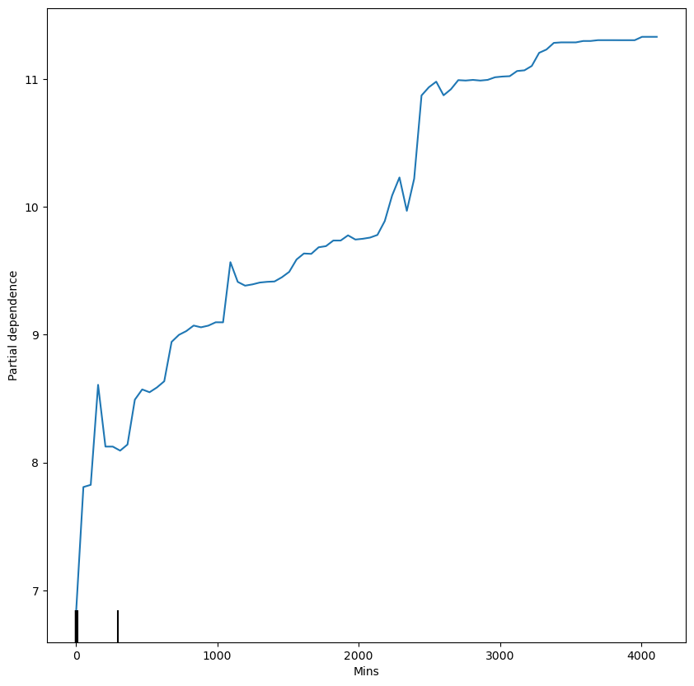
Mins <20

Slide 25
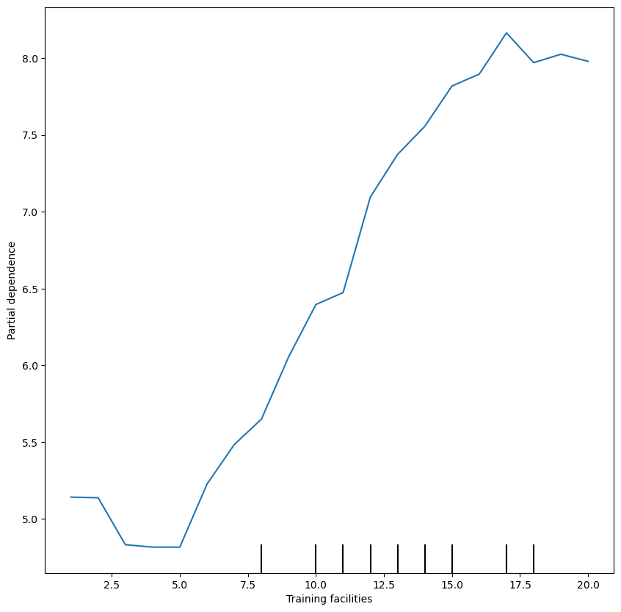
TF <20

Slide 26
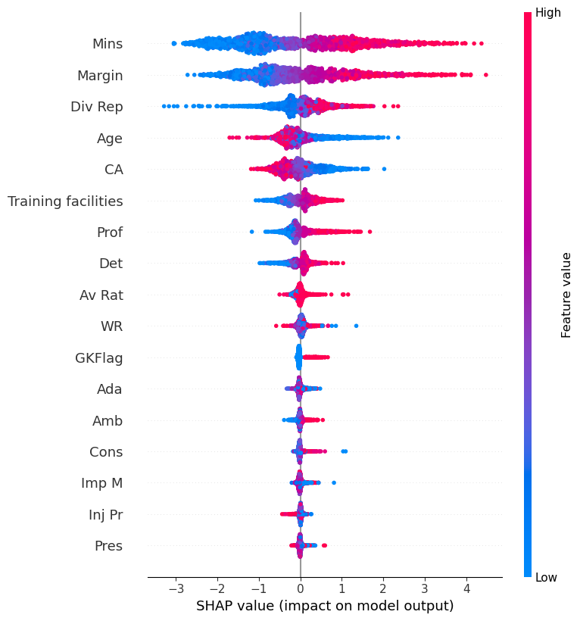
20-25

Slide 27
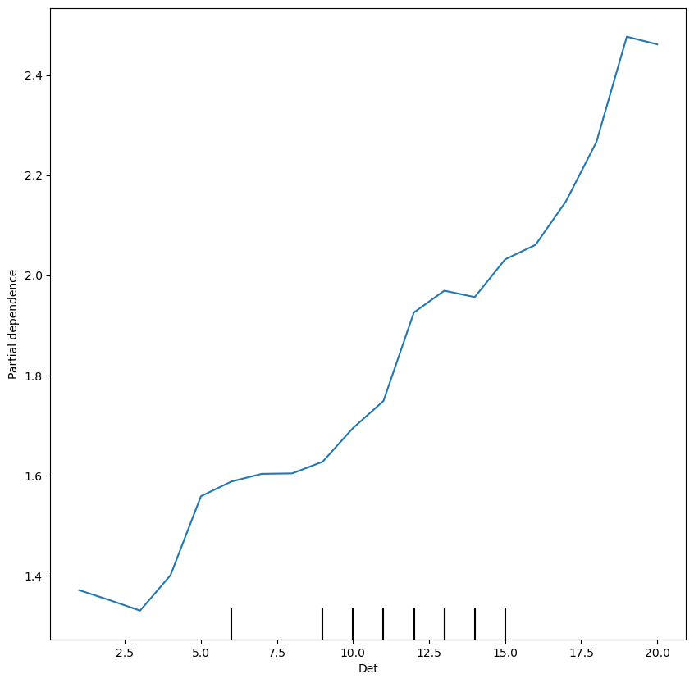
Det 20-25

Slide 28
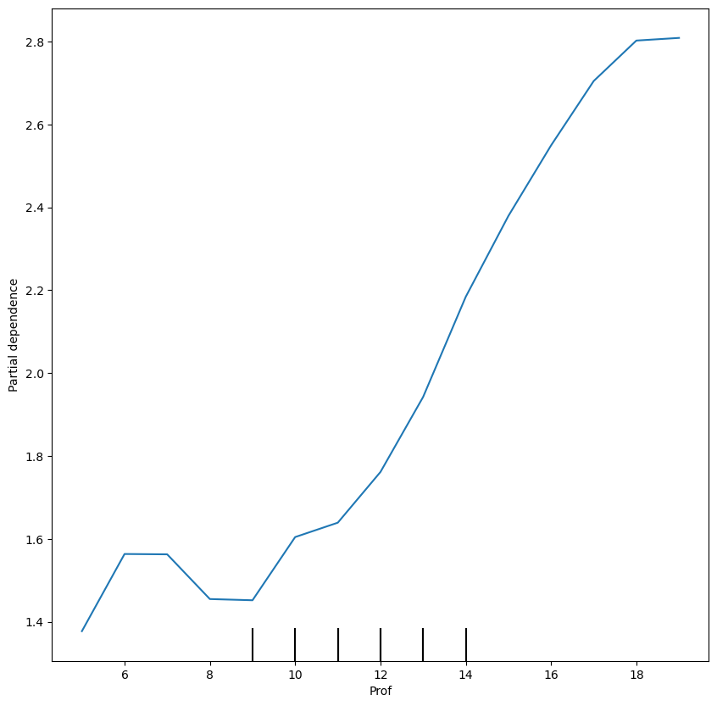
Prof 20-25

Slide 29
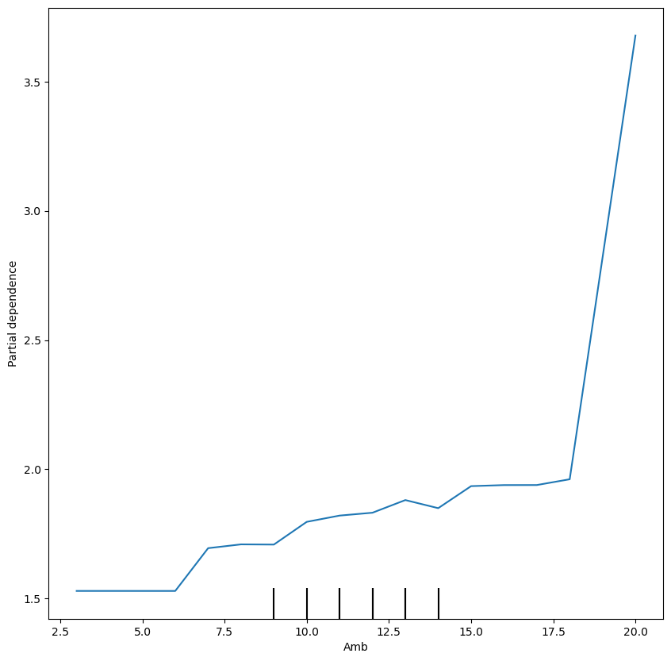
Amb 20-25

Slide 30
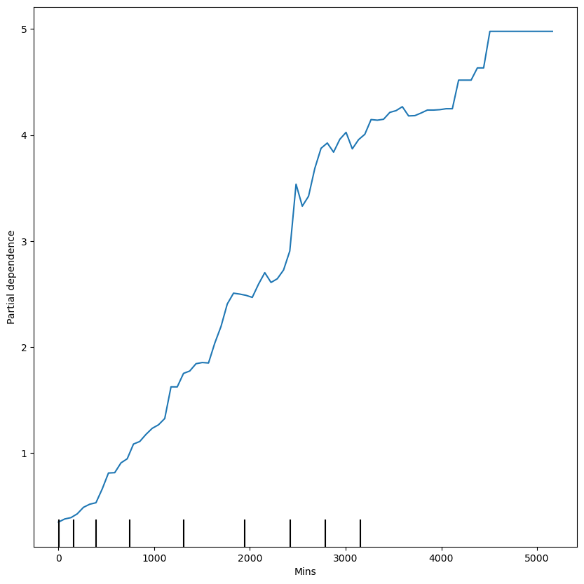
Mins 20-25

Slide 31
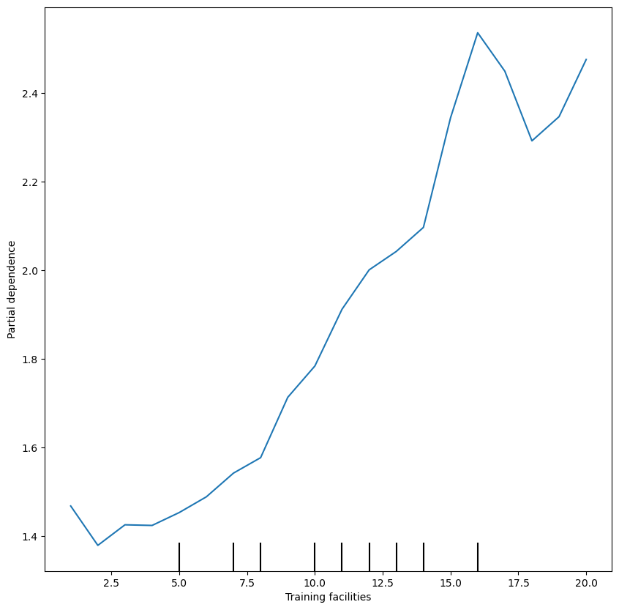
TF 20-25

Slide 32
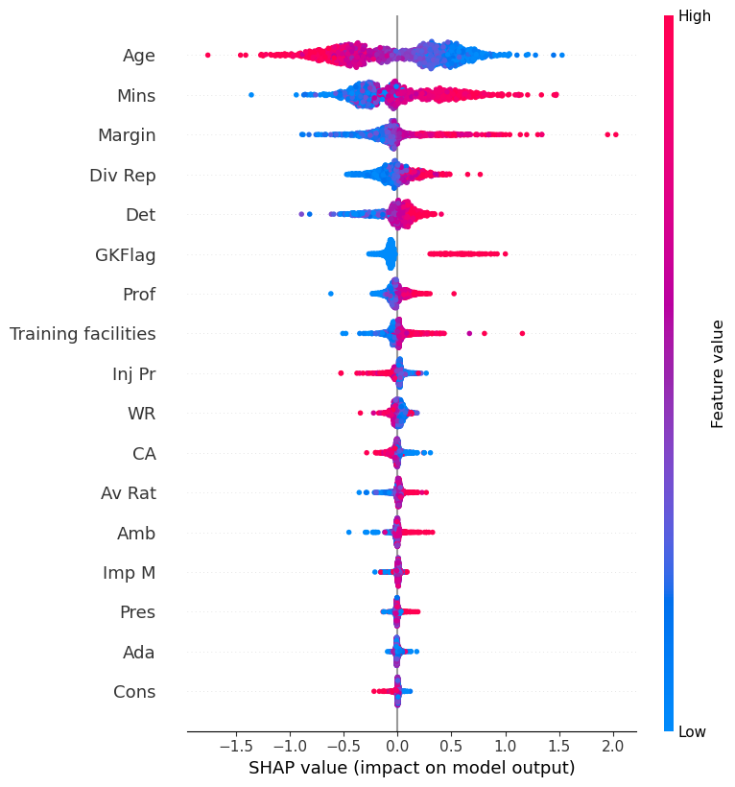
25-30

Slide 33
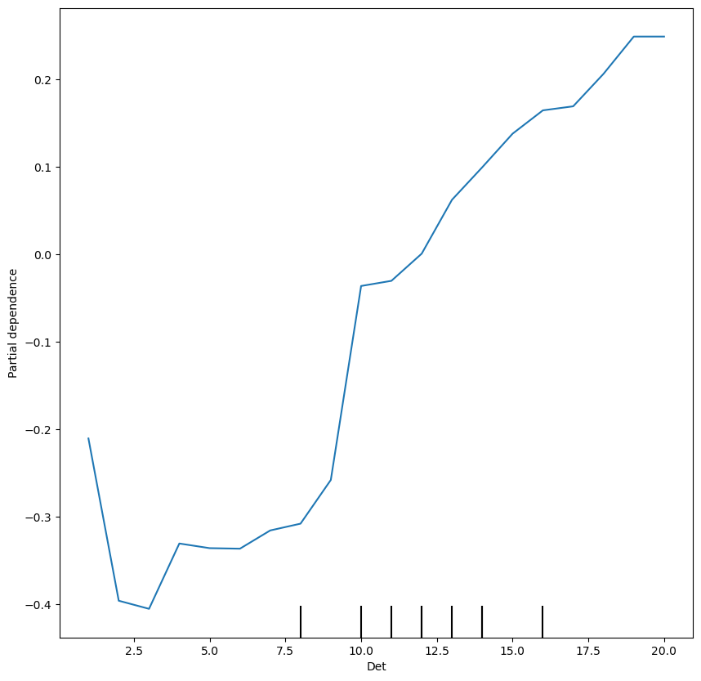
Det 25-30

Slide 34
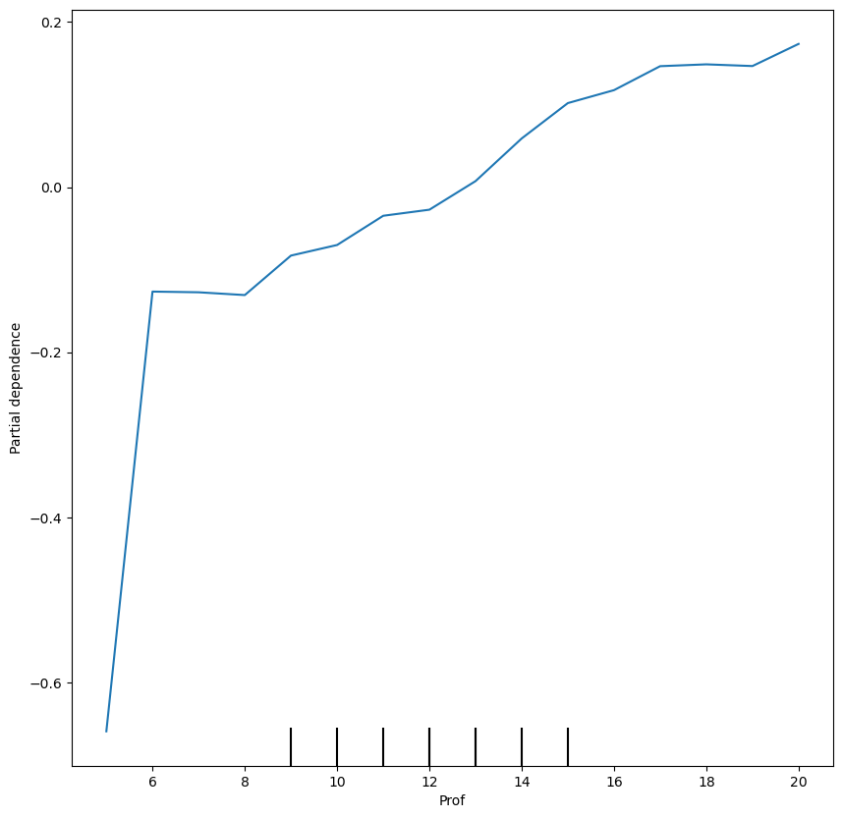
Prof 25-30

Slide 35
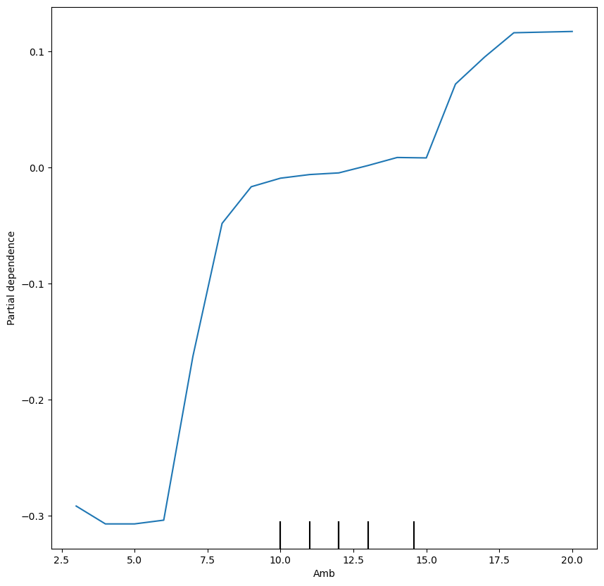
Amb 25-30

Slide 36
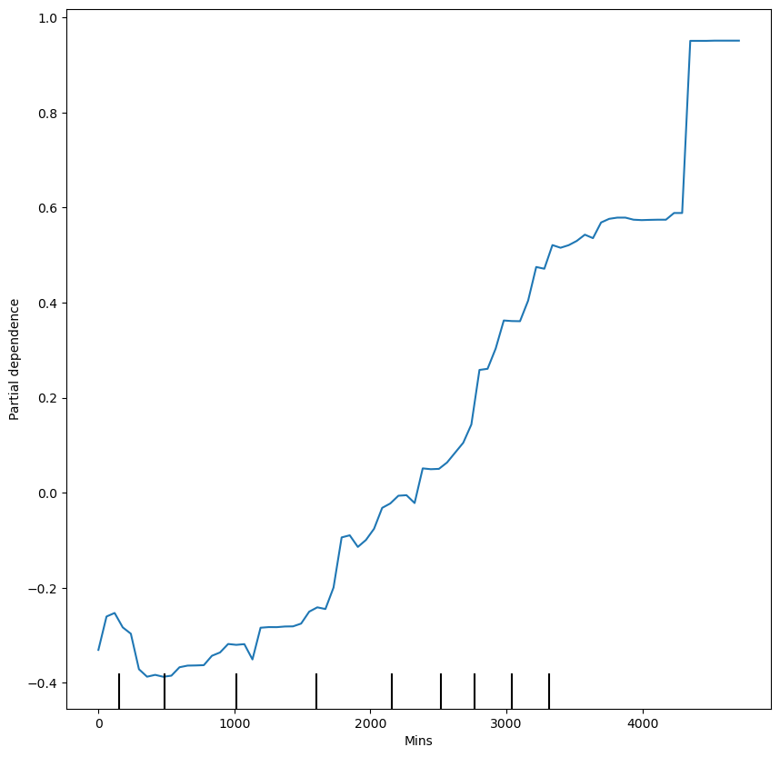
Mins 25-30

Slide 37
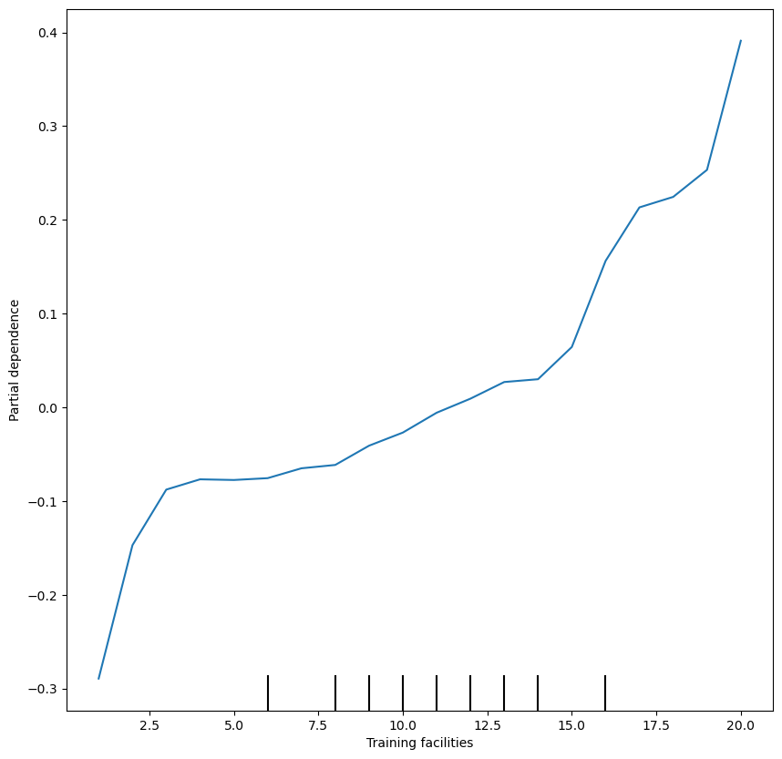
TF 25-30

Slide 38
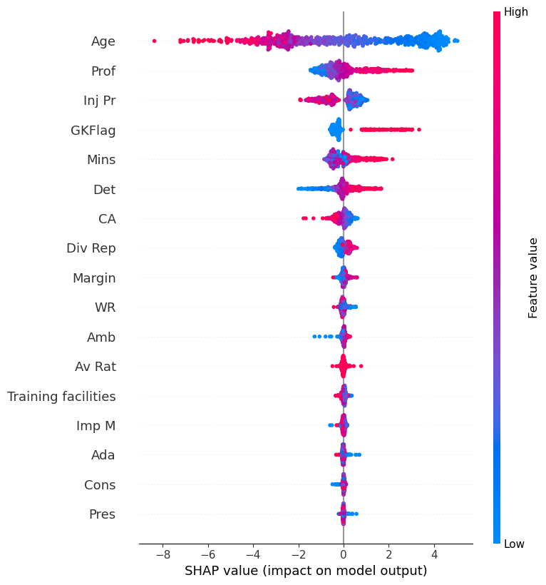
>30

Slide 39
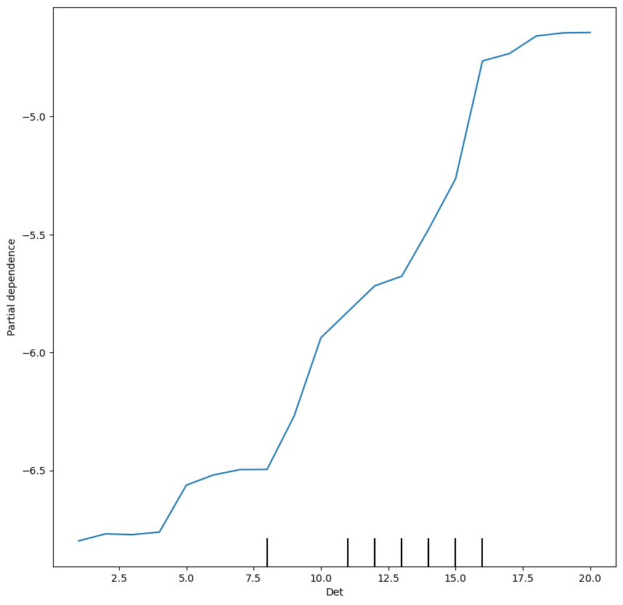
Det >30

Slide 40

Prof >30

Slide 41
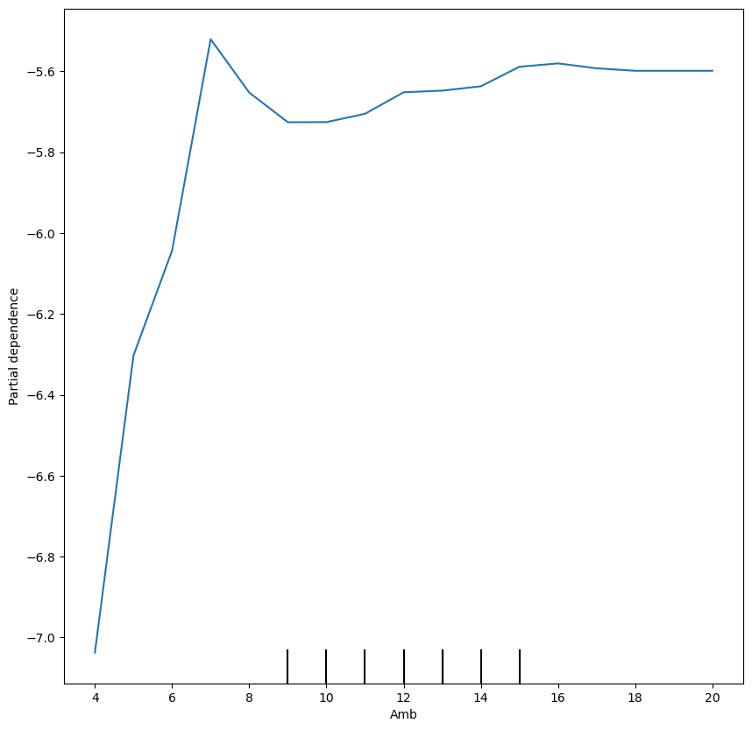
Amb >30

Slide 42
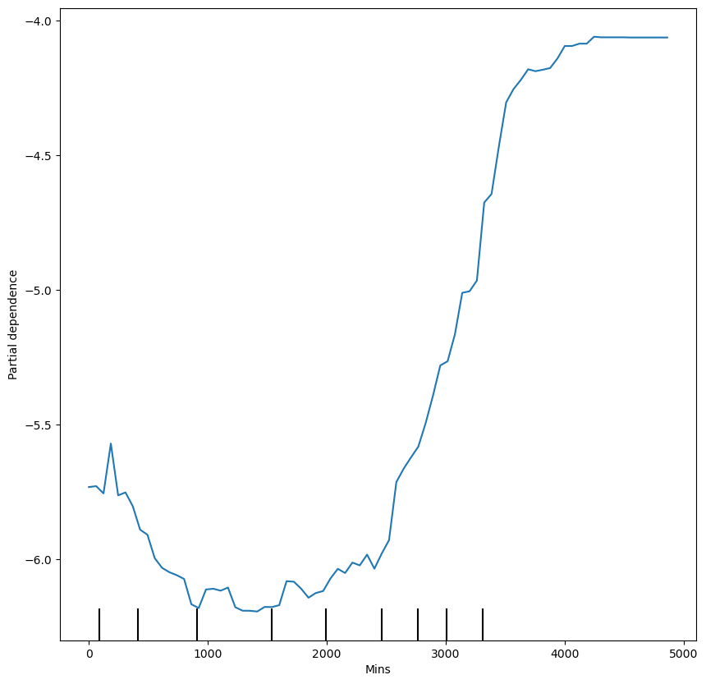
Mins >30

Slide 43
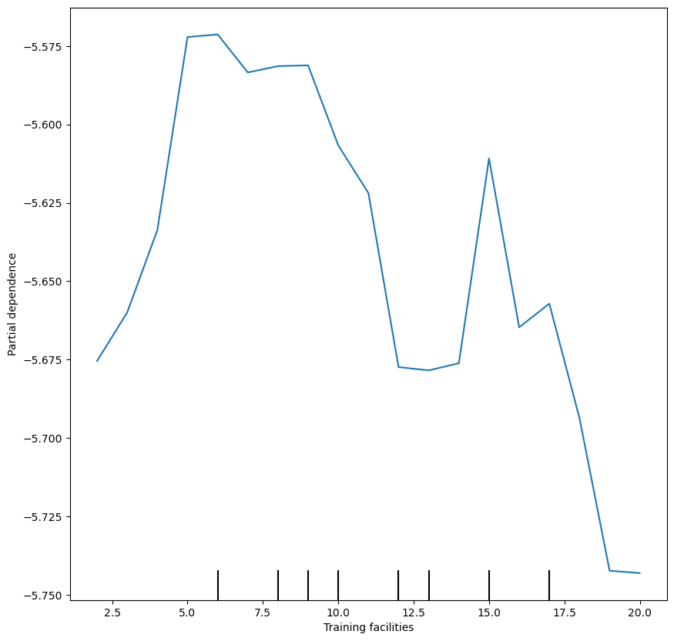
TF >30

Slide 44
Results review table
Average Growth range | <20 | 20-25 | 25-30 | >30 | Overall
Prof | 5 | 1.4 | 0.3-0.8(?) | 3.5 | 3
Det | 3.5 | 1.1 | 0.65 | 2 | 2.5
Amb | 2 | 0.5-2(?) | 0.4 | 1.4 | 1.4
Training F. | 3 | 1.2 | 0.7 | 0 | 2
Mins | 4 | 4.5 | 1.35 | 2 | 4

Slide 45
Conclusions (overall)
It seems that Prof > Det > Amb at all ages, but these differences aren't quite as large as previously stated
Training Facilities matter about as much as determination but only affect growth and don't help with decay
The positive effect of average rating is fairly small, as is the negative effect of injuries (separating from minutes played)
The margin of growth of a player has a huge effect on his yearly growth
Consistency, adaptability, pressure and important matches don't matter

Slide 46
Conclusions (<20)
At this stage the margin of progression has a huge impact
It's very important for determination to be at least 6, after that point the increase in impact is smaller
Professionalism stops mattering at 15
Even playing just 200-300 minutes can have a big impact, but mins played have a relatively small importance in this age group compared to others, mattering less that professionalism
Training Facilities seem to stop mattering past 17
League reputation is not a huge factor at this stage
Injuries don't matter a ton

Slide 47
Conclusions (20-25)
While margin still is very important, it's all about playtime, and division reputation is a big factor here
Professionalism up to 11 doesn't change growth a lot, but past that point there's a big increase for each point
Ambition has a fairly small impact, as do injuries
Training facilities appear to stop mattering past 16

Slide 48
Conclusions (25-30)
Development naturally slows down or halts
Playing a lot and at a high level is still key
Injuries start gaining relevance
Fast increase in growth impact when determination is up to 10, slows down after
Professionalism should be at least 6, after which point it has a relatively small influence
For the first time Training Facilities do seem to matter all the way up to 20

Slide 49
Conclusions (>30)
Margin has no effect on player decay, but CA does (the higher the CA, the faster the fall)
Professionalism is the undisputed king of the HAs in stopping decay
Ambition only needs to be at least 7, after which point it seems to not matter
Training Facilities do not affect player decay at all
The league reputation doesn't seem to have a big impact
Injuries have a very large impact in this stage of the career
Players should play at least 3000 minutes to help stop decay

