Slide 1
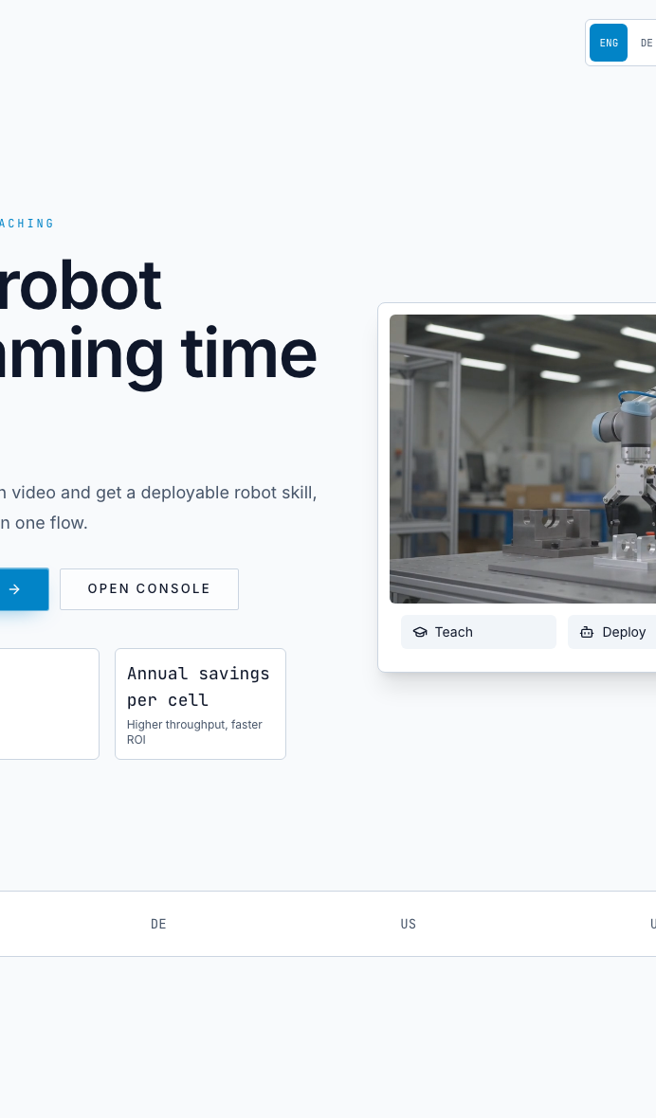
AUREVIX
by Agentic Convergent
Own the task layer between people and industrial robots.
Aurevix turns a video demonstration into validated, auditable, robot-specific work across the robots a factory already owns.
Video
Gate
Passport
captures task intent
simulation + human review
portable automation memory
Confidential · pre-seed investor discussion
01

Slide 2
THE SHIFT
Factories bought robots for flexibility. The bottleneck moved to task changes.
The hardware can move. The painful part is capturing, approving, reprogramming, and remembering what the task should be.
Today
With Aurevix
Company thesis
Call the specialist
Show the task
The durable company is not a prettier teach pendant. It is the task memory and deployment trust layer above every robot runtime.
Retasking leaves the line and enters someone else's calendar.
A worker demonstrates the process in the terms they already know.
Pay again
Review before motion
Every SKU change can become a new programming event.
Simulation, readiness checks, and human approval sit before hardware.
Source basis: live site positioning; internal strategy brief; repo deployment trust layer.
Aurevix by Agentic Convergent · investor deck
02

Slide 3
PROBLEM
The robot was not the expensive part. The programming was.
Every layout change, fixture update, and process improvement can restart a specialist loop.
$5K-15K
3-5 weeks
20-50%
External
typical task-change cost cited on website
typical integrator task setup cited on website
programming and integration share cited on website
task knowledge stays with the specialist
This is a wedge with budget: retasking competes against integrator invoices, downtime, internal automation-engineer time, and delayed production changes.
Website cites Standard Bots cost guide, Konica Minolta insights, and industry survey references. Verify exact source details before fundraising distribution.
Aurevix by Agentic Convergent · investor deck
03

Slide 4
WINNERS AND LOSERS
The factories that win will own their automation memory.
Winners
Losers
High-mix teams
Calendar dependency
They can change tasks without waiting on a calendar.
Routine changes still require a scarce outside expert.
Brownfield fleets
Vendor lock-in
They reuse UR, ABB, FANUC, KUKA, Techman, and Yaskawa cells.
Task knowledge is trapped in proprietary code or one robot brand.
Safety owners
Black-box automation
They get evidence packages and version-bound review records.
Motion without sign-off becomes a liability conversation.
Aurevix by Agentic Convergent · investor deck
04

Slide 5
BEACHHEAD
Start with the plant team whose robot is idle until the next specialist arrives.
Initial ICP assumption: high-mix SME factories with 1-10 cobot cells, recurring task changes, and existing automation spend.
Economic buyer
Daily user
Validator
Blocker
Plant manager or operations owner
Process technician or automation engineer
Safety or automation owner
IT/OT, integrator, procurement
Investor proof needed next: named or anonymized design-partner profile, robot model, task, baseline time/cost, target date, success criteria, and permission level for reference calls.
Aurevix by Agentic Convergent · investor deck
05

Slide 6
PRODUCT APPEARS
Aurevix turns task intent into robot-specific work, with review before motion.
1
2
3
4
5
Capture
Understand
Simulate
Export
Validate
Record the workflow with a phone or camera.
Extract task intent: pick, orient, place, wait, signal, release, repeat.
Review the plan in 3D before hardware moves.
Generate native code for supported robot workflows.
Deploy through the customer's safety process.
Important: Aurevix does not claim to copy human motion directly. It extracts intent, binds it to workcell constraints, and replans for robot kinematics.
Source basis: live site FAQ and repo AGENTS.md core data flow.
Aurevix by Agentic Convergent · investor deck
06

Slide 7
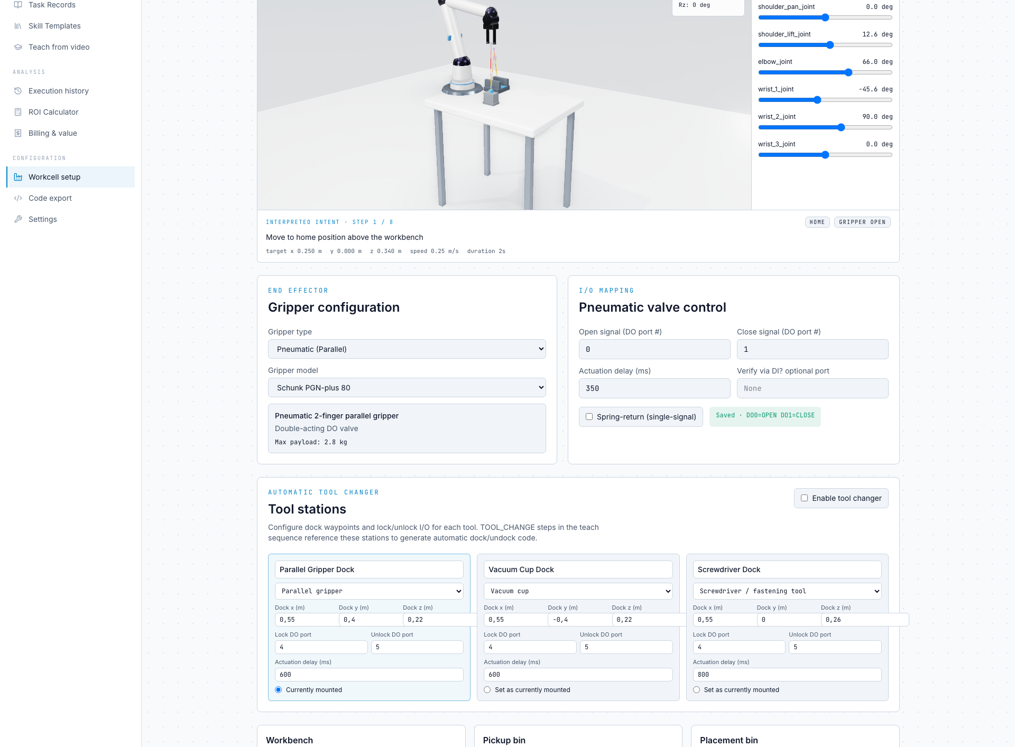
TRUST LAYER
The product is designed to make AI-generated automation reviewable.
Version-bound review
A trust record binds to the exact task version and policy fingerprint.
Required evidence
Simulation review, risk assessment, safeguards, emergency behavior, supervised trial.
Qualified decision
Approval or rejection is appended to an audit history; changed policies invalidate approval.
Source basis: docs/DEPLOYMENT_TRUST_LAYER.md.
Aurevix by Agentic Convergent · investor deck
07

Slide 8
MOAT
The Automation Passport is the memory layer that compounds.
Video teaching is the wedge. The durable asset is a portable record of task intent, constraints, validation, changes, and approvals.
Task intent
Cell constraints
What the work is supposed to accomplish, not only waypoints.
Robot, gripper, frames, I/O, fixtures, safety limits.
Validation history
Cross-brand export
What passed, what failed, who approved, and when.
Reuse the task record across supported robots and workcells.
Moat claim to prove: customers grant data rights and the system learns from real validation outcomes across tasks and robot brands.
Aurevix by Agentic Convergent · investor deck
08

Slide 9
TRACTION
The first design partnership is signed. Now convert it into quantified deployment proof.
Known signal
Investor-grade proof package
First industrial design partner
Paid / unpaid
State precisely. Do not inflate design access into ARR.
Scoped and scheduled
Machine tool and automation profile, with names announced only after approval.
Robot model, task, gripper, baseline, target deployment date.
Measured before/after
Baseline retasking time vs. Aurevix time, attempts, failures, review time.
Source basis: live site design-partner section and docs/pitch-stress-test.md.
Aurevix by Agentic Convergent · investor deck
09

Slide 10
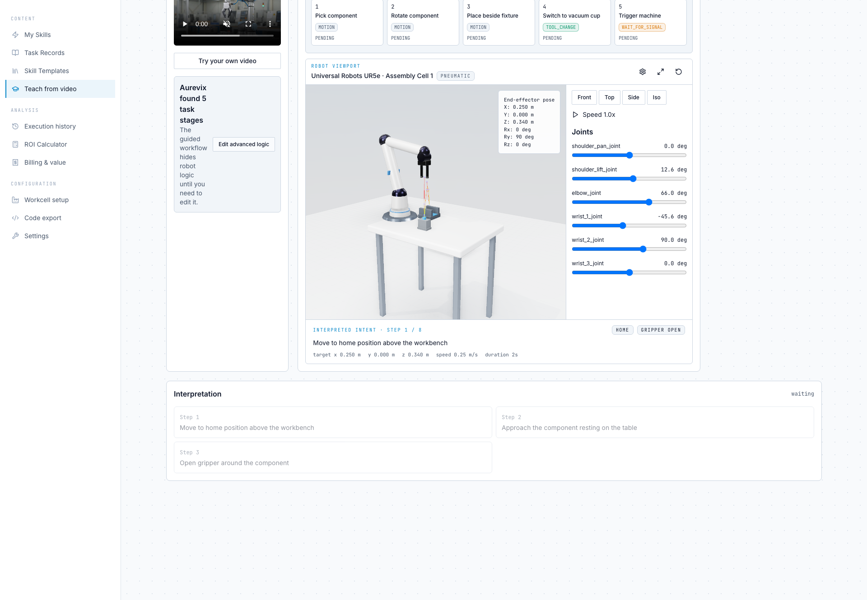
WHY NOW
Physical AI makes motion easier. Factories still need trust, ownership, and proof.
The opening is above the model: capture the task, validate it, preserve it, and export it into the robot runtime the customer already owns.
Robotics labor gap
Factories need more automation without more scarce robot programmers.
Foundation-model tailwind
VLA progress creates belief that task teaching is possible.
Safety pressure
More autonomy raises the need for human oversight, audit trails, and versioned approvals.
Installed-base wedge
Brownfield factories want flexibility without buying one vendor's new hardware stack.
Aurevix by Agentic Convergent · investor deck
10

Slide 11
COMPETITION
Aurevix is not trying to be a universal robot OS.
The wedge is narrower and more survivable: own the task-intent and deployment-trust layer, then export into the runtime.
Hardware players
Platform players
Aurevix lane
Standard Bots, OEMs
Wandelbots, Intrinsic, RoboDK
Operator-owned task memory
Strong distribution, but locked to their own cells or brand economics.
Broad tooling, but oriented to engineers, digital twins, or offline programming.
Video-native intent capture + deploy-readiness gate + Automation Passport.
Competitive claim should be verified against current public positioning before sending to funds. The deck avoids unsourced vendor benchmark claims.
Aurevix by Agentic Convergent · investor deck
11

Slide 12
BUSINESS MODEL
Pricing should capture avoided retasking cost without creating per-task anxiety.
Starter
Professional
Integrator
One factory, one robot, core video teaching, unlimited task changes.
Up to five robots, grippers, multi-step sequencing, guided onboarding.
Partner enablement, co-deployment support, channel margin, volume pricing.
NO PER-TASK FEES
RECOMMENDED
CHANNEL PATH
Next proof: disclose ACV targets, support cost, expected gross margin, and the replacement budget for the first ten customers.
Source basis: live site pricing section. Exact prices are under design-partner review and not claimed here.
Aurevix by Agentic Convergent · investor deck
12

Slide 13
MILESTONES
A pre-seed round should buy deployment proof, not just more demo surface.
0-3 months
Design-partner proof
One scoped task: baseline, generated plan, simulation, human review, supervised result.
3-9 months
Repeatability
Five paid deployments, 20 validated task records, two supported task families.
9-18 months
Seed readiness
$250K ARR target, measurable support load, data-rights template, repeatable channel.
Ask placeholder: raise enough to convert signed access into measured deployment evidence. Insert round size, valuation logic, and runway once confirmed.
Aurevix by Agentic Convergent · investor deck
13

Slide 14
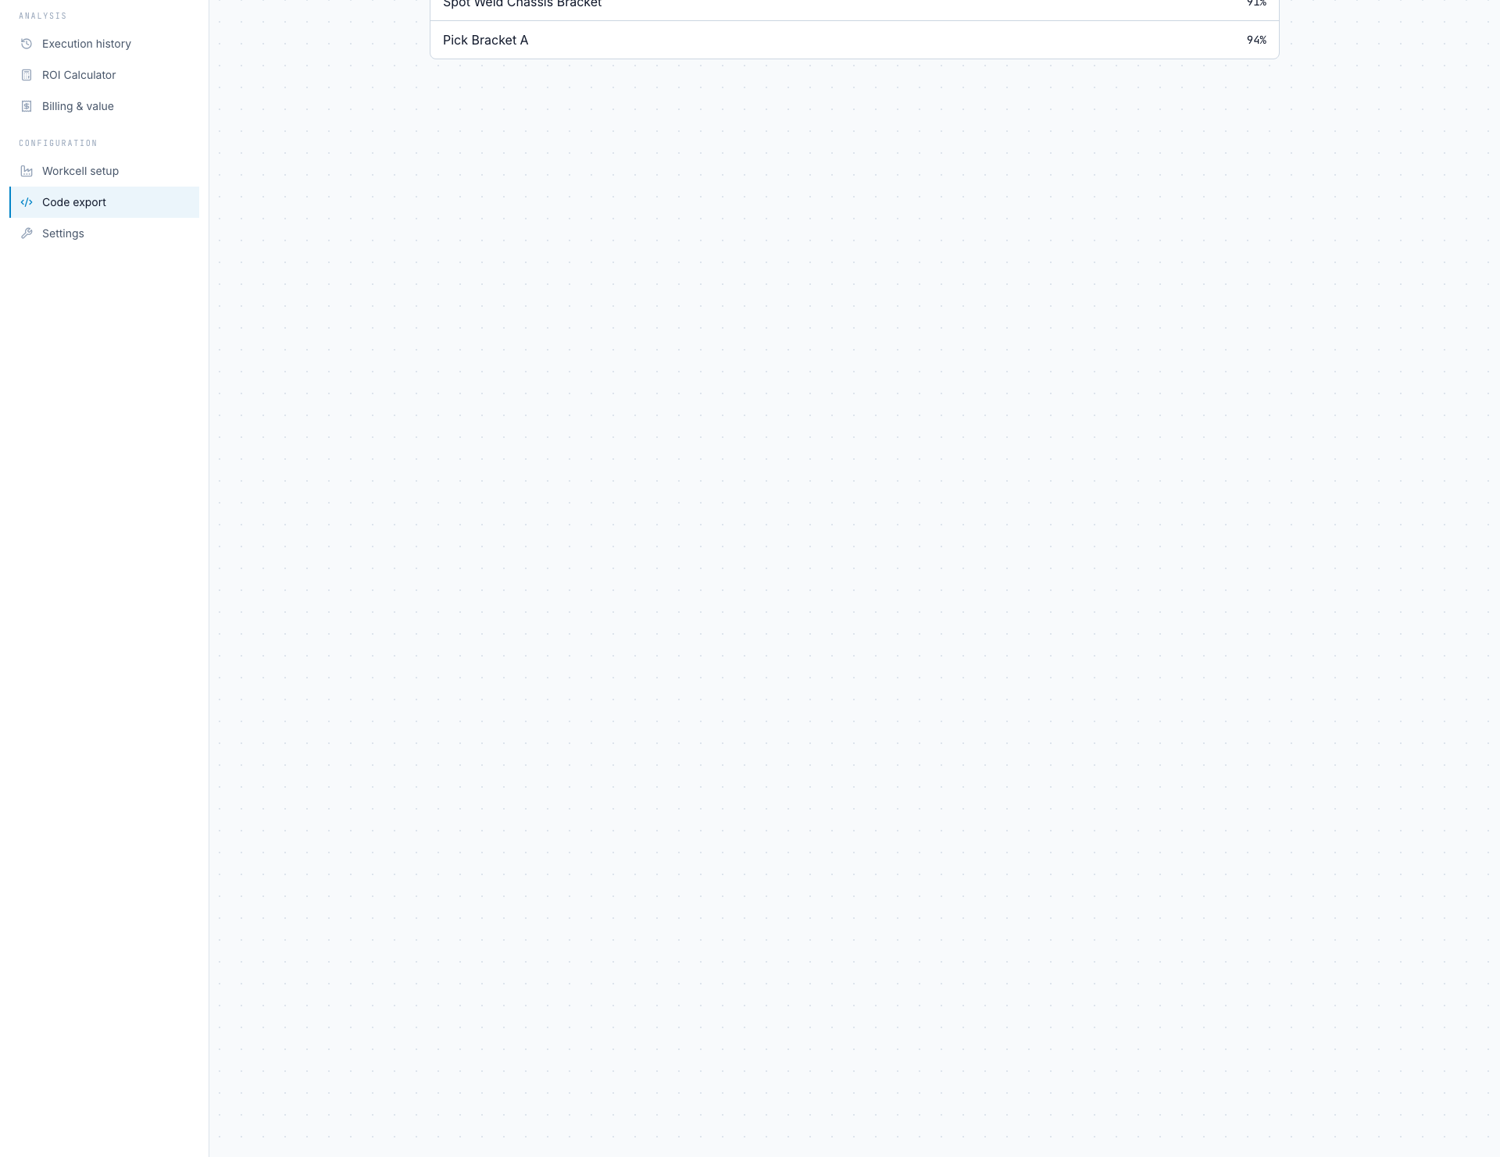
CLOSE
Start by retasking one robot from a video. End with the factory's automation memory.
What we believe
The next industrial software platform will not be the company with the most impressive demo. It will be the company factories trust to capture, validate, approve, and remember work.
Assumptions to verify before sending: paid/scoped/scheduled/referenceable design-partner status; bottom-up SAM; ACV and support costs; customer data-rights; exact round ask.
Aurevix · confidential · assumptions marked for founder verification
14

