Slide 1


How Much Event Data Is Enough?
A Statistical Framework for Process Model Discovery
Martin Bauer, Arik Senderovich, Avigdor Gal,
Lars Grunske, Matthias Weidlich

Slide 2

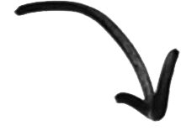

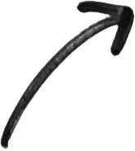

Processes and Events
Automated control
of business processes
Event logs:
Timestamps
Case IDs
Activity IDs
…
Recording of process
execution information
<number>

Slide 3
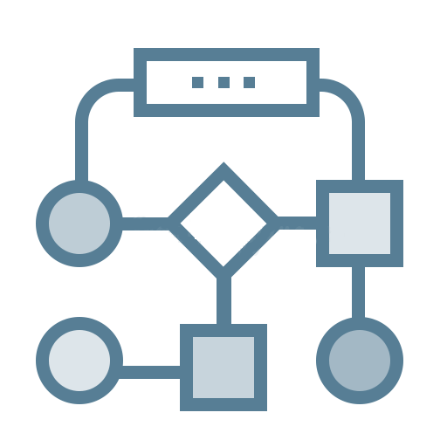

The Question of Process Discovery
Discovery
Event log
Process model
Efficiency of process discovery becomes increasingly important
Pervasiveness of data sensing/logging
=> Large-scale event logs
Tuning a large range of parameters of discovery algorithms
=> Repeated, exploratory analysis
Software-as-a-Service solutions for process discovery
=> Online handling of event logs
<number>
Notes:
<number>

Slide 4
A View on Related Work
Plethora of discovery algorithms [Augusto et al. 2017]
Striving for scalability
By divide-and-conquer: Decompose the discovery problem [van der Aalst & Verbeek 2015]
By parallelization and distribution [Wang et al. 2015, Evermann 2016]
Recently: Idea of sampling event data [Busany & Maoz 2016]
<number>

Slide 5



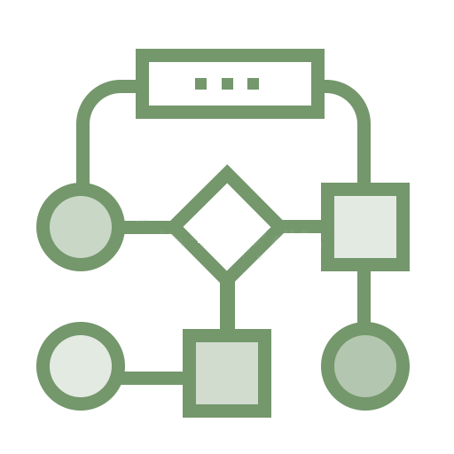

Daring the Gap
Discovery
Sampling
Guarantees?
Discovery
How to determine how much of an event log to use to discover a process model?
<number>

Slide 6
Agenda
Background and Related Work on Process Discovery
A Statistical Framework for Process Discovery
Log sampling
Framework definition
Instantiating the Framework
For control-flow discovery
For performance discovery
Experimental Results
<number>

Slide 7
Log Sampling
We want to stop when new information is unlikely
Log L, sampled Log
Trace abstraction function Ψ(ξ)
boolean predicates γ(L’ ,ξ)
γ(L’ ,ξ) Ψ(ξ) Ψ(ξ’)
γ(L’ ,ξ) d( Ψ(ξ), Ψ(ξ’) ) > ε
is (δ, ε, Ψ)-discovery sufficient if for newly sampled trace ξ:
P(γ(L’,ξ) = 1) < δ
This is our Stopping criteria!
$L'⊆L$
$⇔$
$∉$
$∪$
$⇔$
$∪$
$L'⊆L$
<number>

Slide 8
Minimum Sample Size
„The longer we see no new information, the more likely it is that we have seen everything we need“
Each consecutive Trace Sampling until new Information is a binomial trial (parameters p, k, N)
Interval estimation can compute bounds for unknown p
rearranging interval for N, setting k=0, and p=δ we can compute smallest N for which p<δ holds
BILD DER FORMEL
For α=0.01 and δ=0.05 => N_min=128
After 128 consecutive trials without new information we stop
<number>

Slide 9
Sampling as multiple Binomial Trials
Trace # | Activities | New Info? | New binTrial? | Stop Sampling
1 | A,B,C | Yes | Yes | No (1)
2 | A,B,C | no | No | No (2)
3 | A,B,D | Yes | Yes | No (1)
4-120 | A,B,D | no | no | No (117)
121 | A,B,E | Yes | Yes | No (1)
122-250 | A,B,E | no | no | Yes (128)
<number>

Slide 10
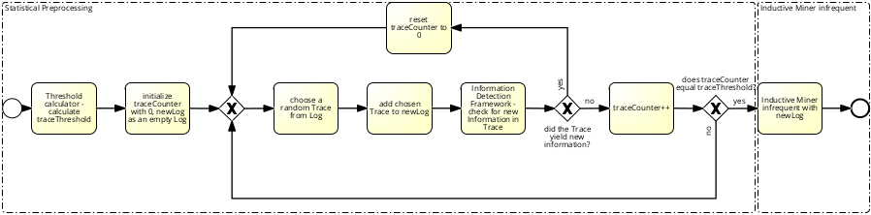
Framework
<number>

Slide 11
Agenda
Background and Related Work on Process Discovery
A Statistical Framework for Process Discovery
Log sampling
Framework definition
Instantiating the Framework
For control-flow discovery
For performance discovery
Experimental Results
<number>

Slide 12
Control-Flow Perspective
A notion of “new control-flow information”
New activity
New directly-follows dependency
New initial or final activity
What about frequencies?
Determine on sample (no guarantee on δ-similarity)
Changes in relative frequencies are “new information”
Trace | New Information
A, B, C | Activity, Start, End, DF
A, B, D | Activity, End, DF
B, C, C | Start, DF
A, B, C, C | -
<number>

Slide 13
Performance Perspective
Focus on cycle time of a process, a fine-grained numerical value
A notion of “new cycle-time information”
Cycle time is more than ε-different
Measuring granularity:
Per complete process
Per individual activities
A (30 ms), A (30 ms), A (30 ms)
A (30 ms, A (30 ms)
A (30 ms), A (10 ms)
A (5 ms) A (25 ms)
<number>

Slide 14
Agenda
Background and Related Work on Process Discovery
A Statistical Framework for Process Discovery
Log sampling
Framework definition
Instantiating the Framework
For control-flow discovery
For performance discovery
Experimental Results
<number>

Slide 15

Setup
Datasets
BPI Challenge 2012
Loan/overdraft applications
>262k events of >13k traces
BPI Challenge 2014
Incident management at Rabobank Group ICT,
>343k events of >46 traces
Discovery algorithm
Inductive Miner Infrequent [Leemans et al. 2013]
Noise threshold set to 20%
Approach implemented as a ProM plugin (@Github)
Measures
Pre-processing effectiveness: #traces sampled
Actual efficiency: runtime, memory footprint
Discovery effectiveness: fitness, approximated cycle time
<number>

Slide 16
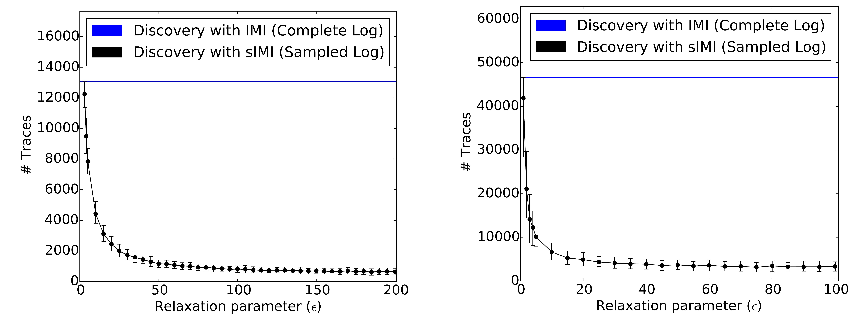
Pre-Processing Effectiveness
BPI-2012
BPI-2014
Drastic reduction of number of traces considered for discovery
Trend is consistent for different datasets
<number>

Slide 17
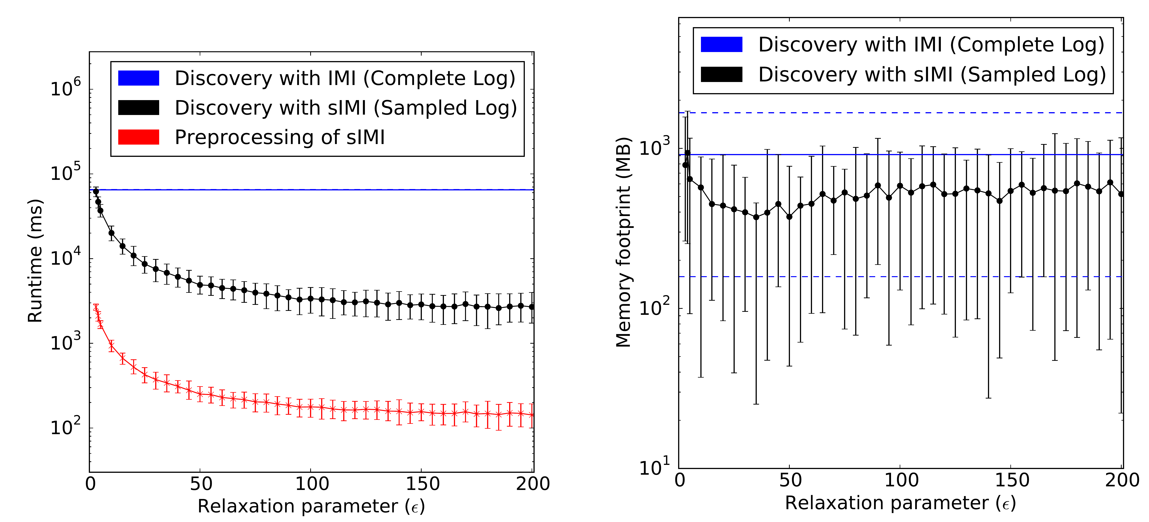
Runtime and Memory Footprint
Pre-processing is efficient
Significant reduction of overall resource utilisation
<number>

Slide 18
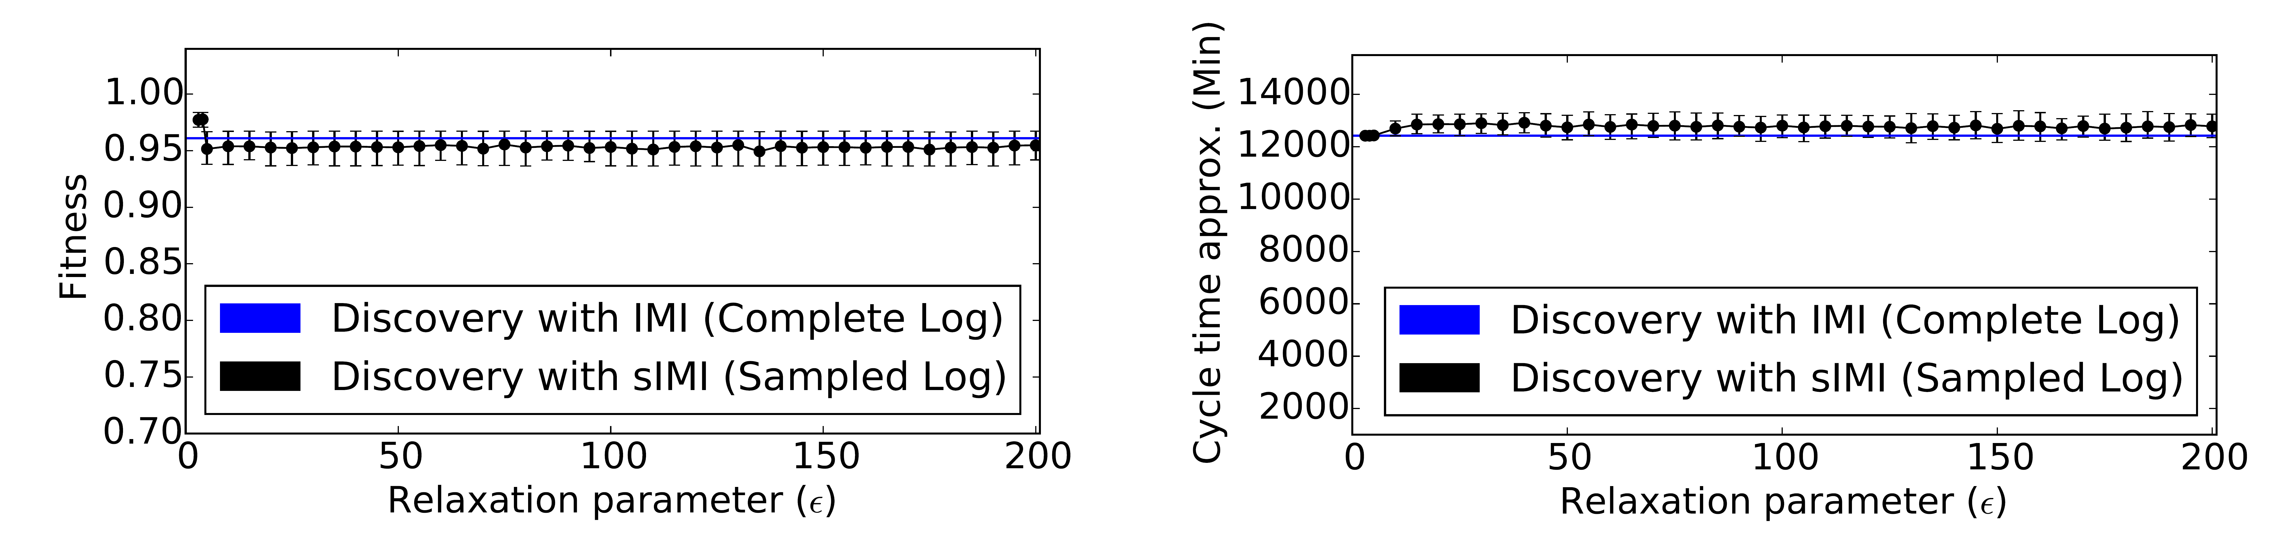
Discovery Effectiveness
Negligible degradation of discovery quality
For control-flow fitness
For the cycle time approximation
<number>

Slide 19
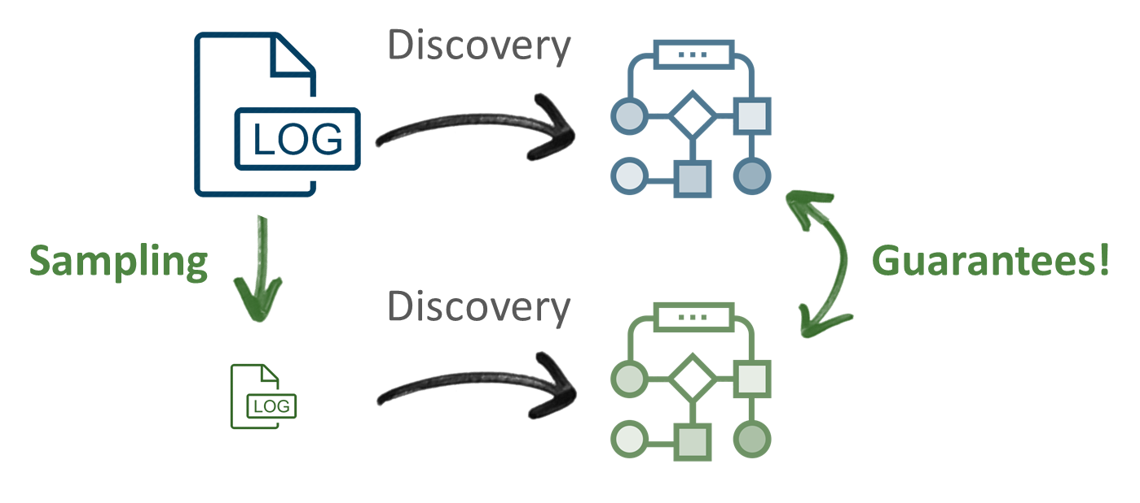
Conclusions
Framework for statistical
process discovery
Sample an event log
Guarantees on the
introduced error
Instantiation for control-flow and performance aspects
Next: Additional model perspectives
Thank you!
<number>

Slide 21


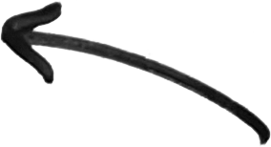
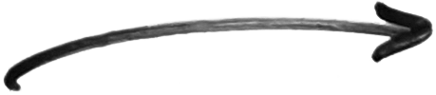

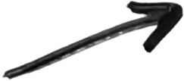
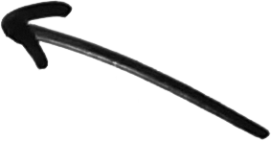
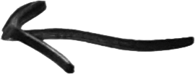
Notes:
Arrow Elements
<number>

