Slide 1
Spatial data and analysis in R
ESM – CDAT course series
Martin Jung, PhD (jung@iiasa.ac.at)

Slide 2
Course plan
Introduction talk
(14 - 15pm, 22th October 2020)
Self study tutorials
(online self paced, link at end of slides)
All slides and materials online

Slide 3







What is GIS?
A geographic information system (GIS) is a system designed to capture, store, manipulate, analyze, manage, and present types of geographical data.

Slide 4
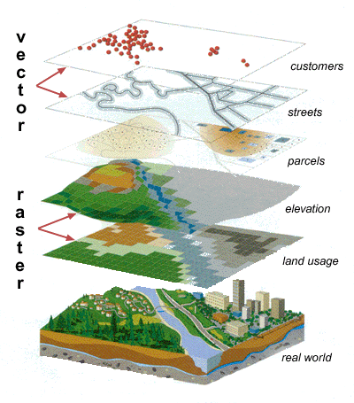
Types of spatial data
Format:
*.shp, *.gpkg, *.gpx, *.kml, ...
Format:
*.tif, *.vrt, *.hdr, *.asc, ...
Source: maprabu.blogspot.com

Slide 5
Vector
Advantage: Accuracy, more visually pleasing
Disadvantage: Space-inefficient. Every vertex needs to be stored. Algorithms computational intensive.
Raster
Advantage: Geogr. Position associated with data, easier for analysis
Disadvantage: Resolution dependent on cell-size. Lack of attributes, MAUP
Notes:
Google, Bing, Openstreetmaps, ... ( OpenLayers plugin)
WMS server, for instance the EEA WMS services
http://discomap.eea.europa.eu/home.html
Can be loaded into QGIS as WMS layer

Slide 6






Spatial databases
SpatiaLite
PostgreSQL & PostGIS
And many more…

Slide 7


Stop using shapefiles!
Multifile system (.shp,.shx,.dbf,.prj, … )
Limited to 2GB (4GB)
Attribute names limitation
Etc...
http://switchfromshapefile.org/
Solution → OGC Geopackages

Slide 8
Why use R for spatial analyses?
Open source
Efficiency (‘Don’t repeat yourself’)
Cross system availability (Win,*Nix, MacO$
Extendable and rich functionality
Clean coding (also for ‘tidy’ data concept)
Parallel computing support
Integration of C, C++ code for speed

Slide 9
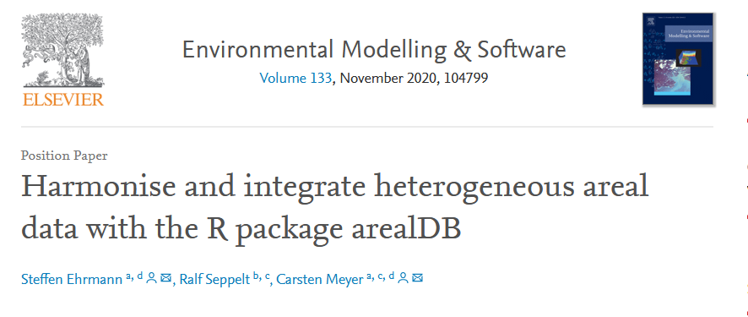
Many spatial packages
Source: https://doi.org/10.1016/j.envsoft.2020.104799

Slide 10
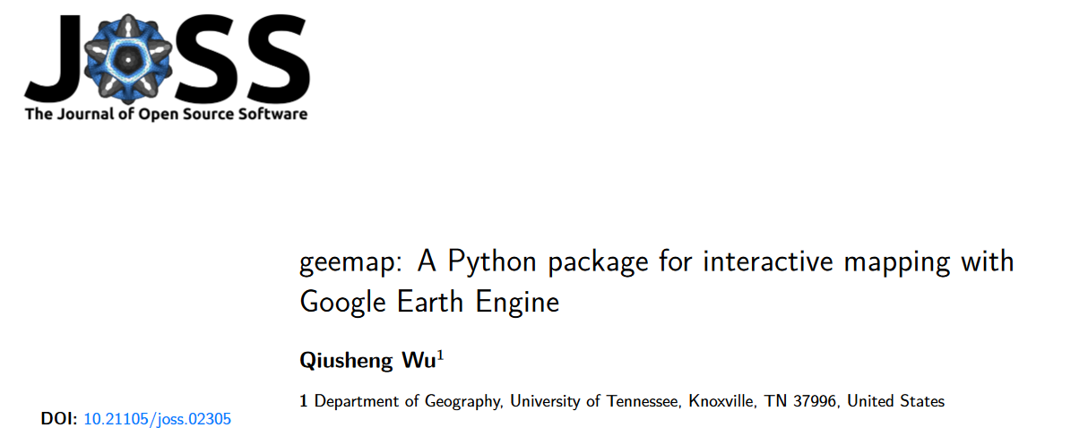

Slide 11
One comprehensive list of spatial packages
https://cran.r-project.org/web/views/Spatial.html

Slide 12
Why/When not to use R for spatial analyses?
R can be slow
Many (sp) packages not memory efficient
Often little support
No GUI
Greater proficiency in other languages

Slide 13
(Personal opinion)
The diversity of open source GIS solutions is both its greatest strength and weakness

Slide 14
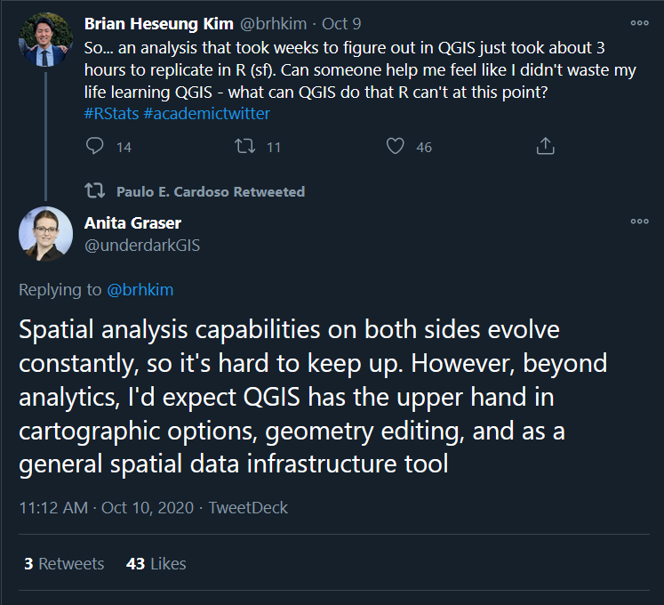

Slide 15




The backbone of most open-source GIS
Standards like WMS, KML, GML, SFC
C/C++ libraries

Slide 16
R as a GIS
Main packages: ‘sp’, ‘raster’ and ‘rgdal’ still go-to functions to use
Problem: Each have their own object-based model, often inefficient code

Slide 17
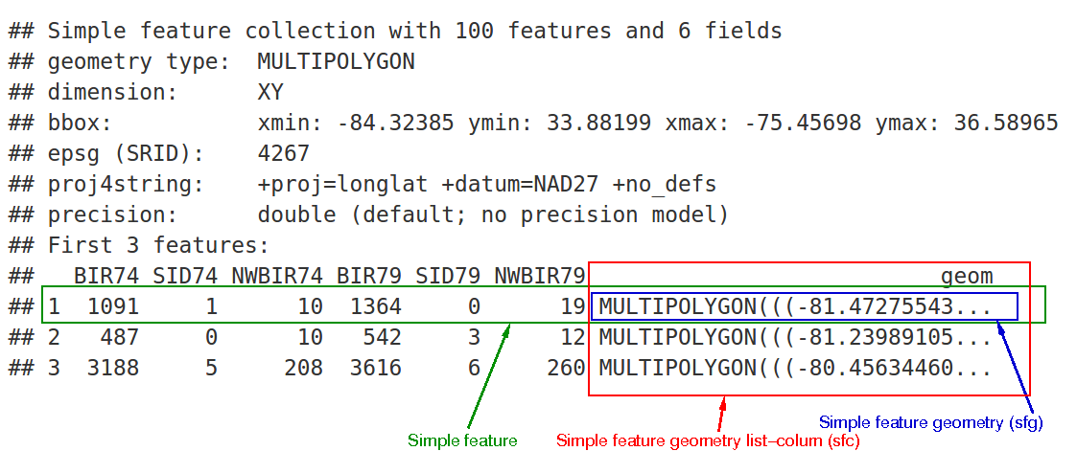
Tidy data and simple features
Simple Features are a set of OGC standards how spatial (vector) data is to be stored
Source: https://r-spatial.github.io/sf/articles/sf1.html

Slide 19
Common spatial tasks I do in R
Aligning raster input data
Extracting zonal statistics
Joining spatial and non-spatial
data

Slide 20

What to do if things don’t work
Too slow
→ Check memory requirements, consider tiling
No Function
→ Check external tools. Is there a wrapper?
Visualization
→ Use QGIS for quick queries

Slide 21
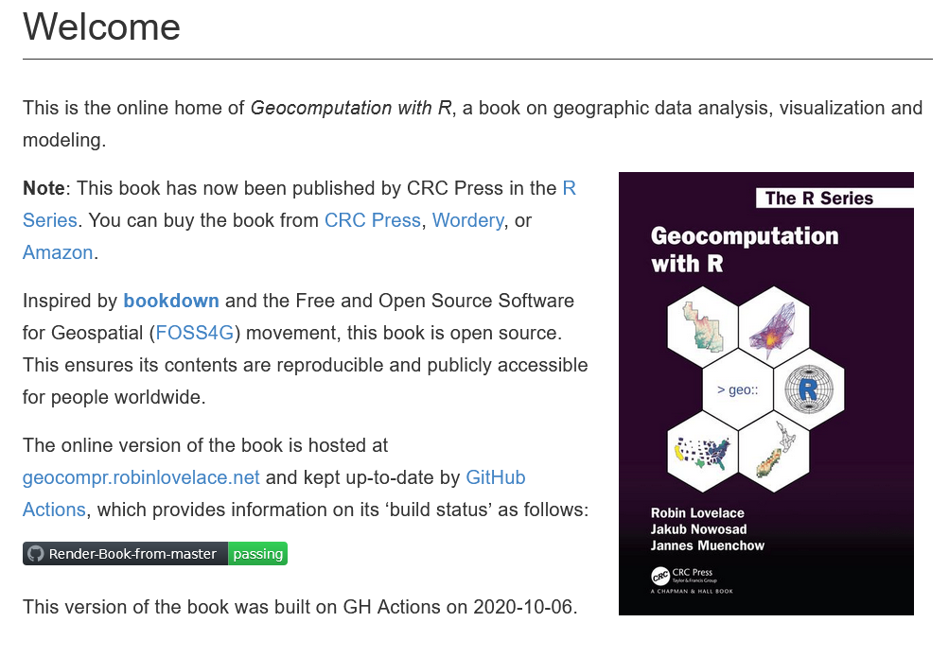
Free online books and materials
https://geocompr.robinlovelace.net/index.html

Slide 22
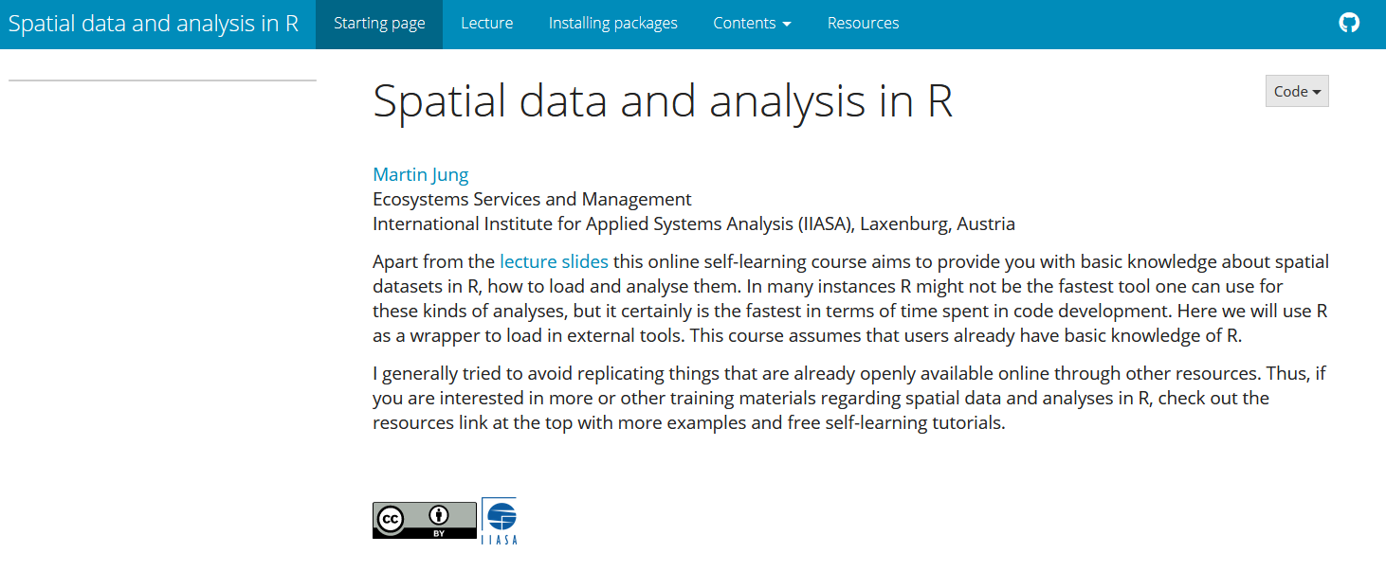
Online course materials
<URL>

Slide 23
Thank you for your attention. Good success with your spatial data!

