Slide 1
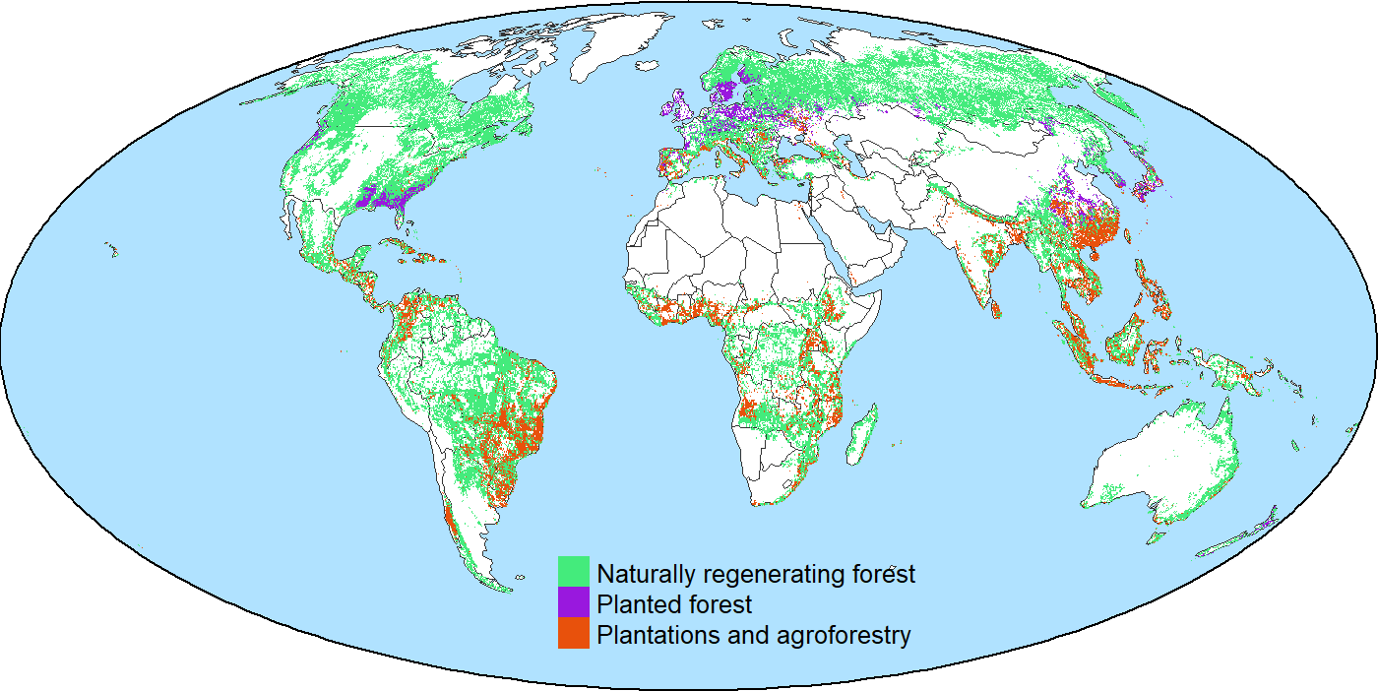
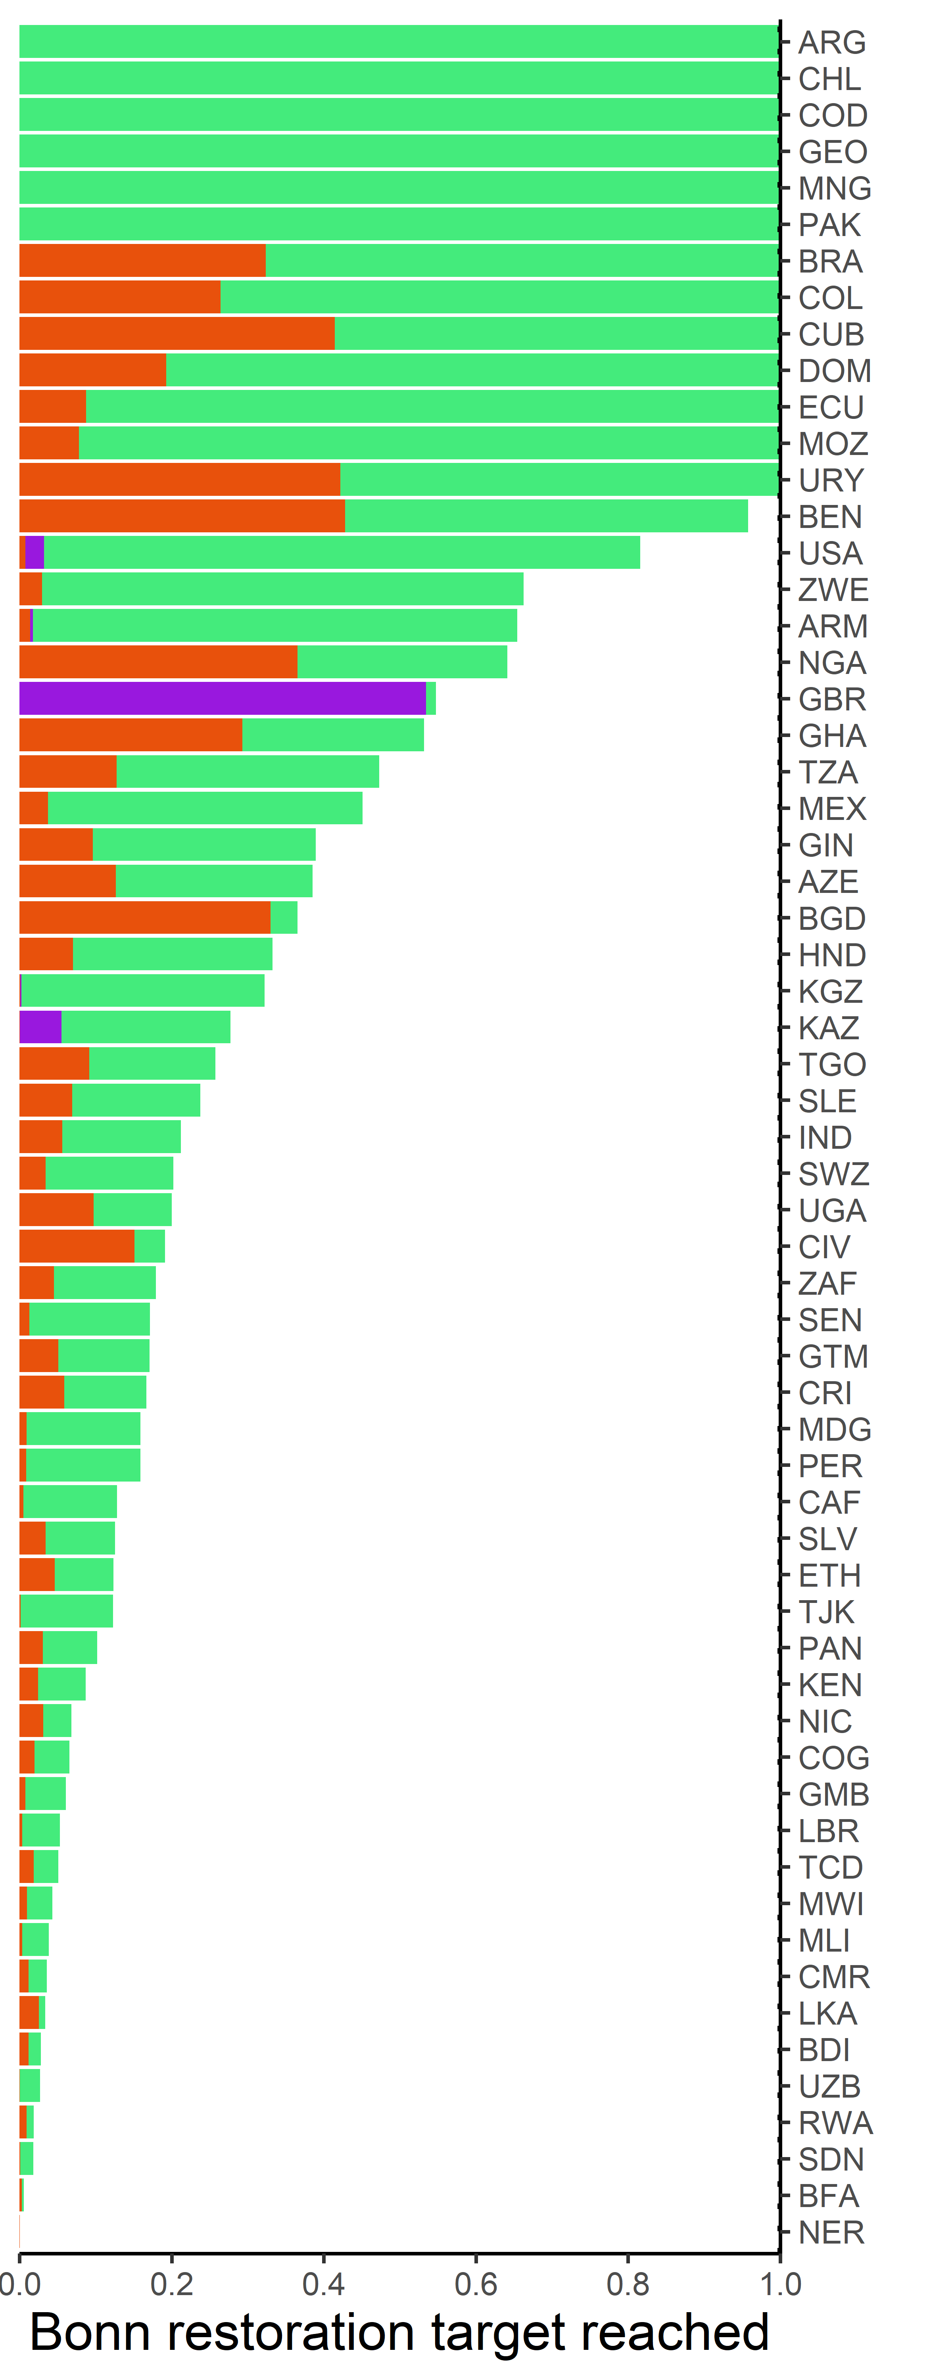
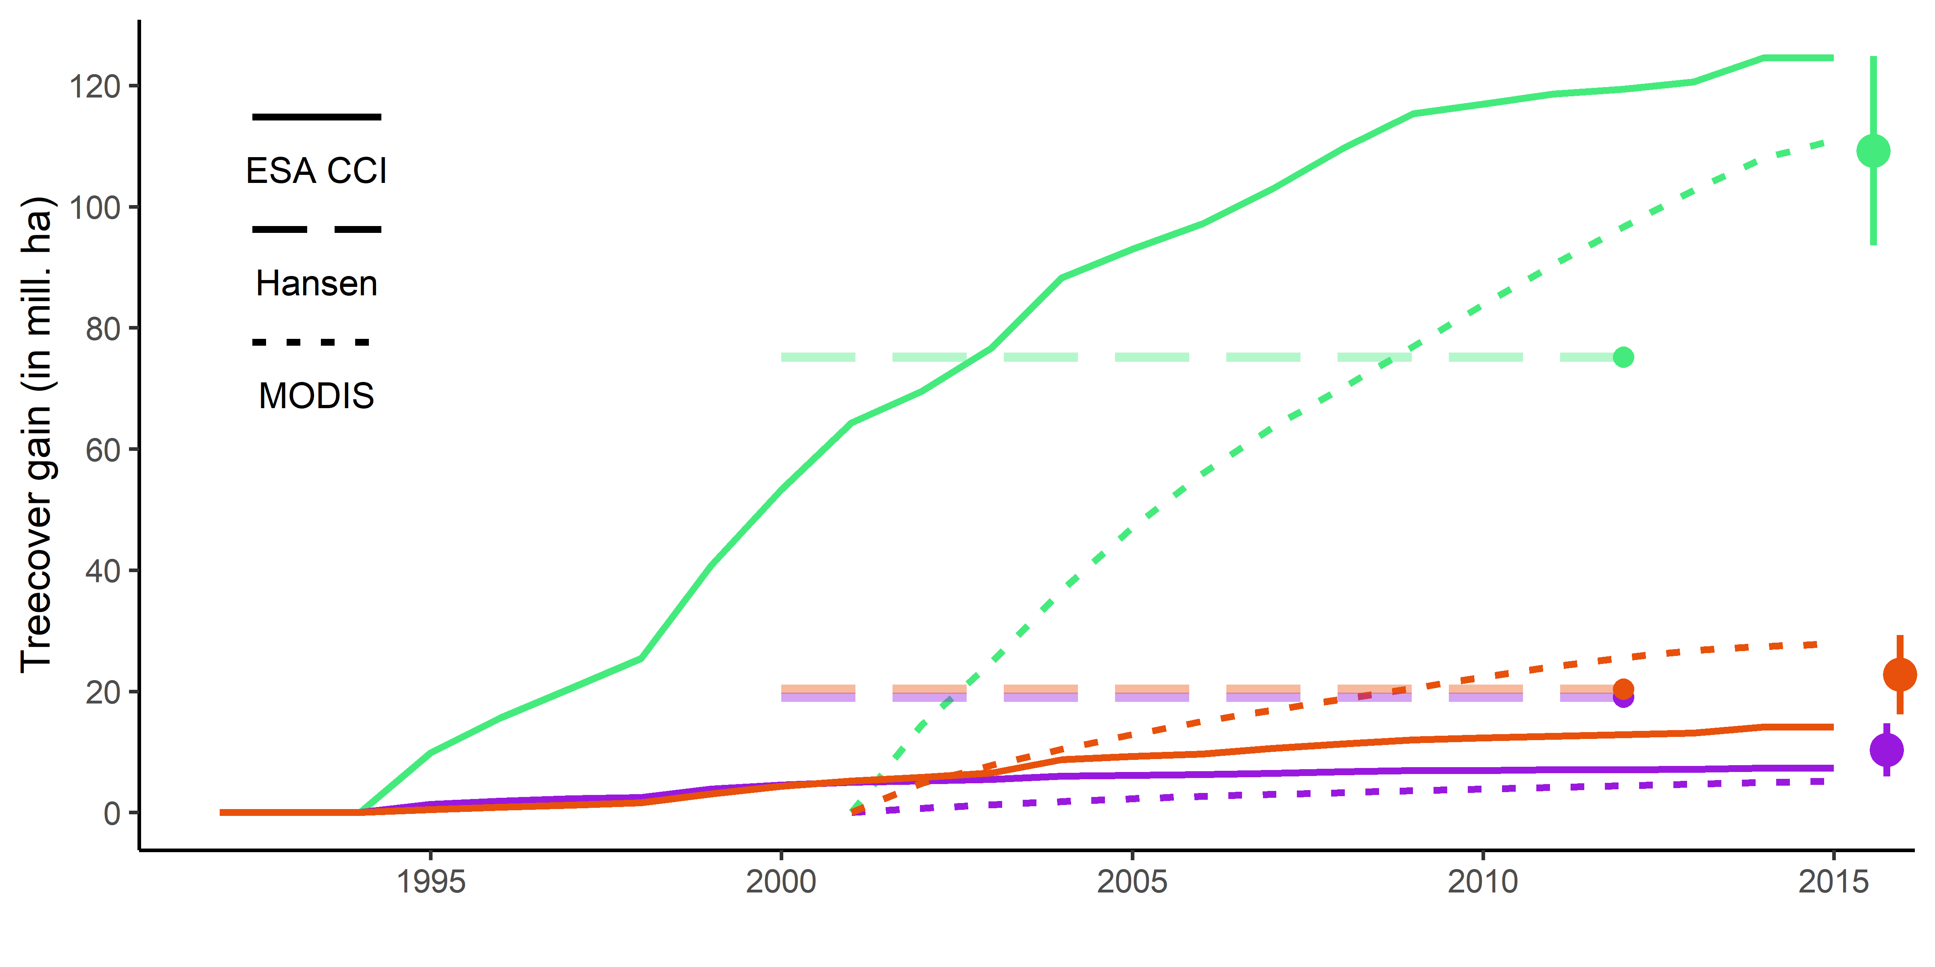
a
c
b

Slide 2
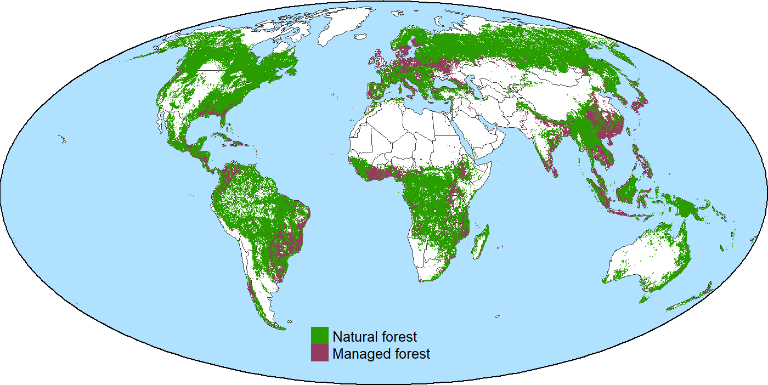

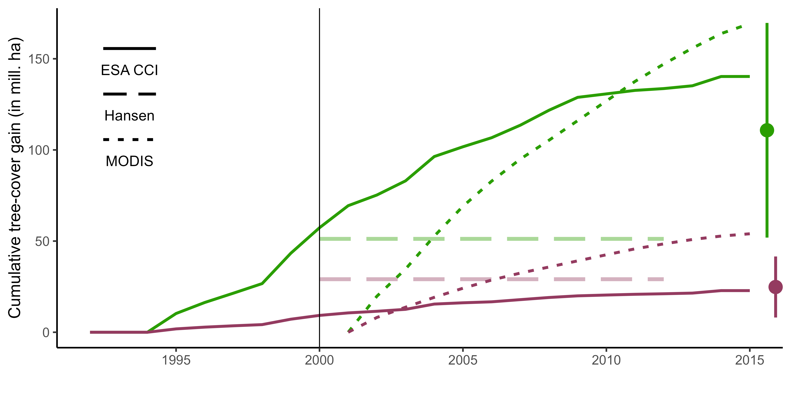
a
c
Tree cover gains in countries with Bonn restoration pledges
b

Slide 3
a
c
Forest cover gains in countries with Bonn restoration pledges
b

