Slide 1
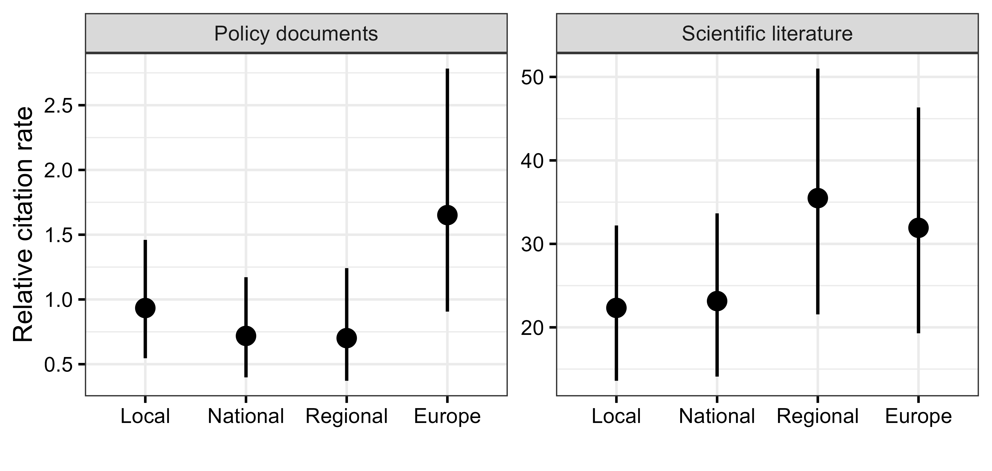
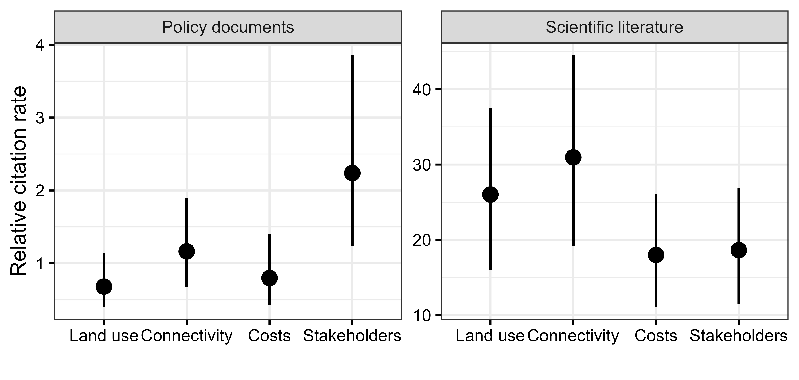
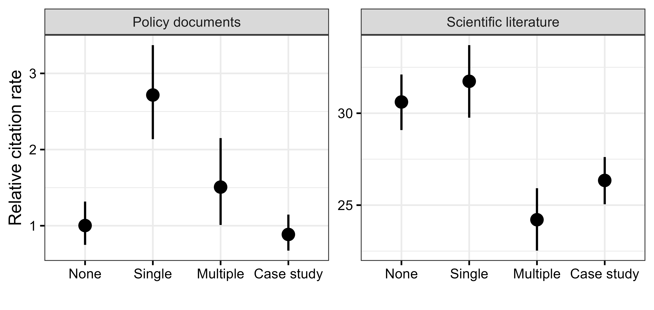
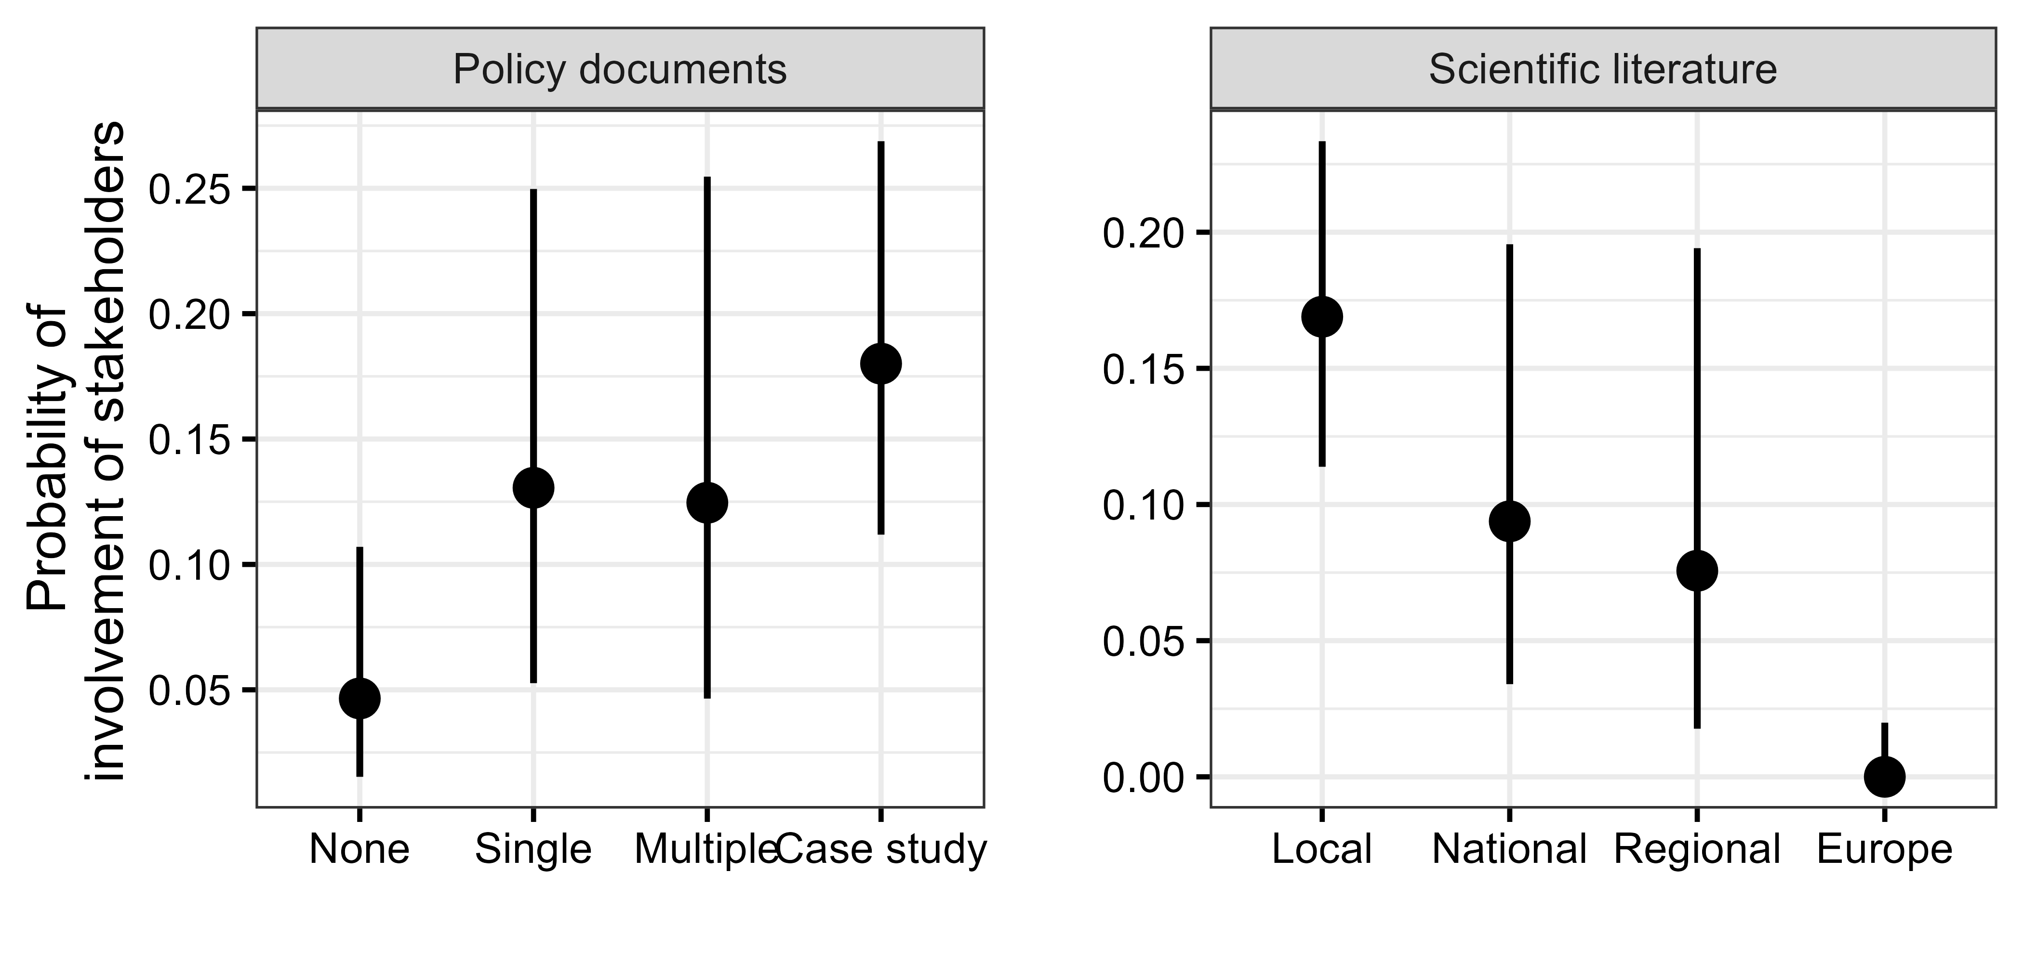
Are the number of citations of conservation planning literature affected by study extent?
Are studies with greater complexity or considered factors more often cited?
Are studies that explicitly refer or make reference to policy goals more often cited?
Is the likelihood that a study included stakeholders dependent on policy goals or scale?

Slide 2
a
Sampling extent
b
Complexity factors
c
Policy reference
d
Probability of stakeholder involvement

