Slide 1
PhD chapter XX (Recycle idea I1 Spectral diversity)

Slide 2
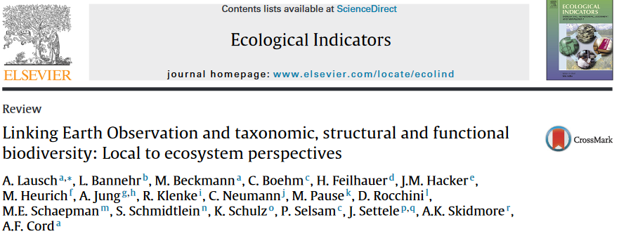
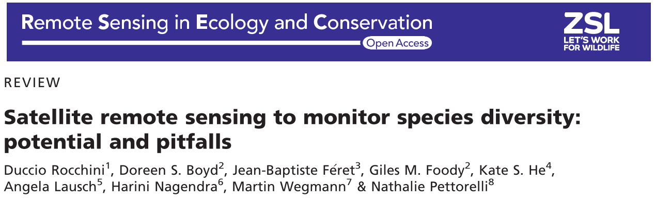
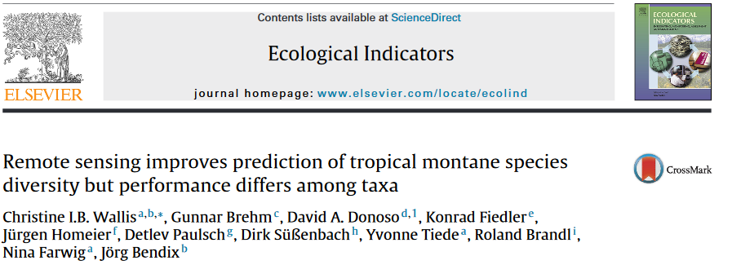
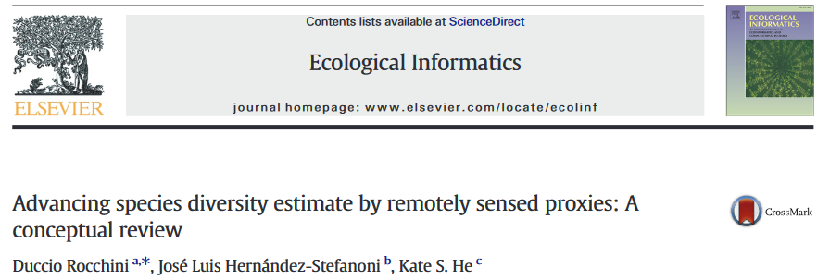
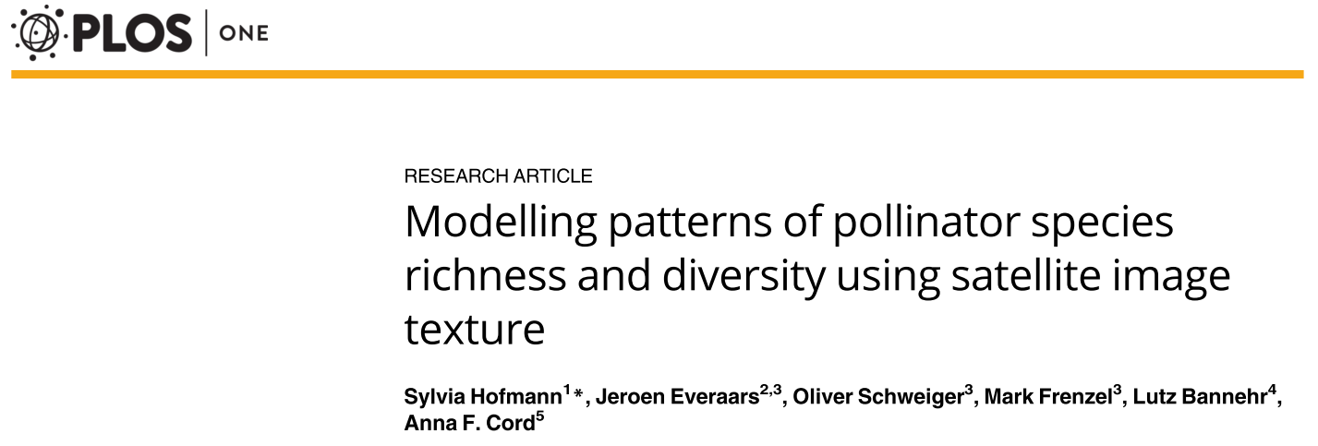
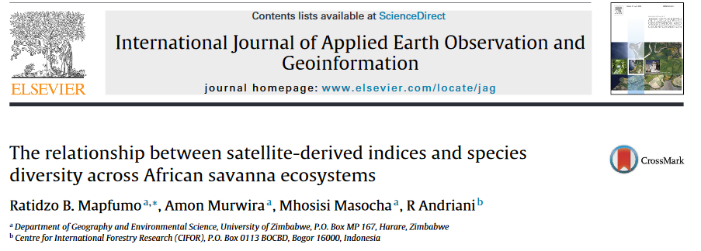

The use of spectral indices to predict biodiversity

Slide 3
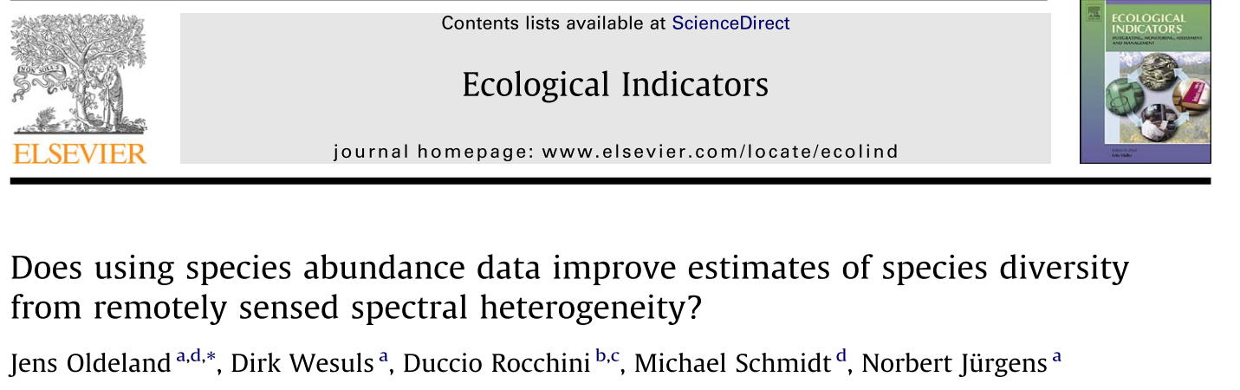
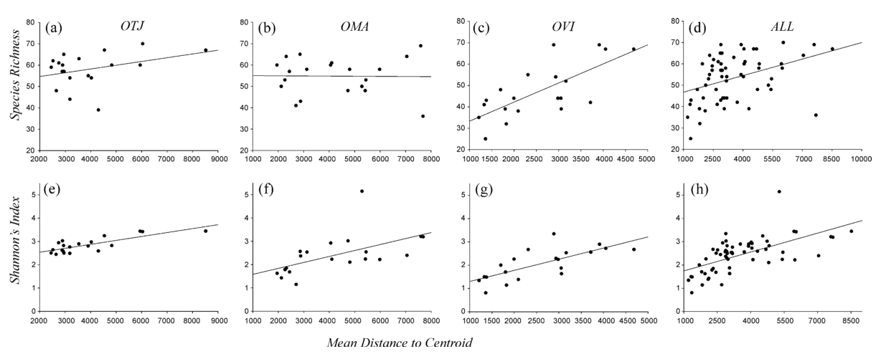

Slide 4
Overall predictive power
Lafage et al. 2014 - NDVI – R2 up to 0.61
Levin et al. 2007 – NDVI – Spearmon rho up to 0.93
Hobi et al. 2017 – multiple - R2 between 0.53 and 0.73
Sweet et al. 2015 – NDVI – R2 up to 0.87
John et al. 2008 – multiple R2 up to 0.4
(also differentiated between climate regions)
…

Slide 5
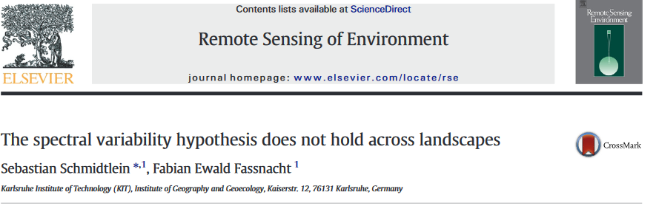
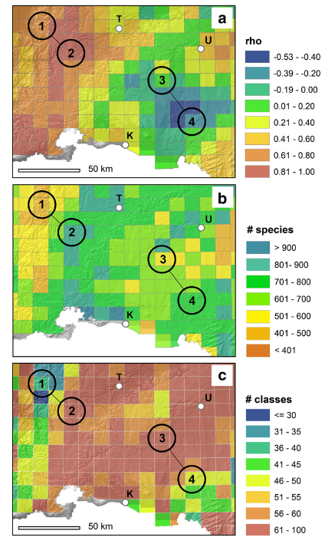
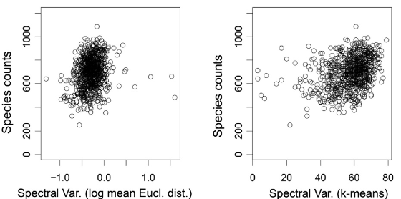
But also

Slide 6
How useful / powerful is remote-sensing in predicting biodiversity ?

Slide 7
Aim
Assessing spectral diversity hypothesis using Landsat texture metrics & PREDICTS across taxonomic groups
Assess where and where not the spectral-diversity hypothesis is working
Difference to previous publications:
Landsat based and across multiple taxonomic groups
Test both abundance based and richness based estimators
Difference to pairwise piece:
Run on a study-by-study basis and avoid PREDICTS model structure
Texture metric instead of turnover
No temporal element (no dynamics)

Slide 8
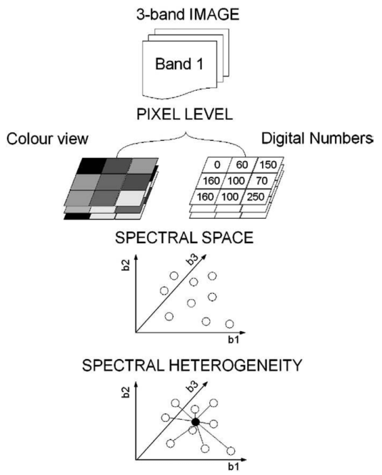
Methods
PREDICTS studies and local biodiversity records
First and second axis of PCA from all bands of
MVC
Mean distance to centroid
Multiple linear models at study level (!)

Slide 9
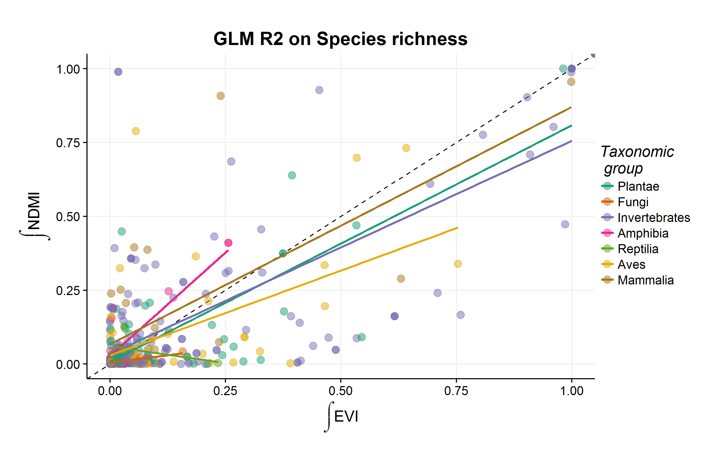
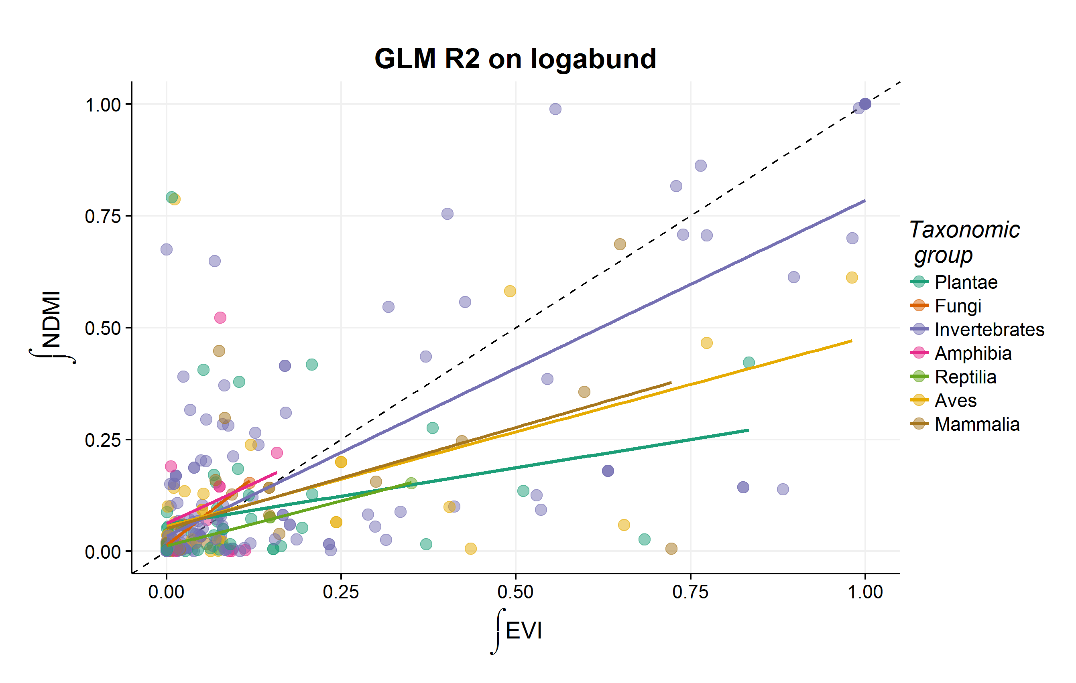
Output (similar as done before)
Differentiate by spectral centroid on PCA scores, but also NDVI.
Separate by Biome / Climate zone / latitude / monitoring technique

Slide 10
Time plan
Data collection/
preparation
Analysis
Write up
For
Ecological indicators
08 / 2018 < -- > 09 / 2018 (or when I am bored)

Slide 11
Any comments?

