Slide 1
Approximation Algorithms
Q. Suppose I need to solve an NP-hard problem. What should I do?
A. Theory says you're unlikely to find a poly-time algorithm.
Must sacrifice one of three desired features.
Solve problem to optimality.
Solve problem in poly-time.
Solve arbitrary instances of the problem.
ρ-approximation algorithm.
Guaranteed to run in poly-time.
Guaranteed to solve arbitrary instance of the problem
Guaranteed to find solution within ratio ρ of true optimum.
Challenge. Need to prove a solution's value is close to optimum, without even knowing what optimum value is!

Slide 2
11.1 Load Balancing

Slide 3
Load Balancing
Input. m identical machines; n jobs, job j has processing time t_{j}.
Job j must run contiguously on one machine.
A machine can process at most one job at a time.
Def. Let J(i) be the subset of jobs assigned to machine i. The
load of machine i is L_{i} = Σ_{j ∈ J(i)} t_{j}.
Def. The makespan is the maximum load on any machine L = max_{i} L_{i}.
Load balancing. Assign each job to a machine to minimize makespan.

Slide 4
Load Balancing: List Scheduling
List-scheduling algorithm.
Consider n jobs in some fixed order.
Assign job j to machine whose load is smallest so far.
Implementation. O(n log n) using a priority queue.
List-Scheduling(m, n, t₁,t₂,…,t_{n}) {
for i = 1 to m {
L_{i} ← 0
J(i) ← φ
}
for j = 1 to n {
i = argmin_{k} L_{k}
J(i) ← J(i) ∪ {j}
L_{i} ← L_{i} + t_{j}
}
}
load on machine i
jobs assigned to machine i
machine i has smallest load
assign job j to machine i
update load of machine i
Notes:
Remark. This is an "on-line" algorithm.

Slide 5
Load Balancing: List Scheduling Analysis
Theorem. [Graham, 1966] Greedy algorithm is a 2-approximation.
First worst-case analysis of an approximation algorithm.
Need to compare resulting solution with optimal makespan L*.
Lemma 1. The optimal makespan L* ≥ max_{j} t_{j}.
Pf. Some machine must process the most time-consuming job. ▪
Lemma 2. The optimal makespan
Pf.
The total processing time is Σ_{j} t_{j} .
One of m machines must do at least a 1/m fraction of total work. ▪
Notes:
Need to compare greedy solution with optimal makespan. Need good lower bounds on the optimal value.
Lower bound too weak in following case: one job is extremely long relative to sum of all processing times. If sufficiently extreme, optimal solution will place long job on a machine all by itself and it will be last to finish. In this case, greedy will do well, but first lower bound will not establish this.

Slide 6
Load Balancing: List Scheduling Analysis
Theorem. Greedy algorithm is a 2-approximation.
Pf. Consider load L_{i} of bottleneck machine i.
Let j be last job scheduled on machine i.
When job j assigned to machine i, i had smallest load. Its load before assignment is L_{i} - t_{j} ⇒ L_{i} - t_{j} ≤ L_{k} for all 1 ≤ k ≤ m.
blue jobs scheduled before j
machine i
j
0
L_{i} - t_{j}
L = L_{i}

Slide 7
Load Balancing: List Scheduling Analysis
Theorem. Greedy algorithm is a 2-approximation.
Pf. Consider load L_{i} of bottleneck machine i.
Let j be last job scheduled on machine i.
When job j assigned to machine i, i had smallest load. Its load before assignment is L_{i} - t_{j} ⇒ L_{i} - t_{j} ≤ L_{k} for all 1 ≤ k ≤ m.
Sum inequalities over all k and divide by m:
Now ▪
Lemma 1
Lemma 2

Slide 8
Load Balancing: List Scheduling Analysis
Q. Is our analysis tight?
A. Essentially yes.
Ex: m machines, m(m-1) jobs length 1 jobs, one job of length m
machine 2 idle
machine 3 idle
machine 4 idle
m = 10
machine 5 idle
machine 6 idle
machine 7 idle
machine 8 idle
machine 9 idle
machine 10 idle
list scheduling makespan = 19

Slide 9
Load Balancing: List Scheduling Analysis
Q. Is our analysis tight?
A. Essentially yes.
Ex: m machines, m(m-1) jobs length 1 jobs, one job of length m
m = 10
optimal makespan = 10

Slide 10
Load Balancing: LPT Rule
Longest processing time (LPT). Sort n jobs in descending order of processing time, and then run list scheduling algorithm.
LPT-List-Scheduling(m, n, t₁,t₂,…,t_{n}) {
Sort jobs so that t₁ ≥ t₂ ≥ … ≥ t_{n}
for i = 1 to m {
L_{i} ← 0
J(i) ← φ
}
for j = 1 to n {
i = argmin_{k} L_{k}
J(i) ← J(i) ∪ {j}
L_{i} ← L_{i} + t_{j}
}
}
load on machine i
jobs assigned to machine i
machine i has smallest load
assign job j to machine i
update load of machine i

Slide 11
Load Balancing: LPT Rule
Observation. If at most m jobs, then list-scheduling is optimal.
Pf. Each job put on its own machine. ▪
Lemma 3. If there are more than m jobs, L* ≥ 2 t_{m+1}.
Pf.
Consider first m+1 jobs t₁, …, t_{m+1}.
Since the t_{i}'s are in descending order, each takes at least t_{m+1} time.
There are m+1 jobs and m machines, so by pigeonhole principle, at least one machine gets two jobs. ▪
machine i
j
m + 1
0
L_{i} - t_{j}
L = L_{i}
Notes:
j = last job scheduled on bottleneck machine.

Slide 12
Load Balancing: LPT Rule
Observation. If at most m jobs, then list-scheduling is optimal.
Pf. Each job put on its own machine. ▪
Lemma 3. If there are more than m jobs, L* ≥ 2 t_{m+1}.
Pf.
Consider first m+1 jobs t₁, …, t_{m+1}.
Since the t_{i}'s are in descending order, each takes at least t_{m+1} time.
There are m+1 jobs and m machines, so by pigeonhole principle, at least one machine gets two jobs. ▪
Theorem. LPT rule is a 3/2 approximation algorithm.
Pf. Same basic approach as for list scheduling.
▪
Lemma 3 ( by observation, can assume number of jobs > m )
Notes:
j = last job scheduled on bottleneck machine.

Slide 13
Load Balancing: LPT Rule
Q. Is our 3/2 analysis tight?
A. No.
Theorem. [Graham, 1969] LPT rule is a 4/3-approximation.
Pf. More sophisticated analysis of same algorithm.
Q. Is Graham's 4/3 analysis tight?
A. Essentially yes.
Ex: m machines, n = 2m+1 jobs, 2 jobs of length m+1, m+2, …, 2m-1 and 3 jobs of length m.
Notes:
Best known: PTAS, 4/3-analysis not too hard

Slide 14
11.2 The k-Center problem

Slide 15
The k-Center Problem
Input. Set of n sites s₁, …, s_{n} in the plane.
The k-center problem. Select k centers C so that maximum distance from a site to nearest center is minimized.
k = 4
r(C)
center
site

Slide 16
The k-Center Problem
Notation.
dist(x, y) = distance between x and y.
dist(s_{i}, C) = min _{c ∈ C} dist(s_{i}, c) = distance from s_{i} to closest center.
r(C) = max_{i} dist(s_{i}, C) = smallest covering radius.
Goal. Find set of centers C that minimizes r(C), subject to |C| = k.
Note. Center may be different from any site.
Remarks:
Only need to consider circles defined by 2 or 3 sites → O(n³) possible locations for centers → a brute-force algorithm runs in n^{O(k)} time.
Not known to be in FPT

Slide 17
1-Center
Trivial algorithm: Returning any site as the center is a 2-approximation!
Pf:
Euclidean space: trivial.
Metric space:
For any site s_{i},
dist(s_{i}, c) ≤ dist(s_{i}, c*) + dist(c*, c)
≤ r* + r* = 2r*.
Properties of a metric space:
dist(x, y) ≥ 0 (non-negativity)
dist(x, y) = 0 iff x = y (identity)
dist(x, y) = dist(y, x) (symmetry)
dist(x, y) ≤ dist(x, z) + dist(z, y) (triangle inequality)
r*
c*
c
2r*
Notes:
1-center can be solved optimally in O(n) time in constant dimensions.

Slide 18
Greedy Algorithm for k-Center: A False Start
Greedy algorithm. Put the first center at the best possible location for a single center, and then keep adding centers so as to reduce the covering radius each time by as much as possible.
Remark: arbitrarily bad!
greedy center 1
center
k = 2 centers
site

Slide 19
k-Center: Greedy Algorithm
Greedy algorithm. Repeatedly choose the next center to be the site farthest from any existing center.
Observation. Upon termination all centers in C are pairwise at least r(C) apart.
Pf. When s_{i} is chosen to add to C, it must lie on the boundary of an existing circle. After adding a center, r(C) cannot increase.
Greedy-Center-Selection(k, n, s₁,s₂,…,s_{n}) {
C = φ
repeat k times {
Select a site s_{i} with maximum dist(s_{i}, C)
Add s_{i} to C
}
return C
}
site farthest from any center
Notes:
Note: in first iteration, can choose any site s

Slide 20
k-Center: Analysis of Greedy Algorithm
Theorem. Let C* be an optimal set of centers. Then r(C) ≤ 2r(C*).
Pf. (by contradiction) Assume r(C*) < ½ r(C).
For each site c_{i}* in C*, consider a ball of radius r(C*) around it.
Each ball must cover exactly one c_{i} ∈ C, since the c_{i}’s are r(C) > 2r(C*) apart
By the 1-center result, Ball(c_{i}, 2r(C*)) can cover all sites covered by c_{i}* in OPT, so a radius of 2r(C*) is already enough for C to cover all sites, meaning r(C) ≤ 2r(C*), contradicting the initial assumption.
r(C*)
r(C*)
c_{i}*
r(C*)
r(C*)
C
C*
c_{i}

Slide 21
The k-Center Problem
Theorem. Let C* be an optimal set of centers. Then r(C) ≤ 2r(C*).
Theorem. Greedy algorithm is a 2-approximation for center selection problem.
Remark. Greedy algorithm always places centers at sites, but is still within a factor of 2 of best solution that is allowed to place centers anywhere.
Question. Is there hope of a 3/2-approximation? 4/3?
Theorem. Unless P = NP, there no ρ-approximation for center-selection problem for any ρ < 2 (for general metric space).
e.g., points in the plane
Notes:
PTAS for Euclidean space

Slide 22
11.3 Set Cover

Slide 23
Set Cover
Definition: Given a universe U of n elements, a list S₁, …, S_{m} of subsets of U, find a collection of these subsets whose union is U.
Example:
U = {1, 2, 3, 4, 5}
S₁ = {1, 2, 3}, S₂ = {2,3}, S₃ = {4, 5}, S₄ = {1, 2, 4}
Solution C = {S₁, S₃}
The greedy algorithm:
R=U
while R is not empty
pick a set S_{i} such that S_{i} covers the most elements in R
R = R – S_{i}

Slide 24
Weighted Set Cover
We will consider the (more general) weighted version, where each S_{i} has a weight w_{i}, and the goal is minimize the total weight of the selected subsets.
The modified greedy algorithm:
R=U
while R is not empty
pick a set S_{i} that minimizes w_{i} /|S_{i} ∩ R|
R = R – S_{i}
Intuitively, the greedy algorithm “pays” w_{i} /|S_{i} ∩ R| to cover each element in |S_{i} ∩ R|.
Define the cost of each element in |S_{i} ∩ R| as c_{s} = w_{i} /|S_{i} ∩ R|
The total weight of the greedy solution is ∑c_{s}

Slide 25
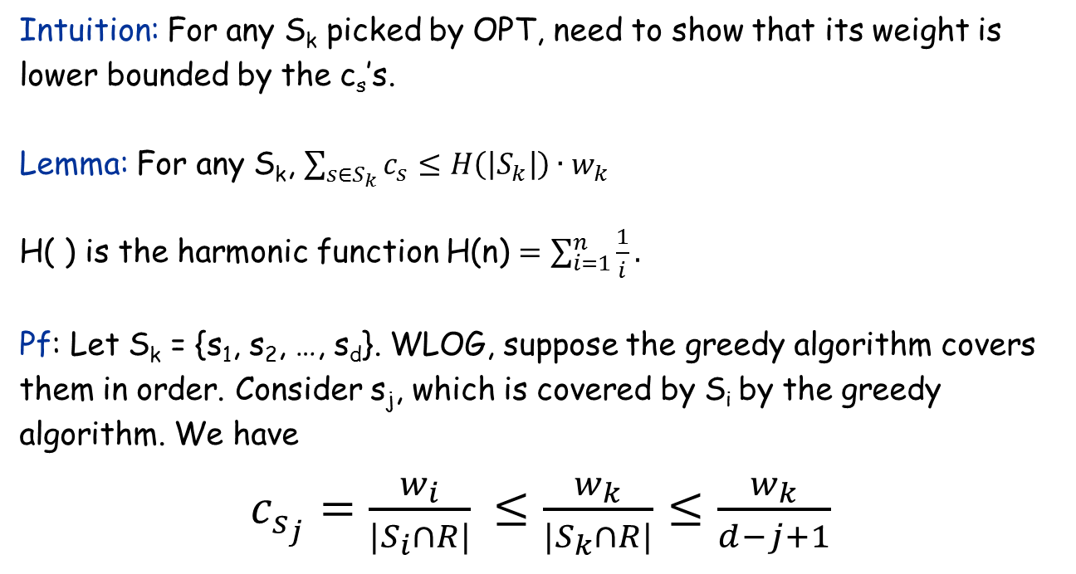
Relating ∑c_{s} with OPT
Intuition: For any S_{k} picked by OPT, need to show that its weight is lower bounded by the c_{s}’s.
Lemma: For any S_{k}, $\sum_{{s∈S}_{k}}{c_{s}}≤H\left(\left|S_{k}\right|\right)∙w_{k}$
H( ) is the harmonic function H(n) $=\sum_{i=1}^{n}{\frac{1}{i}}.$
Pf: Let S_{k} = {s₁, s₂, …, s_{d}}. WLOG, suppose the greedy algorithm covers them in order. Consider s_{j}, which is covered by S_{i} by the greedy algorithm. We have
$c_{s_{j}}=\frac{w_{i}}{|S_{i}∩R|}$ $≤\frac{w_{k}}{|S_{k}∩R|}$ $≤\frac{w_{k}}{d−j+1}$
greedy choice
s_{j}, s_{j+1}, …, s_{d} are not covered

Slide 26
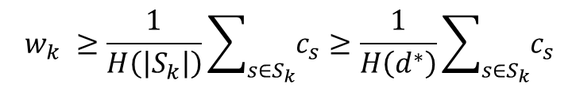
Approximation Ratio of the Greedy Algorithm
Theorem: The total weight of the greedy algorithm <= H(d*) • OPT, where d* = max|S_{i}|.
Pf: Suppose OPT picks a collection of subsets C*. For every S_{k}∈C*, by the Lemma we have
OPT has to cover all elements, so its total weight is at least (even if each element is covered only once) 1/H(d*) • ∑c_{s} = 1/H(d*) • GREEDY
H(d*) = O(log n)
This analysis is tight (i.e., there are instances on which GREEDY is indeed Ω(log n) times worse than OPT
It has been proved that no poly-time algorithm can do better (asymptotically) unless P = NP.
$$w_{k} ≥\frac{1}{H\left(\left|S_{k}\right|\right)}\sum_{{s∈S}_{k}}{c_{s}}≥\frac{1}{H\left(d^{∗}\right)}\sum_{{s∈S}_{k}}{c_{s}}$$

Slide 27
11.4 The Pricing Method: Vertex Cover

Slide 28
Weighted Vertex Cover
Weighted vertex cover. Given a graph G with vertex weights, find a vertex cover of minimum weight.
It’s a special case of the set cover problem, so the H(d*) approximation ratio can be achieved by the greedy algorithm, where d* = max degree.
2
4
2
4
2
9
2
9
weight = 2 + 2 + 4 = 8
weight = 2 + 9 = 11

Slide 29
Weighted Vertex Cover
Pricing method. Each edge must be covered by some vertex i. Edge e pays price p_{e} ≥ 0 to use vertex i.
Fairness. Edges incident to vertex i should pay ≤ w_{i} in total.
Claim. For any vertex cover S and any fair prices p_{e}: ∑_{e} p_{e} ≤ w(S).
Proof. ▪
2
4
2
9
each edge e covered by at least one node in S
sum fairness inequalities for each node in S

Slide 30
Pricing Method
Pricing method. Set prices and find vertex cover simultaneously.
Weighted-Vertex-Cover-Approx(G, w) {
foreach e in E
p_{e} = 0
while (∃ edge i-j such that neither i nor j are tight)
select such an edge e
increase p_{e} without violating fairness
}
S ← set of all tight nodes
return S
}

Slide 31
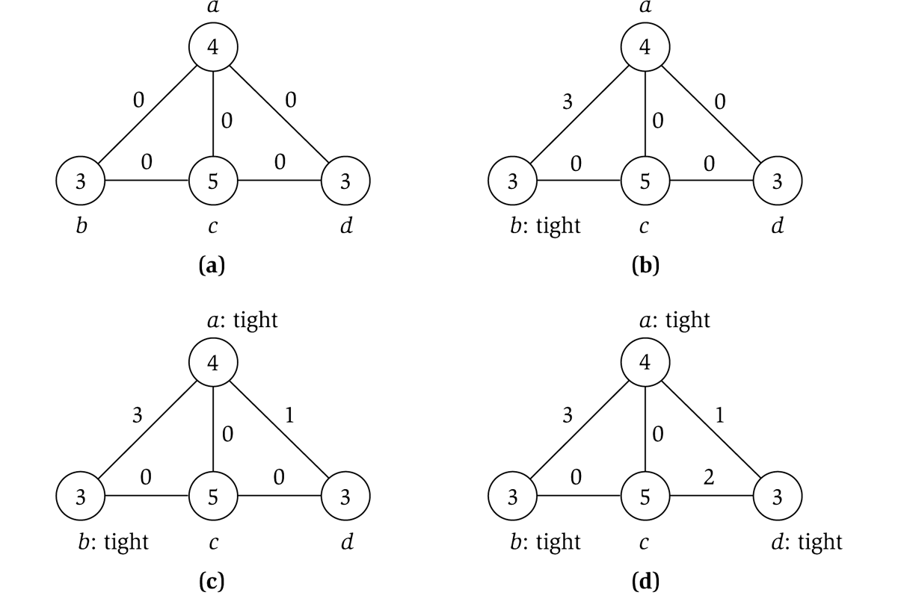
Pricing Method
price of edge a-b
vertex weight
Figure 11.8

Slide 32
Pricing Method: Analysis
Theorem. Pricing method is a 2-approximation.
Pf.
Algorithm terminates in O(n) iterations, since at least one new node becomes tight after each iteration of while loop.
Let S = set of all tight nodes upon termination of algorithm. S is a vertex cover: if some edge i-j is uncovered, then neither i nor j is tight. But then while loop would not terminate.
Let S* be optimal vertex cover. We show w(S) ≤ 2w(S*).
all nodes in S are tight
S ⊆ V, prices ≥ 0
each edge counted twice
fairness lemma

Slide 33
11.5 Disjoint Paths

Slide 34
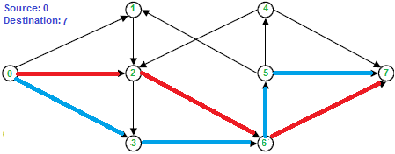
The Problem
Given:
A directed graph G with n vertices and m edges;
k pairs of (source, target) requests: (s₁, t₁), …, (s_{k}, t_{k}).
Goal:
Satisfy largest number of requests by edge-disjoint paths.

Slide 35
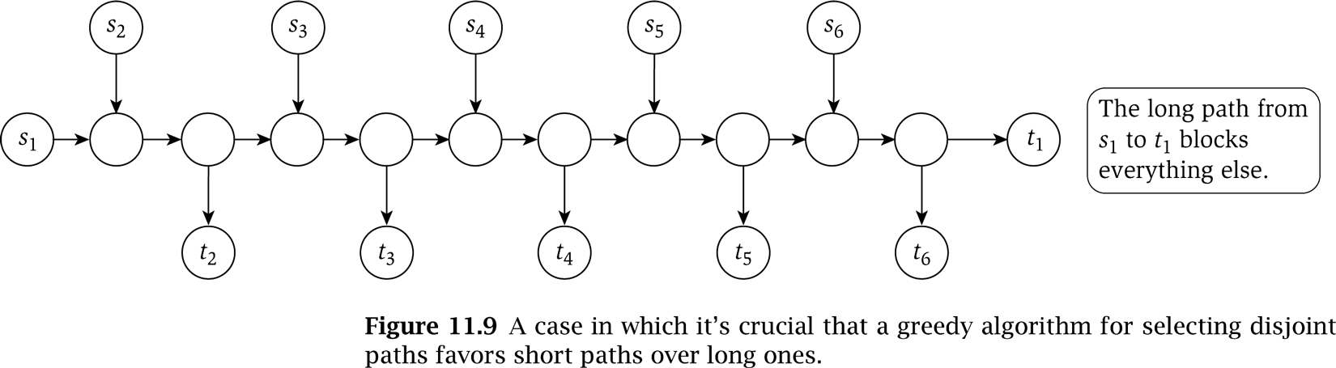
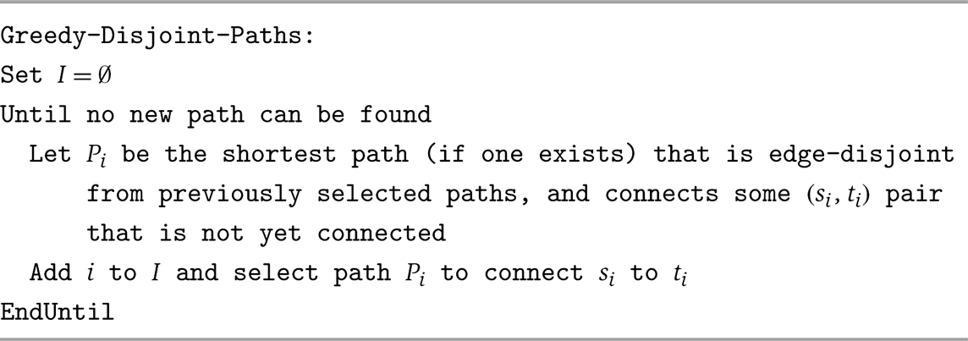
A Greedy Algorithm

Slide 36
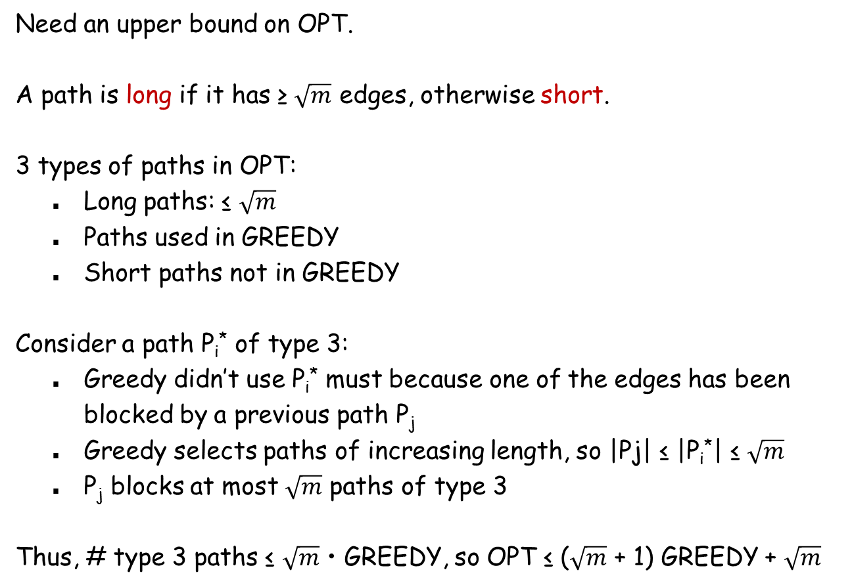
Greedy is an O($\sqrt{m}$)-Approximation
Need an upper bound on OPT.
A path is long if it has ≥ $\sqrt{m}$ edges, otherwise short.
3 types of paths in OPT:
Long paths: ≤ $\sqrt{m}$
Paths used in GREEDY
Short paths not in GREEDY
Consider a path P_{i}* of type 3:
Greedy didn’t use P_{i}* must because one of the edges has been blocked by a previous path P_{j}
Greedy selects paths of increasing length, so |Pj| ≤ |P_{i}*| ≤ $\sqrt{m}$
P_{j} blocks at most $\sqrt{m}$ paths of type 3
Thus, # type 3 paths ≤ $\sqrt{m}$ • GREEDY, so OPT ≤ ($\sqrt{m}$ + 1) GREEDY + $\sqrt{m}$
Notes:
Can’t do better than O(sqrt(m))-approximation unless P=NP.

Slide 37
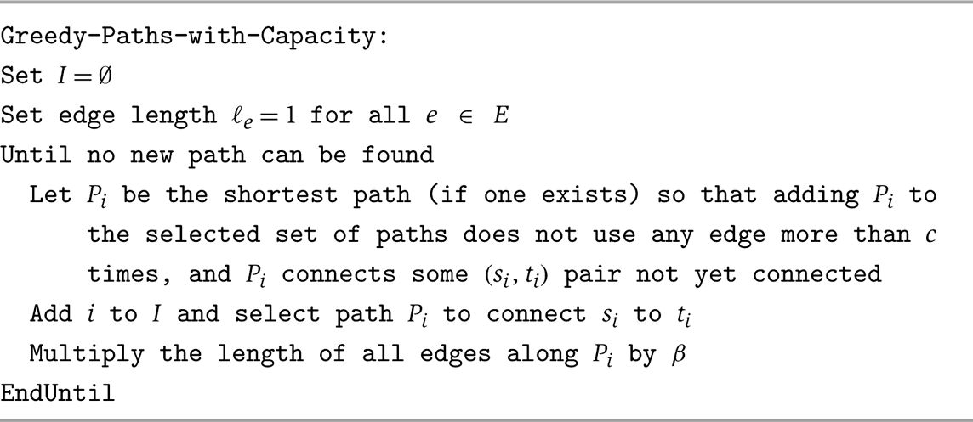
The Pricing Algorithm
A more general problem: Allow an edge to be used at most c times.
Idea: Edges already used are more “expensive”.

Slide 38
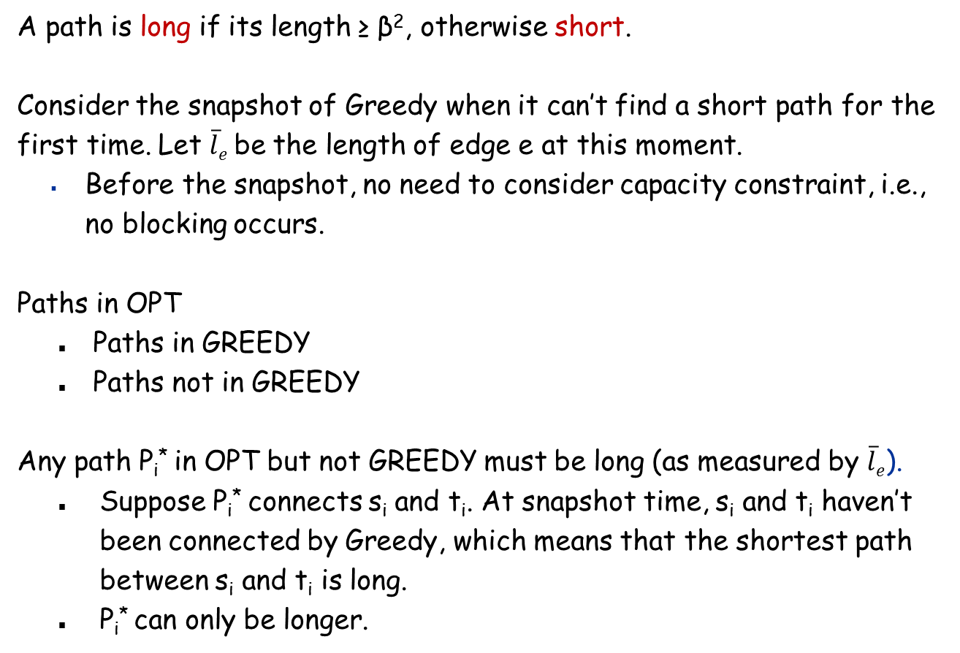
Analysis for the Case c = 2
A path is long if its length ≥ β², otherwise short.
Consider the snapshot of Greedy when it can’t find a short path for the first time. Let $\overline{l}e$ be the length of edge e at this moment.
Before the snapshot, no need to consider capacity constraint, i.e., no blocking occurs.
Paths in OPT
Paths in GREEDY
Paths not in GREEDY
Any path P_{i}* in OPT but not GREEDY must be long (as measured by $\overline{l}e$).
Suppose P_{i}* connects s_{i} and t_{i}. At snapshot time, s_{i} and t_{i} haven’t been connected by Greedy, which means that the shortest path between s_{i} and t_{i} is long.
P_{i}* can only be longer.

Slide 39
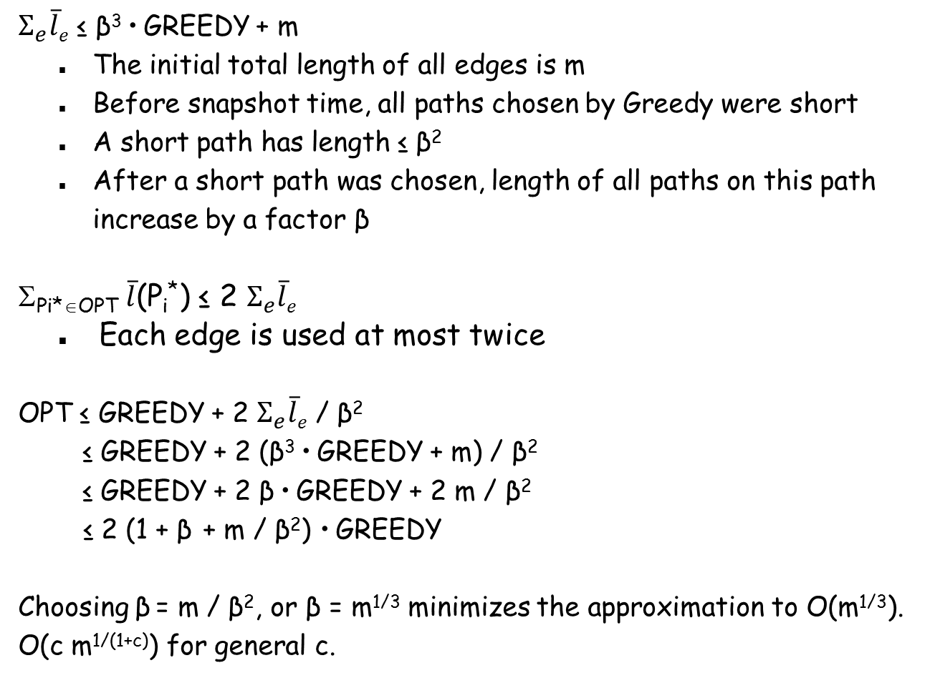
Analysis for the Case c = 2
$Σ_{e}\overline{l}e$ ≤ β³ • GREEDY + m
The initial total length of all edges is m
Before snapshot time, all paths chosen by Greedy were short
A short path has length ≤ β²
After a short path was chosen, length of all paths on this path increase by a factor β
Σ_{Pi*∈OPT} $\overline{l}$(P_{i}*) ≤ 2 $Σ_{e}\overline{l}e$
Each edge is used at most twice
OPT ≤ GREEDY + 2 $Σ_{e}\overline{l}e$ / β²
≤ GREEDY + 2 (β³ • GREEDY + m) / β²
≤ GREEDY + 2 β • GREEDY + 2 m / β²
≤ 2 (1 + β + m / β²) • GREEDY
Choosing β = m / β², or β = m^{1/3} minimizes the approximation to O(m^{1/3}).
O(c m^{1/(1+c)}) for general c.

Slide 40
11.6 LP Rounding: Vertex Cover

Slide 41
Weighted Vertex Cover: IP Formulation
Weighted vertex cover. Given an undirected graph G = (V, E) with vertex weights w_{i} ≥ 0, find a minimum weight subset of nodes S such that every edge is incident to at least one vertex in S.
Integer programming formulation.
Model inclusion of each vertex i using a 0/1 variable x_{i}. Vertex covers in 1-1 correspondence with 0/1 assignments: S = {i ∈ V : x_{i} = 1}
Objective function: maximize Σ_{i} w_{i} x_{i}.
Must take either i or j: x_{i} + x_{j} ≥ 1.

Slide 42
Weighted Vertex Cover: ILP Formulation
Weighted vertex cover. Integer programming formulation.
Observation. If x* is optimal solution to (ILP), then S = {i ∈ V : x*_{i} = 1} is a min weight vertex cover.

Slide 43
Integer Linear Programming
ILP. Given integers a_{ij} and b_{i}, find integers x_{j} that satisfy:
Observation. Vertex cover formulation proves that ILP is NP-hard.
even if all coefficients are 0/1 and at most two variables per inequality

Slide 44
Linear Programming
Linear programming. Max/min linear objective function subject to linear inequalities.
Input: rational numbers c_{j}, b_{i}, a_{ij} .
Output: rational numbers x_{j}.
Linear. No x², xy, arccos(x), x(1-x), etc.
Simplex algorithm. [Dantzig 1947] Can solve LP in practice.
Ellipsoid algorithm. [Khachian 1979] Can solve LP in poly-time.
Notes:
Open questions: Is there a strongly polynomial-time algorithm for LP?
Solving simultaneous linear equations (Ax = b) can be accomplished using Gaussian elimination. LP is a generalization with inequalities instead of equalities.
Note: simple transformations to handle >= inequalities, unrestricted variables, or min objective

Slide 45
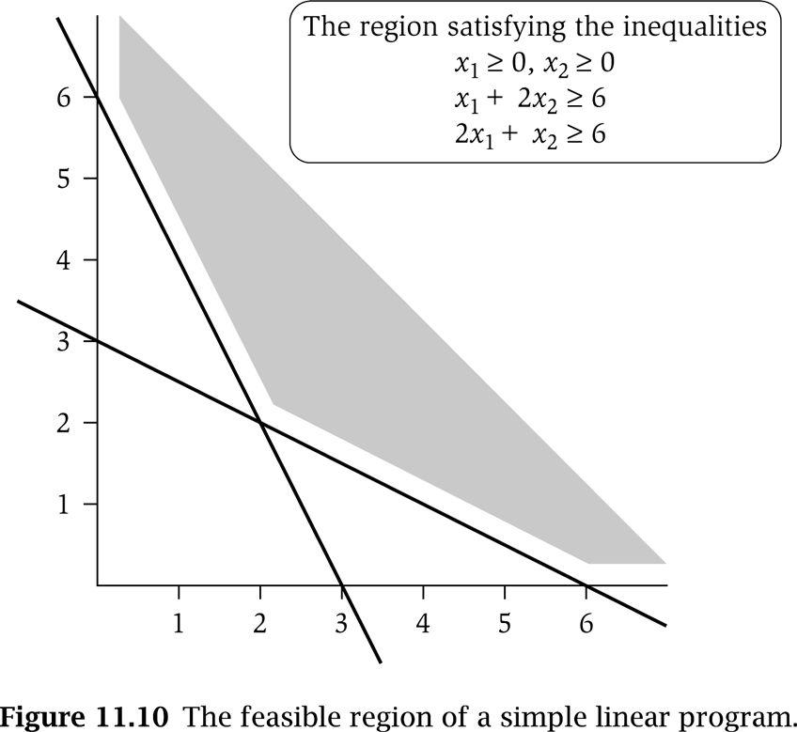
LP Feasible Region
LP geometry in 2D.
x₁ = 0
x₂ = 0
x₁ + 2x₂ = 6
2x₁ + x₂ = 6

Slide 46
Weighted Vertex Cover: LP Relaxation
Weighted vertex cover. Linear programming formulation.
Observation. Optimal value of (LP) is ≤ optimal value of (ILP). Pf. LP has fewer constraints.
Note. LP is not equivalent to vertex cover.
Q. How can solving LP help us find a small vertex cover?
A. Solve LP and round fractional values.
½
½
½
Notes:
LP relaxation is a useful lower bound for designing approximation algorithms.

Slide 47
Weighted Vertex Cover
Theorem. If x* is optimal solution to (LP), then S = {i ∈ V : x*_{i} ≥ ½} is a vertex cover whose weight is at most twice the min possible weight.
Pf. [S is a vertex cover]
Consider an edge (i, j) ∈ E.
Since x*_{i} + x*_{j} ≥ 1, either x*_{i} ≥ ½ or x*_{j} ≥ ½ ⇒ (i, j) covered.
Pf. [S has desired cost]
Let S* be optimal vertex cover. Then
LP is a relaxation
x*_{i} ≥ ½

Slide 48
Weighted Vertex Cover
Theorem. 2-approximation algorithm for weighted vertex cover.
Integrality gap. The integrality gap of an LP formulation of a problem is sup_{I} OPT_{ILP}(I) / OPT_{LP}(I)
No hope to beat the integrality gap with any rounding scheme.
The integrality gap of the above LP formulation for vertex cover is 2.
Consider a complete graph
Lower bound. [Dinur-Safra 2005] If P ≠ NP, then no ρ-approximation for ρ < 1.3607, even with unit weights.
Open research problem. Close the gap.
Notes:
NP-hard even on 3-regular planar graphs with unit weights.

Slide 49
LP Rounding: Set Cover

Slide 50
ILP Formulation of Set Cover
Problem Definition: Given a universe U of n elements, a list S₁, …, S_{m} of subsets of U, find a collection of these subsets whose union is U.
Weighted version: S_{i} has weight w_{i}. Want to minimize total weight of the subsets selected in the set cover.
ILP formulation:
x_{i} = 1 if S_{i} is selected, 0 otherwise.

Slide 51
LP Relaxation for Set Cover and Rounding
Algorithm:
Find the optimal fractional solution to the LP.
Return all sets for which x_{i} ≥ 1/f, where f is the frequency of the most frequent element
Theorem: This algorithm returns an f-approximation for set cover.
Pf: Same as in vertex cover – just replace 2 with f.

Slide 52
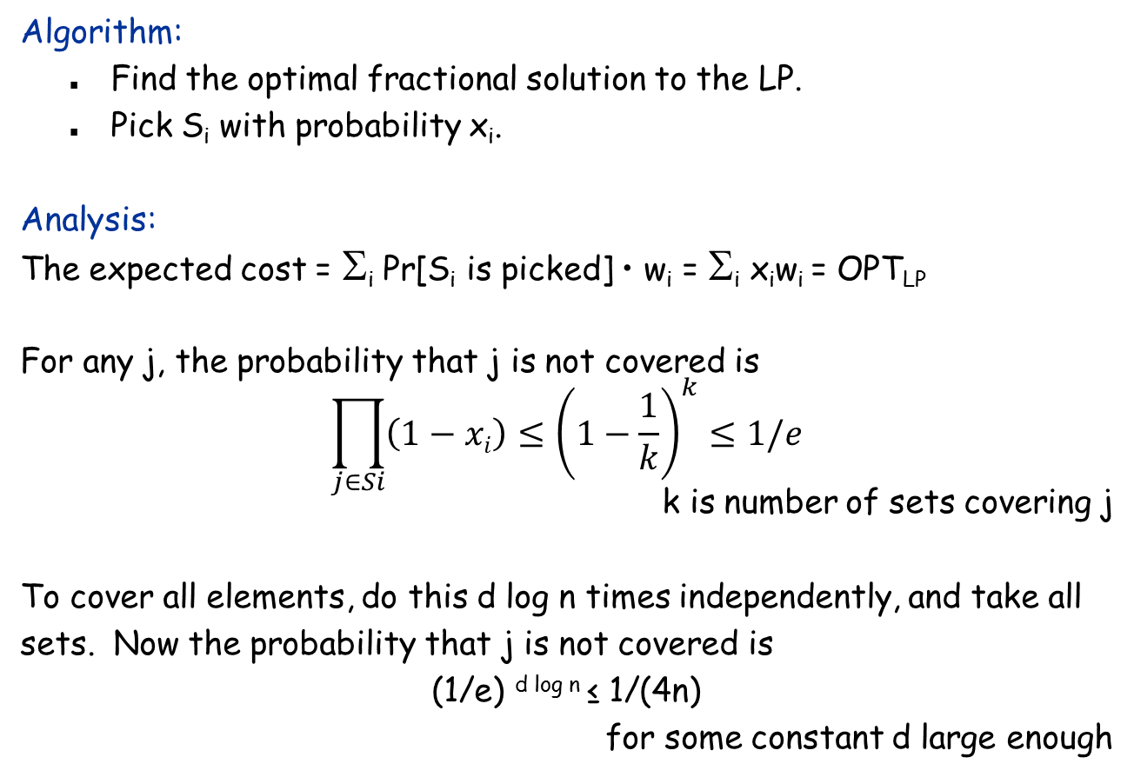
Randomized Rounding
Algorithm:
Find the optimal fractional solution to the LP.
Pick S_{i} with probability x_{i}.
Analysis:
The expected cost = Σ_{i} Pr[S_{i} is picked] • w_{i} = Σ_{i} x_{i}w_{i} = OPT_{LP}
For any j, the probability that j is not covered is
$$\prod_{j∈Si}{\left(1−xi\right)}≤{\left(1−\frac{1}{k}\right)}^{k}≤1/e$$
k is number of sets covering j
To cover all elements, do this d log n times independently, and take all sets. Now the probability that j is not covered is
(1/e) ^{d log n} ≤ 1/(4n)
for some constant d large enough

Slide 53
O(log n)-Approximation
Bad Event 1: Some element is not covered
The probability of this event ≤ 1/(4n) • n = 1/4
Bad Event 2: Cost of the picked sets is too high
E[cost of one round] = OPT_{LP}
E[cost of d log n rounds] ≤ d log n • OPT_{LP}
Pr[cost of d log n rounds ≥ 4 d log n • OPT_{LP}] ≤ 1/4
Markov inequality: For X ≥ 0, t > 0, Pr[X ≥ t E[X]] ≤ 1/t.
Probability that one bad event occurs ≤ 1/4 + 1/4 =1/2. (union bound)
Probability that the algorithm succeeds ≥ 1/2.
What if it fails? Start over again!

Slide 54
11.8 FPTAS: The Knapsack Problem

Slide 55
Polynomial Time Approximation Scheme
PTAS. (1 + ε)-approximation algorithm with poly-time running time for any constant ε > 0.
Consequence. PTAS produces arbitrarily high quality solution, but trades off accuracy for time.
FPTAS. (1 + ε)-approximation algorithm with running time poly(n, 1/ε).
This section. FPTAS for knapsack problem via rounding and scaling.

Slide 56
Knapsack Problem
Knapsack problem.
Given n objects and a "knapsack."
Item i has value v_{i} > 0 and weighs w_{i} > 0.
Knapsack can carry weight up to W.
Goal: fill knapsack so as to maximize total value.
Ex: { 3, 4 } has value 40.
we'll assume w_{i} ≤ W
Item
Value
Weight
1
1
1
2
6
2
W = 11
3
18
5
4
22
6
5
28
7
Notes:
Fractional version can be solved optimally by Greedy

Slide 57
Knapsack Problem: Dynamic Programming I
Def. OPT(i, w) = max value subset of items 1,..., i with weight limit w.
Case 1: OPT does not select item i.
OPT selects best of 1, …, i–1 with weight limit w
Case 2: OPT selects item i.
new weight limit = w – w_{i}
OPT selects best of 1, …, i–1 with weight limit w – w_{i}
Running time. O(n W).
W = weight limit.
Not polynomial in input size!
Knapsack is actually NP-hard.

Slide 58
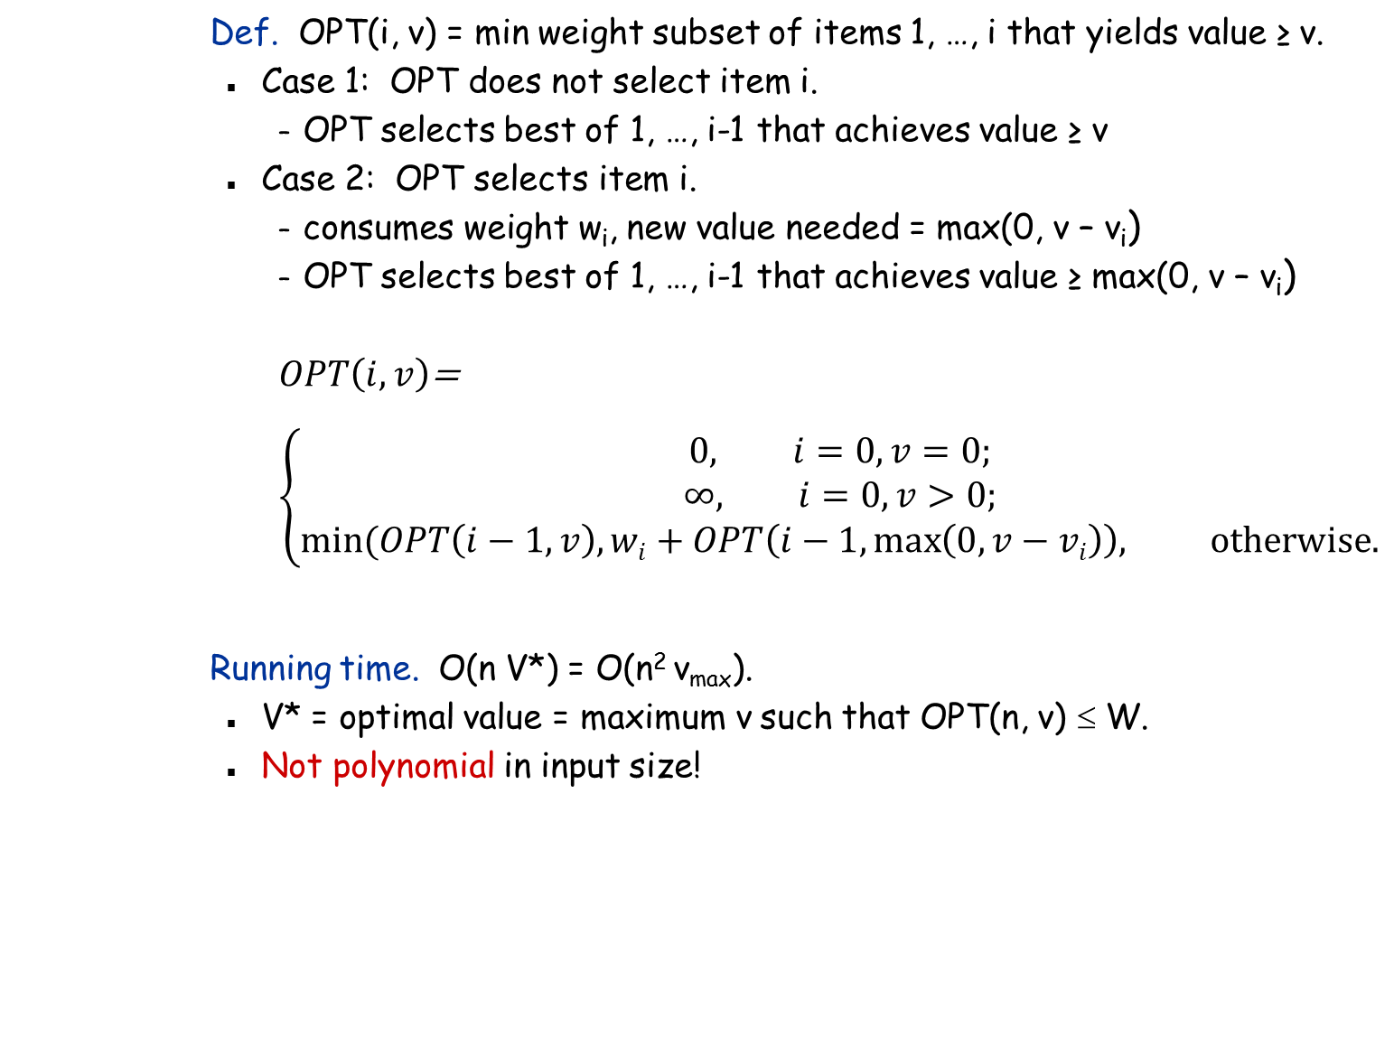
Knapsack Problem: Dynamic Programming II
Def. OPT(i, v) = min weight subset of items 1, …, i that yields value ≥ v.
Case 1: OPT does not select item i.
OPT selects best of 1, …, i-1 that achieves value ≥ v
Case 2: OPT selects item i.
consumes weight w_{i}, new value needed = max(0, v – v_{i})
OPT selects best of 1, …, i-1 that achieves value ≥ max(0, v – v_{i})
$OPT\left(i, v\right)$=
$$\left\{\begin{aligned}0, i=0,v=0; \\ ∞, i=0, v>0; \\ min⁡(OPT\left(i−1,v\right), wi+OPT\left(i−1,\max\left(0,v−vi\right)\right), \text{otherwise}\text{.}\end{aligned}\right.$$
Running time. O(n V*) = O(n² v_{max}).
V* = optimal value = maximum v such that OPT(n, v) ≤ W.
Not polynomial in input size!
V* ≤ n v_{max}

Slide 59
Knapsack: FPTAS
Intuition for approximation algorithm.
Round all values up to lie in smaller range.
Run dynamic programming algorithm on rounded instance.
Return optimal items in rounded instance.
Item
Value
Weight
Item
Value
Weight
1
134,221
1
1
2
1
2
656,342
2
2
7
2
3
1,810,013
5
3
19
5
4
22,217,800
6
4
23
6
5
28,343,199
7
5
29
7
W = 11
W = 11
original instance
rounded instance

Slide 60
Knapsack: FPTAS
Knapsack FPTAS. Round up all values:
v_{max} = largest value in original instance
ε = precision parameter
θ = scaling factor = ε v_{max} / n
Observation. Optimal solution to problems with or are equivalent.
Intuition. close to v so optimal solution using is nearly optimal; small and integral so dynamic programming algorithm is fast.
Running time. O(n³ / ε).
Dynamic program II running time is , where

Slide 61
Knapsack: FPTAS
Theorem. If S is solution found by our algorithm and S* is the optimal solution, then
Pf.
never round up by more than θ
|S| ≤ n
solve rounded instance optimally
always round up
n θ = ε v_{max}, v_{max} ≤ Σ_{i∈S*} v_{i}
Q: Can we use Dynamic Programming I and round up the weights?
Note: SOL > (1 – ε) OPT is actually as good as
SOL > OPT /(1 + ε), since 1 – ε > 1/(1 + 2ε), for ε small enough. Replacing ε with ε/2 makes the former a (1+ε)-approximation.

Slide 62
PTAS for Load Balancing

Slide 63
Load Balancing
Input. m identical machines; n jobs, job j has processing time t_{j}.
Def. Let J(i) be the subset of jobs assigned to machine i. The
load of machine i is L_{i} = Σ_{j ∈ J(i)} t_{j}.
Def. The makespan is the maximum load on any machine L = max_{i} L_{i}.
Load balancing. Assign each job to a machine to minimize makespan.
We already have a 2-approximation, i.e., we know that OPT ∈ [LB, 2LB].
Idea: Narrow down the range by binary search, and solve the following decision problem:
Given a target makespan L, are m machines enough? (also known as the bin packing problem)

Slide 64
Load Balancing to Bin Packing
Decision problem: Given a target makespan L, are m machines enough?
Bin packing: Given a bin size L, what’s the minimum # bins needed?
We will design an algorithm that:
Suppose the minimum # bins needed is b
Returns a packing using ≤ b bins of size (1 + ε) L
Do binary search in [LB, 2LB] until the range is smaller than ε • LB
The last ‘yes’ answer must have been obtained from some L ∈ [OPT, OPT + ε • LB]
Solution must ≤ (1 + ε) (OPT + ε • LB) = OPT + ε • OPT + ε • LB + ε² • LB ≤ (1 + 3ε) OPT
Replacing ε with ε/3 yields a (1 + ε)-approximation

Slide 65
Solving Bin Packing Exactly on k Different Job Sizes
Assume the jobs have only k different sizes.
Def: B(i₁, i₂, …, i_{k}) = min # bins needed to pack i₁ jobs of size₁, i₂ jobs of size₂, …, i_{k} jobs of size_{k}
O(n^{k}) subproblems
Def: Q = {(i₁, i₂, …, i_{k}) : B(i₁, i₂, …, i_{k}) = 1}
Checking if B(i₁, i₂, …, i_{k}) = 1 takes O(k) time.
DP: B(i₁, i₂, …, i_{k}) = 1 + min_{(q1, …, qk)∈Q} B(i₁-q₁, …, i_{k}-q_{k})
Computing all the B(i₁, i₂, …, i_{k})’s takes O(n^{2k}) time.

Slide 66
Solving Bin Packing with Slack
Small jobs: Jobs of size < ε L, remove them for now.
Rounding: Round jobs down to ε L (1 + ε)^{i}, for integer i.
log_{1+ε}(1/ε) = O(1/ε log (1/ε)) different job sizes
Each job loses a factor of at most (1 + ε)
DP: Find the optimal solution on rounded jobs
Must be able to accommodate original jobs with bin size (1 + ε) L
Pack: Using bin size (1 + ε) L, pack small jobs back to bins, and open new bins when necessary
Claim: If OPT uses b bins of size L, then this algorithm uses ≤ b bins of size (1 + ε) L.
Pf: If no new bins are opened, obvious.
If new bins are opened, all but one bin is packed to > L, so OPT can’t use less bins with bin size = L.

