Slide 1
Coping With NP-Completeness
Q. Suppose I need to solve an NP-complete problem. What should I do?
A. Theory says you're unlikely to find poly-time algorithm.
Must sacrifice at least one of three desired features.
Solve problem in polynomial time.
Solve problem to optimality.
Solve arbitrary instances of the problem.
This lecture. Solve some special cases of NP-complete problems that arise in practice.

Slide 2
10.1 Finding Small Vertex Covers

Slide 3
Vertex Cover
VERTEX COVER: Given a graph G = (V, E) and an integer k, is there a subset of vertices S ⊆ V such that |S| ≤ k, and for each edge (u, v) either u ∈ S, or v ∈ S, or both.
1
6
2
7
k = 4 S = { 3, 6, 7, 10 }
3
8
4
9
5
10

Slide 4
Finding Small Vertex Covers
Q. What if k is small?
Brute force. O(k n^{k+1}).
Try all C(n, k) = O(n^{k}) subsets of size k.
Takes O(k n) time to check whether a subset is a vertex cover.
Goal. Limit exponential dependency on k, e.g., to O(2^{k} n).
Ex. n = 1,000, k = 10.
Brute. k n^{k+1} = 10³⁴ ⇒ infeasible.
Better. 2^{k} n = 10⁶ ⇒ feasible.
Parameterized complexity. FPT (fixed parameter tractable) is the class of problems solvable in time f(k) • poly(n).

Slide 5
Finding Small Vertex Covers
Claim. Let u-v be an edge of G. G has a vertex cover of size ≤ k iff at least one of G − { u } and G − { v } has a vertex cover of size ≤ k-1.
Pf. ⇒
Suppose G has a vertex cover S of size ≤ k.
S contains either u or v (or both). Assume it contains u.
S − { u } is a vertex cover of G − { u }.
Pf. ⇐
Suppose S is a vertex cover of G − { u } of size ≤ k-1.
Then S ∪ { u } is a vertex cover of G. ▪
delete v and all incident edges

Slide 6
Finding Small Vertex Covers: Algorithm
Claim. The following algorithm determines if G has a vertex cover of size ≤ k in O(2^{k} n) time.
Pf.
Correctness follows previous two claims.
There are ≤ 2^{k+1} nodes in the recursion tree; each invocation takes O(n) time. ▪
Q. How to modify the algorithm to find the actual vertex cover?
boolean Vertex-Cover(G, k) {
if (G contains no edges) return true
if (k = 0) return false
let (u, v) be any edge of G
a = Vertex-Cover(G - {u}, k-1)
b = Vertex-Cover(G - {v}, k-1)
return a or b
}

Slide 7
Finding Small Vertex Covers: Recursion Tree
k
k-1
k-1
k-2
k-2
k-2
k-2
k - i
0
0
0
0
0
0
0
0

Slide 8
10.2 Solving NP-Hard Problems on Trees

Slide 9
Independent Set on Trees
Independent set on trees. Given a tree, find a maximum cardinality subset of nodes such that no two share an edge.
Def. A leaf is a node with degree 1.
Key observation. If v is a leaf, there exists a maximum size independent set containing v.
Pf. (exchange argument)
Consider a max size independent set S.
If v ∈ S, we're done.
If u ∉ S and v ∉ S, then S ∪ { v } is independent ⇒ S not maximum.
IF u ∈ S and v ∉ S, then S ∪ { v } − { u } is independent. ▪
u
v
Notes:
Is independent set in FPT?

Slide 10
Independent Set on Trees: Greedy Algorithm
Theorem. The following greedy algorithm finds a maximum cardinality independent set in forests (and hence trees).
Pf. Correctness follows from the previous key observation. ▪
Remark. Can implement in O(n) time by considering nodes in postorder.
Independent-Set-In-A-Forest(F) {
S ← φ
while (F has at least one edge) {
Let e = (u, v) be an edge such that v is a leaf
Add v to S
Delete from F nodes u and v, and all edges
incident to them.
}
Add all remaining vertices to S
return S
}

Slide 11
Weighted Independent Set on Trees
Weighted independent set on trees. Given a tree and node weights w_{v} > 0, find an independent set S that maximizes Σ_{v∈S} w_{v}.
Observation. If (u, v) is an edge such that v is a leaf node, then either OPT includes u, or it includes all leaf nodes incident to u.
Dynamic programming solution. Root tree at some node, say r.
OPT_{in} (u) = max weight independent set rooted at u, containing u.
OPT_{out}(u) = max weight independent set rooted at u, not containing u.
r
u
v
w
x
children(u) = { v, w, x }

Slide 12
Independent Set on Trees: Greedy Algorithm
Theorem. The dynamic programming algorithm find a maximum weighted independent set in trees in O(n) time.
Pf. Takes O(n) time since we visit nodes in postorder and examine each edge exactly once. ▪
Weighted-Independent-Set-In-A-Tree(T) {
Root the tree at a node r
foreach (node u of T in postorder) {
if (u is a leaf) {
M_{in} [u] = w_{u}
M_{out}[u] = 0
}
else {
M_{in} [u] = Σ_{v∈children(u)} M_{out}[v] + w_{v}
M_{out}[u] = Σ_{v∈children(u)} max(M_{out}[v], M_{in}[v])
}
}
return max(M_{in}[r], M_{out}[r])
}
ensures a node is visited after all its children

Slide 13
Context
Independent set on trees. This structured special case is tractable because we can find a node that breaks the communication among the
subproblems in different subtrees.
Graphs of bounded tree width. Elegant generalization of trees that:
Captures a rich class of graphs that arise in practice.
Enables decomposition into independent pieces.
u
u
see Chapter 10.4 if interested

Slide 14
10.3 Circular Arc Coloring

Slide 15
Wavelength-Division Multiplexing
Wavelength-division multiplexing (WDM). Allows m communication streams (arcs) to share a portion of a fiber optic cable, provided they are transmitted using different wavelengths.
Ring topology. Special case is when network is a cycle on n nodes.
Bad news. NP-complete, even on rings.
Brute force. Can determine if k colors suffice in O(k^{m}) time by trying all k-colorings.
Goal. f(k) ⋅ poly(m, n) on rings.
c
b
1
a
4
2
e
f
d
3
n = 4, m = 6

Slide 16
Wavelength-Division Multiplexing
Wavelength-division multiplexing (WDM). Allows m communication streams (arcs) to share a portion of a fiber optic cable, provided they are transmitted using different wavelengths.
Ring topology. Special case is when network is a cycle on n nodes.
Bad news. NP-complete, even on rings.
Brute force. Can determine if k colors suffice in O(k^{m}) time by trying all k-colorings.
Goal. f(k) ⋅ poly(m, n) on rings.
c
b
1
a
4
2
e
f
d
3
n = 4, m = 6

Slide 17
Review: Interval Coloring
Interval coloring. Greedy algorithm finds coloring such that number of colors equals depth of schedule.
Circular arc coloring.
Weak duality: number of colors ≥ depth.
Strong duality does not hold.
maximum number of streams at one location
c
d
f
j
b
g
i
a
e
h
max depth = 2 min colors = 3

Slide 18
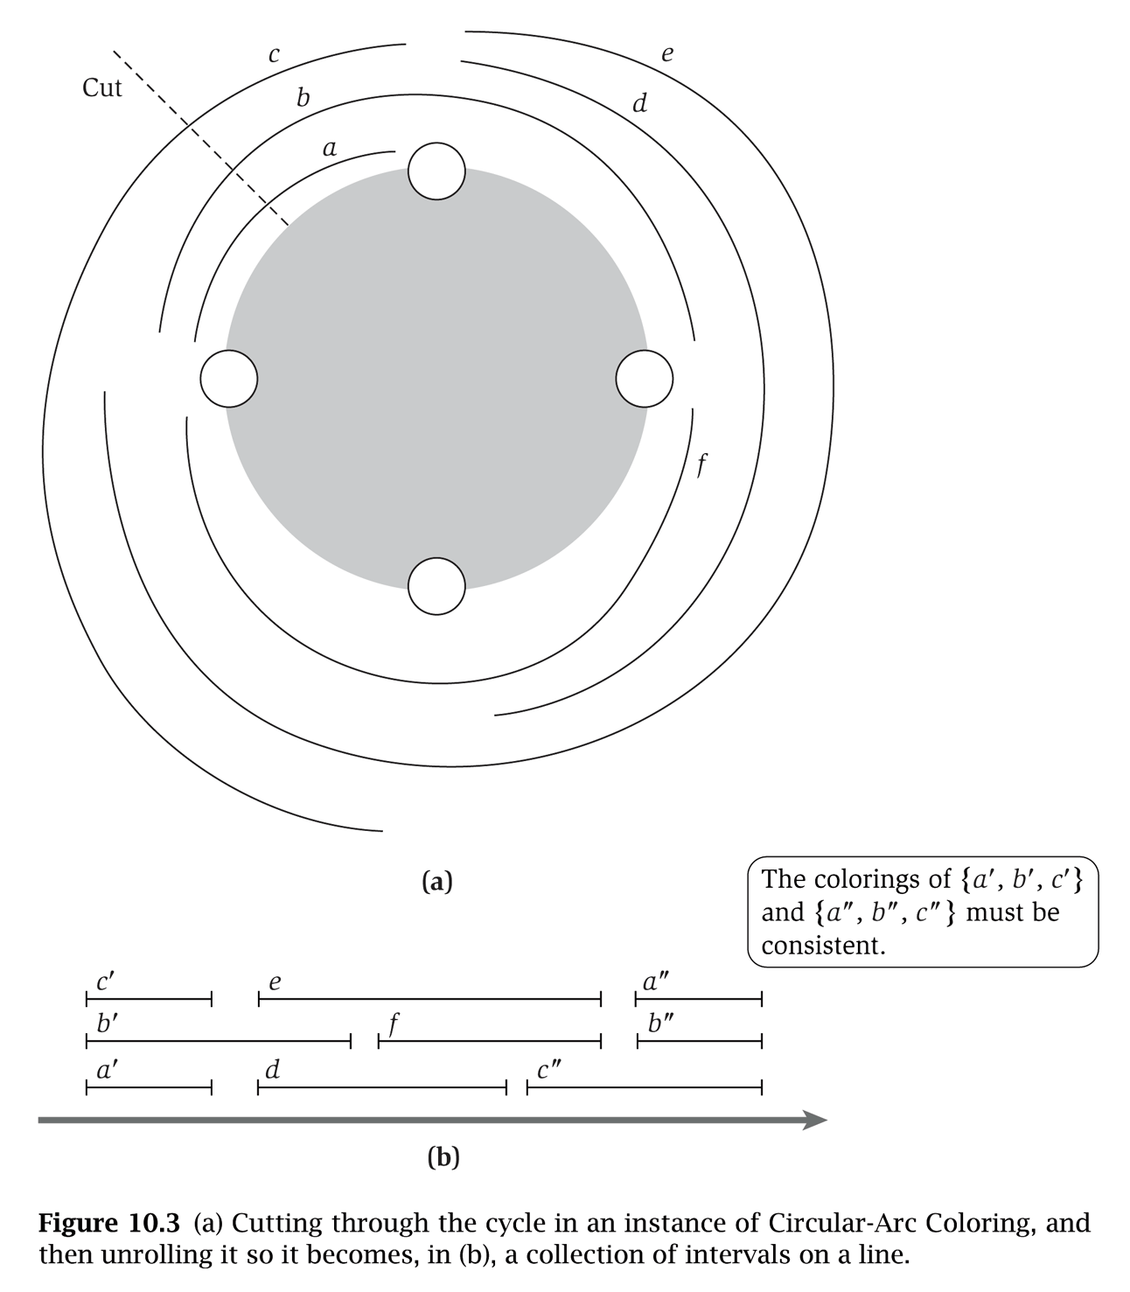
(Almost) Transforming Circular Arc Coloring to Interval Coloring
Circular arc coloring. Given a set of n arcs with depth d ≤ k, can the arcs be colored with k colors?
Equivalent problem. Cut the network between nodes v₁ and v_{n}. The arcs can be colored with k colors iff the intervals can be colored with k colors in such a way that "sliced" arcs have the same color.
v₁
colors of a', b', and c' must correspond to colors of a", b", and c"
v₀
v₄
v₂
v₃
v₀
v₁
v₂
v₃
v₄
v₀

Slide 19
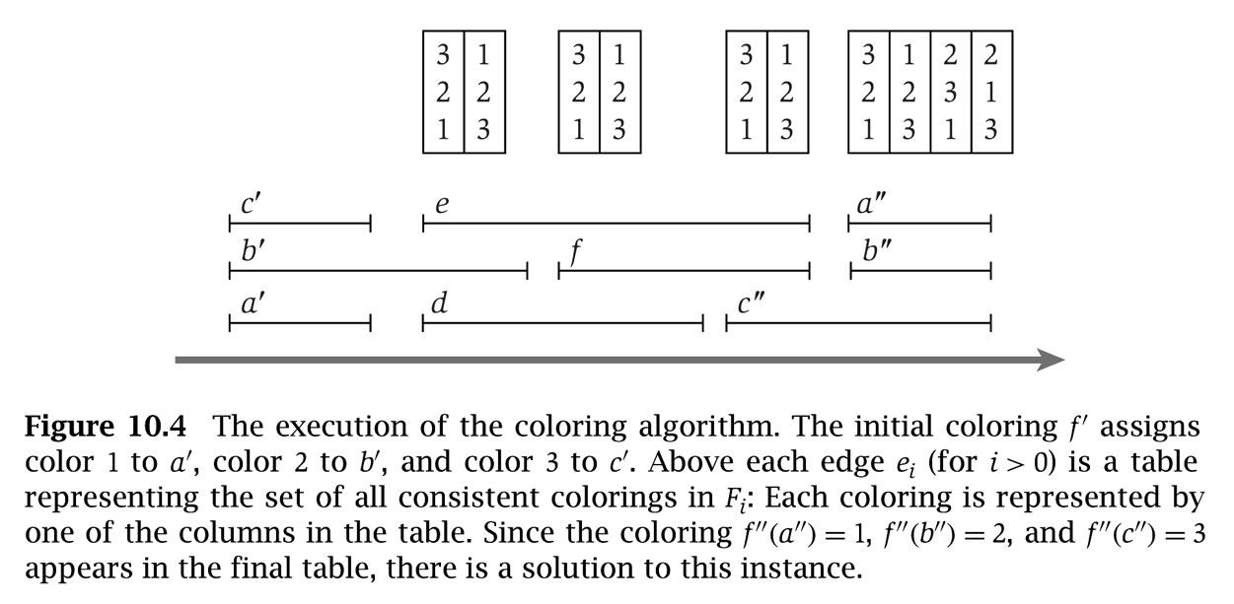
Circular Arc Coloring: Dynamic Programming Algorithm
Dynamic programming algorithm.
Assign distinct color to each interval which begins at cut node v₀.
At each node v_{i}, some intervals may finish, and others may begin.
Enumerate all k-colorings of the intervals through v_{i} that are consistent with the colorings of the intervals through v_{i-1}.
The arcs are k-colorable iff some coloring of intervals ending at cut node v₀ is consistent with original coloring of the same intervals.
yes
c'
3
e
3
1
e
3
1
e
3
1
a"
3
2
1
2
b'
2
b'
2
2
f
2
2
f
2
2
b"
2
3
2
1
a'
1
d
1
3
d
1
3
c"
1
3
c"
1
1
3
3
v₀
v₁
v₂
v₃
v₄
v₀

Slide 20
Circular Arc Coloring: Running Time
Running time. O(k! ⋅ n).
n phases of the algorithm.
Bottleneck in each phase is enumerating all consistent colorings.
There are at most k intervals through v_{i}, so there are at most k! colorings to consider.
Remark. poly(n) time for k = O(log n / loglog n)

Slide 21
A Few Issues about FPT
Definition A problem can be solved in f(k) • poly(n) time iff it can be solved in f’(k) + poly(n) time.
Complexity FPT ⊆ NP ? NP ⊆ FPT ?
Choice of parameters k-vertex cover ∈ FPT, k-independent set ∈ FPT ?
Kernelization

