Slide 1
Randomization
in practice, access to a pseudo-random number generator
Randomization. Allow fair coin flip in unit time.
Why randomize? Can lead to simplest, fastest, or only known algorithm for a particular problem.
Big open question: Can a randomized algorithm solve a problem in poly time that cannot be solved by a deterministic algorithm (P=BPP)?
However, randomization has been shown to be necessary in a variety of other settings:
Sublinear-time algorithms
Distributed computing
Streaming algorithms
Communication complexity
Interactive proof systems

Slide 2
13.1 Contention Resolution
A example in distributed computing where randomization is necessary.

Slide 3
Contention Resolution in a Distributed System
Contention resolution. Given n processes P₁, …, P_{n}, each competing for access to a shared database. If two or more processes access the database simultaneously, all processes are locked out. Devise protocol to ensure all processes get through on a regular basis.
Restriction. Processes can't communicate, and they don’t have id’s.
Challenge. Need symmetry-breaking paradigm.
No deterministic protocol can solve the problem.
P₁
P₂
. . .
P_{n}

Slide 4
Contention Resolution: Randomized Protocol
Protocol. Each process requests access to the database at time t with probability p = 1/n.
Claim. Let S[i, t] = event that process i succeeds in accessing the database at time t. Then 1/(e ⋅ n) ≤ Pr[S(i, t)] ≤ 1/(2n).
Pf. By independence, Pr[S(i, t)] = p (1-p)^{n-1}.
Setting p = 1/n, we have Pr[S(i, t)] = 1/n (1 - 1/n) ^{n-1}. ▪
Useful facts from calculus.
1/4 < (1 - 1/n)^{n} < 1/e < (1 - 1/n)^{n-1} < 1/2
9/4 < (1 + 1/n)^{n} < e < (1 + 1/n)^{n+1-}< 27/8
process i requests access
none of remaining n-1 processes request access
between 1/e and 1/2

Slide 5
Contention Resolution: Randomized Protocol
Claim. The probability that process i fails to access the database in e⋅n rounds is at most 1/e. After e⋅n⋅c ln n rounds, the probability is at most n^{-c}.
Pf. Let F[i, t] = event that process i fails to access database in rounds 1 through t. By independence and previous claim, we have Pr[F(i, t)] ≤ (1 - 1/(en))^{t}.
Choose t = e n:
Choose t = (e n) (c ln n):

Slide 6
Contention Resolution: Randomized Protocol
Claim. The probability that all processes succeed within 2e ⋅ n ln n rounds is at least 1 - 1/n.
Pf. Let F[t] = event that at least one of the n processes fails to access database in any of the rounds 1 through t.
Choosing t = 2 e n ln n yields Pr[F[t]] ≤ n · n⁻² = 1/n. ▪
Union bound. Given events E₁, …, E_{n}, independent or not,
union bound
previous slide

Slide 7
13.2 Global Minimum Cut
A problem for which the best known randomized algorithm is faster than the best known deterministic algorithm.

Slide 8
Global Minimum Cut
Global min cut. Given a connected, undirected graph G = (V, E), find a cut (A, B) of minimum cardinality.
Applications. Partitioning items in a database, identify clusters of related documents, network reliability, network design, circuit design, TSP solvers.
Network flow solution.
Replace every edge (u, v) with two antiparallel edges (u, v) and (v, u).
Pick some vertex s and compute min s-v cut separating s from each other vertex v ∈ V.
False intuition. Global min-cut is harder than min s-t cut.

Slide 9
Contraction Algorithm
Contraction algorithm. [Karger 1995]
Pick an edge e = (u, v) uniformly at random.
Contract edge e.
replace u and v by a single new supernode w
preserve edges, updating endpoints of u and v to w
keep parallel edges, but delete self-loops
Repeat until graph has just two supernodes v₁ and v₂.
Return the cut (between the two supernodes).
a
b
c
⇒
a
b
c
u
d
v
contract u-v
w
e
f
f

Slide 10
Contraction Algorithm
Claim. The contraction algorithm returns a min cut with prob ≥ 2/n².
Pf. Consider a global min-cut (A*, B*) of G. Let F* be edges with one endpoint in A* and the other in B*. Let k = |F*| = size of min cut.
In first step, algorithm contracts an edge in F* with prob k / |E|.
Every node has degree ≥ k since otherwise (A*, B*) would not be min-cut. ⇒ |E| ≥ ½kn.
Thus, algorithm contracts an edge in F* with probability ≤ 2/n.
A*
B*
F*

Slide 11
Contraction Algorithm
Claim. The contraction algorithm returns a min cut with prob ≥ 2/n².
Pf. Consider a global min-cut (A*, B*) of G. Let F* be edges with one endpoint in A* and the other in B*. Let k = |F*| = size of min cut.
Let G' be graph after j iterations. There are n' = n-j supernodes.
Suppose no edge in F* has been contracted. The min-cut in G' is still k.
Since value of min-cut is k, |E'| ≥ ½kn'.
Thus, algorithm contracts an edge in F* with probability ≤ 2/n'.
Let E_{j} = event that an edge in F* is not contracted in iteration j.

Slide 12
Contraction Algorithm
Amplification. To amplify the probability of success, run the contraction algorithm many times.
Claim. If we repeat the contraction algorithm n² times with independent random choices and return the best cut found, then the algorithm finds the min-cut with constant probability.
Pf. By independence, the probability of failure is at most
Convention: We are usually happy with a constant success probability; repeating the algorithm O(log(1/δ)) times will amplify it to 1 - δ.

Slide 13
Global Min Cut: Context
Remark. Overall running time is slow since we perform O(V²) iterations and each takes O(E log V) time (we always merge the vertex with smaller degree into the other).
Max flow algorithms. O(V E²), O(V² E), O(V³) (in textbook) O(V E log V), O(V E) (very complicated)
Best known. [Karger 2000] O(E log³V).
faster than best known deterministic global min cut algorithm
Notes:
Best known deterministic. [Nagamochi-Ibaraki 1992] O(mn + n² log n).

Slide 14
13.3 Random Variables and Expectations

Slide 15
Expectation
Expectation. Given a discrete random variables X, its expectation E[X] is defined by:
Waiting for a first success. Coin is heads with probability p and tails with probability 1-p. How many independent flips X until first heads?
Remark: X follows a geometric distribution.
j-1 tails
1 head

Slide 16
Expectation: Two Properties
Useful property. If X is a 0/1 random variable, E[X] = Pr[X = 1].
Linearity of expectation. Given two random variables X and Y,
E[X + Y] = E[X] + E[Y].
Decouples a complex calculation into simpler pieces.
E[X Y] =E[X] E[Y] only when X and Y are independent.
not necessarily independent

Slide 17
Guessing Cards
Game. Shuffle a deck of n cards; turn them over one at a time; try to guess each card.
Memoryless guessing. No psychic abilities; can't even remember what's been turned over already. Guess a card from full deck uniformly at random.
Claim. The expected number of correct guesses is 1.
Pf. (surprisingly effortless using linearity of expectation)
Let X_{i} = 1 if i^{th} prediction is correct and 0 otherwise.
Let X = number of correct guesses = X₁ + … + X_{n}.
E[X_{i}] = Pr[X_{i} = 1] = 1/n.
E[X] = E[X₁] + … + E[X_{n}] = 1/n + … + 1/n = 1. ▪
Claim. X follows the binomial distribution.
linearity of expectation

Slide 18
Guessing Cards
Game. Shuffle a deck of n cards; turn them over one at a time; try to guess each card.
Guessing with memory. Guess a card uniformly at random from cards not yet seen.
Claim. The expected number of correct guesses is Θ(log n).
Pf.
Let X_{i} = 1 if i^{th} prediction is correct and 0 otherwise.
Let X = number of correct guesses = X₁ + … + X_{n}.
E[X_{i}] = Pr[X_{i} = 1] = 1 / (n - i - 1).
E[X] = E[X₁] + … + E[X_{n}] = 1/n + … + 1/2 + 1/1 = H(n). ▪
linearity of expectation

Slide 19
Coupon Collector
Coupon collector. Each box of cereal contains a coupon. There are n different types of coupons. Assuming all boxes are equally likely to contain each coupon, how many boxes before you have ≥ 1 coupon of each type?
Claim. The expected number of boxes is Θ(n log n).
Pf.
Phase j = time between j and j+1 distinct coupons.
Let X_{j} = number of steps you spend in phase j.
Let X = number of steps in total = X₀ + X₁ + … + X_{n-1}.
prob of success = (n-j)/n ⇒ expected waiting time = n/(n-j) (geometric distribution)

Slide 20
13.4 MAX 3-SAT
An extremely simple randomized approximation algorithm.

Slide 21
Maximum 3-Satisfiability
MAX-3SAT. Given 3-SAT formula, find a truth assignment that satisfies as many clauses as possible.
Remark. NP-hard search problem.
Simple idea. Flip a coin, and set each variable true with probability ½, independently for each variable.
exactly 3 distinct literals per clause

Slide 22
Maximum 3-Satisfiability: Analysis
Claim. Given a 3-SAT formula with k clauses, the expected number of clauses satisfied by a random assignment is 7k/8.
Pf. Consider random variable
Let Z = total number of clauses satisfied.
linearity of expectation

Slide 23
The Probabilistic Method
Corollary. For any instance of 3-SAT, there exists a truth assignment that satisfies at least a 7/8 fraction of all clauses.
Pf. Random variable is at least its expectation some of the time. ▪
Probabilistic method. We showed the existence of a non-obvious property of 3-SAT by showing that a random construction produces it with positive probability!

Slide 24
Maximum 3-Satisfiability: Analysis
Q. Can we turn this idea into a 7/8-approximation algorithm? Does Markov inequality help?
Lemma. The probability that a random assignment satisfies ≥ 7k/8 clauses is at least 1/(8k).
Pf. Let p_{j} be probability that exactly j clauses are satisfied.
Rearranging terms yields ∑_{j≥7k/8} p_{j} ≥ 1 / (8k). ▪
Repetition. Repeating the algorithm O(k) times amplifies the success probability to a constant.

Slide 25
Types of Randomized Algorithms
Las Vegas algorithms. Algorithm always succeeds, but running time is randomized (e.g., quicksort).
Monte Carlo algorithms. Algorithm’s running time is fixed by may fail with a small probability.
For optimization problems, this prob can be any constant > 0: Repeating the algorithm O(log(1/δ)) times and taking the best amplifies the prob to 1 - δ.
For decision problems, this prob. must > 1/2. Then repeating the algorithm O(log(1/δ)) times and taking the majority amplifies the prob to 1 – δ (to be proved later).
Monte Carlo to Las Vegas? Yes, if we can verify the correctness of the result efficiently: Just repeat until success (a constant number of iterations in expectation).
Las Vegas to Monte Carlo? Yes, terminate algorithm when running time too long (Markov inequality shows that this happens with constant prob).

Slide 26
13.5 Randomized Divide-and-Conquer

Slide 27
Randomized Selection
Selection. Given a set of n distinct elements S and an integer k, return the k-th smallest element of S.
RandomizedSelection(S,k) {
if |S| = 1 return S
choose a splitter a_{i} ∈ S uniformly at random
foreach (a ∈ S) {
if (a < a_{i}) put a in S⁻
else if (a > a_{i}) put a in S⁺
}
if |S⁻| = k-1 return a_{i}
if |S⁻| > k-1 then RandomizedSelection(S⁻,k)
RandomizedSelection(S⁺,k-|S⁻|-1)
}

Slide 28
Randomized Selection Analysis
Claim. The expected running time of Randomized Selection is O(n).
Pf: Call a splitter “good” if it is between the 25%- and 75%-percentile of S, otherwise “bad”. Each good splitter reduces n by at least 1/4.
Each good splitter reduces n by at least 1/4.
The prob. of a random splitter being good is 1/2.
Let X_{i} be the running time between the i-th good splitter (not including) and the (i+1)-th splitter (including), i = 0, 1, 2, …
The cost to process each splitter in this phase ≤ (3/4)^{i} n
E[# splitters in this phase] = 2
E[X_{i}] ≤ 2 ∙ (3/4)^{i} n
Expected total running time = E[∑_{i} X_{i}] = ∑_{i} E[X_{i}] = O(n).

Slide 29
Quicksort
Sorting. Given a set of n distinct elements S, rearrange them in ascending order.
RandomizedQuicksort(S) {
if |S| = 0 return
choose a splitter a_{i} ∈ S uniformly at random
foreach (a ∈ S) {
if (a < a_{i}) put a in S⁻
else if (a > a_{i}) put a in S⁺
}
RandomizedQuicksort(S⁻)
output a_{i}
RandomizedQuicksort(S⁺)
}

Slide 30
Quicksort
Running time.
[Best case.] Select the median element as the splitter: quicksort makes Θ(n log n) comparisons.
[Worst case.] Select the smallest element as the splitter: quicksort makes Θ(n²) comparisons.
Randomize. Protect against worst case by choosing splitter at random.
Intuition. If we always select an element that is bigger than 25% of the elements and smaller than 25% of the elements, then quicksort makes Θ(n log n) comparisons.
Notation. Label elements so that x₁ < x₂ < … < x_{n}.

Slide 31
Quicksort: BST Representation of Splitters
BST representation. Draw recursive BST of splitters.
x₇
x₆
x₁₂
x₃
x₁₁
x₈
x₇
x₁
x₁₅
x₁₃
x₁₇
x₁₀
x₁₆
x₁₄
x₉
x₄
x₅
first splitter, chosen uniformly at random
x₁₀
S⁻
x₅
S⁺
x₁₃
x₃
x₉
x₁₁
x₁₆
x₂
x₄
x₇
x₁₂
x₁₅
x₁₇
x₁
x₆
x₈
x₁₄

Slide 32
Quicksort: BST Representation of Splitters
Observation. Element only compared with its ancestors and descendants.
x₂ and x₇ are compared if their lca = x₂ or x₇.
x₂ and x₇ are not compared if their lca = x₃ or x₄ or x₅ or x₆.
Claim. Pr[x_{i} and x_{j} are compared] = 2 / |j - i + 1|.
x₁₀
x₅
x₁₃
x₃
x₉
x₁₁
x₁₆
x₂
x₄
x₇
x₁₂
x₁₅
x₁₇
x₁
x₆
x₈
x₁₄

Slide 33
Quicksort: Expected Number of Comparisons
Theorem. Expected # of comparisons is O(n log n).
Pf.
probability that i and j are compared

Slide 34
13.6 Hashing and Hash Tables
A data structure problem for which the randomized algorithm is conjectured to be strictly better than any deterministic algorithm.
See KT 13.6 and MR 8.4
Notes:
There is a purported proof in the following paper:
R. Sundar. A lower bound for the dictionary problem under a hashing model. In Proc. IEEE Symposium on Foundations of Computer Science,
pages 612–621, 1991.
But no one understands the proof and the author cannot be reached for explanation.

Slide 35
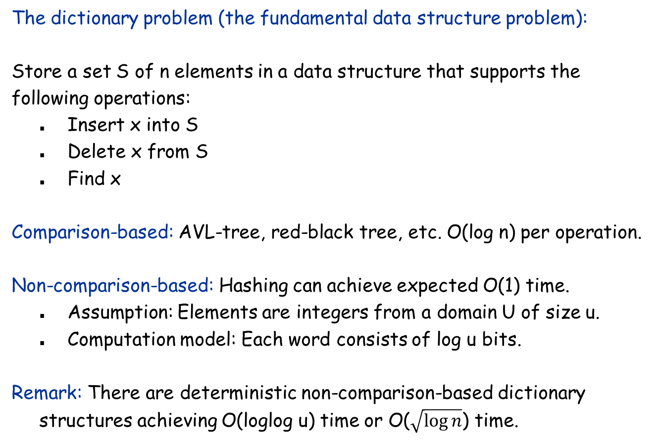
The Dictionary Problem
The dictionary problem (the fundamental data structure problem):
Store a set S of n elements in a data structure that supports the following operations:
Insert x into S
Delete x from S
Find x
Comparison-based: AVL-tree, red-black tree, etc. O(log n) per operation.
Non-comparison-based: Hashing can achieve expected O(1) time.
Assumption: Elements are integers from a domain U of size u.
Computation model: Each word consists of log u bits.
Remark: There are deterministic non-comparison-based dictionary structures achieving O(loglog u) time or O($\sqrt{\log{n}}$) time.

Slide 36
Hash Table
Hash function. h : U → { 0, 1, …, n-1 }.
Hash table. Create an array H of size n. When processing element x, access array element H[h(x)].
Collision. When h(x) = h(y) but x ≠ y.
Separate chaining: H[i] stores linked list of elements x with h(x) = i.
Linear probing: if H[h(x)] is occupied, try H[h(x)+1], H[h(x)+2], … (wrap around when necessary)
H[0]
51230
12350
H[1]
null
H[2]
12352
562
122
H[9]
969

Slide 37
Analysis of Hashing in an Undergrad Algorithms Course
Suppose we use separate chaining
Assumption: h is a truly random hash function.
For any x, h(x) is uniformly distributed in { 0, 1, …, n-1 }.
Let U = {x₁, x₂, …, x_{u}}. h(x₁), h(x₂), …, h(x_{u}) are mutually independent.
Theorem: For any x, the expected number of elements colliding with x is O(1).
Pf: Use linearity of expectation.
Corollary: Insert, delete, find all take O(1) time in expectation. Amortization is needed to maintain Θ(n) space.
Unfortunately, truly random hash functions don’t exist. (More precisely, such a function requires O(u log n) bits to represent.)

Slide 38
Ad Hoc Hash Function
Ad hoc hash function.
Deterministic hashing. If u ≥ n², then for any fixed hash function h, there is a subset S ⊆ U of n elements that all hash to same slot. Thus, Θ(n) time per search in the worst case.
Q. But isn't ad hoc hash function good enough in practice?
int h(String s, int n) {
int hash = 0;
for (int i = 0; i < s.length(); i++)
hash = (31 * hash) + s[i];
return hash % n;
}
hash function ala Java string library

Slide 39
Algorithmic Complexity Attacks
When can't we live with ad hoc hash functions?
Obvious situations: aircraft control, nuclear reactors.
Denial-of-service attacks.
Q: How about using MD5, SHA-x?
A: Performance Cryptographic guarantees vs probabilistic guarantees
malicious adversary learns your ad hoc hash function (e.g., by reading Java API) and causes a big pile-up in a single slot that grinds performance to a halt

Slide 40

Universal Hashing
Universal class of hash functions. [Carter-Wegman 1980s]
For any pair of elements x, y $∈$ U, Pr_{h∈H}[h(x)=h(y)] ≤ 1/n
Can select random h efficiently.
Can compute h(x) efficiently.
Ex. U = { a, b, c, d, e, f }, n = 2.
chosen uniformly at random
a
b
c
d
e
f
H = {h₁, h₂}
Pr _{h ∈ H} [h(a) = h(b)] = 1/2
Pr _{h ∈ H} [h(a) = h(c)] = 1 Pr _{h ∈ H} [h(a) = h(d)] = 0 . . .
h₁(x)
0
1
0
1
0
1
not universal
h₂(x)
0
0
0
1
1
1
a
b
c
d
e
f
H = {h₁, h₂ , h₃ , h₄}
Pr _{h ∈ H} [h(a) = h(b)] = 1/2 Pr _{h ∈ H} [h(a) = h(c)] = 1/2
Pr _{h ∈ H} [h(a) = h(d)] = 1/2
Pr _{h ∈ H} [h(a) = h(e)] = 1/2
Pr _{h ∈ H} [h(a) = h(f)] = 0
. . .
h₁(x)
0
1
0
1
0
1
h₂(x)
0
0
0
1
1
1
universal
h₃(x)
0
0
1
0
1
1
h₄(x)
1
0
0
1
1
0

Slide 41
Universal Hashing
Universal hashing property. Let H be a universal class of hash functions, let h ∈ H be chosen uniformly at random from H, and let x ∈ U. For any subset S ⊆ U of size at most n, the expected number of items in S that collide with x is at most 1.
Pf. For any element s ∈ S, define indicator random variable X_{s} = 1 if h(s) = h(x) and 0 otherwise. Let X be a random variable counting the total number of collisions with u.
linearity of expectation
X_{s} is a 0-1 random variable
universal (assumes u ∉ S)

Slide 42
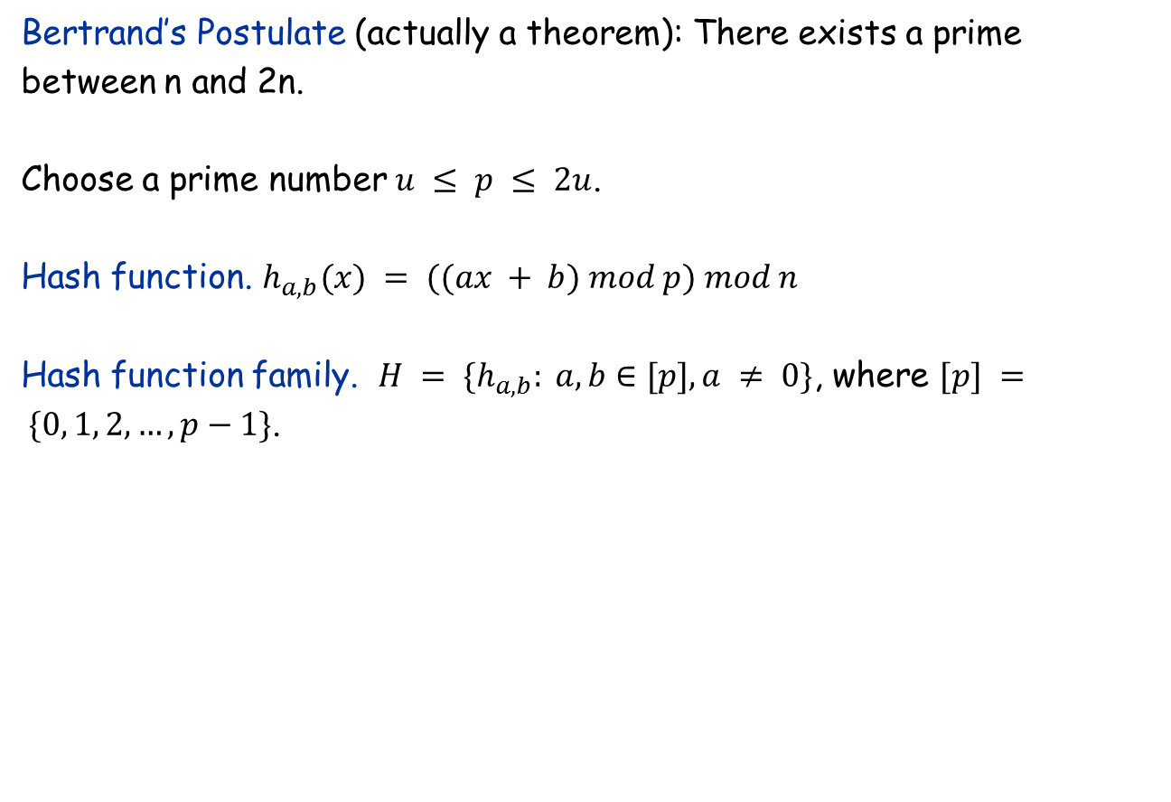
Designing a Universal Family of Hash Functions
Bertrand’s Postulate (actually a theorem): There exists a prime between n and 2n.
Choose a prime number $u ≤ p ≤ 2u$.
Hash function. $h_{a,b}(x) = ((ax + b) mod p) mod n$
Hash function family. $H = \{h_{a,b}: a, b∈[p], a ≠ 0\}$, where $[p] = \{0, 1, 2, …, p−1\}$.
no need for randomness here

Slide 43
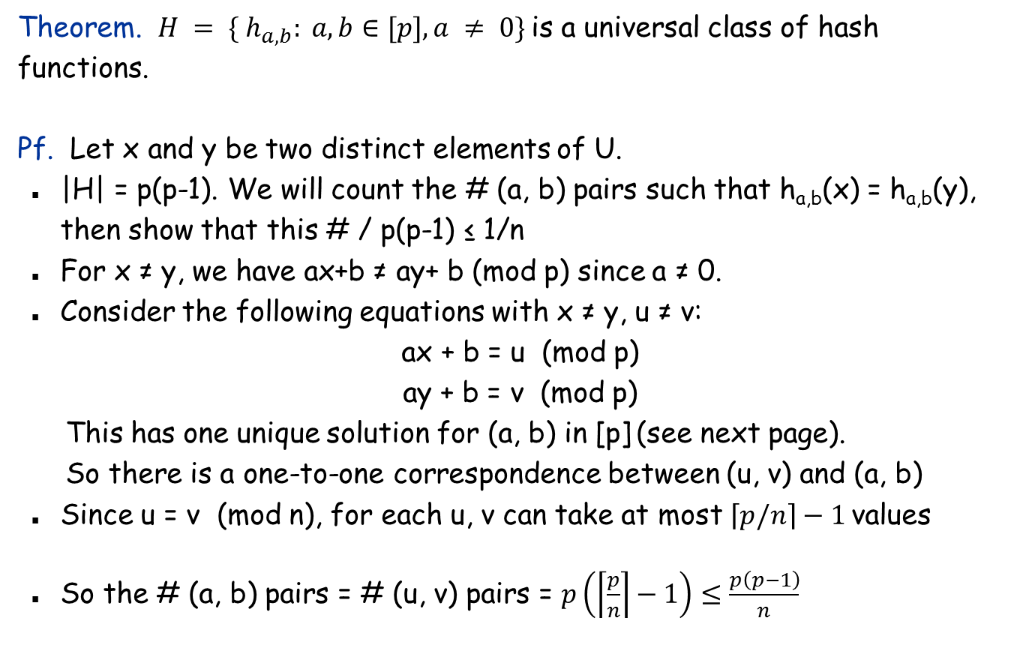
Designing a Universal Class of Hash Functions
Theorem. $H = \{ h_{a,b}: a, b∈[p], a ≠ 0\}$is a universal class of hash functions.
Pf. Let x and y be two distinct elements of U.
|H| = p(p-1). We will count the # (a, b) pairs such that h_{a,b}(x) = h_{a,b}(y), then show that this # / p(p-1) ≤ 1/n
For x ≠ y, we have ax+b ≠ ay+ b (mod p) since a ≠ 0.
Consider the following equations with x ≠ y, u ≠ v:
ax + b = u (mod p)
ay + b = v (mod p)
This has one unique solution for (a, b) in [p] (see next page).
So there is a one-to-one correspondence between (u, v) and (a, b)
Since u = v (mod n), for each u, v can take at most $\left\lceil p/n\right\rceil −1$values
So the # (a, b) pairs = # (u, v) pairs = $p\left(\left\lceil \frac{p}{n}\right\rceil −1\right)≤\frac{p\left(p−1\right)}{n}$

Slide 44
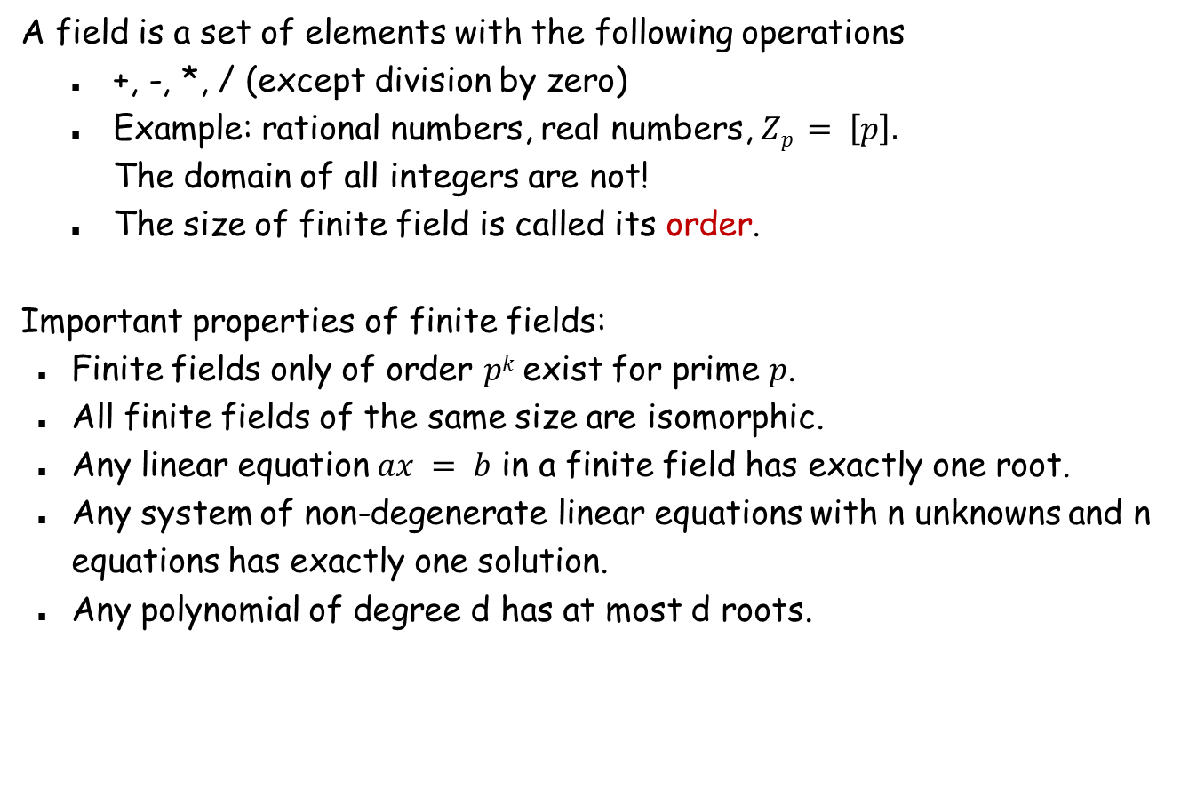
Finite Field Basics
A field is a set of elements with the following operations
+, -, *, / (except division by zero)
Example: rational numbers, real numbers, $Zp = \left[p\right].$ The domain of all integers are not!
The size of finite field is called its order.
Important properties of finite fields:
Finite fields only of order $pk$ exist for prime $p$.
All finite fields of the same size are isomorphic.
Any linear equation $ax = b$ in a finite field has exactly one root.
Any system of non-degenerate linear equations with n unknowns and n equations has exactly one solution.
Any polynomial of degree d has at most d roots.

Slide 45
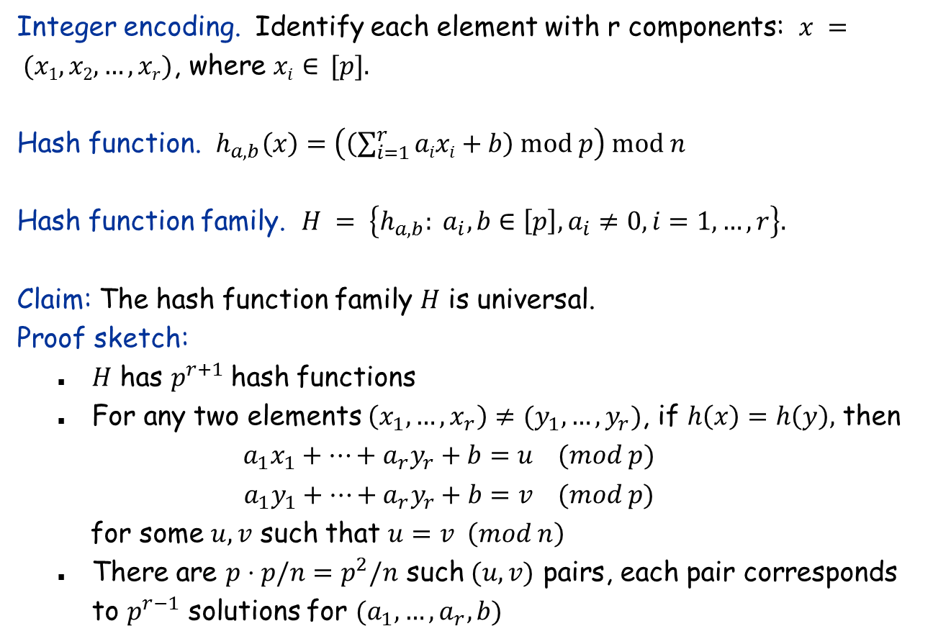
How to Deal with Composite Data Types
Integer encoding. Identify each element with r components: $x = (x1, x2, …, xr)$, where $xi∈ [p].$
Hash function. $h_{a,b}\left(x\right)=\left(\left(\sum_{i=1}^{r}{aixi}+b\right) mod p\right) mod n$
Hash function family. $H = \left\{h_{a,b}: a_{i}, b∈\left[p\right], a_{i}≠0,i=1,…,r\right\}.$
Claim: The hash function family $H$ is universal.
Proof sketch:
$H$ has $p^{r+1}$hash functions
For any two elements $\left(x_{1},…,x_{r}\right)≠(y_{1},…,y_{r})$, if $h\left(x\right)=h\left(y\right),$ then
$$a_{1}x_{1}+…+a_{r}y_{r}+b=u (mod p)$$
$$a_{1}y_{1}+…+a_{r}y_{r}+b=v (mod p)$$
for some $u,v$ such that $u=v \left(mod n\right)$
There are $p⋅p/n=p^{2}/n$ such $(u,v)$ pairs, each pair corresponds to $p^{r−1}$ solutions for $(a_{1},…,a_{r}, b)$

Slide 46
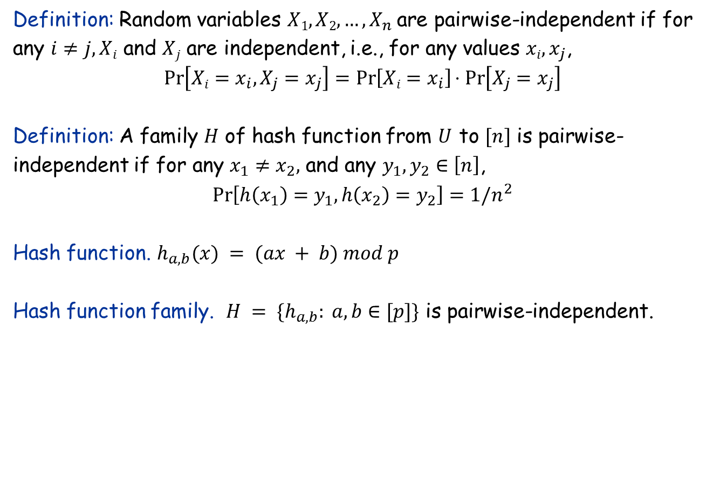
Pairwise-Independent Hash Functions
Definition: Random variables $X1, X2, …, X_{n}$are pairwise-independent if for any $i≠j, Xi$ and $Xj$ are independent, i.e., for any values $xi, x_{j}$,
$$\operatorname{Pr}\left[Xi=x_{i},X_{j}=x_{j}\right]=\operatorname{Pr}\left[Xi=x_{i}\right]⋅Pr\left[X_{j}=x_{j}\right]$$
Definition: A family $H$ of hash function from $U$ to $[n]$ is pairwise-independent if for any $x_{1}≠x_{2},$ and any $y_{1},y_{2}∈\left[n\right]$,
$$\operatorname{Pr}\left[h\left(x_{1}\right)=y_{1},h\left(x_{2}\right)=y_{2}\right]=1/n^{2}$$
Hash function. $h_{a,b}(x) = (ax + b) mod p$
Hash function family. $H = \{h_{a,b}: a, b∈[p]\}$ is pairwise-independent.

Slide 47
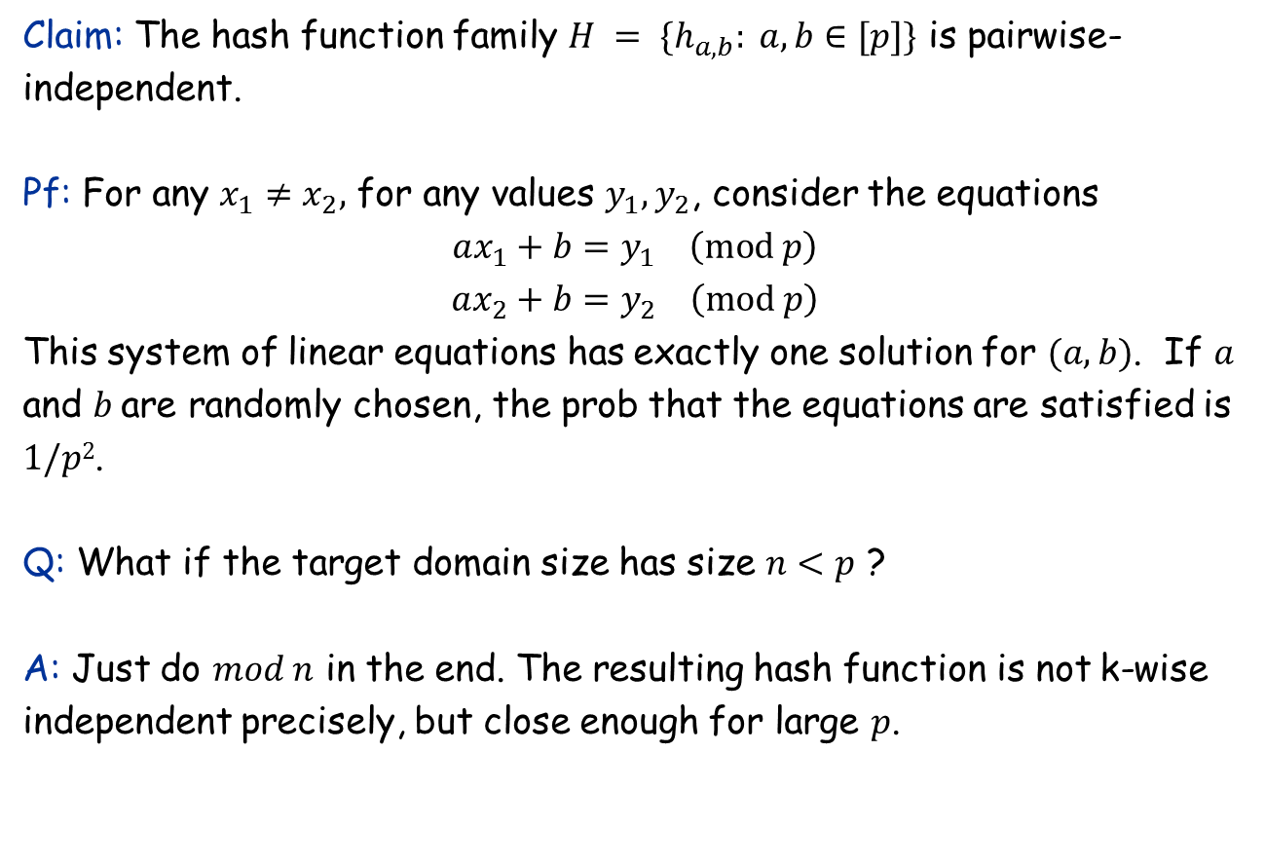
Pairwise-Independent Hash Functions
Claim: The hash function family $H = \{h_{a,b}: a, b∈[p]\}$ is pairwise-independent.
Pf: For any $x_{1}≠x_{2},$ for any values $y_{1},y_{2}$, consider the equations
$$ax_{1}+b=y_{1} \left(mod p\right)$$
$$ax_{2}+b=y_{2} \left(mod p\right)$$
This system of linear equations has exactly one solution for $(a, b)$. If $a$ and $b$are randomly chosen, the prob that the equations are satisfied is $1/p2$.
Q: What if the target domain size has size $n<p$ ?
A: Just do $mod n$ in the end. The resulting hash function is not k-wise independent precisely, but close enough for large $p$.

Slide 48
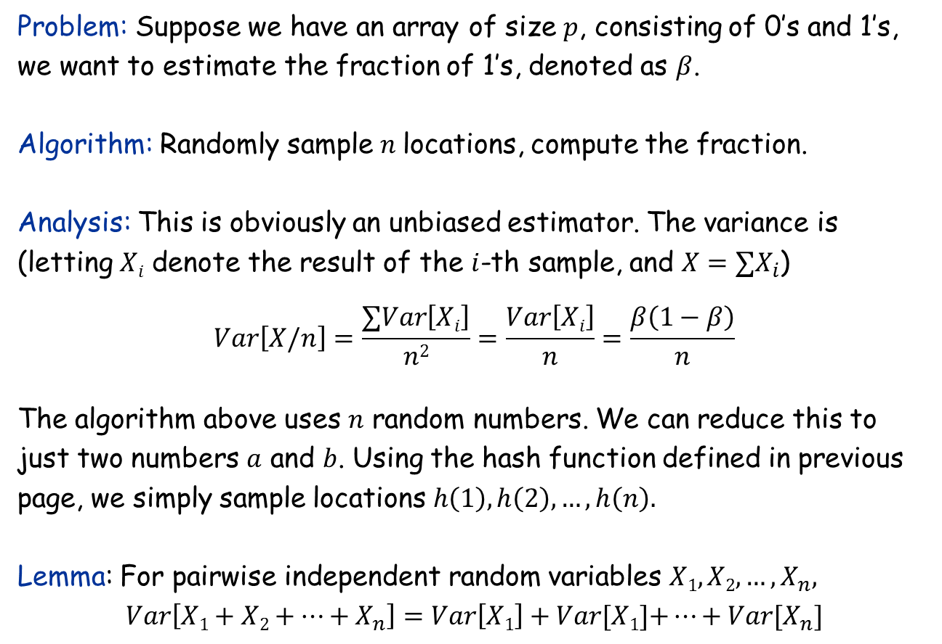
Application of Pairwise Independence: Randomness Reduction
Problem: Suppose we have an array of size $p$, consisting of 0’s and 1’s, we want to estimate the fraction of 1’s, denoted as $β$.
Algorithm: Randomly sample $n$locations, compute the fraction.
Analysis: This is obviously an unbiased estimator. The variance is (letting $Xi$ denote the result of the $i$-th sample, and $X=∑X_{i}$)
$$Var\left[X/n\right]=\frac{∑Var\left[Xi\right]}{n2}=\frac{Var\left[Xi\right]}{n}=\frac{β\left(1−β\right)}{n}$$
The algorithm above uses $n$ random numbers. We can reduce this to just two numbers $a$ and $b$. Using the hash function defined in previous page, we simply sample locations $h\left(1\right), h\left(2\right),…,h\left(n\right).$
Lemma: For pairwise independent random variables $X1, X2, …, X_{n},$
$$Var\left[X1+X2+…+X_{n}\right]=Var\left[X1\right]+Var[X1]\text{+}…+Var[X_{n}]$$

Slide 49
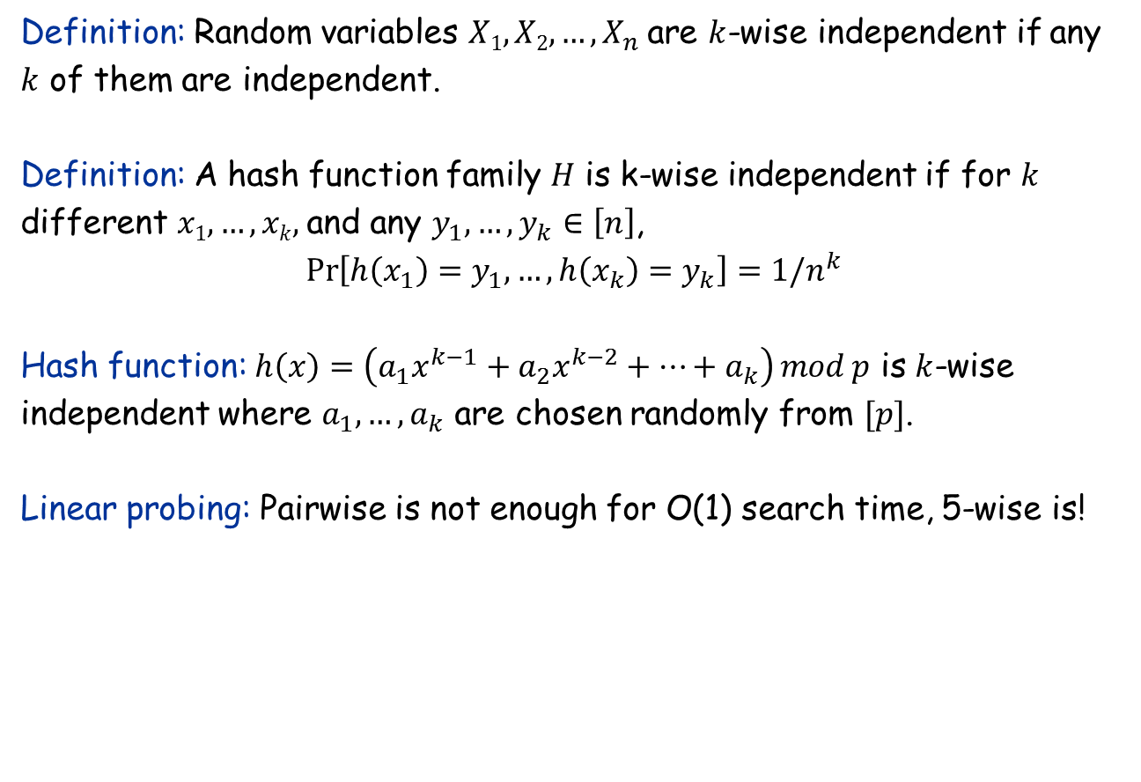
Generalization to k-wise independence
Definition: Random variables $X1, X2, …, X_{n}$are $k$-wise independent if any $k$ of them are independent.
Definition: A hash function family $H$ is k-wise independent if for $k$ different $x1,…,xk,$and any $y_{1},{…,y}_{k}∈\left[n\right]$,
$$\operatorname{Pr}\left[h\left(x_{1}\right)=y_{1},…,h\left(x_{k}\right)=y_{k}\right]=1/n^{k}$$
Hash function: $h\left(x\right)=\left(a_{1}x^{k−1}+a_{2}x^{k−2}+…+a_{k}\right) mod p$ is $k$-wise independent where $a_{1},…, a_{k}$ are chosen randomly from $[p]$.
Linear probing: Pairwise is not enough for O(1) search time, 5-wise is!

Slide 50
13.7 Finding the Closest Pair of Points
One of the first problems studied in computational geometry. The randomized algorithm is faster than the best known deterministic algorithm.

Slide 51
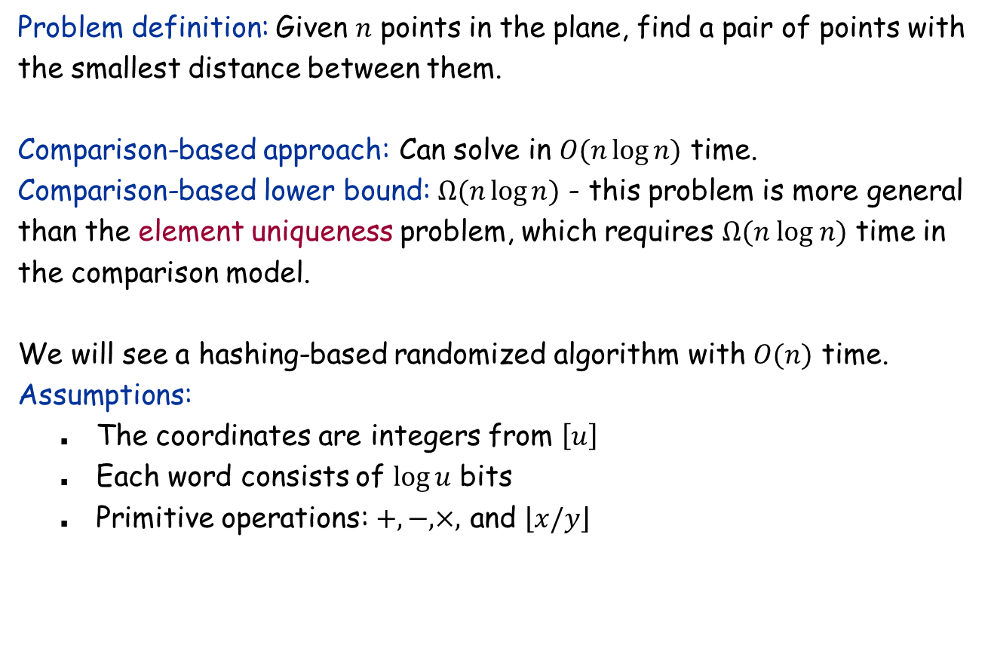
The Closest Pair of Points Problem
Problem definition: Given $n$ points in the plane, find a pair of points with the smallest distance between them.
Comparison-based approach: Can solve in $O(n\log{n)}$ time.
Comparison-based lower bound: $Ω(n\log{n)}$ - this problem is more general than the element uniqueness problem, which requires $Ω(n log n)$ time in the comparison model.
We will see a hashing-based randomized algorithm with $O(n)$ time.
Assumptions:
The coordinates are integers from $\left[u\right]$
Each word consists of $\log{u}$ bits
Primitive operations: $+,−,×,$ and $\left\lfloor x/y\right\rfloor$

Slide 52
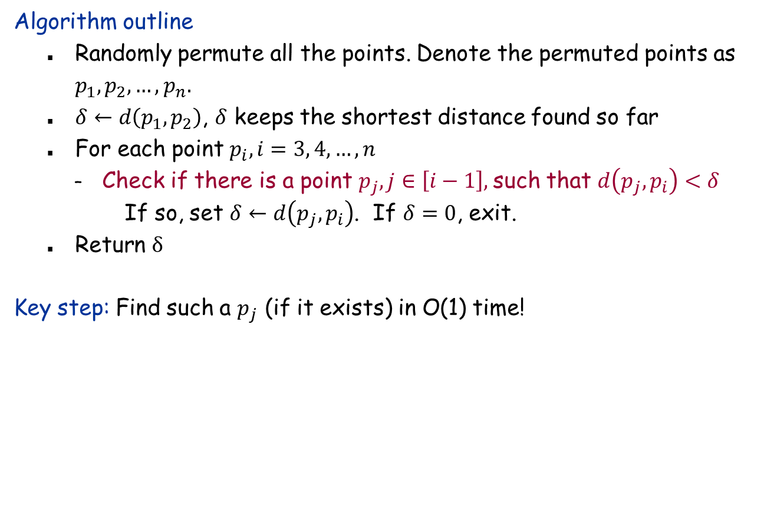
Algorithm Outline
Algorithm outline
Randomly permute all the points. Denote the permuted points as $p_{1},p_{2},…, p_{n}.$
$δ←d\left(p_{1},p_{2}\right)$, $δ$ keeps the shortest distance found so far
For each point $p_{i},i=3, 4,…,n$
Check if there is a point $p_{j}, j∈\left[i−1\right],$such that $d\left(p_{j},p_{i}\right)<δ$
If so, set $δ←d\left(p_{j},p_{i}\right)$. If $δ=0$, exit.
Return $δ$
Key step: Find such a $p_{j}$ (if it exists) in O(1) time!

Slide 53
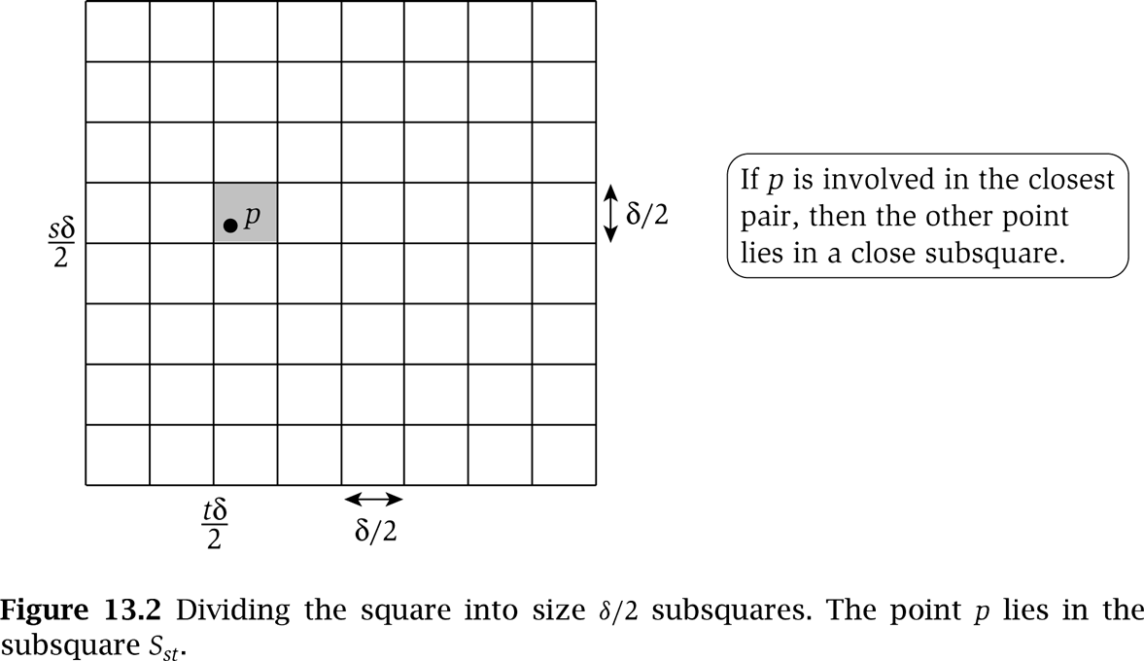
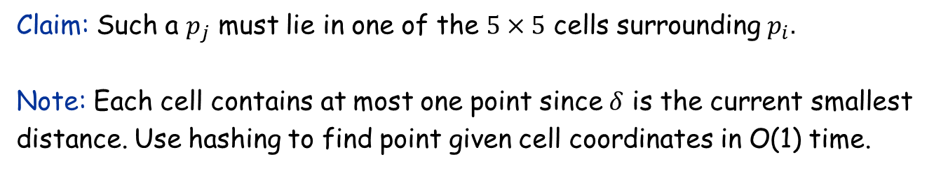
Gridding
Claim: Such a $p_{j}$ must lie in one of the $5×5$ cells surrounding $p_{i}.$
Note: Each cell contains at most one point since $δ$ is the current smallest distance. Use hashing to find point given cell coordinates in O(1) time.

Slide 54
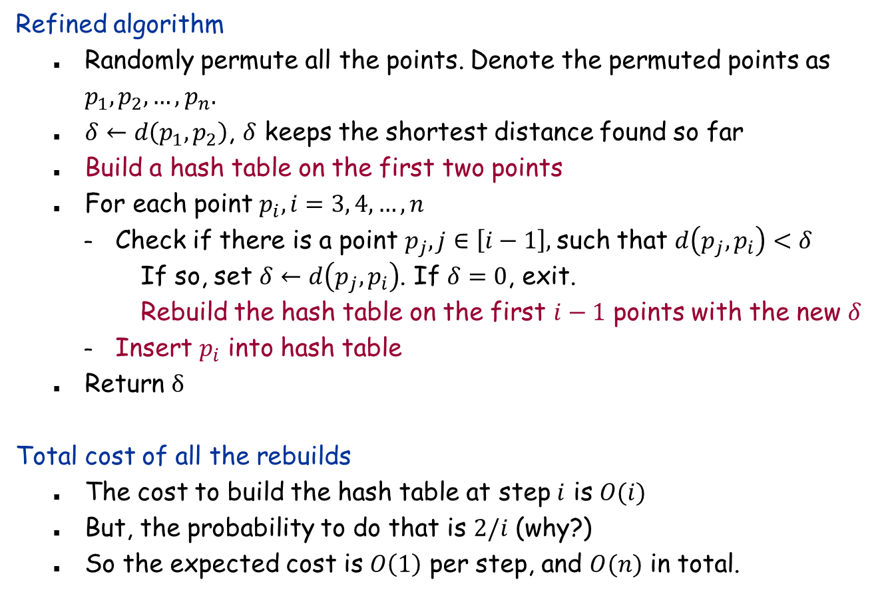
Refined Algorithm
Refined algorithm
Randomly permute all the points. Denote the permuted points as $p_{1},p_{2},…, p_{n}.$
$δ←d\left(p_{1},p_{2}\right)$, $δ$ keeps the shortest distance found so far
Build a hash table on the first two points
For each point $p_{i},i=3, 4,…,n$
Check if there is a point $p_{j}, j∈\left[i−1\right],$such that $d\left(p_{j},p_{i}\right)<δ$
If so, set $δ←d\left(p_{j},p_{i}\right)$. If $δ=0$, exit.
Rebuild the hash table on the first $i−1$ points with the new $δ$
Insert $p_{i}$ into hash table
Return $δ$
Total cost of all the rebuilds
The cost to build the hash table at step $i$ is $O(i)$
But, the probability to do that is $2/i$ (why?)
So the expected cost is $O\left(1\right)$ per step, and $O(n)$ in total.

Slide 55
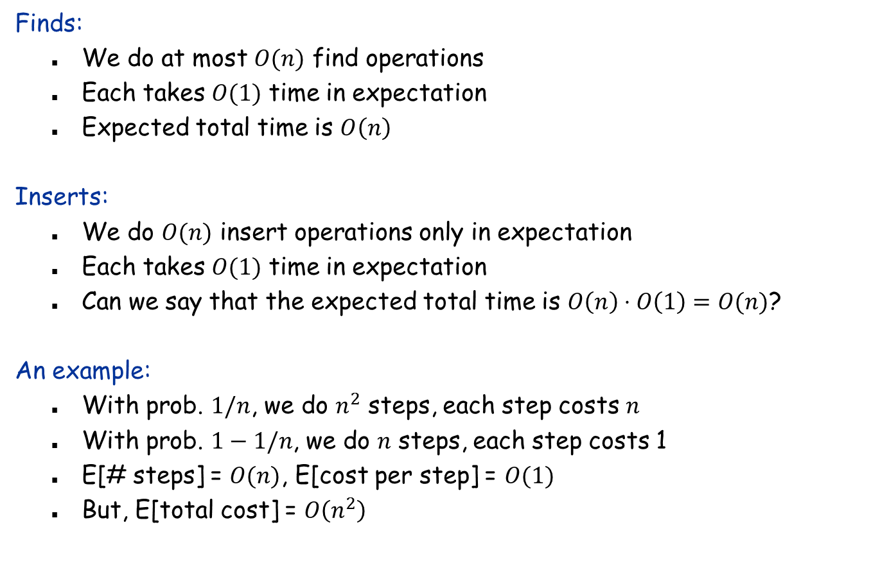
Analysis
Finds:
We do at most $O(n)$ find operations
Each takes $O(1)$ time in expectation
Expected total time is $O\left(n\right)$
Inserts:
We do $O(n)$ insert operations only in expectation
Each takes $O(1)$ time in expectation
Can we say that the expected total time is $O\left(n\right)⋅O\left(1\right)=O(n)$?
An example:
With prob. $1/n$, we do $n^{2}$ steps, each step costs $n$
With prob. $1−1/n$, we do $n$ steps, each step costs 1
E[# steps] = $O(n)$, E[cost per step] = $O(1)$
But, E[total cost] = $O\left(n^{2}\right)$

Slide 56
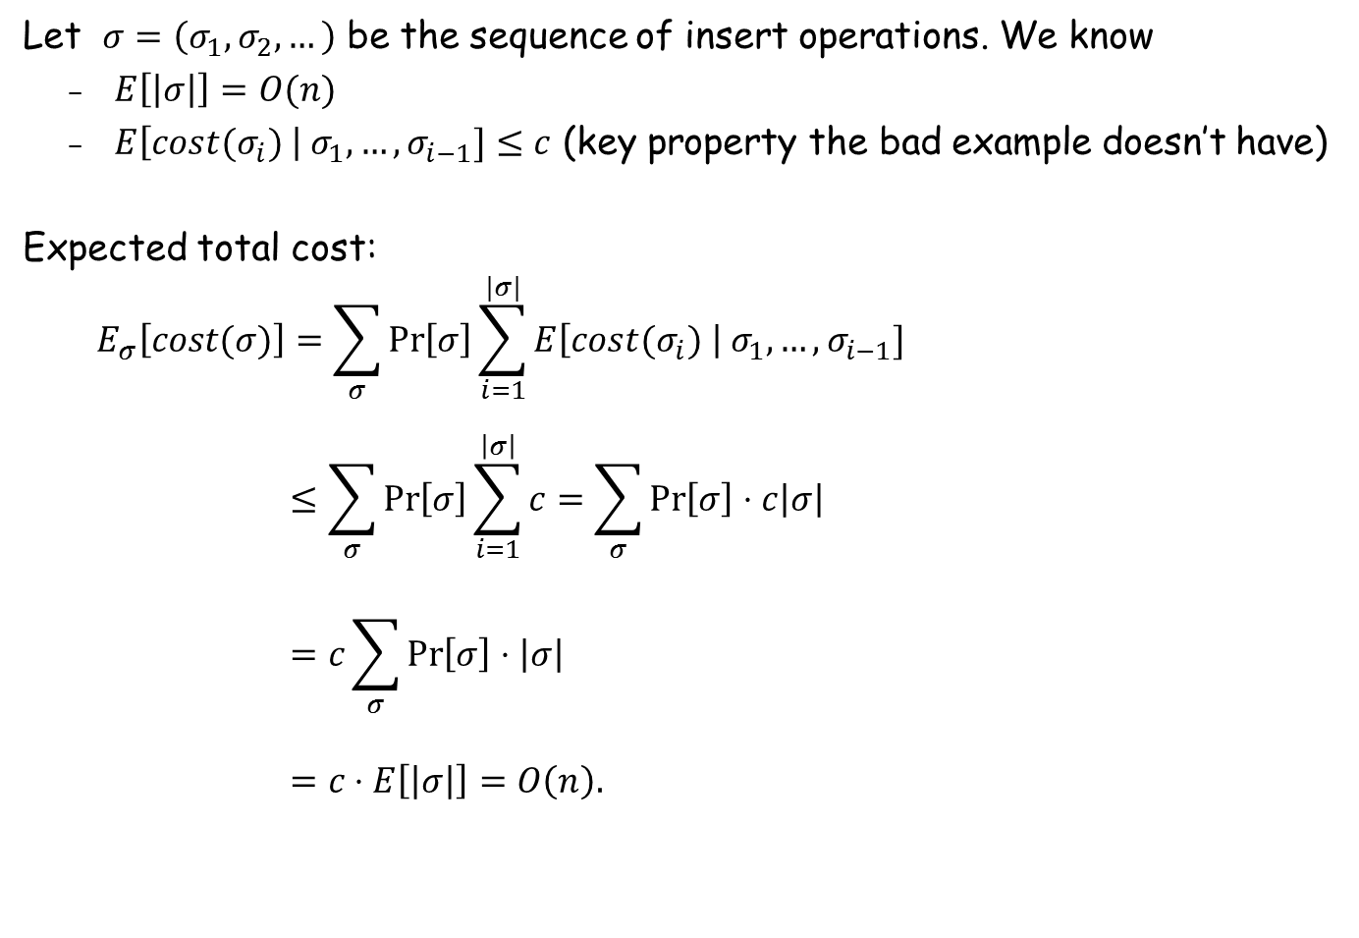
A More Rigorous Analysis
Let $σ=\left(σ_{1},σ_{2},…\right)$ be the sequence of insert operations. We know
$E\left[\left|σ\right|\right]=O(n)$
$E\left[cost(σ_{i}) \right| σ_{1},…,σ_{i−1}]≤c$ (key property the bad example doesn’t have)
Expected total cost:
$$E_{σ}\left[cost(σ)\right]=\sum_{σ}{\operatorname{Pr}\left[σ\right]\sum_{i=1}^{|σ|}{E\left[cost(σ_{i}) \right| σ_{1},…,σ_{i−1}]}}$$
$$≤\sum_{σ}{\operatorname{Pr}\left[σ\right]}\sum_{i=1}^{\left|σ\right|}{c}=\sum_{σ}{\operatorname{Pr}\left[σ\right]}⋅c\left|σ\right|$$
$$=c\sum_{σ}{\operatorname{Pr}\left[σ\right]}⋅\left|σ\right|$$
$$=c⋅E\left[\left|σ\right|\right]=O\left(n\right).$$

Slide 57
Skip List
A simple randomized comparison-based dictionary

Slide 58
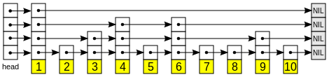
Skip List
Structure
Each key is promoted to the next higher level with probability 1/2.
All keys on each level are stored in a sorted linked list
Multiple copies of the same key are stored together
Find(x):
Start from the top level, search though the list until find the first key greater than or equal to x, or reaching the end
Then go one level down, and continue the same process
Insert/delete(x): O(1) expected time after Find.

Slide 59
Skip List: Benefits
Easy implementation: only need to use lists
No bookkeeping data as in AVL/red-black (similar to splay tree): smaller space
Faster range queries
Better and easier concurrent access
Check Wikipedia page for usage in practice

Slide 60
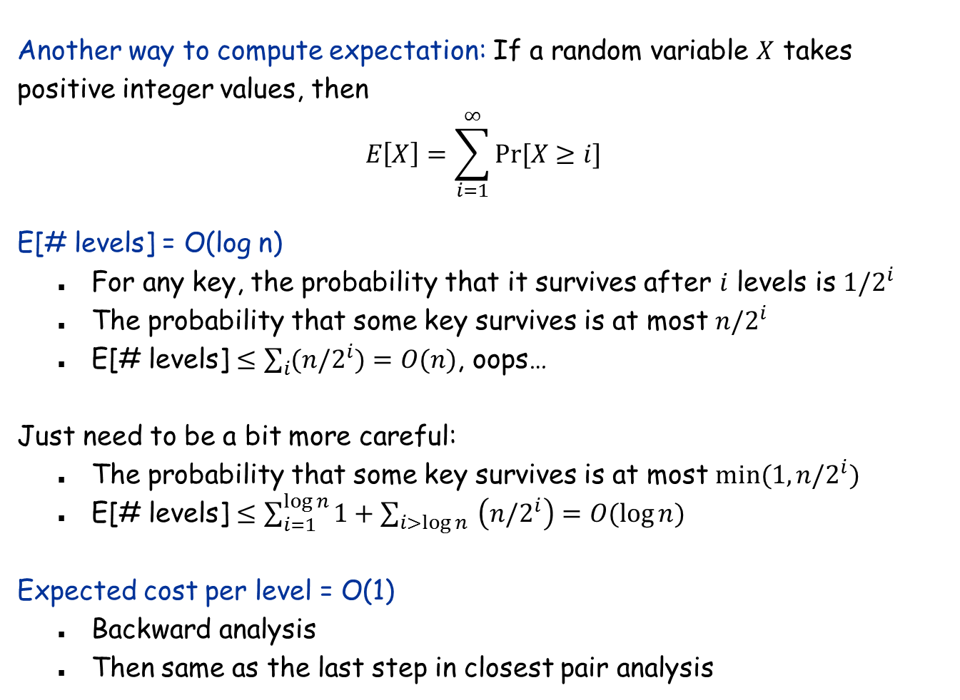
Skip List: Analysis
Another way to compute expectation: If a random variable $X$ takes positive integer values, then
$$E\left[X\right]=\sum_{i=1}^{∞}{Pr⁡[X≥i]}$$
E[# levels] = O(log n)
For any key, the probability that it survives after $i$ levels is ${1/2}^{i}$
The probability that some key survives is at most $n/2^{i}$
E[# levels] $≤\sum_{i}{(n/2^{i})}=O(n)$, oops…
Just need to be a bit more careful:
The probability that some key survives is at most $min(1,n/2^{i})$
E[# levels] $≤\sum_{i=1}^{\log{n}}{1}+\sum_{i>\log{n}}{ \left(n/2^{i}\right)}=O(\log{n})$
Expected cost per level = O(1)
Backward analysis
Then same as the last step in closest pair analysis

Slide 61
Randomized Incremental Construction
See MR 9.1-9.2

Slide 62

Convex Hulls
Problem: Given $n$ points in the plane, output the points on the convex hull in order.
Non-degenerate assumption: No 3 points are collinear. (In practice, make small perturbations to the points.)
Primitive operation: Given two line segments, do they intersect?
Lower bound: It is known that this problem is at least as hard as sorting.

Slide 63

Randomized Incremental Construction
Algorithm outline:
Randomly permute the points as $p_{1},p_{2},…,p_{n}$
Build the convex hull for $p_{1},p_{2},p_{3}$
Add the remaining points one by one, and update the convex hull after each step
Structural changes:
Each step adds at most one point to convex hull, but may delete many
Amortized # changes = O(1) (why?) Randomization not needed here

Slide 64

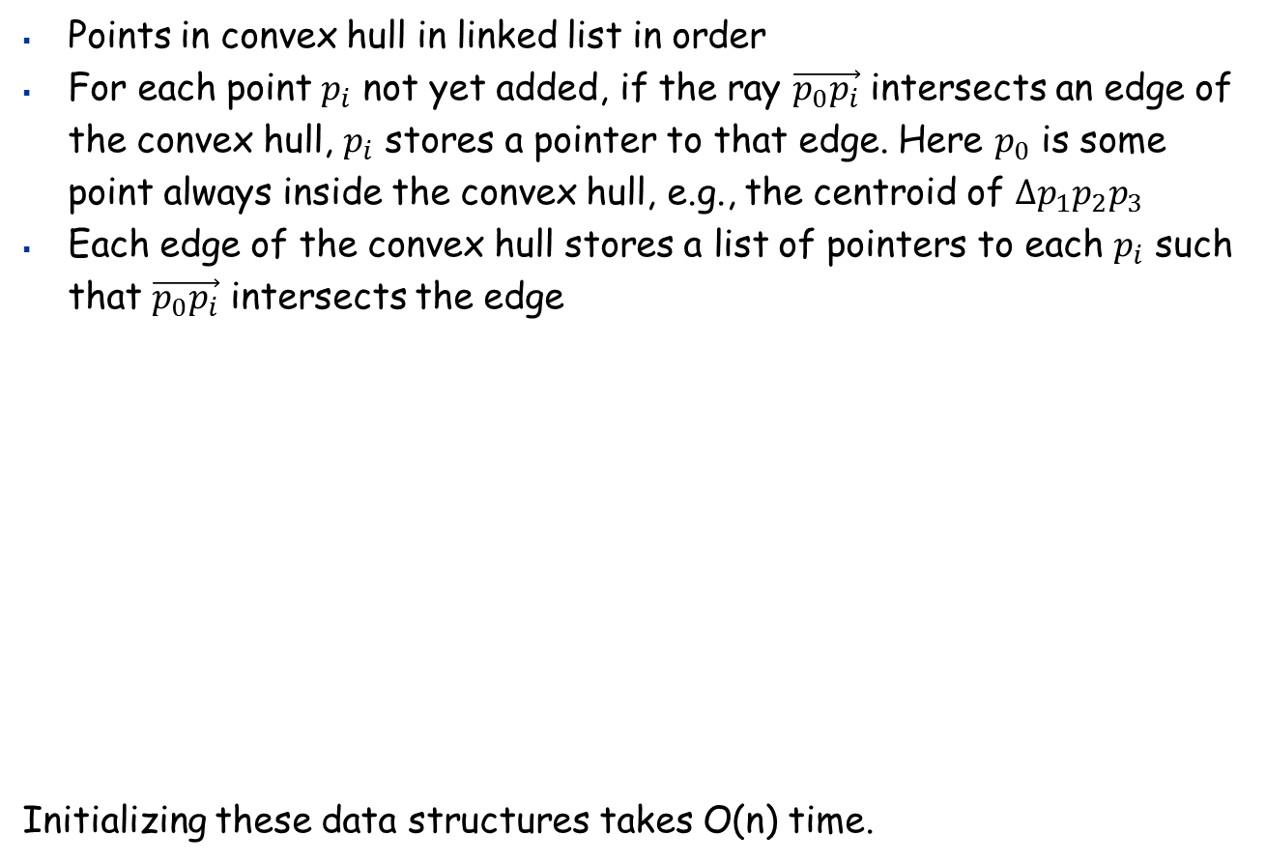
Data Structures
Points in convex hull in linked list in order
For each point $p_{i}$ not yet added, if the ray $\vec{p_{0}p_{i}}$ intersects an edge of the convex hull, $p_{i}$ stores a pointer to that edge. Here $p_{0}$ is some point always inside the convex hull, e.g., the centroid of $∆p_{1}p_{2}p_{3}$
Each edge of the convex hull stores a list of pointers to each $p_{i}$ such that $\vec{p_{0}p_{i}}$ intersects the edge
Initializing these data structures takes O(n) time.
$$p_{0}$$

Slide 65

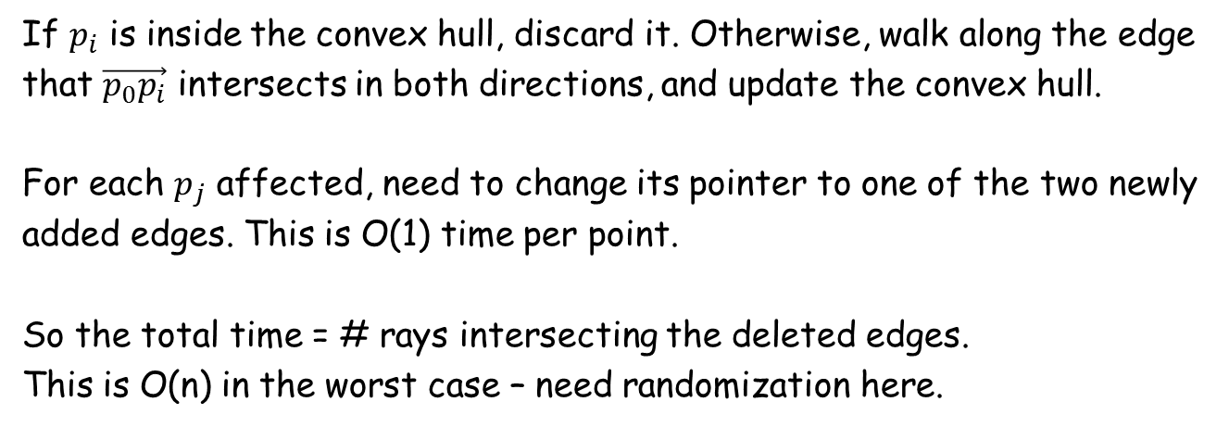


Add One Point
If $p_{i}$ is inside the convex hull, discard it. Otherwise, walk along the edge that $\vec{p_{0}p_{i}}$ intersects in both directions, and update the convex hull.
For each $p_{j}$ affected, need to change its pointer to one of the two newly added edges. This is O(1) time per point.
So the total time = # rays intersecting the deleted edges.
This is O(n) in the worst case – need randomization here.
$$p_{j}$$
$$p_{i}$$
$$p_{0}$$

Slide 66

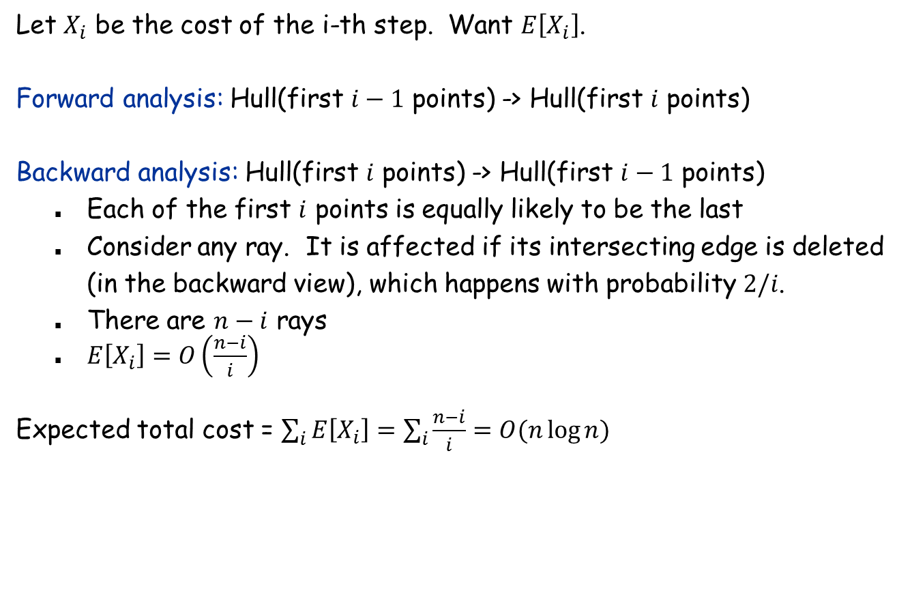
Analysis
Let $X_{i}$ be the cost of the i-th step. Want $E\left[X_{i}\right]$.
Forward analysis: Hull(first $i−1$ points) -> Hull(first $i$ points)
Backward analysis: Hull(first $i$ points) -> Hull(first $i−1$ points)
Each of the first $i$ points is equally likely to be the last
Consider any ray. It is affected if its intersecting edge is deleted (in the backward view), which happens with probability $2/i$.
There are $n−i$ rays
$E\left[X_{i}\right]=O\left(\frac{n−i}{i}\right)$
Expected total cost = $\sum_{i}{E\left[X_{i}\right]=\sum_{i}{\frac{n−i}{i}}=O(n\log{n})}$
$$p_{0}$$

Slide 67
13.8 Randomized Caching
An randomized online algorithm

Slide 68
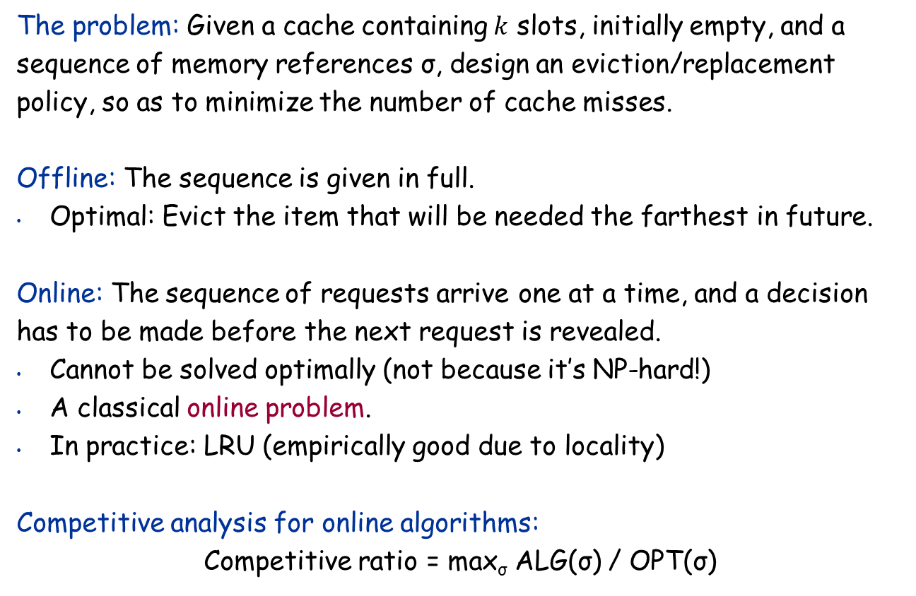
The Caching (Paging) Problem
The problem: Given a cache containing $k$ slots, initially empty, and a sequence of memory references σ, design an eviction/replacement policy, so as to minimize the number of cache misses.
Offline: The sequence is given in full.
Optimal: Evict the item that will be needed the farthest in future.
Online: The sequence of requests arrive one at a time, and a decision has to be made before the next request is revealed.
Cannot be solved optimally (not because it’s NP-hard!)
A classical online problem.
In practice: LRU (empirically good due to locality)
Competitive analysis for online algorithms:
Competitive ratio = max_{σ} ALG(σ) / OPT(σ)
# cache misses of the algorithm on input σ
Offline optimal on input σ

Slide 69
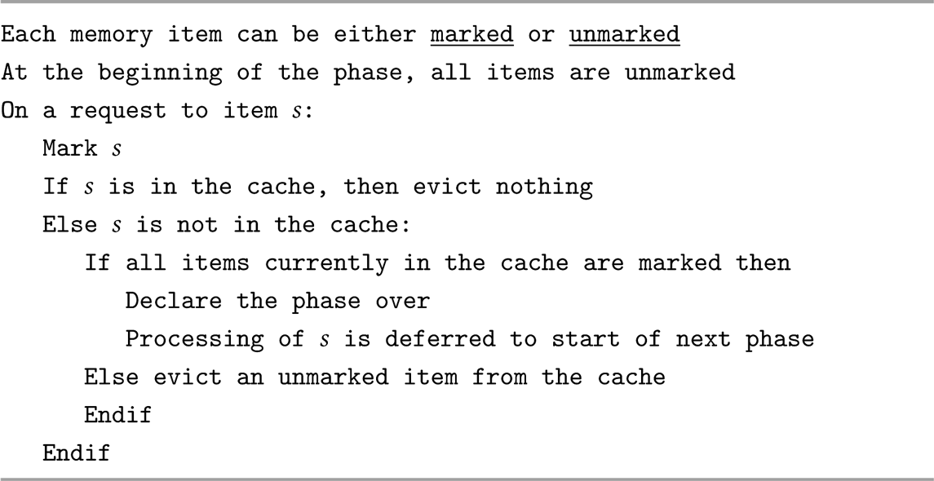
Marking Algorithms
Very similar to NRU (not recently used), often used on hardware level.
LRU is a special case of the marking algorithm

Slide 70
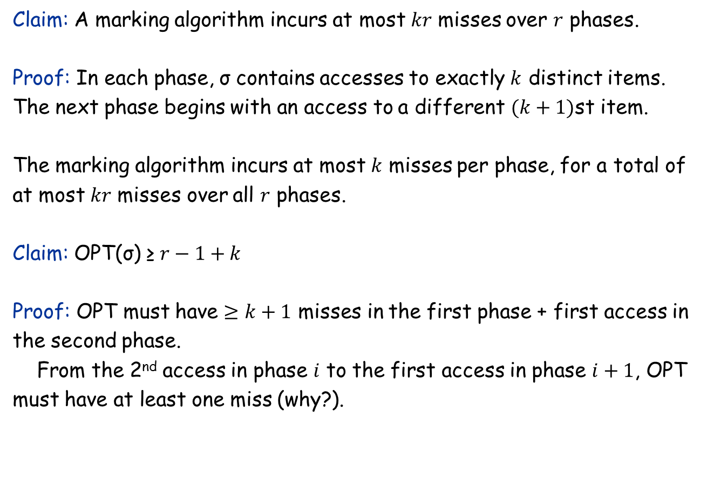
Analyzing Marking Algorithms
Claim: A marking algorithm incurs at most $kr$ misses over $r$ phases.
Proof: In each phase, σ contains accesses to exactly $k$ distinct items. The next phase begins with an access to a different $(k+1)$st item. The marking algorithm incurs at most $k$ misses per phase, for a total of at most $kr$ misses over all $r$ phases.
Claim: OPT(σ) ≥ $r−1+k$
Proof: OPT must have $≥k+1$ misses in the first phase + first access in the second phase. From the 2nd access in phase $i$ to the first access in phase $i+1$, OPT must have at least one miss (why?).

Slide 71
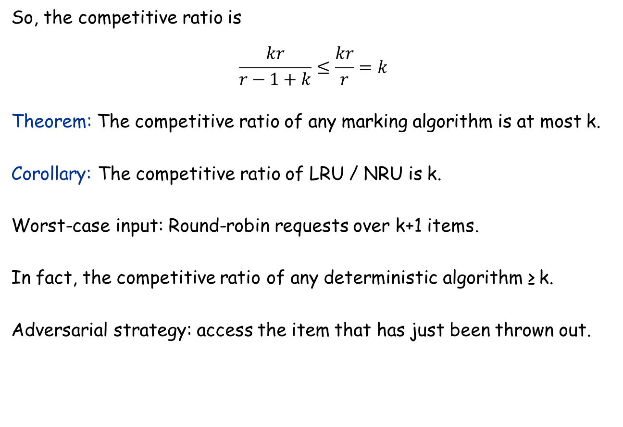
Competitive Ratio for a Marking Algorithm
So, the competitive ratio is
$$\frac{kr}{r−1+k}≤\frac{kr}{r}=k$$
Theorem: The competitive ratio of any marking algorithm is at most k.
Corollary: The competitive ratio of LRU / NRU is k.
Worst-case input: Round-robin requests over k+1 items.
In fact, the competitive ratio of any deterministic algorithm ≥ k. Adversarial strategy: access the item that has just been thrown out.

Slide 72
A Randomized Marking Algorithm
Chosen uniformly at random
Assumption: Adversary doesn’t know our random numbers.

Slide 73
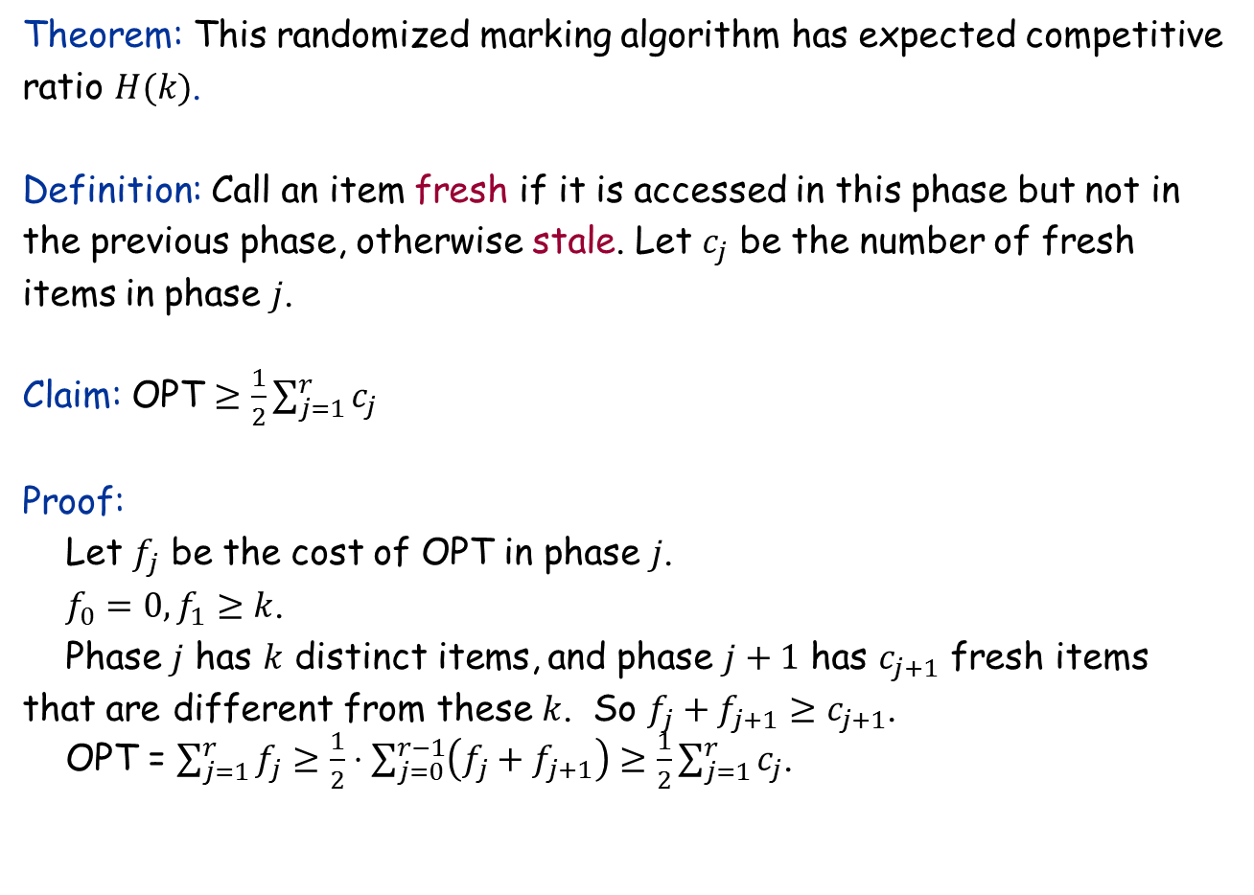
Analysis for the Randomized Marking Algorithm
Theorem: This randomized marking algorithm has expected competitive ratio $H(k)$.
Definition: Call an item fresh if it is accessed in this phase but not in the previous phase, otherwise stale. Let $c_{j}$ be the number of fresh items in phase $j$.
Claim: OPT $≥\frac{1}{2}\sum_{j=1}^{r}{c_{j}}$
Proof: Let $f_{j}$ be the cost of OPT in phase $j$. $f_{0}=0,f_{1}≥k$. Phase $j$ has $k$ distinct items, and phase $j+1$ has $c_{j+1}$ fresh items that are different from these $k$. So $f_{j}+f_{j+1}≥c_{j+1}$. OPT = $\sum_{j=1}^{r}{f_{j}}≥\frac{1}{2}⋅\sum_{j=0}^{r−1}{\left(f_{j}+f_{j+1}\right)≥\frac{1}{2}\sum_{j=1}^{r}{c_{j}}}$.

Slide 74

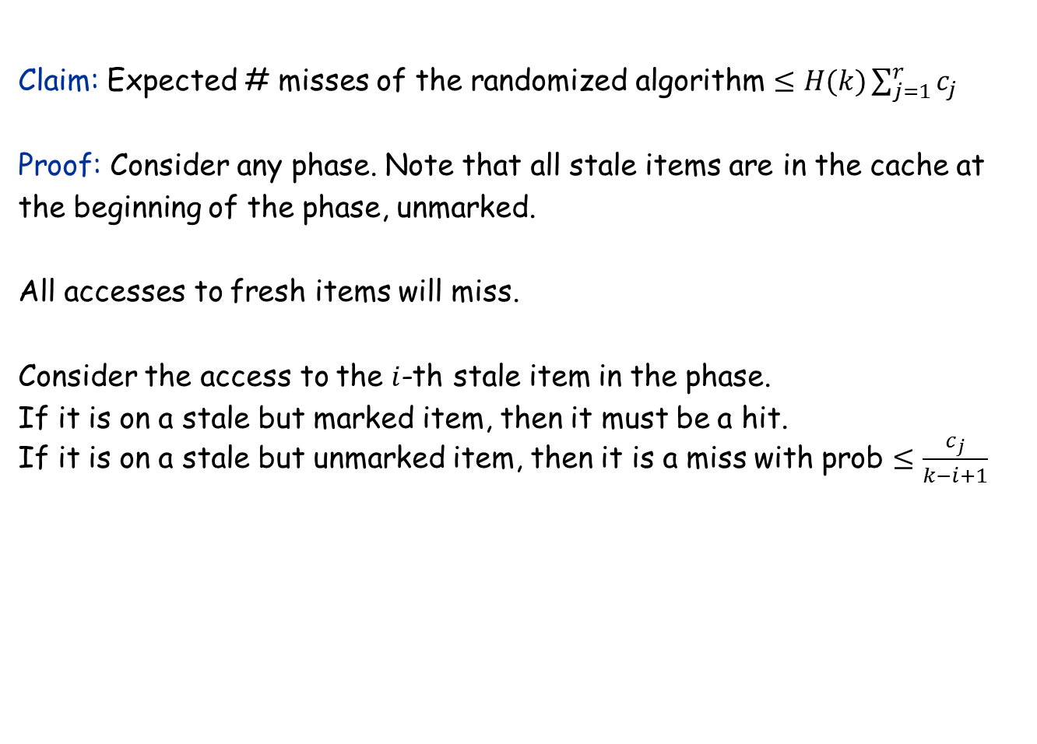

Analysis for the Randomized Marking Algorithm
Claim: Expected # misses of the randomized algorithm $≤H(k)\sum_{j=1}^{r}{c_{j}}$
Proof: Consider any phase. Note that all stale items are in the cache at the beginning of the phase, unmarked.
All accesses to fresh items will miss.
Consider the access to the $i$-th stale item in the phase. If it is on a stale but marked item, then it must be a hit. If it is on a stale but unmarked item, then it is a miss with prob $≤\frac{c_{j}}{k−i+1}$
$≤c_{j}$ fresh items
$i−1$ stale items accesses so far

Slide 75
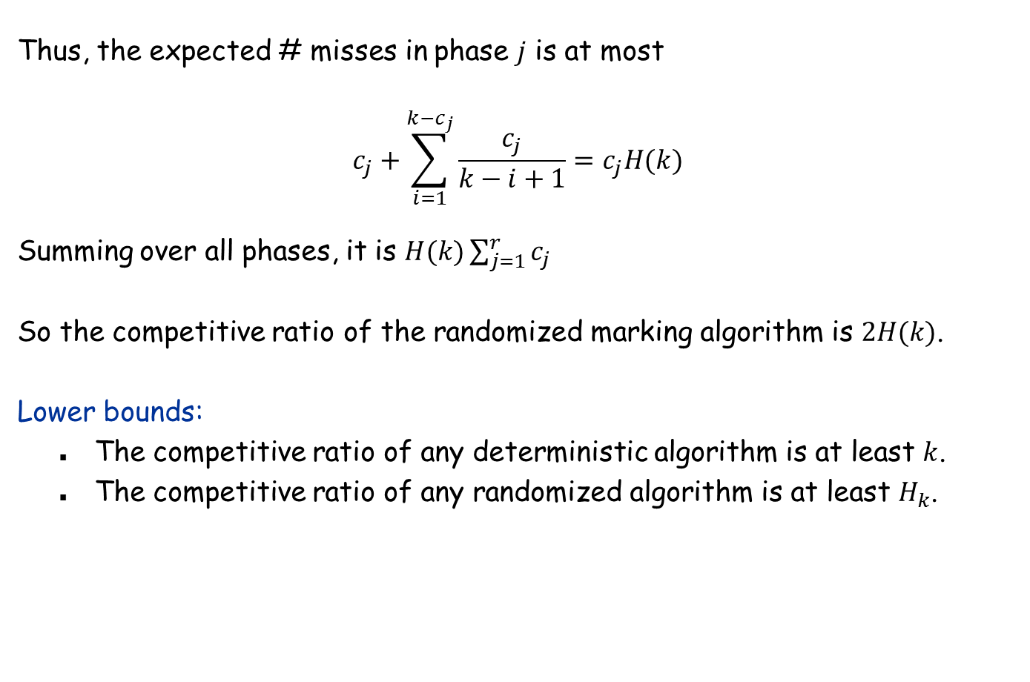
Analysis for the Randomized Marking Algorithm
Thus, the expected # misses in phase $j$ is at most
$$c_{j}+\sum_{i=1}^{k−c_{j}}{\frac{c_{j}}{k−i+1}}=c_{j}H(k)$$
Summing over all phases, it is $H(k)\sum_{j=1}^{r}{c_{j}}$
So the competitive ratio of the randomized marking algorithm is $2H(k)$.
Lower bounds:
The competitive ratio of any deterministic algorithm is at least $k$.
The competitive ratio of any randomized algorithm is at least $H_{k}$.

Slide 76
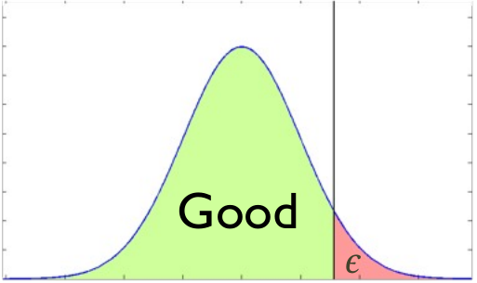
13.9 Tail Inequalities
KT 13.9
MR 3.2, 4.1

Slide 77
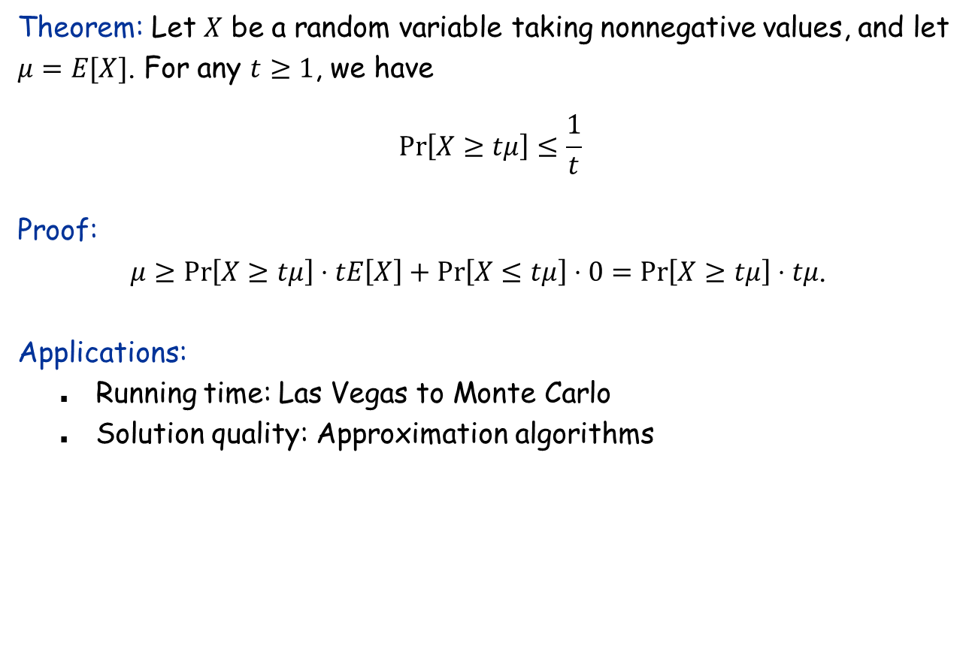
Markov inequality
Theorem: Let $X$ be a random variable taking nonnegative values, and let $μ=E[X]$. For any $t≥1$, we have $$\operatorname{Pr}\left[X≥tμ\right]≤\frac{1}{t}$$
Proof: $μ≥\operatorname{Pr}\left[X≥tμ\right]⋅tE\left[X\right]+\operatorname{Pr}\left[X≤tμ\right]⋅0=\operatorname{Pr}\left[X≥tμ\right]⋅tμ$.
Applications:
Running time: Las Vegas to Monte Carlo
Solution quality: Approximation algorithms

Slide 78
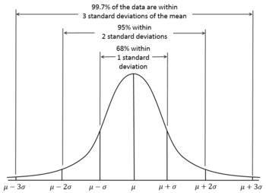
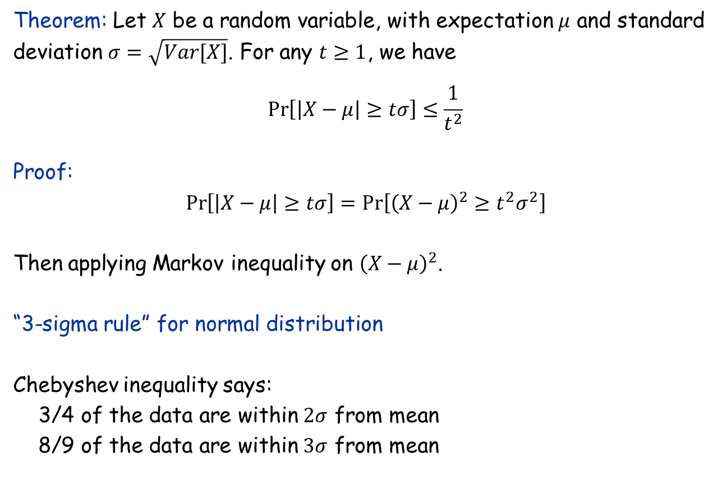
Chebyshev inequality
Theorem: Let $X$ be a random variable, with expectation $μ$ and standard deviation $σ=\sqrt{Var[X]}$. For any $t≥1$, we have $$\operatorname{Pr}\left[\left|X−μ\right|≥tσ\right]≤\frac{1}{t^{2}}$$
Proof: $$\operatorname{Pr}\left[\left|X−μ\right|≥tσ\right]=Pr\left[{\left(X−μ\right)}^{2}≥t^{2}σ^{2}\right]$$ Then applying Markov inequality on ${\left(X−μ\right)}^{2}$.
“3-sigma rule” for normal distribution Chebyshev inequality says: 3/4 of the data are within $2σ$ from mean 8/9 of the data are within $3σ$ from mean

Slide 79
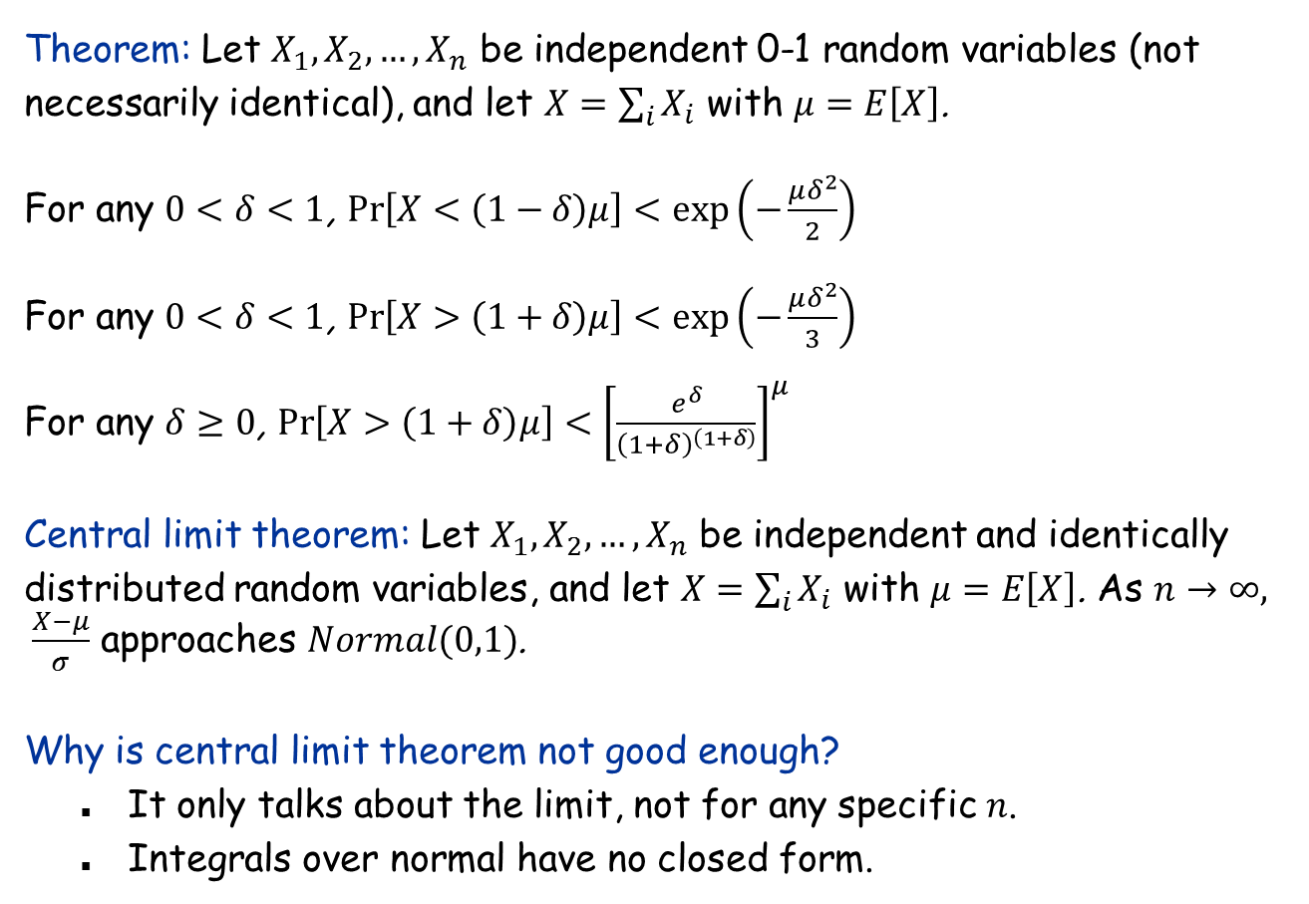
Chernoff inequality
Theorem: Let $X_{1},X_{2},…, X_{n}$ be independent 0-1 random variables (not necessarily identical), and let $X=\sum_{i}{X_{i}}$ with $μ=E\left[X\right]$.
For any $0<δ<1$, $\operatorname{Pr}\left[X<\left(1−δ\right)μ\right]<\exp\left(−\frac{μδ^{2}}{2}\right)$ For any $0<δ<1$, $\operatorname{Pr}\left[X>\left(1+δ\right)μ\right]<\exp\left(−\frac{μδ^{2}}{3}\right)$ For any $δ≥0$, $\operatorname{Pr}\left[X>\left(1+δ\right)μ\right]<{\left[\frac{e^{δ}}{{\left(1+δ\right)}^{\left(1+δ\right)}}\right]}^{μ}$ Central limit theorem: Let $X_{1},X_{2},…, X_{n}$ be independent and identically distributed random variables, and let $X=\sum_{i}{X_{i}}$ with $μ=E\left[X\right]$. As $n→∞, \frac{X−μ}{σ}$ approaches $Normal(0,1)$.
Why is central limit theorem not good enough?
It only talks about the limit, not for any specific $n$.
Integrals over normal have no closed form.

Slide 80
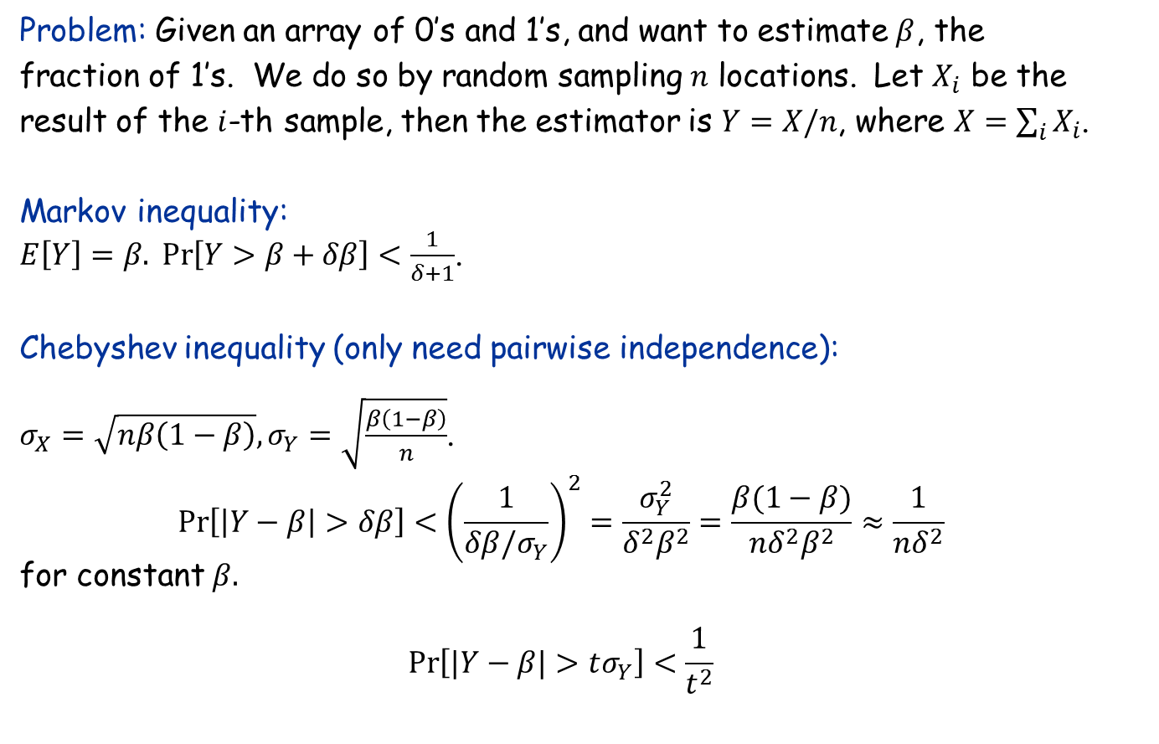
Application to Random Sampling
Problem: Given an array of 0’s and 1’s, and want to estimate $β$, the fraction of 1’s. We do so by random sampling $n$ locations. Let $X_{i}$ be the result of the $i$-th sample, then the estimator is $Y=X/n$, where $X=\sum_{i}{X_{i}}$.
Markov inequality: $E\left[Y\right]=β. \operatorname{Pr}\left[Y>β+δβ\right]<\frac{1}{δ+1}$.
Chebyshev inequality (only need pairwise independence): $σ_{X}=\sqrt{nβ\left(1−β\right)}, σ_{Y}=\sqrt{\frac{β\left(1−β\right)}{n}}$.
$$\operatorname{Pr}\left[\left|Y−β\right|>δβ\right]<{\left(\frac{1}{δβ/σ_{Y}}\right)}^{2}=\frac{σ_{Y}^{2}}{δ^{2}β^{2}}=\frac{β(1−β)}{{nδ}^{2}β^{2}}≈\frac{1}{nδ^{2}}$$
for constant $β.$
$$\operatorname{Pr}\left[|Y−β|>tσ_{Y}\right]<\frac{1}{t^{2}}$$

Slide 81
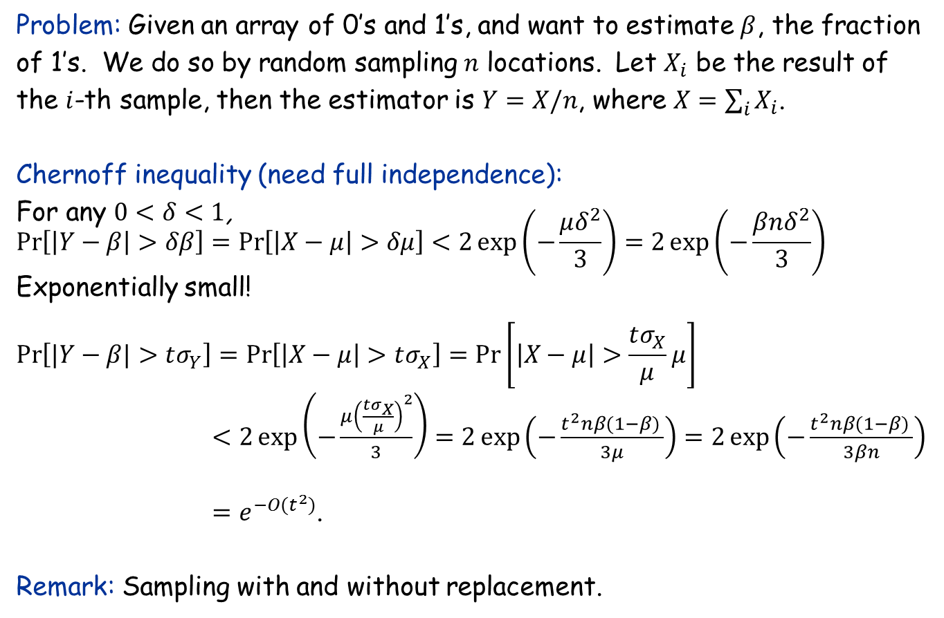
Application to Random Sampling
Problem: Given an array of 0’s and 1’s, and want to estimate $β$, the fraction of 1’s. We do so by random sampling $n$ locations. Let $X_{i}$ be the result of the $i$-th sample, then the estimator is $Y=X/n$, where $X=\sum_{i}{X_{i}}$.
Chernoff inequality (need full independence): For any $0<δ<1$, $$\operatorname{Pr}\left[\left|Y−β\right|>δβ\right]=\operatorname{Pr}\left[\left|X−μ\right|>δμ\right]<2\exp\left(−\frac{μδ^{2}}{3}\right)=2\exp\left(−\frac{βnδ^{2}}{3}\right)$$ Exponentially small!
$$\operatorname{Pr}\left[|Y−β|>tσ_{Y}\right]=\operatorname{Pr}\left[\left|X−μ\right|>tσ_{X}\right]=\operatorname{Pr}\left[\left|X−μ\right|>\frac{tσ_{X}}{μ}μ\right]$$
$<2\exp\left(−\frac{μ{\left(\frac{tσ_{X}}{μ}\right)}^{2}}{3}\right)=2\exp\left(−\frac{t^{2}nβ(1−β) }{3μ}\right)=2\exp\left(−\frac{t^{2}nβ(1−β) }{3βn}\right)$ $=e^{−O(t^{2})}$.
Remark: Sampling with and without replacement.

Slide 82
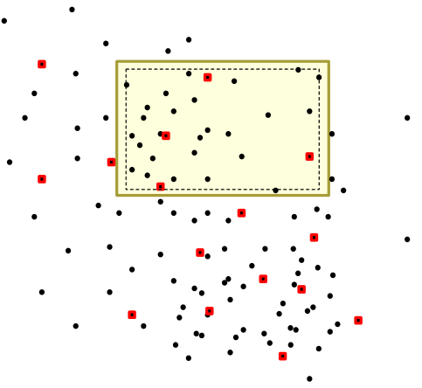
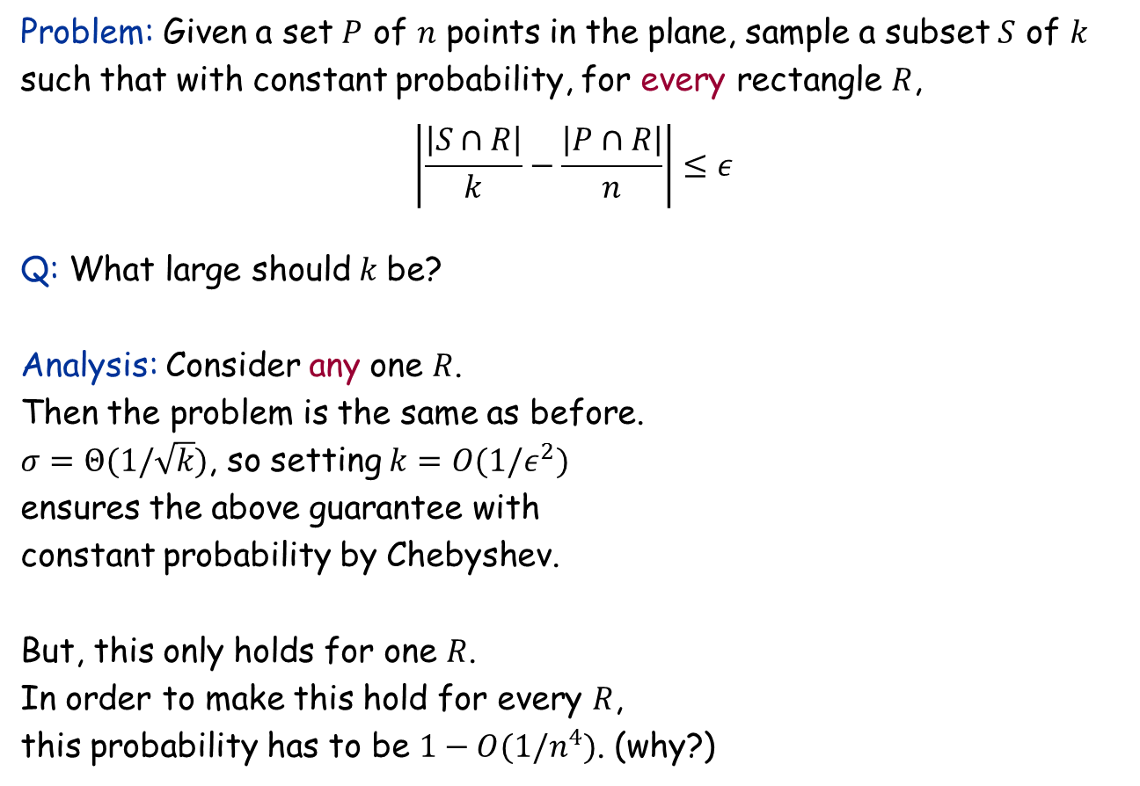
Random Sampling for Density Approximation
Problem: Given a set $P$ of $n$ points in the plane, sample a subset $S$ of $k$ such that with constant probability, for every rectangle $R$, $$\left|\frac{\left|S∩R\right|}{k}−\frac{\left|P∩R\right|}{n}\right|≤ε$$
Q: What large should$k$ be?
Analysis: Consider any one $R$. Then the problem is the same as before. $σ=Θ(1/\sqrt{k})$, so setting $k=O(1/ε^{2})$ ensures the above guarantee with constant probability by Chebyshev.
But, this only holds for one $R$. In order to make this hold for every $R$, this probability has to be $1−O(1/n^{4})$. (why?)

Slide 83
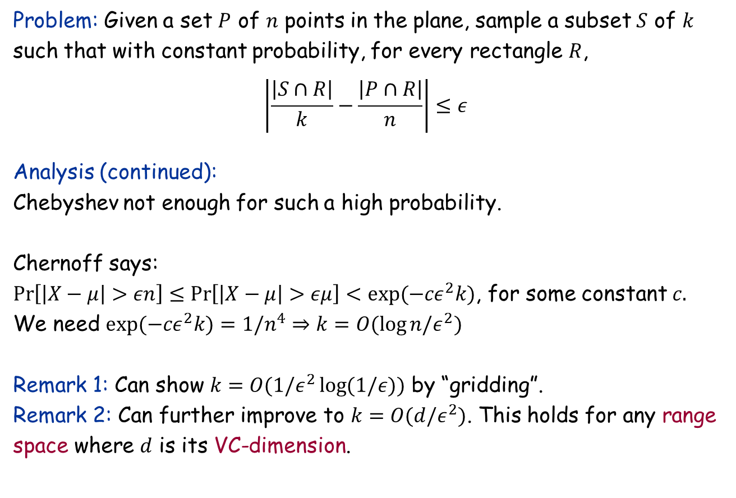
Random Sampling for Density Approximation
Problem: Given a set $P$ of $n$ points in the plane, sample a subset $S$ of $k$ such that with constant probability, for every rectangle $R$, $$\left|\frac{\left|S∩R\right|}{k}−\frac{\left|P∩R\right|}{n}\right|≤ε$$
Analysis (continued):
Chebyshev not enough for such a high probability.
Chernoff says: $\operatorname{Pr}\left[\left|X−μ\right|>εn\right]≤\operatorname{Pr}\left[\left|X−μ\right|>εμ\right]<exp({−cε}^{2}k)$, for some constant $c.$
We need $exp(−cε^{2}k)=1/n^{4}⇒k=O(\log{n/ε^{2})}$
Remark 1: Can show $k=O(1/ε^{2}\log{(1/ε)})$ by “gridding”.
Remark 2: Can further improve to $k=O(d/ε^{2})$. This holds for any range space where $d$ is its VC-dimension.

Slide 84
13.10 Balls and Bins

Slide 85
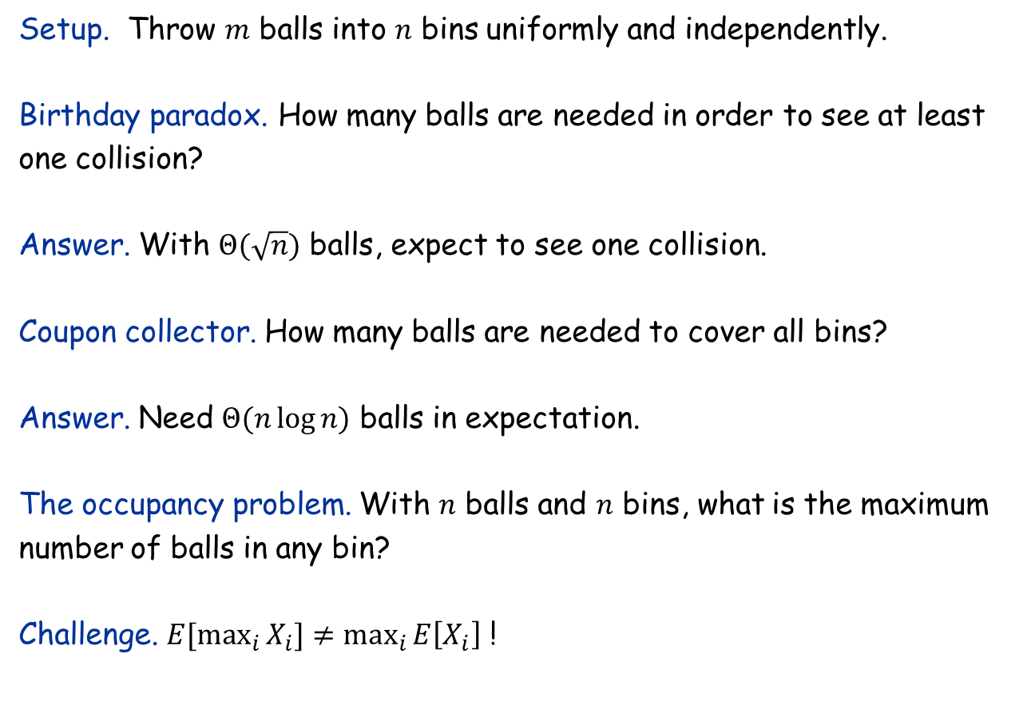
Balls and Bins
Setup. Throw $m$ balls into $n$ bins uniformly and independently.
Birthday paradox. How many balls are needed in order to see at least one collision?
Answer. With $Θ(\sqrt{n})$ balls, expect to see one collision.
Coupon collector. How many balls are needed to cover all bins?
Answer. Need $Θ(n\log{n)}$ balls in expectation.
The occupancy problem. With $n$ balls and $n$ bins, what is the maximum number of balls in any bin?
Challenge. $E[\max_{i}{X_{i}]≠\max_{i}{E\left[X_{i}\right]}}$ !

Slide 86
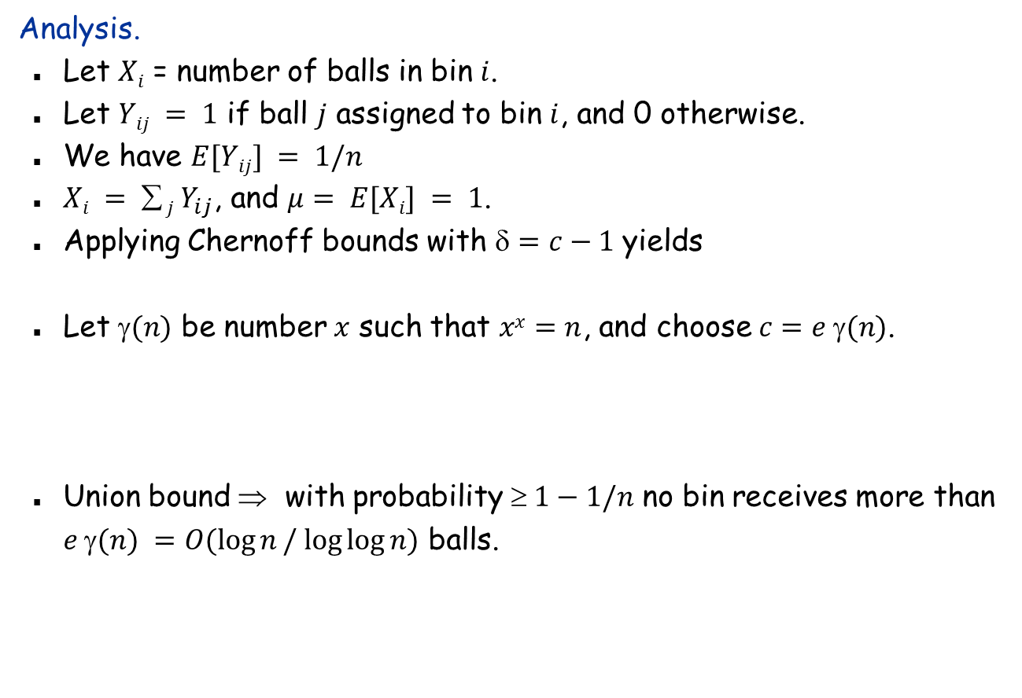

The Occupancy Problem
Analysis.
Let $Xi$ = number of balls in bin $i$.
Let $Yij = 1$ if ball $j$ assigned to bin $i$, and 0 otherwise.
We have $E[Yij] = 1/n$
$Xi =  j Y_{ij}$, and $μ= E[Xi] = 1$.
Applying Chernoff bounds with $=c−1$ yields
Let $(n)$ be number $x$ such that $xx=n$, and choose $c=e (n)$.
Union bound ⇒ with probability $ 1−1/n$ no bin receives more than $e γ(n) =O(\log{n}/ log⁡log⁡n)$ balls.
Fact: this bound is asymptotically tight: with high probability, some bin receives $Ω(\log{n}/ log⁡log⁡n)$

Slide 87
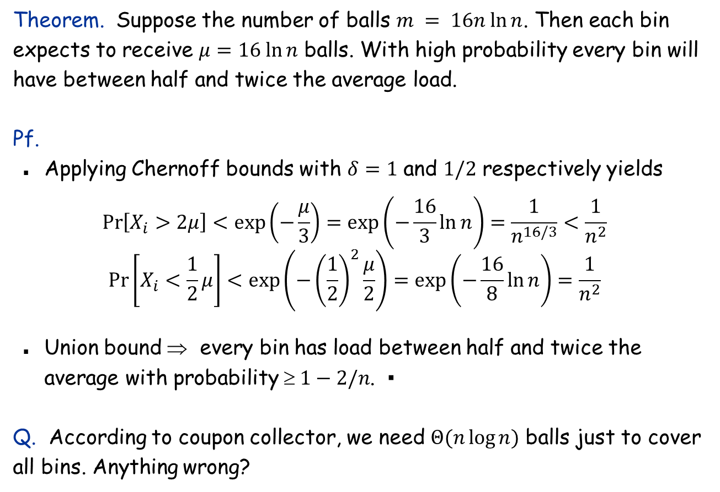
Even more balls
Theorem. Suppose the number of balls $m = 16n ln⁡n$. Then each bin expects to receive $μ=16 ln⁡n$ balls. With high probability every bin will have between half and twice the average load.
Pf.
Applying Chernoff bounds with $δ=1$ and $1/2$ respectively yields
$$\operatorname{Pr}\left[X_{i}>2μ\right]<\exp\left(−\frac{μ}{3}\right)=\exp\left(−\frac{16}{3}\ln{n}\right)=\frac{1}{n^{16/3}}<\frac{1}{n^{2}}$$
$$\operatorname{Pr}\left[X_{i}<\frac{1}{2}μ\right]<\exp\left(−{\left(\frac{1}{2}\right)}^{2}\frac{μ}{2}\right)=\exp\left(−\frac{16}{8}\ln{n}\right)=\frac{1}{n^{2}}$$
Union bound ⇒ every bin has load between half and twice the average with probability $ 1−2/n$. ▪
Q. According to coupon collector, we need $Θ(n\log{n)}$ balls just to cover all bins. Anything wrong?

Slide 88
More Applications with Chernoff

Slide 89
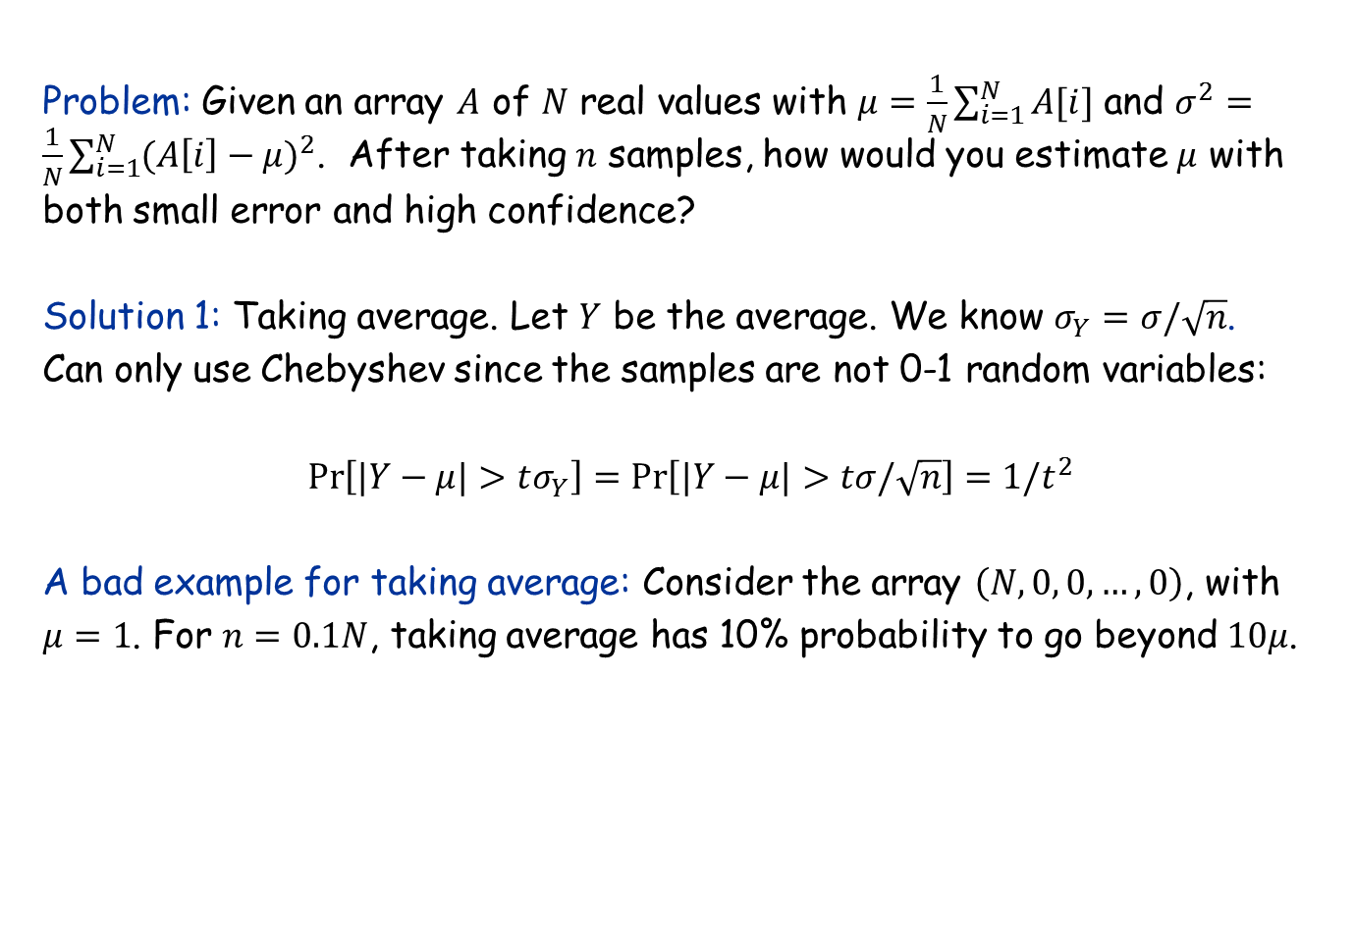
Sampling from a general distribution
Problem: Given an array $A$ of $N$ real values with $μ=\frac{1}{N}\sum_{i=1}^{N}{A[i]}$ and $σ^{2}=\frac{1}{N}\sum_{i=1}^{N}{(A{\left[i\right]−μ)}^{2}}$. After taking $n$ samples, how would you estimate $μ$ with both small error and high confidence?
Solution 1: Taking average. Let $Y$ be the average. We know $σ_{Y}=σ/\sqrt{n}$. Can only use Chebyshev since the samples are not 0-1 random variables: $$\operatorname{Pr}\left[|Y−μ|>tσ_{Y}\right]=\operatorname{Pr}\left[|Y−μ|>tσ/\sqrt{n}\right]=1/t^{2}$$
A bad example for taking average: Consider the array $\left(N, 0, 0, …, 0\right)$, with $μ=1$. For $n=0.1N$, taking average has 10% probability to go beyond $10μ$.

Slide 90
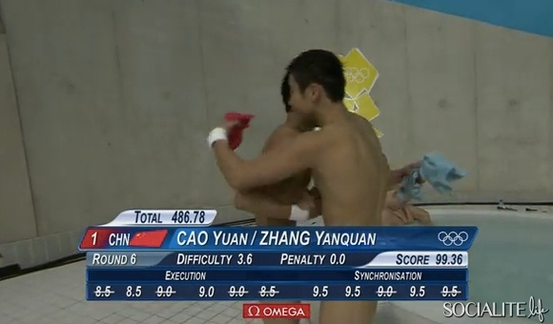
Score computation in Olympics

Slide 91
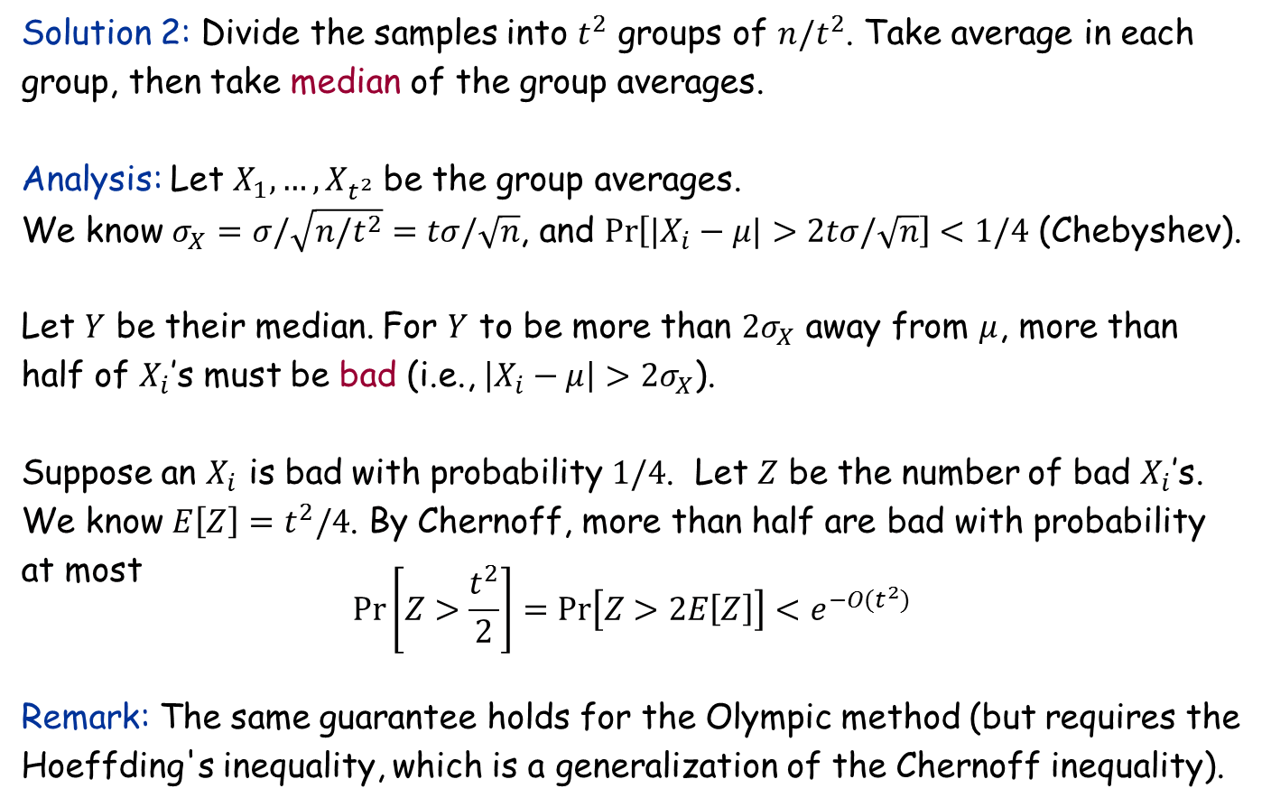
“Median of averages” technique
Solution 2: Divide the samples into $t^{2}$ groups of $n/t^{2}$. Take average in each group, then take median of the group averages.
Analysis: Let $X_{1},…,X_{t^{2}}$ be the group averages. We know $σ_{X}=σ/\sqrt{n/t^{2}}=tσ/\sqrt{n}$, and $\operatorname{Pr}\left[|X_{i}−μ|>2tσ/\sqrt{n}\right]<1/4$ (Chebyshev).
Let $Y$ be their median. For $Y$ to be more than $2σ_{X}$ away from $μ$, more than half of $X_{i}$’s must be bad (i.e., $\left|X_{i}−μ\right|>2σ_{X}$).
Suppose an $X_{i}$ is bad with probability $1/4$. Let $Z$ be the number of bad $X_{i}$’s. We know $E\left[Z\right]=t^{2}/4$. By Chernoff, more than half are bad with probability at most $$Pr\left[Z>\frac{t^{2}}{2}\right]=Pr\left[Z>2E\left[Z\right]\right]<e^{−O(t^{2})}$$
Remark: The same guarantee holds for the Olympic method (but requires the Hoeffding's inequality, which is a generalization of the Chernoff inequality).

Slide 92
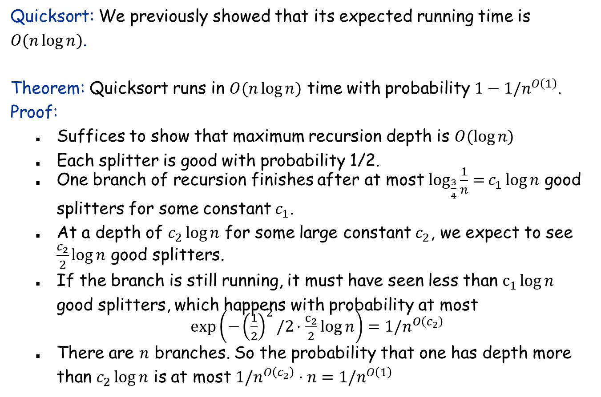
High probability bound on running time
Quicksort: We previously showed that its expected running time is $O(n\log{n})$.
Theorem: Quicksort runs in $O(n\log{n})$ time with probability $1−1/n^{O\left(1\right)}$.
Proof:
Suffices to show that maximum recursion depth is $O(\log{n)}$
Each splitter is good with probability 1/2.
One branch of recursion finishes after at most $\log_{\frac{3}{4}}\frac{1}{n}{=}c_{1}\log{n}$ good splitters for some constant $c_{1}$.
At a depth of $c_{2}\log{n}$ for some large constant $c_{2}$, we expect to see $\frac{c_{2}}{2}\log{n}$ good splitters.
If the branch is still running, it must have seen less than $c_{1}\log{n}$ good splitters, which happens with probability at most
$\exp\left(−{\left(\frac{1}{2}\right)}^{2}/2⋅\frac{c_{2}}{2}log{n}\right)=1/n^{O\left(c_{2}\right)}$
There are $n$ branches. So the probability that one has depth more than $c_{2}\log{n}$ is at most $1/n^{O\left(c_{2}\right)}⋅n=1/n^{O\left(1\right)}$

Slide 93
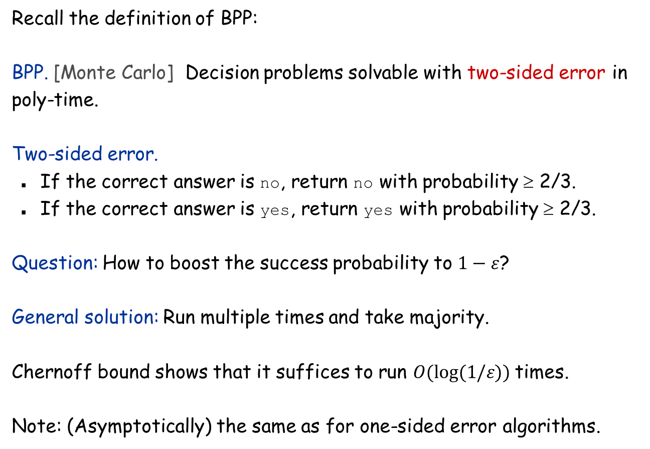
Chernoff Bound: Probability Boosting
Recall the definition of BPP:
BPP. [Monte Carlo] Decision problems solvable with two-sided error in poly-time.
Two-sided error.
If the correct answer is no, return no with probability ≥ 2/3.
If the correct answer is yes, return yes with probability ≥ 2/3.
Question: How to boost the success probability to $1−ε$?
General solution: Run multiple times and take majority.
Chernoff bound shows that it suffices to run $O(log⁡(1/ε))$times.
Note: (Asymptotically) the same as for one-sided error algorithms.

Slide 94
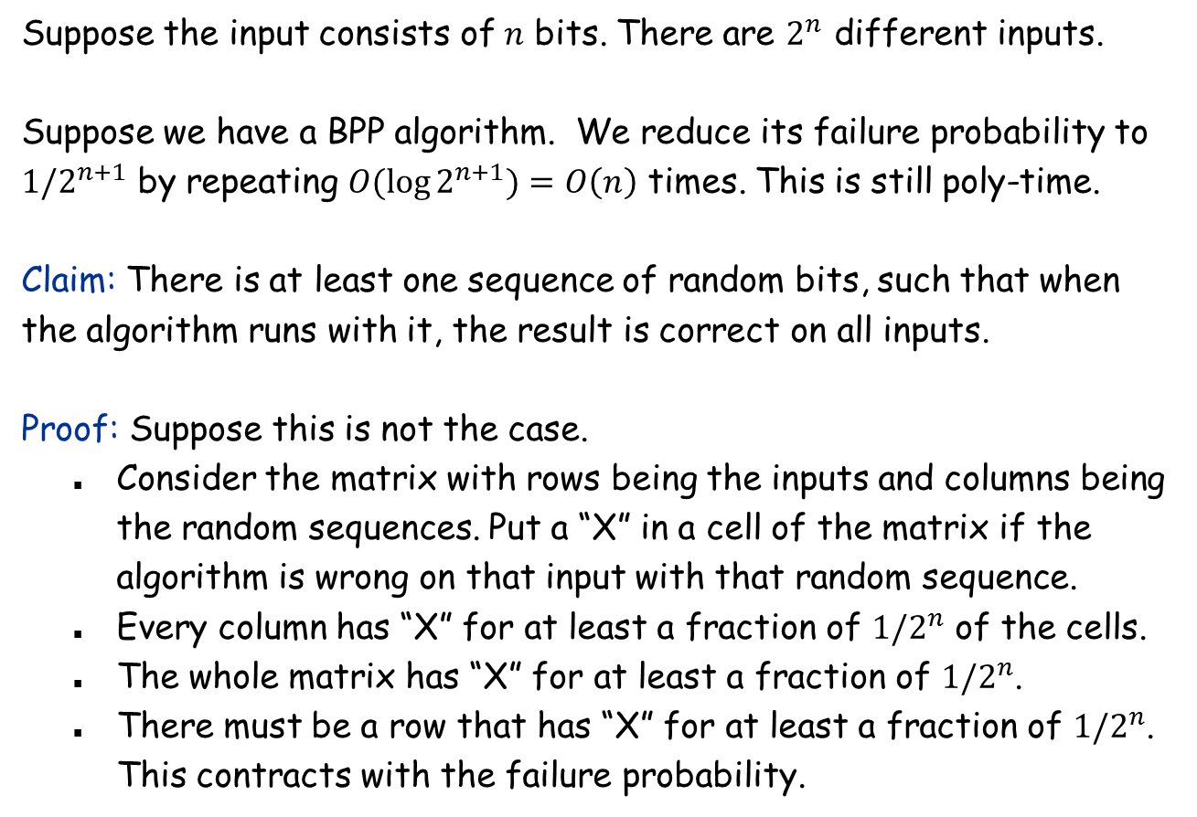
Randomness and Uniformity
Suppose the input consists of $n$ bits. There are $2^{n}$ different inputs.
Suppose we have a BPP algorithm. We reduce its failure probability to $1/2^{n+1}$ by repeating $O(\log{2^{n+1})=O\left(n\right)}$ times. This is still poly-time.
Claim: There is at least one sequence of random bits, such that when the algorithm runs with it, the result is correct on all inputs.
Proof: Suppose this is not the case.
Consider the matrix with rows being the inputs and columns being the random sequences. Put a “X” in a cell of the matrix if the algorithm is wrong on that input with that random sequence.
Every column has “X” for at least a fraction of $1/2^{n}$ of the cells.
The whole matrix has “X” for at least a fraction of $1/2^{n}$.
There must be a row that has “X” for at least a fraction of $1/2^{n}$. This contracts with the failure probability.

Slide 95

Randomness and Uniformity
Surprising consequence: We can just run the algorithm with the “perfect” sequence of random numbers, which turns this algorithm into a deterministic algorithm. Finding that “perfect” sequence may take exponential time, but that’s not part of the running time, e.g., it can be hard-coded in the algorithm. Did we prove P = BPP?
Uniformity: All algorithms must be uniform, i.e., its description (code, transition function of a Turing machine, etc.) must have constant size (that does not depend on $n$). Equivalent formulation: The same algorithm has to work for all $n$.
Implication: The decision tree model cannot be used to prove P ≠ BPP.

