Slide 1
Big data algorithms

Slide 2



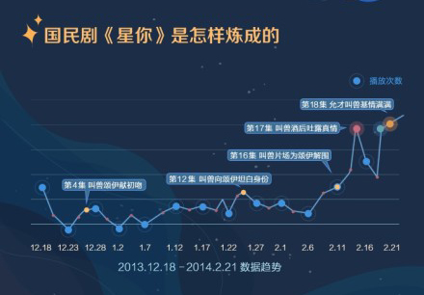

Slide 3
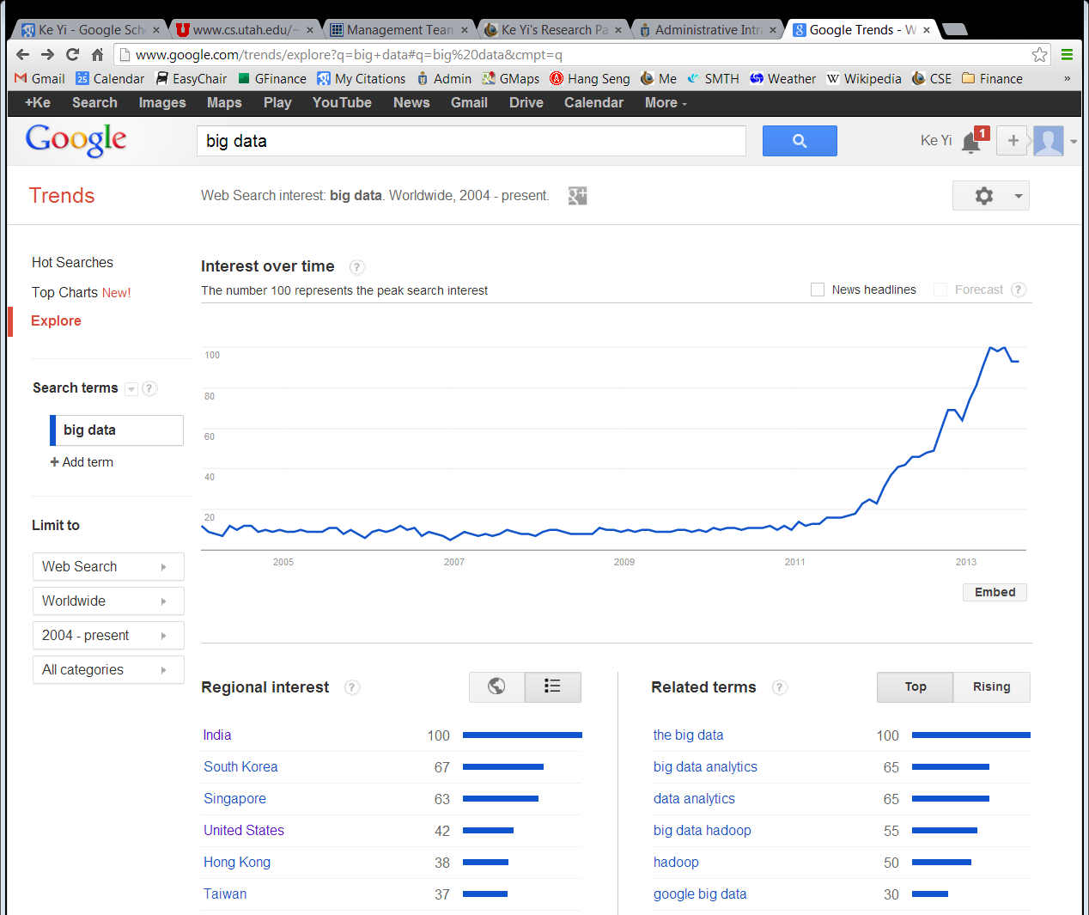
Google trend

Slide 4
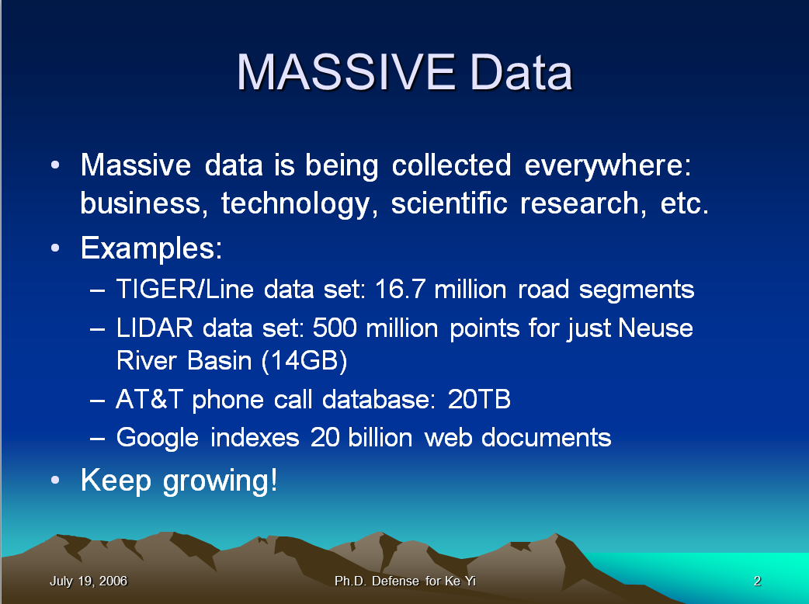

Slide 5
Is there anything fundamentally new?
Massive Data vs Big Data
The 3 V’s
Volume
Velocity
Variety

Slide 6
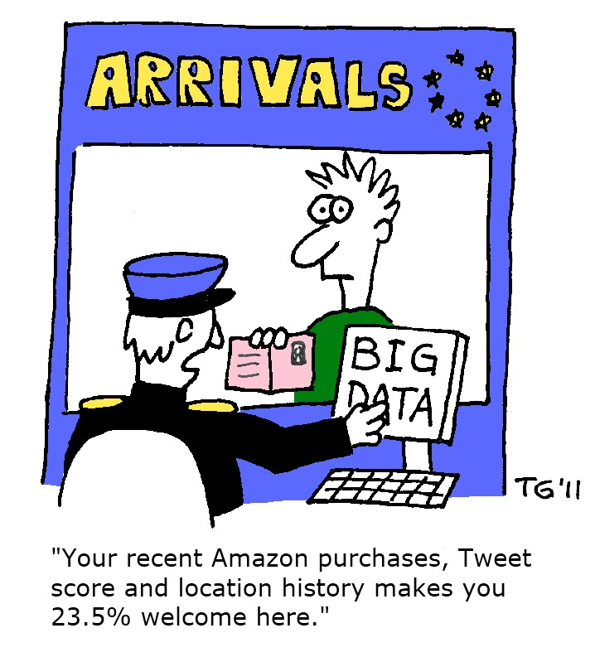
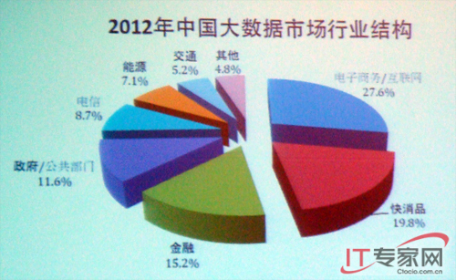



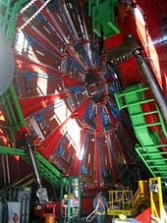

Big data Applications

Slide 7

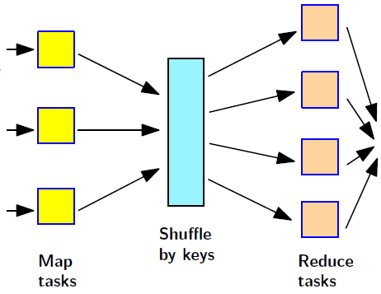
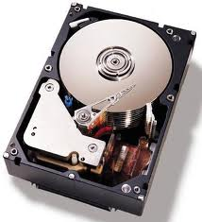

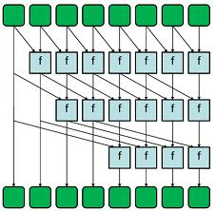
Big Data Algorithms
Parallel/Distributed
Algorithms
External memory
Algorithms
Data stream
Algorithms
Parallel
Algorithms
1988
1999
2006
1980

Slide 8
Computational models for big data
All models are wrong,
But some are useful.
George E. P. Box

Slide 9
What’s the Bottleneck?
CPU speed approaching limit
Does it matter?
From CPU-intensive computing to data-intensive computing
Algorithm has to be near-linear, linear, or even sub-linear!
Data movement, i.e., communication is the bottleneck!

Slide 10
Random Access Machine Model
R
A
M
Standard theoretical model of computation:
Unlimited memory
Uniform access cost
Simple model crucial for success of computer industry

Slide 11
Hierarchical Memory
R
A
M
L
1
L
2
Modern machines have complicated memory hierarchy
Levels get larger and slower further away from CPU
Data moved between levels using large blocks

Slide 12
Slow I/O
Disk access is 10⁶ times slower than main memory access
read/write arm
track
“The difference in speed between modern CPU and disk technologies is analogous to the difference in speed in sharpening a pencil using a sharpener on one’s desk or by taking an airplane to the other side of the world and using a sharpener on someone else’s desk.” (D. Comer)
4835 1915 5748 4125
magnetic surface
Disk systems try to amortize large access time transferring large contiguous blocks of data (8-16Kbytes)
Important to store/access data to take advantage of blocks (locality)

Slide 13
Scalability Problems
Most programs developed in RAM-model
Run on large datasets because
OS moves blocks as needed
Modern OS utilizes sophisticated paging and prefetching strategies
But if program makes scattered accesses even good OS cannot take advantage of block access
⇓
Scalability problems!
running time
data size

Slide 14
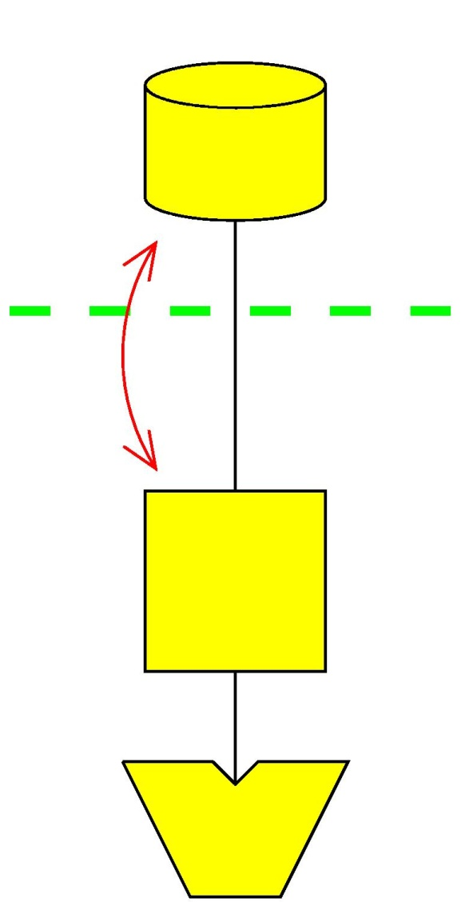
External Memory Model
N = # of items in the problem instance
B = # of items per disk block
M = # of items that fit in main memory
I/O: # blocks moved between memory and disk
CPU time is ignored
Successful model used extensively in massive data algorithms and database communities
D
Block I/O
M
P

Slide 15
Fundamental Bounds
Internal External
Scanning: N
Sorting: N log N
Permuting
Searching:
Note:
Linear I/O: O(N/B)
Permuting not linear
Permuting and sorting bounds are equal in all practical cases
B factor VERY important:

Slide 16
Queues and Stacks
Queue:
Maintain push and pop blocks in main memory
⇓
O(1/B) I/O per operation (amortized)
Stack:
Maintain push/pop block in main memory
⇓
O(1/B) I/O per operation (amortized)
Push
Pop
Notes:
Queue: If only push or pop -> one block

Slide 17
Sorting
Merge sort:
Create N/M memory sized sorted lists
Repeatedly merge lists together Θ(M/B) at a time
⇒ phases using I/Os each ⇒ I/Os

Slide 18
Sorting
<M/B sorted lists (queues) can be merged in O(N/B) I/Os
M/B blocks in main memory
The M/B head elements kept in a heap in main memory

Slide 19
Toy Experiment: Permuting
Problem:
Input: N elements out of order: 6, 7, 1, 3, 2, 5, 10, 9, 4, 8
Each element knows its correct position
Output: Store them on disk in the right order
Internal memory solution:
Just scan the original sequence and move every element in the right place!
O(N) time, O(N) I/Os
External memory solution:
Use sorting
O(N log N) time, I/Os

Slide 20
Searching in External Memory
Store N elements in a data structure such that
Given a query element x, find it or its predecessor

Slide 21
B-trees
BFS-blocking naturally corresponds to tree with fan-out
B-trees balanced by allowing node degree to vary
Rebalancing performed by splitting and merging nodes

Slide 22
(a,b)-tree
T is an (a,b)-tree (a≥2 and b≥2a-1)
All leaves on the same level (contain between a and b elements)
Data stored only in leaves
Except for the root, all nodes have degree between a and b
Root has degree between 2 and b
(2,4)−tree
(a,b)-tree uses linear space and has height
⇓
Choosing a,b = each node/leaf stored in one disk block
⇓
Ο(Ν/Β) space and query

Slide 23
(a,b)-Tree Insert
Insert:
Search and insert element in leaf v
DO v has b+1 elements/children
Split v:
make nodes v’ and v’’ with
and elements
insert element (ref) in parent(v)
(make new root if necessary)
v=parent(v)
Insert touch nodes
v
v’
v’’

Slide 24
(a,b)-Tree Insert

Slide 25
(a,b)-Tree Delete
Delete:
Search and delete element from leaf v
DO v has a-1 elements/children
Fuse v with sibling v’:
move children of v’ to v
delete element (ref) from parent(v)
(delete root if necessary)
If v has >b (and ≤ a+b-1<2b) children split v
v=parent(v)
Delete touch nodes
v
v

Slide 26
(a,b)-Tree Delete

Slide 27
(a,b)-Tree
(2,3)-tree
(a,b)-tree properties:
Every update can
cause O(log_{a}N) rebalancing
operations
If b=4a rebalancing operations amortized
Why?
delete
insert

Slide 28
Pointer Dereferencing
“Almost every problem in computer science can be solved by another level of indirection”
Dereference each pointer needs many random I/Os
How do we get the values I/O-efficiently?
Output (i, data) pairs
pointer array P[i]
5 | 3 | 7 | 3 | 6 | 4 | 8 | 4 | 6 | 8
data array D[i]

Slide 29
I/O-Efficient Pointer Dereferencing
pointer array P[i]
5 | 3 | 7 | 3 | 6 | 4 | 8 | 4 | 6 | 8
data array D[i]
Total I/O: sort(N)
Sort pointer array by pointers
Produce a list of (i, P[i]) pairs, sorted by P[i]
Scan both arrays in parallel
Produce (i, data) pairs
Sort the list back by i if needed

Slide 30
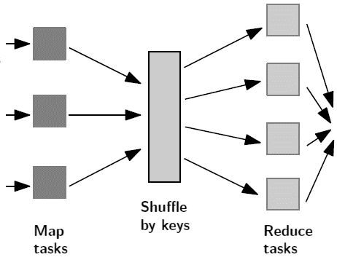
Big Data Algorithms
Distributed
Algorithms
External memory
Algorithms
Data stream
Algorithms
Parallel
Algorithms
1988
1999
2006
1980

Slide 31
Problem One: Missing Card
I take one from a deck of 52 cards, and pass the rest to you. Suppose you only have a (very basic) calculator and bad memory, how can you find out which card is missing with just one pass over the 51 cards?
What if there are two missing cards?

Slide 32
A data stream algorithm …
Makes one pass over the input data
Uses a small amount of memory (much smaller than the input data)
Computes something

Slide 33
Why do we need streaming algorithms
Networking
Often get to see the data once
Don’t want to store the entire data
Databases
Data stored on disk, sequential scans are much faster
Data stream algorithms have been a very active research area for the past 15 years
Problems considered today
Missing card
Reservoir sampling
Majority
Heavy hitters

Slide 34
Reservoir Sampling [Waterman ' ??; Vitter '85]
Maintain a (uniform) sample (w/o replacement) of size s from a stream of n items
Every subset of size s has equal probability to be the sample
When the i-th item arrives
With probability s/i, use it to replace an item in the current sample chosen uniformly at random
With probability 1-s/i, throw it away

Slide 35


Reservoir Sampling: Correctness Proof

Slide 36
Problem two: Majority
Given a sequence of items, find the majority if there is one
A A B C D B A A B B A A A A A A C C C D A B A A A
Answer: A
Trivial if we have O(n) memory
Can you do it with O(1) memory and two passes?
First pass: find the possible candidate
Second pass: compute its frequency and verify that it is > n/2
How about one pass?
Unfortunately, no

Slide 37
Problem three: Heavy hitters
Problem: find all items with counts > φn, for some 0< φ<n
Relaxation:
If an item has count > φ n, it must be reported, together with its estimated count with (absolute) error < εn
If an item has count < (φ − ε) n, it cannot be reported
For items in between, don’t care
In fact, we will solve the most difficult case φ = ε
Applications
Frequent IP addresses
Data mining

Slide 38
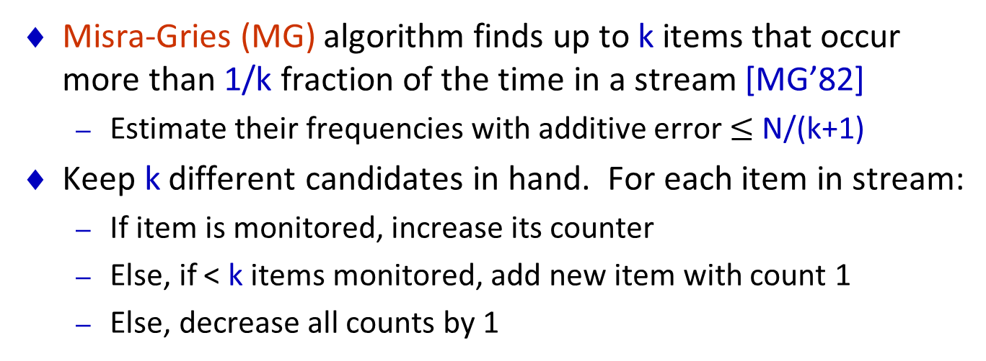
Heavy hitters
Misra-Gries (MG) algorithm finds up to k items that occur more than 1/k fraction of the time in a stream [MG’82]
Estimate their frequencies with additive error $≤$ N/(k+1)
Keep k different candidates in hand. For each item in stream:
If item is monitored, increase its counter
Else, if < k items monitored, add new item with count 1
Else, decrease all counts by 1
k=5
1 2 3 4 5 6 7 8 9

Slide 39
Heavy hitters
Misra-Gries (MG) algorithm finds up to k items that occur more than 1/k fraction of the time in a stream [MG’82]
Estimate their frequencies with additive error $≤$ N/(k+1)
Keep k different candidates in hand. For each item in stream:
If item is monitored, increase its counter
Else, if < k items monitored, add new item with count 1
Else, decrease all counts by 1
k=5
1 2 3 4 5 6 7 8 9

Slide 40
Heavy hitters
Misra-Gries (MG) algorithm finds up to k items that occur more than 1/k fraction of the time in a stream [MG’82]
Estimate their frequencies with additive error $≤$ N/(k+1)
Keep k different candidates in hand. For each item in stream:
If item is monitored, increase its counter
Else, if < k items monitored, add new item with count 1
Else, decrease all counts by 1
k=5
1 2 3 4 5 6 7 8 9

Slide 41
Streaming MG analysis
N = total input size
Error in any estimated count at most N/(k+1)
Estimated count a lower bound on true count
Each decrement spread over (k+1) items: 1 new one and k in MG
Equivalent to deleting (k+1) distinct items from stream
At most N/(k+1) decrement operations
Hence, can have “deleted” N/(k+1) copies of any item
So estimated counts have at most this much error

Slide 42
How about deletions?
Any deterministic algorithm needs Ω(n) space
Why?
In fact, Las Vegas randomization doesn’t help
Will design a randomized algorithm that works with high probability
For any item x, we can estimate its actual count within error εn with probability 1-δ for any small constant δ

Slide 43
The Count-Min sketch [Cormode, Muthukrishnan, 2003]
A Count-Min (CM) Sketch with parameters is represented by
a two-dimensional array counts with width w and depth
Given parameters , set and .
Each entry of the array is initially zero.
hash functions are chosen uniformly at random from a 2-univeral family
For example, we can choose a prime number p > u, and random a_{j}, b_{j}, j=1,…,d. Define:
h_{j}(x) = (a_{j} x + b_{j} mod p) mod w
Property: for any x ≠ y, Pr[h_{j}(x)=h_{j}(y)] ≤ 1/w

Slide 44
Updating the sketch
Update procedure :
When item x arrives, set
When item x is deleted, do the same except changing +1 to -1

Slide 45
Estimating the count of x
actual count
estimated count
Theorem 1

Slide 46
Proof
We introduce indicator variables
1 if
0 otherwise
Define the variable
By construction,

Slide 47
For the other direction, observe that
Markov inequality
■
So, the Count-Min Sketch has size

Slide 48
Big Data Algorithms
Parallel/Distributed
Algorithms
External memory
Algorithms
Data stream
Algorithms
Parallel
Algorithms
1988
1999
2006
1980

Slide 49
The Random Access Machine Model
RAM model of serial computers:
Memory is a sequence of words, each capable of containing an integer with O(log n) bits.
Each memory access takes one unit of time
Basic operations (add, multiply, compare, etc.) take one unit time.

Slide 50
PRAM [Parallel Random Access Machine]
(Introduced by Fortune and Wyllie, 1978)
PRAM composed of:
P processors, each with its own program.
Usually use as large P as necessary to see the limit of parallelism.
If an algorithm works with P processors, we can also make it work on P’ processors, with a slowdown factor of P/P’.
A single shared memory composed of a sequence of words, each capable of containing an arbitrary integer.
Shared memory

Slide 51
Variants of PRAM model

Slide 52
PRAM: Success or Failure?
Elegant, but unrealistic
Many beautiful techniques and results in 80’s and 90’s, but start to die out
But, many ideas prove useful for realized parallel computation
Gives a lower bound
If you can’t do it on PRAM, no hope to parallelize in practice
Many people are working on making PRAM algorithms practical

Slide 53
Problem: Sum
Given: Sequence a of n elements
Compute: S = a₁ + ... + a_{n}
Can be done in O(log n) time with n processors.

Slide 54
How to do prefix sum ?
Input: Sequence x of n = 2^{k} elements
Output: Sequence s of n = 2^{k} elements, with y_{k} = x₁ + ... + x_{k}
Example:
x = [1, 4, 3, 5, 6, 7, 0, 1]
y = [1, 5, 8, 13, 19, 26, 26, 27]

Slide 55
Parallel Prefix Sum
Algorithm:
Prefix-Sum(A)
if |A| = 1 then return A;
for i=1 to |A|/2 in parallel do
B[i] = A[i*2 -1] + A[i*2];
C = Prefix-Sum(B);
for i=1 to |A| in parallel do
if i is even D[i] = C[i/2];
else D[i] = C[(i-1)/2] + A[i];
return D;
T(n) = T(n/2) + O(1) = O(log n)

Slide 56
Parallel Mergesort
Recall Mergesort
Mergesort(A)
n = |A|;
Mergesort(A[1..n/2]);
Mergesort(A[n/2+1..n]);
Merge A[1..n/2] and A[n/2+1..n];
Can be done in parallel

Slide 57
Parallel Merge
Use the median of the longer list to do binary search in the other
O(log n) time
In parallel, recursively merge the corresponding portions
O(log n) depth of recursion
Total parallel time: O(log²n)
Overall parallel time:
T(n) = T(n/2) + O(log²n) = T(log³n)
It’s possible to do sorting in O(log²n) steps (sorting networks, practical); and O(log n) steps theoretically.

Slide 58
Distributed algorithms
Models loosely coupled multiprocessors
Internet
Sensor networks
Computer clusters
The model
Nodes are connected by an arbitrary network
No shared memory
Each node is unaware of other nodes except its immediate neighbors
Synchronous / asynchronous
Existence of an initiator (coordinator)
Node/link failures (stopping failures and Byzantine failures)
Complexity measures:
Communication
Time: # rounds (only for synchronous model, ignore local computation cost)

Slide 59
Example: Flooding
The problem: An “initiator” node wants to broadcast its information to all nodes
Protocol for initiator:
Send information to all neighbors
Protocol for each node:
When receive a message from a neighbor, broadcast to all other neighbors

Slide 60
Example: Flooding
Protocol for initiator:
Send information to all neighbors
Protocol for each node:
Done = false;
When receive a message from a neighbor and not Done
broadcast to all other neighbors
Done = true
Communication: O(m), also works in asynchronous model
Time: O(diameter of the network)

Slide 61
Application of Flooding: Spanning Tree Construction
Problem: Construct a spanning tree rooted at the initiator
Protocol for initiator:
Send information to all neighbors
Protocol for each node:
Done = false;
When receive a message from a neighbor u and not Done
mark the edge from u as a spanning tree edge
broadcast to all other neighbors
Done = true
Applications of a spanning tree:
Routing data back to root, computing sum, minimum, …

Slide 62
Leader Election
Q: What if there is no initiator?
In some distributed applications (such as P2P, ad hoc networks), there is no central coordinator (or the central coordinator may have left or failed).
Problem: Design a distributed protocol such that in the end, exactly one node should output “leader”.
Assumption: Each node has a unique id (otherwise the problem is impossible to solve).
Naïve solution: Each node runs the flooding algorithm to broadcast its UID to all other nodes. If a node has never seen a larger UID, declare itself as “leader”. (But, how long should a node wait?)
Communication cost: O(mn)

Slide 63
Reducing communication on a ring
From O(n²) to O(n log n),
Algorithm:
Successive doubling strategy
Each nodes sends a UID token in both directions, to successively greater distances (double each time).
Going outbound: Token is discarded if it reaches a node whose UID is bigger.
Going inbound: Everyone passes the token back.
Nodes begins next phase only when it gets its token back.
Nodes that gets its own token in outbound direction, elects itself the leader.
Technical details
Keep hop count/direction on token.

Slide 64
Communication bound: O(n log n)
1 + ⎡log n⎤ phases: 0,1,2,…
Phase 0: All send messages both ways, ≤ 4n messages.
Phase k > 0:
Within any block of 2^{k-1} + 1 consecutive nodes, at most one is still alive at the start of phase k.
Others’ tokens are discarded in earlier phases, stop participating.
So at most ⎣ n / (2^{k-1} + 1) ⎦ start phase k.
Total number of messages at phase k is at most
4 (2^{k} ⎣n / (2^{k-1} + 1) ⎦ ) ≤ 8n
So total communication is as most 8 n (1 + ⎡log n⎤ ) = O(n log n)
On an arbitrary network, this problem can be solved with O(m + n log n) communication (but very complicated).
Out and back,
both directions
New distance
Notes:
Ignoring roundoffs.

Slide 65
The Bulk Synchronous Parallel Model (BSP)
Introduced by Leslie Valiant in 1990

Slide 66
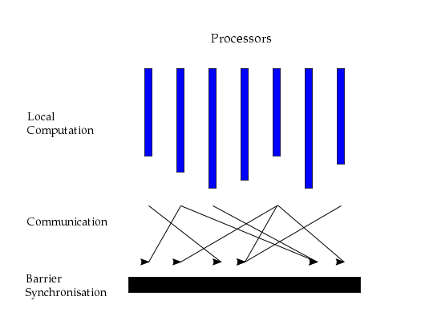
The BSP Model
Cost of a superstep = w + hg + l
w : maximum time by a processor in local computation
h: maximum message size sent/received by a processor
g: time cost to send a message of size 1
l : overhead
Total cost = sum of all supersteps
not a very clean model …
One super step

Slide 67
MapReduce
map(key, val) is run on each item in set
emits new-key / new-val pairs
reduce(key, vals) is run for each unique key emitted by map()
emits final output
Example: Count words in documents.
Input consists of (url, contents) pairs
map(key=url, val=contents):
For each word w in contents, emit (w, “1”)
reduce(key=word, values=uniq_counts):
Sum all “1”s in values list
Emit result “(word, sum)”

Slide 68
Google Pregel for Graph Data
Master initiates each iteration (called a “superstep”)
At every superstep
Vertices execute a user function
Vertices can receive messages sent to it in the last superstep
Vertices can send messages to other vertices to be received in the next superstep
Vertices have local storage
Vertices can change the topology of the graph (add/remove vertices or edges)
Vertices can “vote to halt”
Execution stops when all vertices have voted to halt and no vertices have messages.
Vote to halt trumped by non-empty message queue

Slide 69
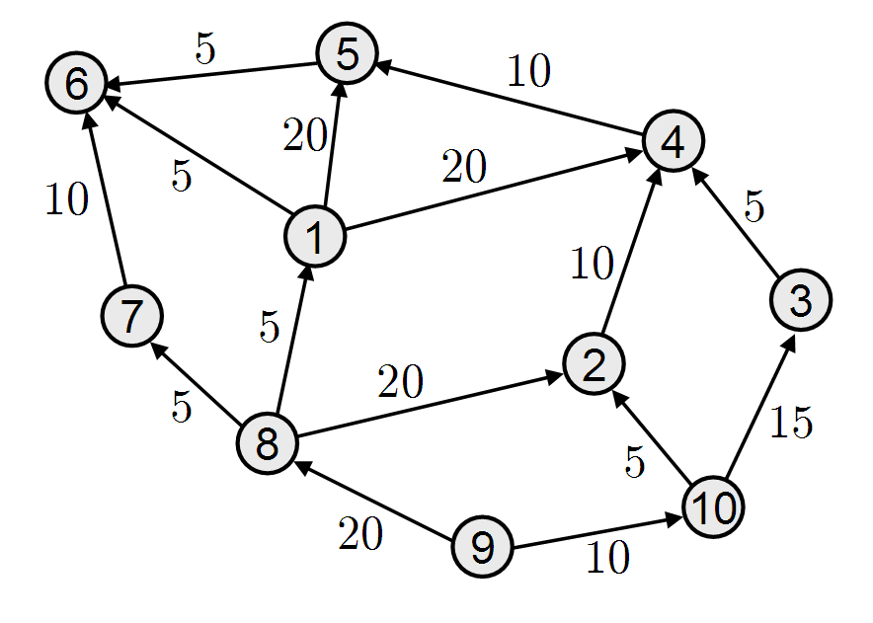
Illustration: vertex partitions
Worker 3
Worker 1
Worker 2

Slide 70
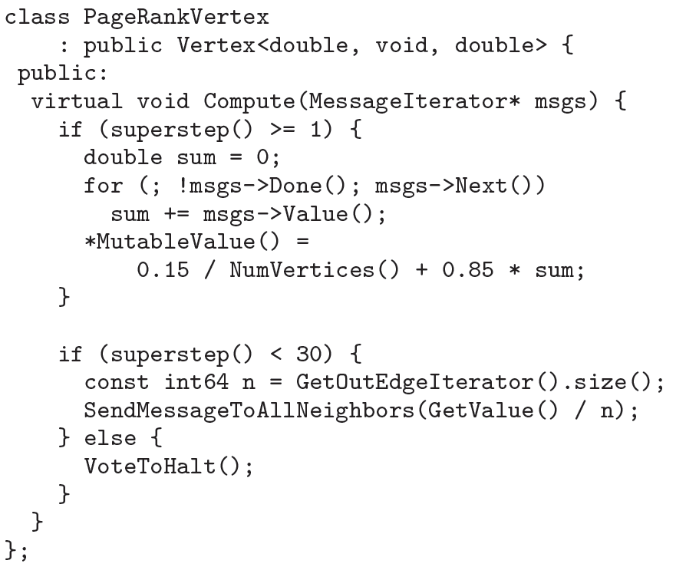
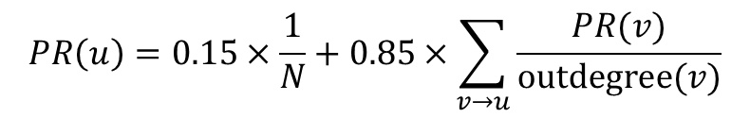
Example 1: PageRank
$$PR\left(u\right)=0.15×\frac{1}{N}+0.85×\sum_{v→u}{\frac{PR(v)}{outdegree(v)}}$$

Slide 71
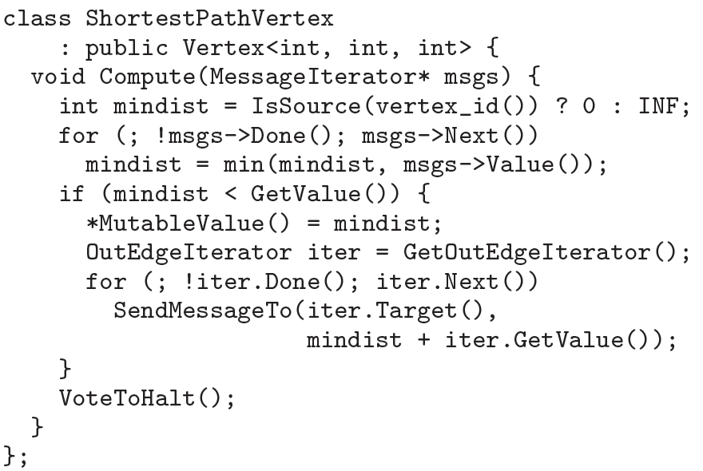
Example 2: Single Source Shortest Paths

Slide 72
At each superstep…
s
…
d₀
d₁
vertex receives messages
d_{v}
d₀ + w_{s}
d₀ + w_{t}
w_{s}
if min(d₀,d₁) < d_{v}, then
updates its new minimum distance
it sends messages to its neighbors
vote to halt
w_{t}
d_{s}
d_{t}
More efficient algorithms exist…

