Slide 1
COMP 5711 Advanced Algorithms
Ke Yi
Dept CSE, HKUST

Slide 2
Background Requirements
COMP3711 (Undergrad algorithms course)
Sorting and searching, divide & conquer, greedy, dynamic programming, graph algorithms (MST, shortest path, etc.),
Analysis of algorithms
NP-completeness
Basic discrete math
Recurrences, logic and proofs, basic graph theory
Basic probability theory
Probability space, random variables, expectation, variance

Slide 3
Background Check
Q1: What do you need to prove in order to show that
an algorithm runs in O(n log n) time
an algorithm runs in Ω(n log n) time
an algorithm runs in Θ(n log n) time
Q1’: What do you need to prove in order to show that
a problem can be solved in O(n log n) time
a problem must be solved in Ω(n log n) time
the time complexity of a problem is Θ(n log n)

Slide 4
Background Check
Q2: Radix sort can sort n numbers in O(n) time, which breaks the Ω(n log n) sorting lower bound. What’s wrong?

Slide 5
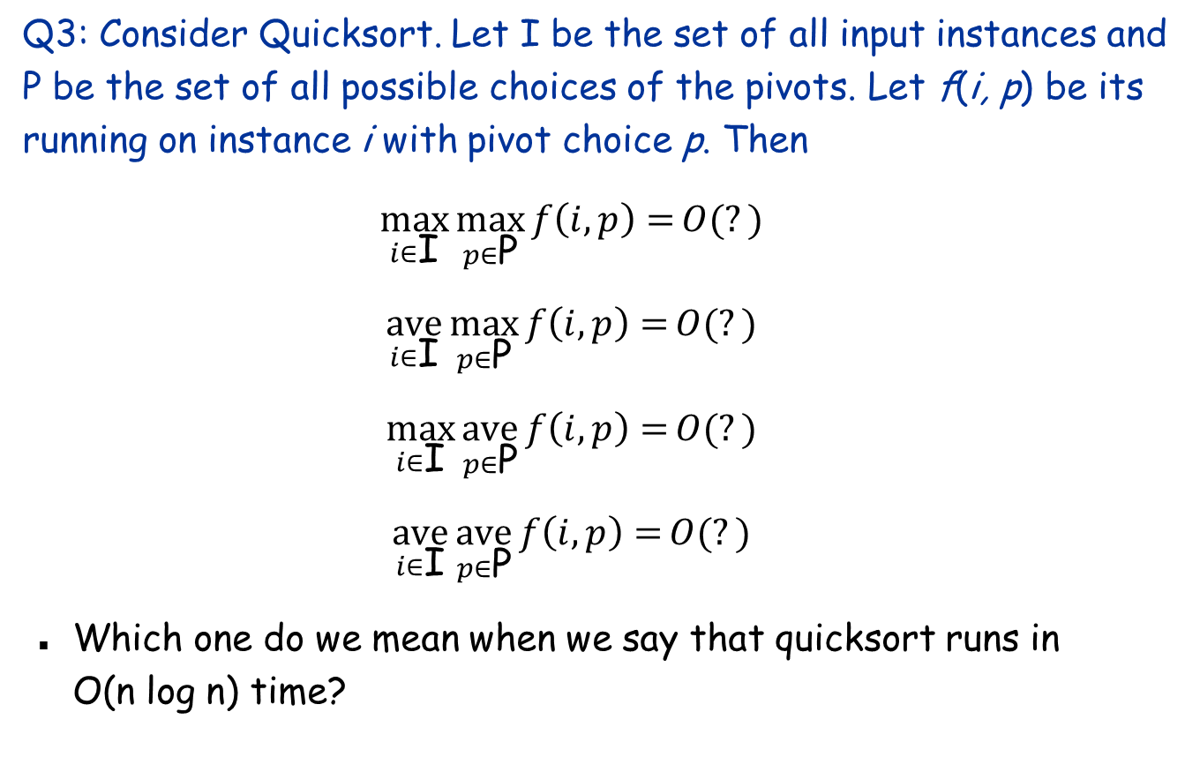
Background Check
Q3: Consider Quicksort. Let I be the set of all input instances and P be the set of all possible choices of the pivots. Let f(i, p) be its running on instance i with pivot choice p. Then
$$\max_{i∈\text{I}}\max_{p∈\text{P}}{f\left(i,p\right)}{=}{O(?)}$$
$$\underset{i∈\text{I}}{ave}\max_{p∈\text{P}}{f\left(i,p\right)}{=}{O(?)}$$
$$\max_{i∈\text{I}}\underset{p∈\text{P}}{ave}{f\left(i,p\right)}{=}{O(?)}$$
$$\underset{i∈\text{I}}{ave}\underset{p∈\text{P}}{ave}{f\left(i,p\right)}{=}{O(?)}$$
Which one do we mean when we say that quicksort runs in O(n log n) time?

Slide 6
A Few General Issues about Algorithm Design & Analysis

Slide 7
Models of Computation
All models are wrong,
But some are useful.
George E. P. Box

Slide 8
Models of Computation
Turing machine
Random Access Machine (RAM)

Slide 9
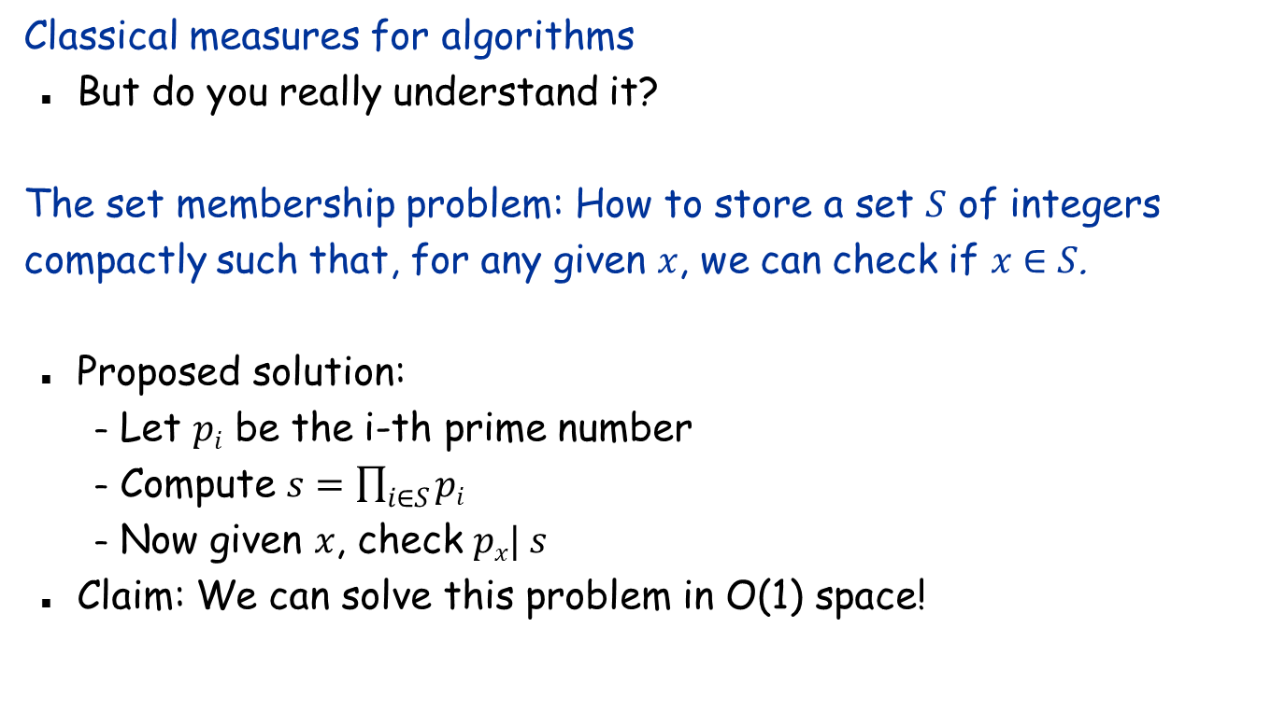
RAM
Classical measures for algorithms
But do you really understand it?
The set membership problem: How to store a set $S$ of integers compactly such that, for any given $x$, we can check if $x∈S$.
Proposed solution:
Let $pi$ be the i-th prime number
Compute $s=\prod_{i∈S}{pi}$
Now given $x$, check $px| s$
Claim: We can solve this problem in O(1) space!

Slide 10
RAM
Cannot have unbounded integers!
Can also screw up time complexity: Can solve NP-complete problems in polynomial time if allow unbounded integers
Consider bit-level complexity?
Then multiplication/division is more costly than addition/subtraction
Common assumptions
Each integer has O(log n) bits, any arithmetic operation (+, - , *, /, mod) on O(log n)-bit integers takes one unit of time
Or assume the word length is w bits, where w is a parameter
How about real numbers?
Real RAM

Slide 11
Models of Computation
Turing machine
Random Access Machine
Comparison model
Computation models for “Big data”
Data stream model
External memory model
Parallel models: PRAM, BSP, MapReduce
Distributed computing

Slide 12

Asymptotics
Asymptotics: $O, Ω, Θ$
Why?
Easier to analyze
Result independent of implementation
Focus on growth rate as $n→∞$
Worst-case analysis

Slide 13
Upper and Lower Bounds
Can you tell the differences of these statements:
The complexity of algorithm A is O(n log n)
The complexity of algorithm A is Ω(n log n)
The complexity of algorithm A is Θ(n log n)
The complexity of problem P is O(n log n)
The complexity of problem P is Ω(n log n)
The complexity of problem P is Θ(n log n)

Slide 14
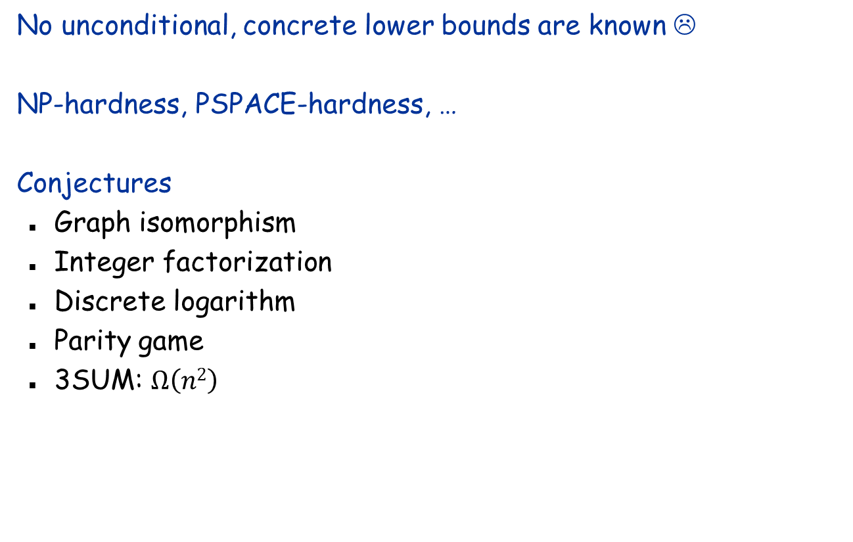
Lower Bounds
No unconditional, concrete lower bounds are known ☹
NP-hardness, PSPACE-hardness, …
Conjectures
Graph isomorphism
Integer factorization
Discrete logarithm
Parity game
3SUM: $Ω\left(n2\right)$

Slide 15
Lower Bounds
Restricted computational models
Decision tree
Non-time lower bounds
Circuit complexity
Communication lower bounds
Space lower bounds
Data structure lower bounds
Cell-probe lower bounds
Pointer-machine lower bounds
I/O lower bounds

Slide 16
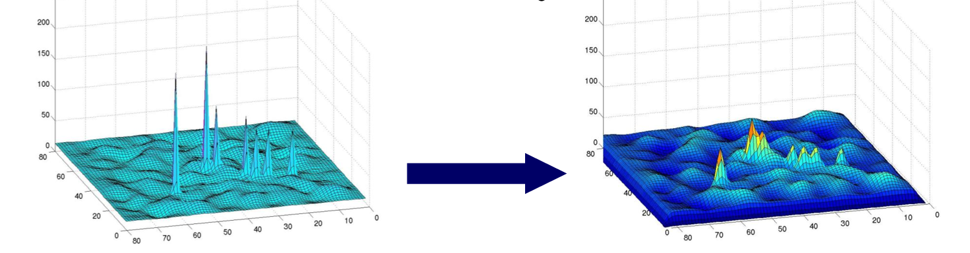
Beyond Worst-Case Analysis
Expected case (for randomized algorithms)
Also high-probability bound
Instance-optimality
Average-case analysis
Smoothed Analysis

