Slide 1

EXPERIMENT 1 · DESIGN SYSTEM GENERATION
Corporate Tech Branding
Ocean Blue & Minimalist
Tokenized palette, restrained typography, native layout primitives, and a reusable visual language for security-focused decks.
Design System
Colors, type scale, component rhythm, spacing, and presentation rules captured as deck-ready atoms.
Notes:
Slide 1 speaker notes: design-system prompt baseline.

Slide 2
EXPERIMENT 2 · NATIVE PPTX OBJECTS
Design Tokens Captured as Editable Text and Shapes
Ocean 700
Cyan 600
Mint 500
Slate 900
#075985 · primary
#0891B2 · accent
#14B8A6 · success
#0F172A · text
8 px
1.35
18-34
Base spacing unit
Body line-height
Corner radius range
Notes:
Slide 2 speaker notes: token capture and editability inspection.

Slide 3
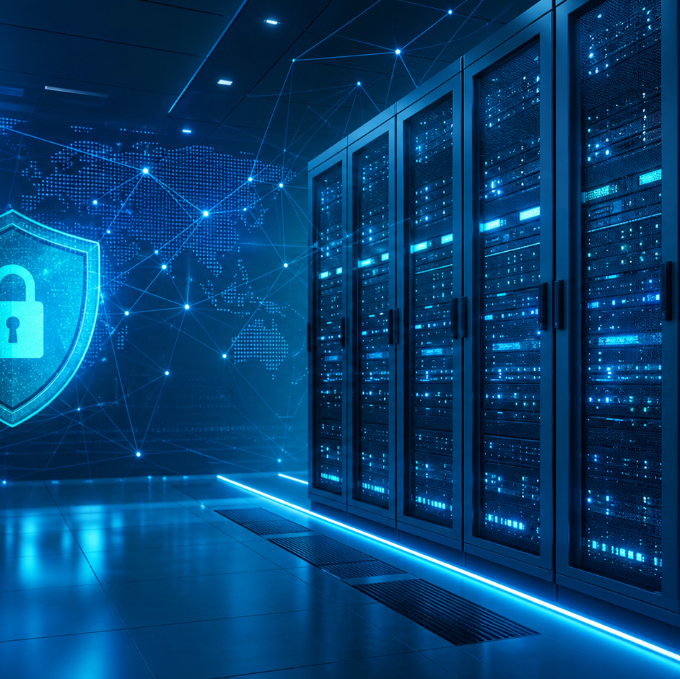
EXPERIMENT 3 · IMAGE GENERATION INSERTION
Image Placeholder Workflow
The illustration below is generated by the local image generation tool for an AI image prompt. The exporter must fetch, rasterize, size, and place it without flattening all surrounding text into screenshots.
Prompt: A futuristic server room icon.
Expected fit: cover, centered crop.
Expected PPTX result: generated picture plus editable labels.
Generated image response
Notes:
Slide 3 speaker notes: local image generation insertion workflow.

