Slide 1

EXPERIMENT 1 · DESIGN SYSTEM GENERATION
Corporate Tech Branding
Ocean Blue & Minimalist
Tokenized palette, restrained typography, native layout primitives, and a reusable visual language for security-focused decks.
Design System
Colors, type scale, component rhythm, spacing, and presentation rules captured as deck-ready atoms.
Notes:
Slide 1 speaker notes: design-system prompt baseline.

Slide 2
EXPERIMENT 2 · NATIVE PPTX OBJECTS
Design Tokens Captured as Editable Text and Shapes
Ocean 700
Cyan 600
Mint 500
Slate 900
#075985 · primary
#0891B2 · accent
#14B8A6 · success
#0F172A · text
8 px
1.35
18-34
Base spacing unit
Body line-height
Corner radius range
Notes:
Slide 2 speaker notes: token capture and editability inspection.

Slide 3
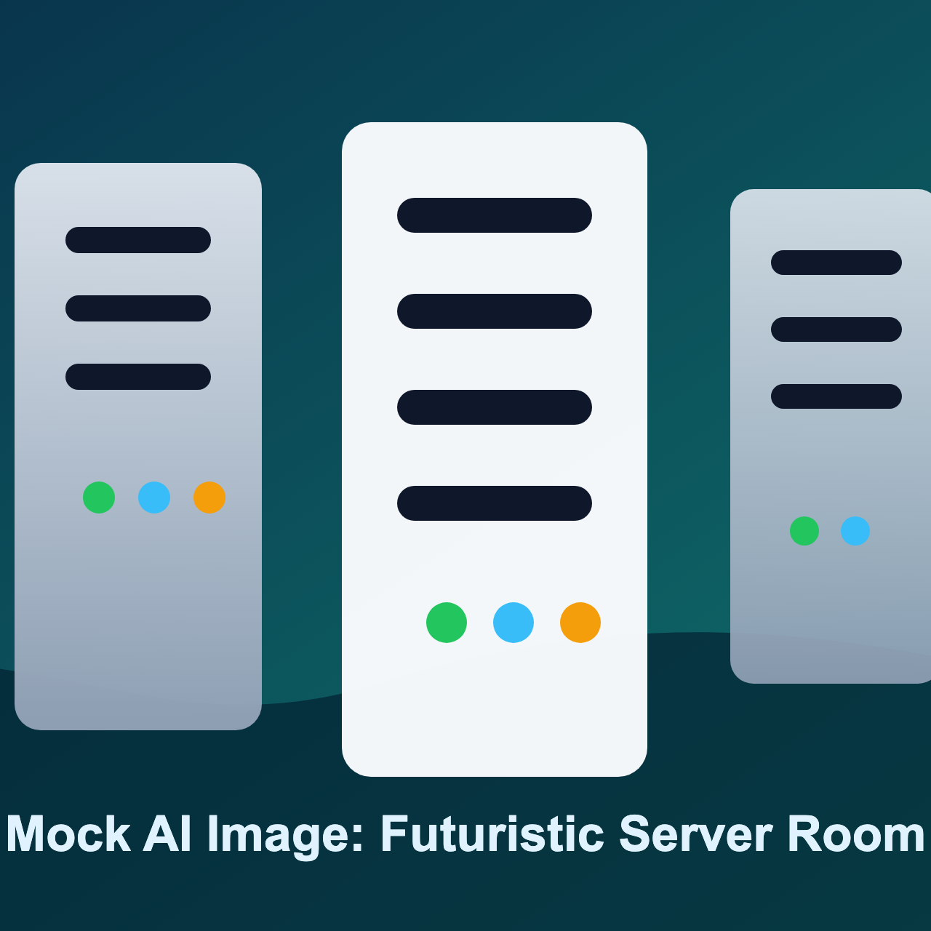
EXPERIMENT 3 · MOCK AI IMAGE INSERTION
Image Placeholder Workflow
The illustration below is a local mock response for an AI image prompt. The exporter must fetch, rasterize, size, and place it without flattening all surrounding text into screenshots.
Prompt: A futuristic server room icon.
Expected fit: cover, centered crop.
Expected PPTX result: native picture plus editable labels.
Mocked image generation response
Notes:
Slide 3 speaker notes: mocked image generation insertion workflow.

