Slide 1

Trabajo final de la especialización:
RailML
Mg. Eng. Martín Nicolás Menéndez
Directores: Dr. Ing. Ariel Lutenberg
Mg. Ing. Facundo Larosa

Slide 2

CONICET-GICSAFe
Research Group on Quality and Safety of Railway Applications
(in spanish : Grupo de Investigación en Calidad y Seguridad de las Aplicaciones Ferroviarias)

Slide 3

About me
Mg. Eng. Martin N. Menendez
Electronic Engineer (UBA)
Embedded system specialist (UBA)
Embedded system magister (next April)
GICSAFe’s member since December 2017
Beginning Doctorate in engineering (PhD 2020)
Scholarships: UBACyT(Master) and CONICET(PhD)
Currently designing a Railway Interlocking System

Slide 4
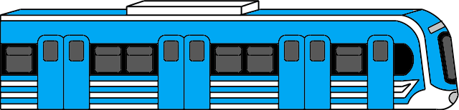
Transport railway network
We need something to avoid train’s collisions!
A bypass is used to allow trains to move in both direction with only one track. To cover long distances with a single track infrastructure

Slide 5
Typical railway station
How can we describe this system?
Station
It allows passengers to travel on trains that run in both directions

Slide 6
Typical railway hub
Railway workshop
Station
Station
Station
And this one?

Slide 7
Typical railway terminal
Station
Station
Station
Station
Is there a simple way to describe this between different suppliers?

Slide 8

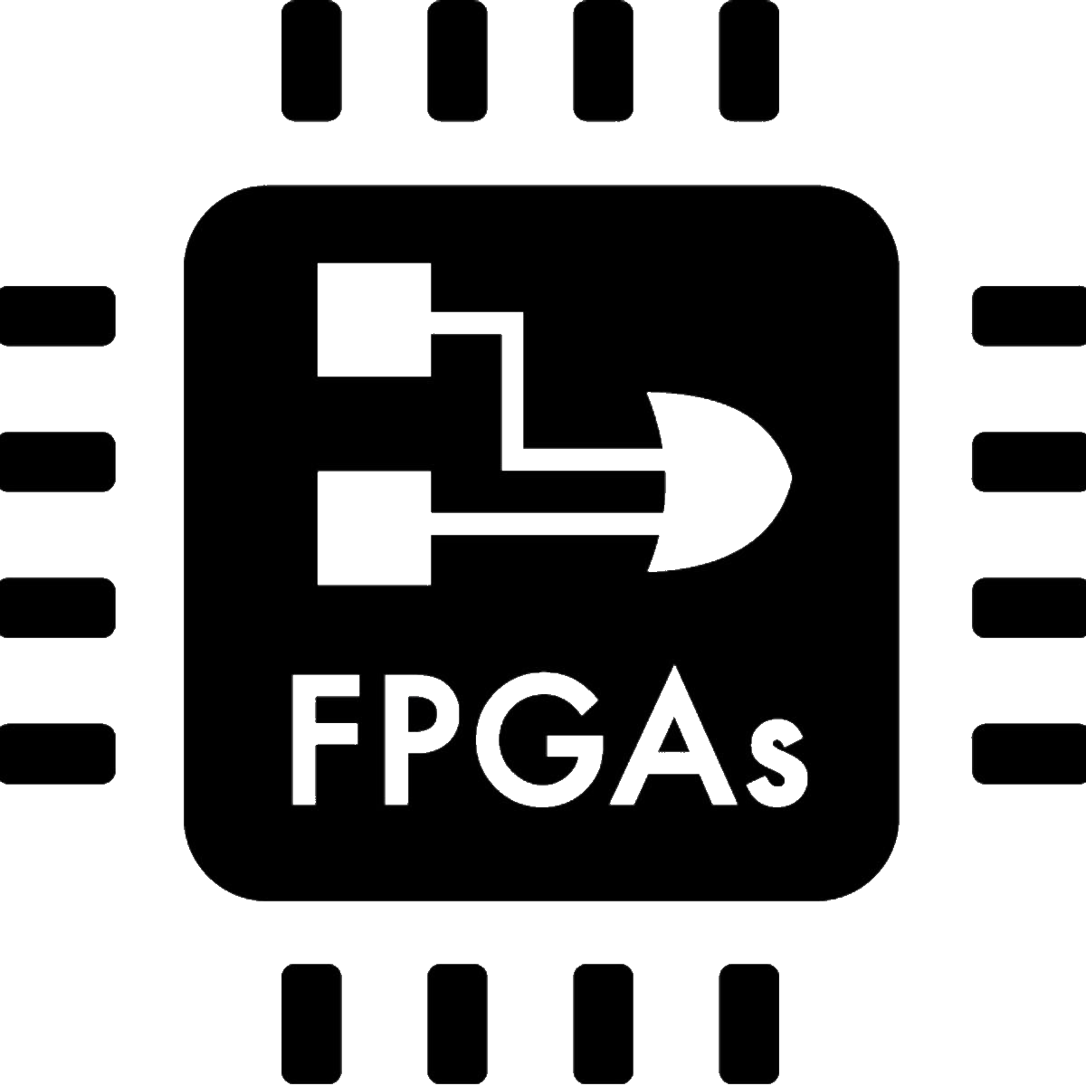
Can we automatically interpret any railway network?

Slide 9
Markup languages
1
Describing hierarchies

Slide 10
HMTL - HyperText Markup Language
<!DOCTYPE html>
<html>
<head>
<title>This is a title</title>
</head>
<body>
<div>
<p>Hello world!</p>
</div>
</body>
</html>
Web Browsers

Slide 11
XML - Extensible Markup Language
<breakfast_menu>
<food>
<name>Belgian Waffles</name>
<price>$5.95</price>
<description>Two of our famous Belgian Waffles with plenty of real maple syrup</description>
<others calories = 650>
</food>
<food>
<name>Strawberry Belgian Waffles</name>
<price>$7.95</price>
<description>Light Belgian waffles covered with strawberries and whipped cream</description>
<others calories = 900>
</food>
</breakfast_menu>
General structures

Slide 12



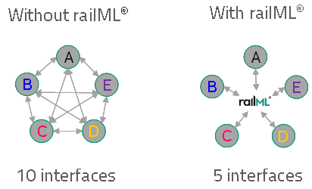




railML - Partners

Slide 13
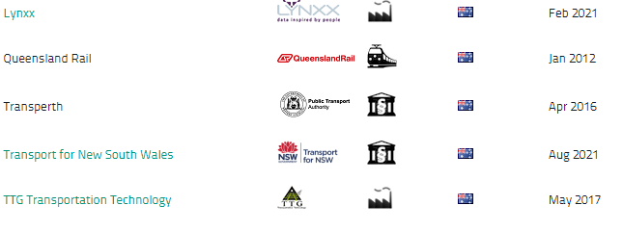
railML - Local partners

Slide 14
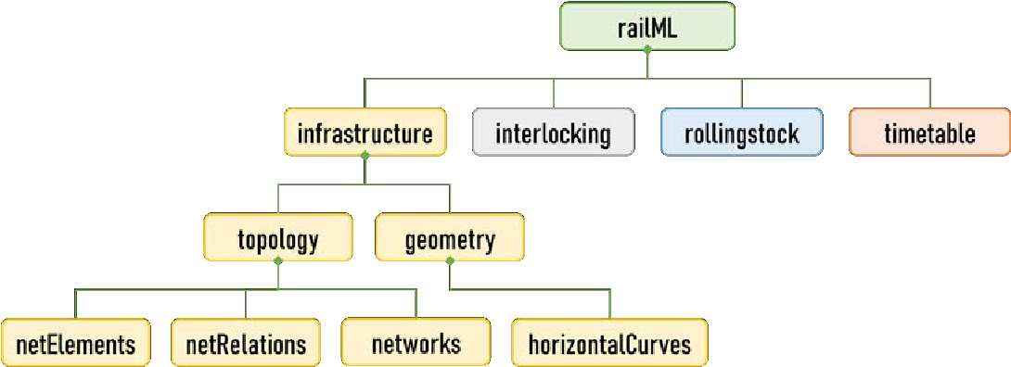
railML - Schemas
Link

Slide 15
railML 2.0 vs railML 3.0
2
Functional vs geographical approach

Slide 16
RailTopoModel
Railway Network
Macro
Meso
Micro
Levels
Topology
Physical Objects
Immaterial Objects
Logical Objects
Lines
Tracks
Nodes
Speed limits
Radio coverage
...
Signalling
Interlocking
...
Rails
Stations
Bridges & Tunnels
Signal & Balises
...
Dimensions and properties attached to all functional objects
Positioning System
Geometry
Time
Project
Intrinsic
Geographic
Schematic
Math/curves
Polylines
...
Creation & Update
Validity
...
Project
Scenarios
...

Slide 17
RailTopoModel - Stacks
...
Routes
Actual routes
Interlocking
Logical and wired behavior
Installations & properties
Tracks, switches, signals, bridges, gauge, slopes, speed limits
Logical paths
Oriented network
Topology
Wired network

Slide 18
RailTopoModel - Graph
Graph model of Topology
Usual view
Topology
B
B
1
3
A
A
C
C
2
netElement = Node
netRelation = Edge

Slide 19
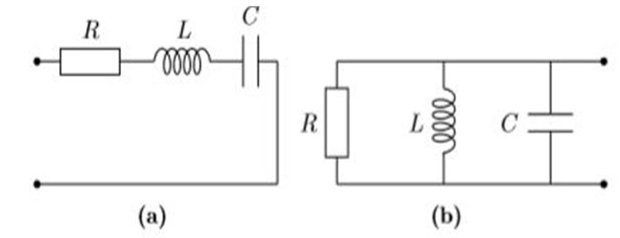
RLC circuits
Both have the same componentes but it is their topology what determines its general behaviour

Slide 20
RailTopoModel - Levels
Micro
Detailed tracks
Division & Aggregations
Operational Point 1
Operational Point 2
Meso
OPs connected by tracks
Aggregations
SoL1
Operational Point 1
Section of Line 2
Operational Point 2
SoL3
Macro
OPs & sections of lines

Slide 21
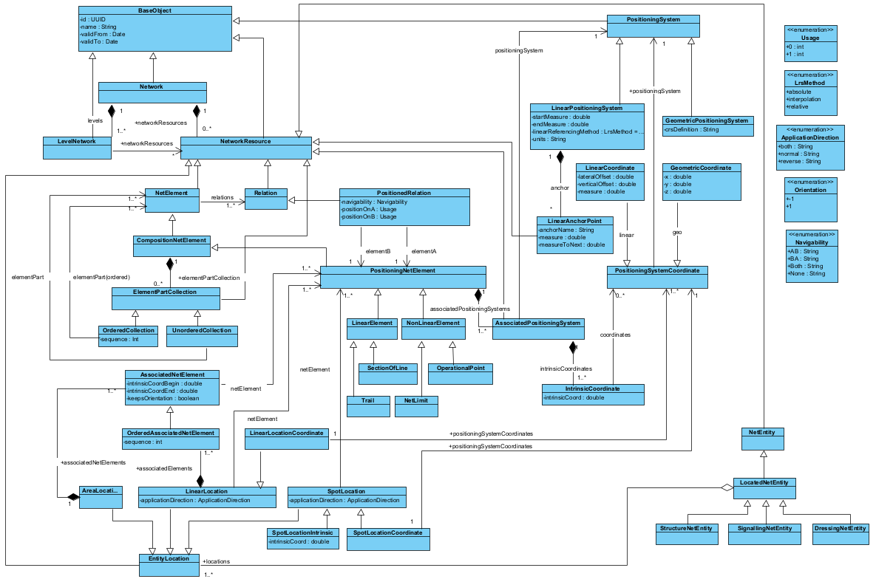
RailTopoModel - Classes

Slide 22
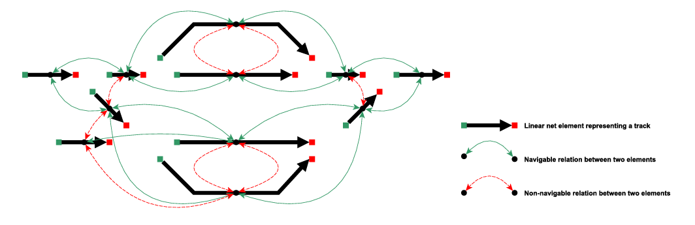
Graph network
We can model every brick and we know how to connect them … It’s like playing Lego!

Slide 23
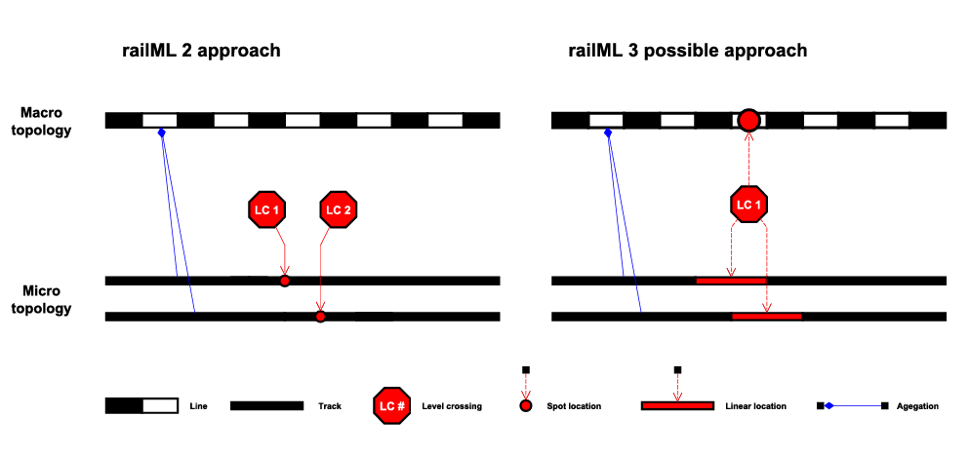
railML 2.0 vs railML 3.0

Slide 24
Functional vs Geographical
3
CISC vs RISC: an interlocking approach

Slide 25
How to model the system?
Track sections are read-only information
Track sections
Traffic lights
Traffic lights
Switches
Switches
Interlocking Railway System
Level crossings
Level crossings
CISC: Complex Instruction Set Computing | RISC: Reduced Instruction Set Computing

Slide 26
CISC approach: the functional approach
One Route to rule them all!
The route is the functional unit
Big and complex FSM
Track sections
Traffic lights
Traffic lights
Switches
Switches
Routes
Level crossings
Level crossings
Interlocking table

Slide 27
RISC approach: the geographical approach
Routes? Where we're going, we don't need routes.
Track sections
Traffic lights
Traffic lights
Track changers
Track changers
Level crossings
Level crossings
Have you ever seen a car moving without a road?
Have you ever seen a train moving without a track?

Slide 28
CISC approach: the functional approach
You need BIGGER bricks!
Complexity

Slide 29
RISC approach: the geographical approach
You need MORE bricks!
Complexity

Slide 30
Functional approach
Easy to implement
Modular
Incompleteness
Testing after implementation
Oversized blocks
Excessive memory usage
Risk of not being synthesizable
Interlocking table already defined by professionals.
Technically correct, but define only what is necessary.
Certify iteratively.
Low scalability.
Hard to include redundancies.

Slide 31
Geographical approach
Hard to implement
Modular
Complete
Testing before implementation
It depends on the network topology
Minimum memory usage
Greater chance of being synthesizable
Processing the graph can be complicated
Define ALL possible circulations
Complete tests. Certify once.
Scalability.
Redundable.

Slide 32
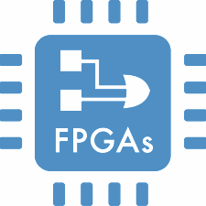
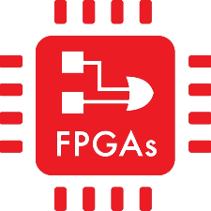
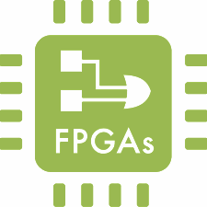
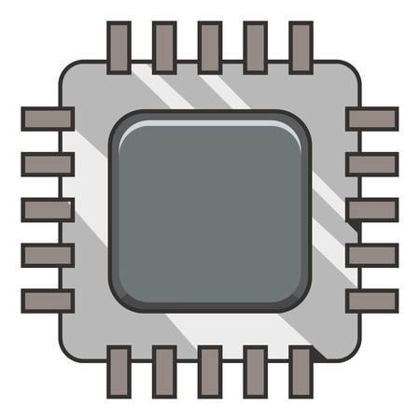
Functional workflow
Redundancy
Availability
Interlocking table
(Safety Integrity Level)
SIL 4
Script
Validation
VHDL
Diversity
Mitigate common cause failures
μC
Simulation
C/Python

Slide 33
Geographical workflow
Graph network
Redundancy
Availability
Layout
(Safety Integrity Level)
SIL 4
Logic
Validation
Diversity
Mitigate common cause failures
Interlocking table
VHDL

Slide 34
Design4Rails
4
railML editor/viewer

Slide 35
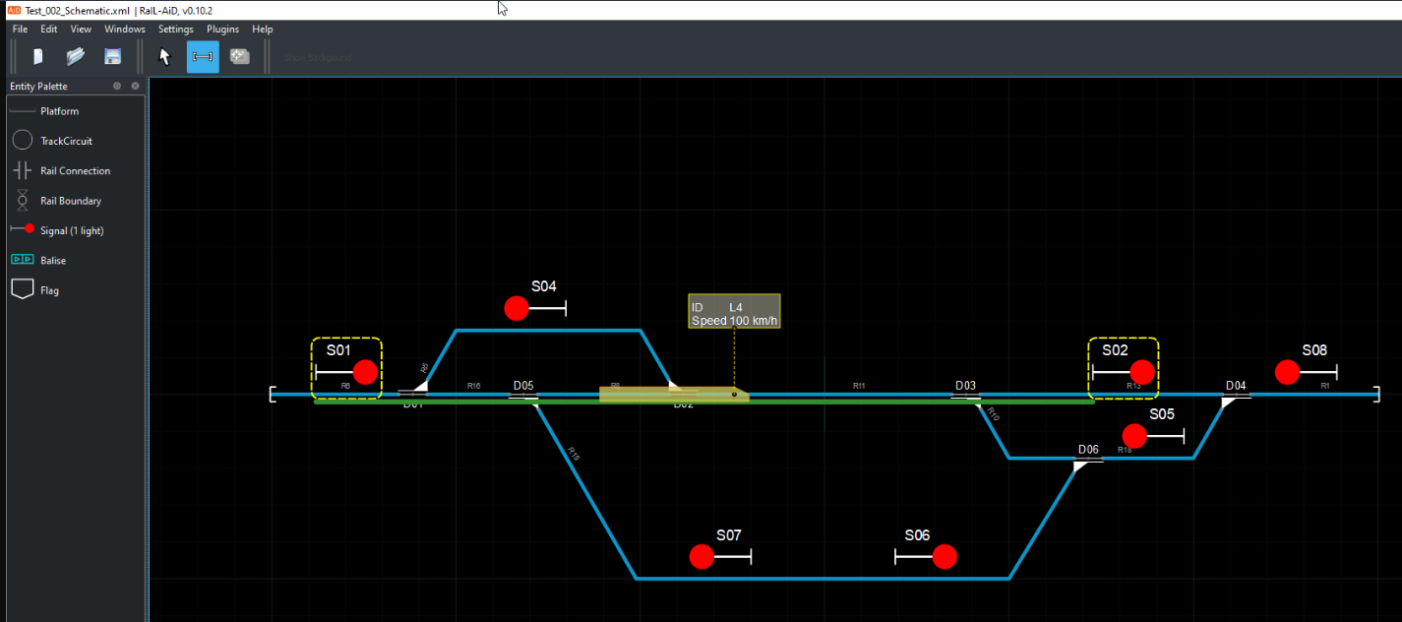
Design4Rail

Slide 36
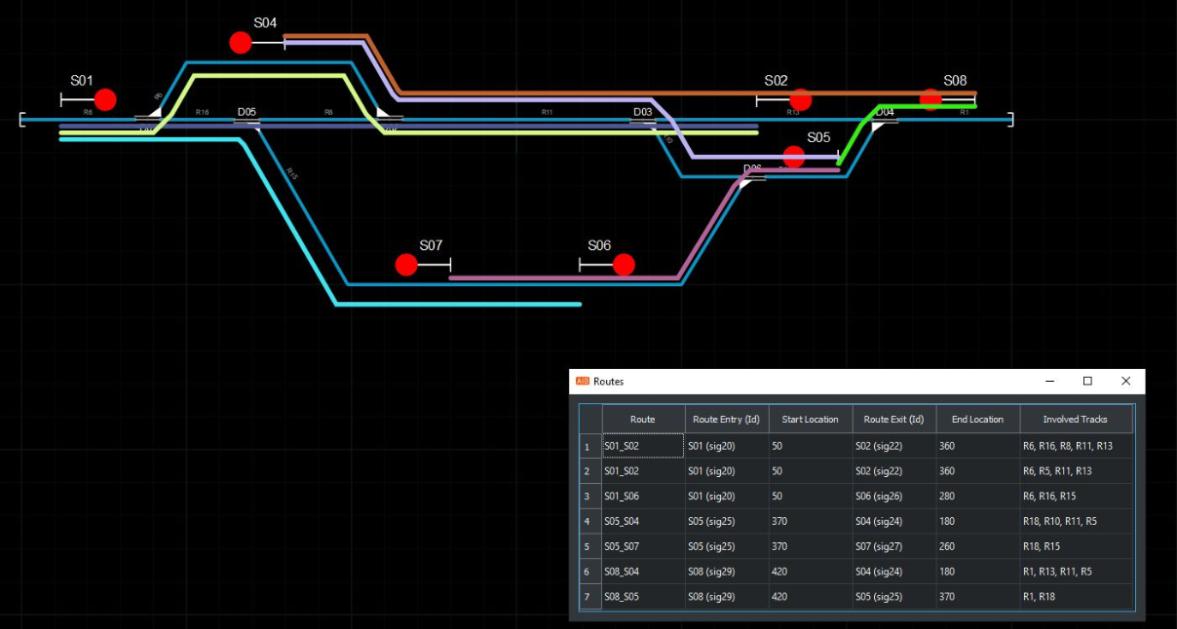
Design4Rail

Slide 37
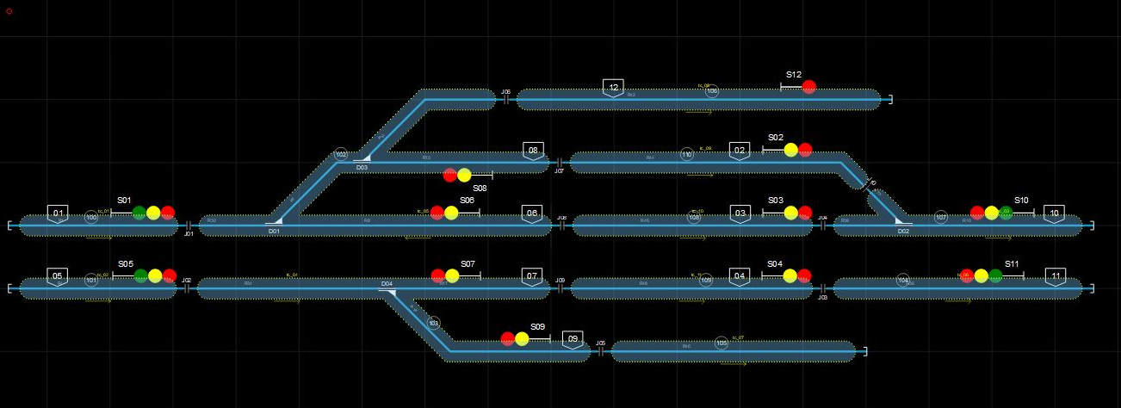
Design4Rail

Slide 38
Thank you!
Any questions?

Slide 39
SlidesCarnival icons are editable shapes.
This means that you can:
Resize them without losing quality.
Change line color, width and style.
Isn’t that nice? :)
Examples:

