Slide 1
An introduction to R I wish I had
A pirates favorite programming language… sorry

Slide 2
Overview
1. Data classes
Different traits of data and how they are handled in R
2. Data structures
Different options how to work with data in R
3. Functions in R
How does R work with data and how do we tell it what to do
4. Closing thoughts
What R is, can do and what it doesn’t do

Slide 3
1. Data classes in R
1.1 Logical
Simple yes or no question, referred to as TRUE (T) or FALSE (F) in R
1.2 Letters and Words
Single letters and words are referred to as character in R (a sequence of letters/words can be referred to as string from fellow scientists)
1.3 Numbers
Everything that is a number is classified as numeric in R, however there are differences (which can be important concerning what you want to do)
for example: numeric (integer, double), complex numbers (a + bi)
Nerd site talk: each real number is a complex number (b = 0) but not every complex number is a real number
1.4 Factors (not liked, weird but useful data class)
Every character or number can be a factor

Slide 4


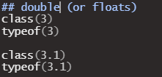


1. Data classes in R
Logical
Numbers
True (yes)
False (no)
Integer
Numeric/double
Complex numbers
Characters

Slide 5
1.2 Factor, “the special case”
Factors are not stored in R as what they are displayed
They can be harmful for your statistics and plots
However they are also super useful for us to order our plots/data
Factor
 | [1] | [2] | [3]
What you think it is | 10 | 2 | 6
What R knows it is | 3L | 1L | 2L
Numbers
Characters
Logical
Integer

Slide 6
1.3 Coercion (Zwang) in R
R assigns everything a data class
logical
integer
double
complex
character
If you load data with multiple data classes, R will assign the class where you don’t lose information
Logical column | Integer column | Double column | Complex column | Character
TRUE | 1 | 1.0 | 1.0 + 0i | “TRUE”
FALSE | 0 | 0.0 | 0.0 + 0i | “FALSE
 | 3L | 3.0 | 3.0 + 0i | “3”
 |  | 3.1 | 3.1 + 0i | “3.1”
 |  |  | 4.0 + 1i | “4.0 + 1i”
 |  |  |  | “Pirate”

Slide 7
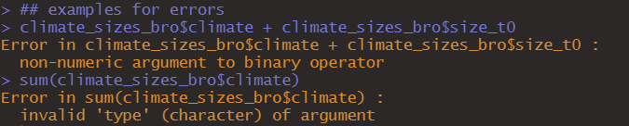

1.4 Why should you care?
R uses them to tell you what‘s wrong
2. Or it sometimes it just gives you warnings
3. Can be important for your statistics you want to run

Slide 8
2. Data structures
Matrix
Data Frame
columns
Array
columns
Vector
rows
rows
coercion
coercion
coe
coercion
coercion
Indexing: [position]
Indexing: [row, column]
Indexing:
[row, column, array position]
Indexing: [row, column]
List
Indexing:
[[list position]][depends]

Slide 9

2.1 Vector
A “line” of data
You can also name your vector entries (change its definition to named “data class”)
[1]
[2]
[3]
[4]
[5]
[6]
3.5 | 6 | 7 | 34 | 3 | 20
[“entry1”]
[“entry2”]
[“entry3”]
[“entry4”]
[“entry5”]
[“entry6”]
3.5 | 6 | 7 | 34 | 3 | 20
Common mistake when trying to store (loops):

Slide 10
2.2 Matrix & Array
A matrix is a vector with an additional dimension
Array is a compound of matrices adding more dimensions (I never use them)
 | [,1] | [,”col2”] | [,3]
[1,] | “23” | “70” | “45”
[“row2”,] | “65” | “31” | “70”
[3,] | “99” | “10” | “578”
[4,] | “34” | “4” | “34”
[5,] | “45” | “34” | “Pirate”
 | [,1] | [,2] | [,3]
[1,] | “23” | “70” | “45”
[2,] | “65” | “31” | “70”
[3,] | “99” | “10” | “578”
[4,] | “34” | “4” | “34”
[5,] | “45” | “34” | “Pirate”
 | [,1] | [,2] | [,3]
[1,] | “23” | “70” | “45”
[2,] | “65” | “31” | “70”
[3,] | “99” | “10” | “578”
[4,] | “34” | “4” | “34”
[5,] | “45” | “34” | “Pirate”
 | [,1] | [,2] | [,3]
[1,] | “23” | “70” | “45”
[2,] | “65” | “31” | “70”
[3,] | “99” | “10” | “578”
[4,] | “34” | “4” | “34”
[5,] | “45” | “34” | “Pirate”
[, , 3]
[, , 2]
[, , 1]

Slide 11
2.3 Data frame
Data frames can consist of different data types
That is because each column is a individual vector
 | [,1] | [,”col2”] | $col3 | [, 4]
[1,] | 45 | “43” | 3 + 3i | T
[“row2”,] | 234 | “Pirate” | 34 + 0i | T
[3,] | 34 | “32” | 23 + 1i | F
[4,] | 34 | “12” | 0 + 0i | T

Slide 12
2.4 Lists
They can consist of multiple data structures, each entry being another
Index like this: [[list entry]][what ever you want to call in the object]
Different to other programming language, you can name list entries from the beginning in R
Vector
List entry 1
List_name[[1]][1:2], calls first list entry position 1 - 2
List
Data Frame
List entry 2
List_name[[2]][, 2], calls second list entry column 2

Slide 13

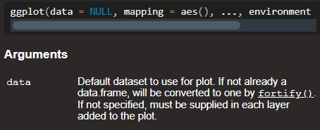
3. FUNctions
You can think about it as: Tell R what to do and what to use in order to do the task
Thats how every function in R works
Name_of_function(expected_input_1, expected_input_2… expected_input_N)

Slide 14
4. For loops
Will repeat everything in it n times
Alternatives: apply, repeat
R example

Slide 15
4. Closing thoughts
R is a powerful tool
Like every tool, we need to understand it
However it is nothing more but a tool, your job is it to use it right and interpret
Don’t end up being the person who hangs a picture and says after that: “look isn’t that an awesome hammer.“
Don‘t be scared of making mistakes or not knowing something
„You can‘t look cool learning something new.“

Slide 16

Exponential growth - Muskoxen

Slide 17
1. Import and check muskox dataset
Use provided link to read data (read.csv())
Check your data, anything weird?
Plot the population through time (ggplot(), plot())

Slide 18
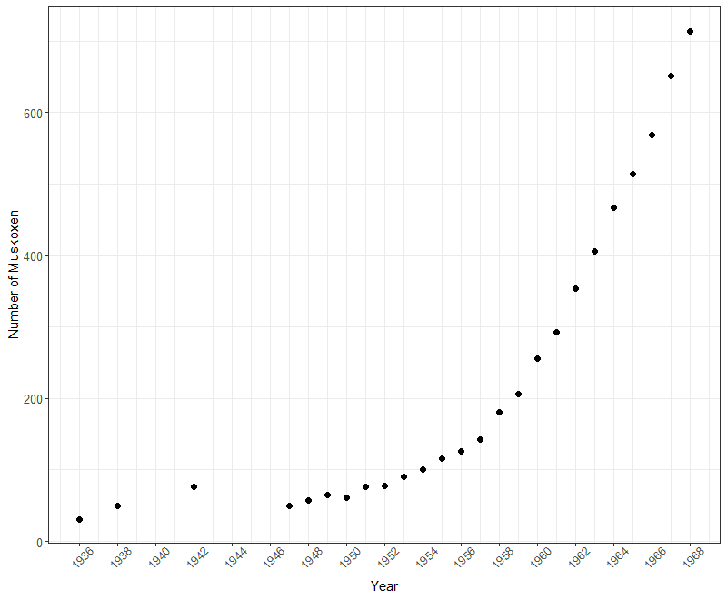
1. Import and check muskox dataset

Slide 19
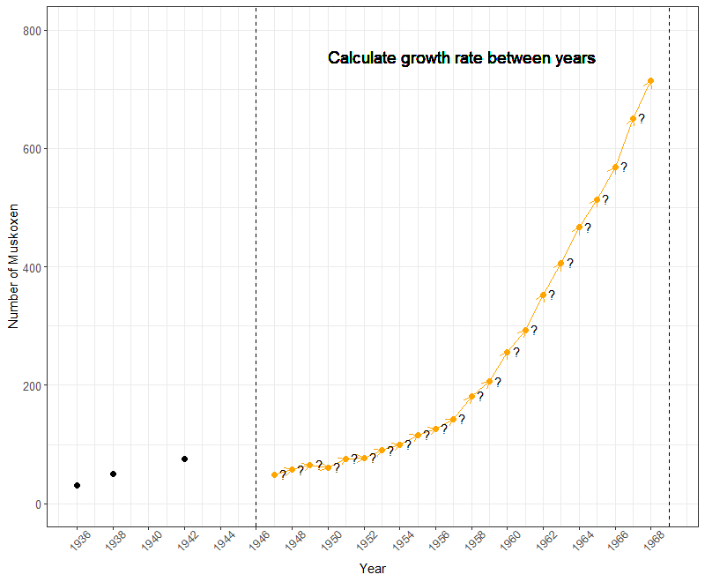
2. Calculating the growth rate (λ) for each year
Calculate the growth rate for each year from 1947 until 1968
For loop could be helpful
We need subset(), filter()*, which()……
for(i in….)

Slide 20
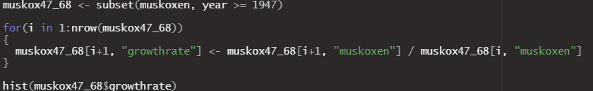
2. Calculating the growth rate (λ) for each year
Calculate the growth rate for each year from 1947 until 1968
For loop could be helpful
Plot your result as a histogram (use hist())

Slide 21
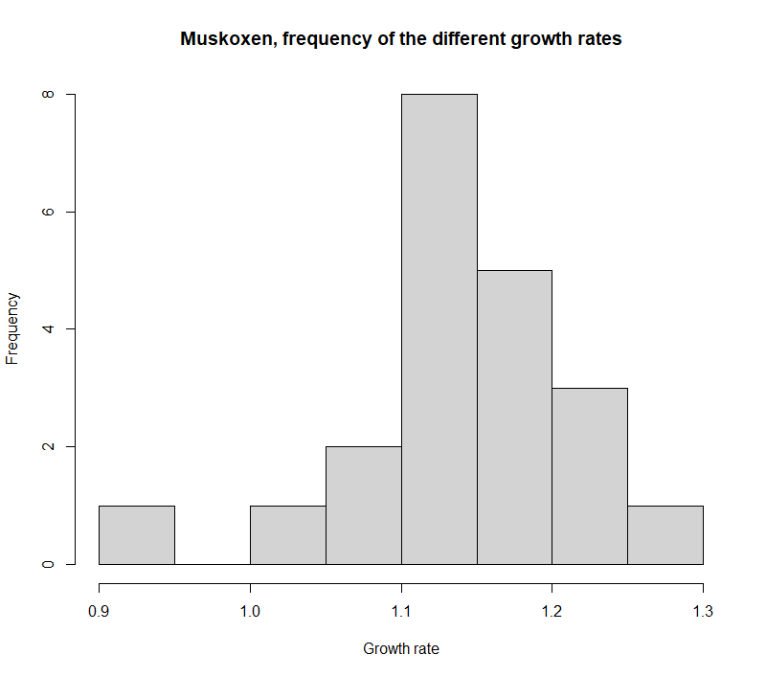
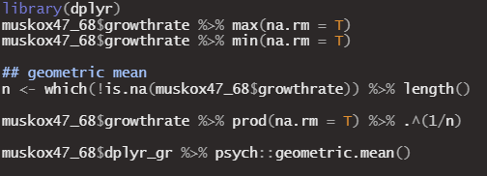
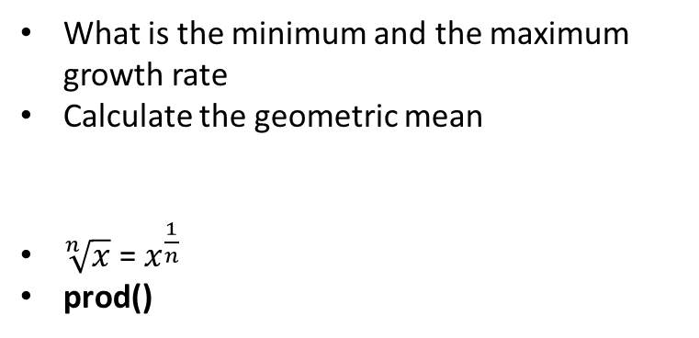

2. Calculating the growth rate (λ) for each year
What is the minimum and the maximum growth rate
Calculate the geometric mean
$\sqrt[n]{x}$ = $x^{\frac{1}{n}}$
prod()
$$\sqrt[n]{product of R values}$$

Slide 22
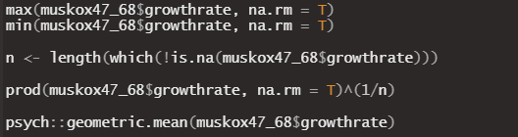
Note for pipes in R
%>% passes the result of a function to the next functions “data = “ statement

Slide 23
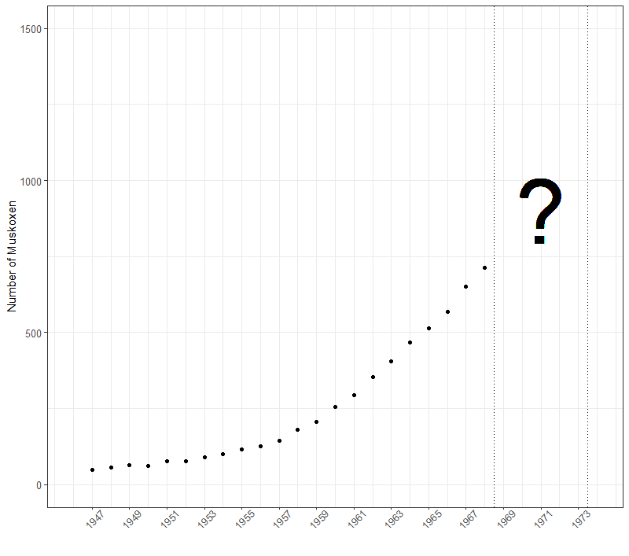
3. Projecting the future

Slide 24
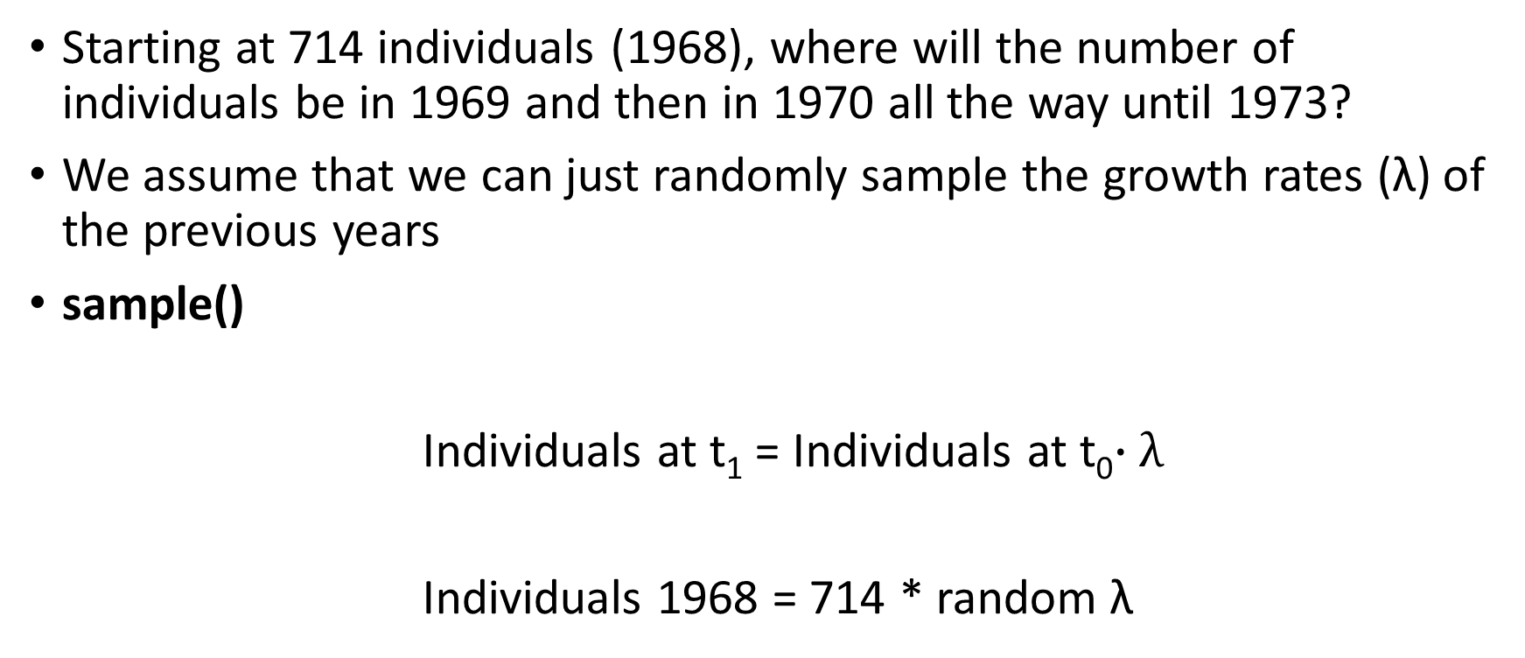
3. Projecting the future
Starting at 714 individuals (1968), where will the number of individuals be in 1969 and then in 1970 all the way until 1973?
We assume that we can just randomly sample the growth rates (λ) of the previous years
sample()
Individuals at t₁ = Individuals at t₀$∙λ$
Individuals 1968 = 714 * random λ

Slide 25

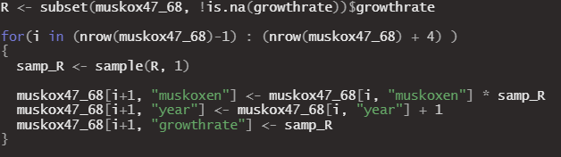
3. Projecting the future
Individuals 1969 = 714 * random λ
Individuals 1970 = Individuals 1971 * new random λ
What do we need for what we have in mind?
or

Slide 26
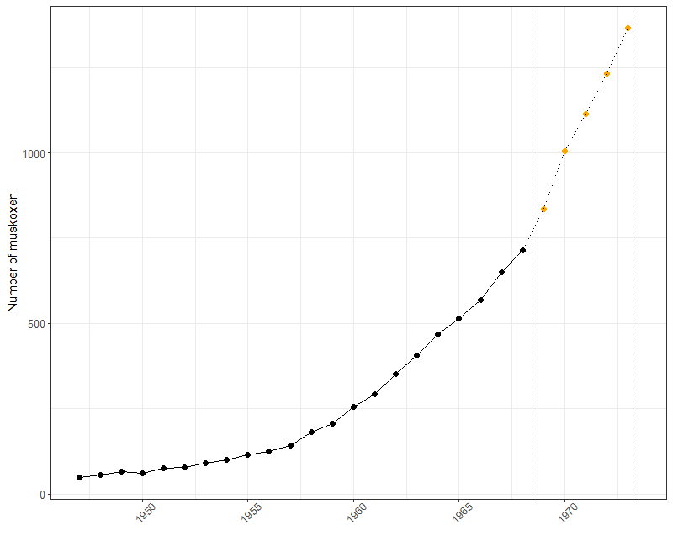
3. Projecting the future
Projecting this only one time doesn‘t help us much, why?

Slide 27
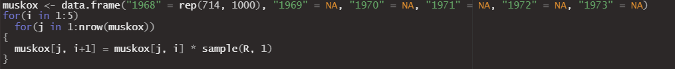
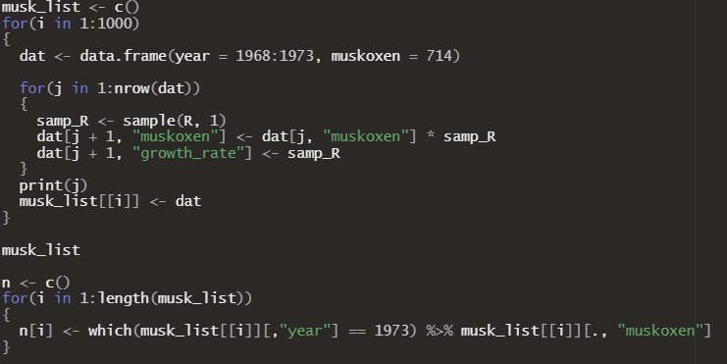
3. Projecting the future
We are going to repeat that process a 1000 times!
or

Slide 28
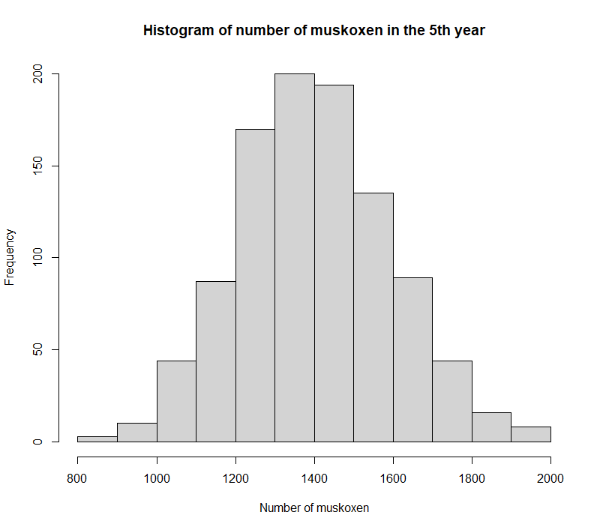
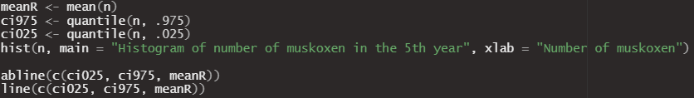
3. Projecting the future
Calculate the mean and the 95% confidence intervals

