Slide 1
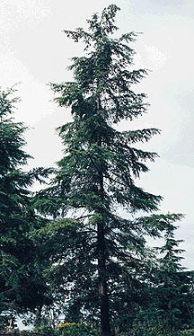
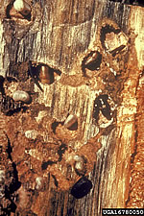
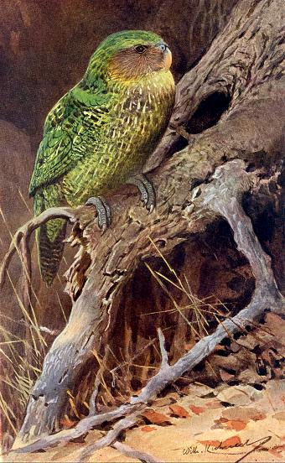
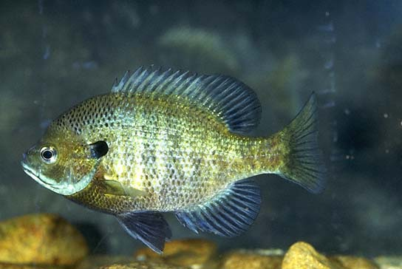
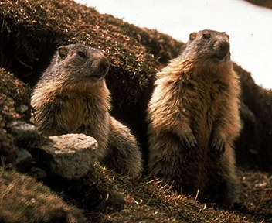
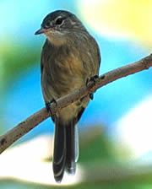
Lecture 3:
Density Dependence

Slide 2
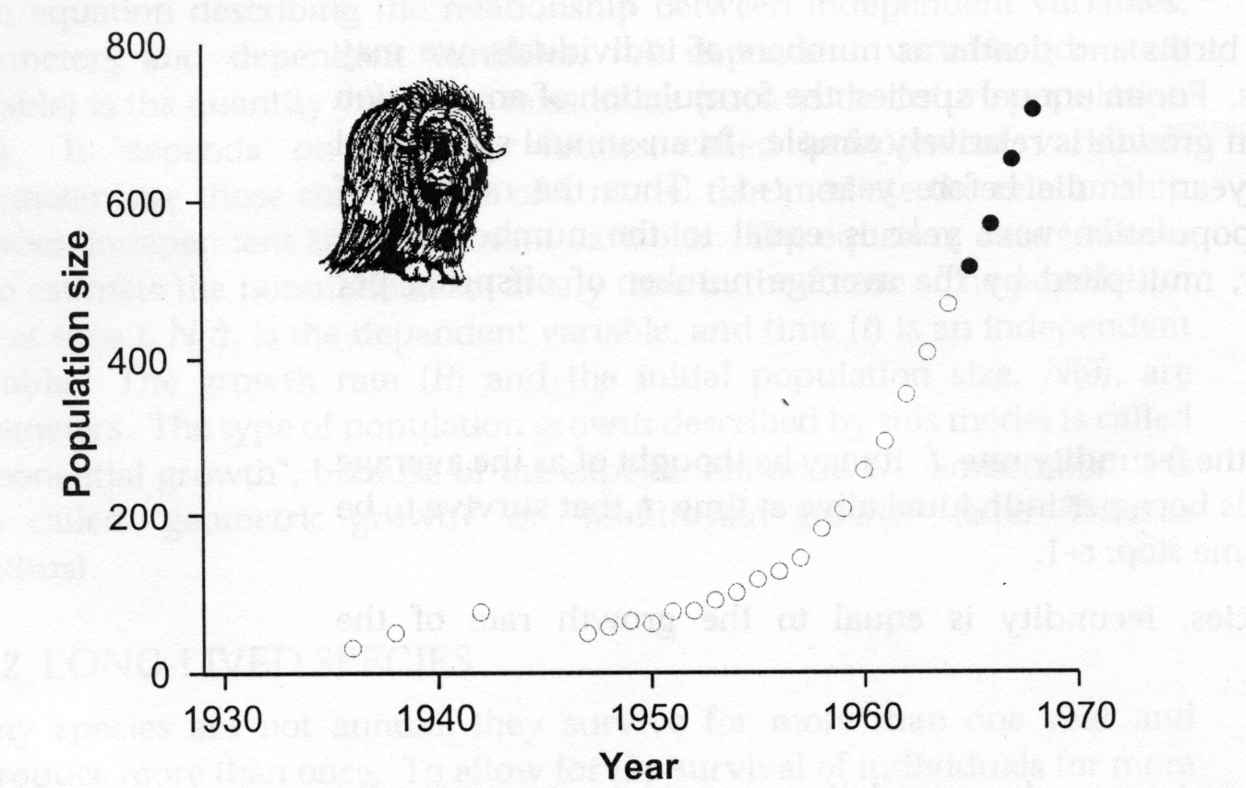
Muskox- exponential population growth for 30 years

Slide 3
Effects of Crowding

Slide 4
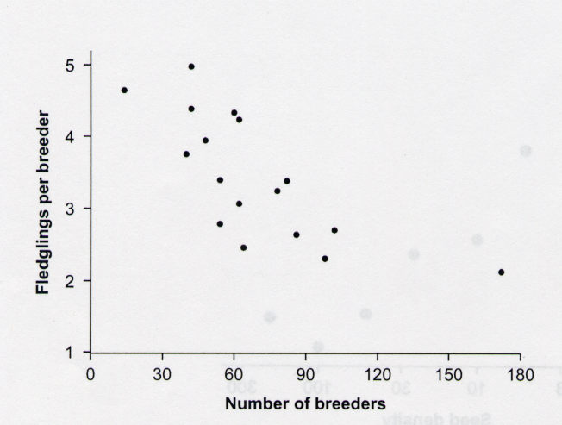
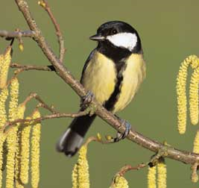
Birth rates decrease with density

Slide 5
Density dependence

Slide 6
Types of density dependence
Scramble competition- a resource is shared equally among individuals- as the population size increases the amount of resource per individual decreases.
Contest competition- resources are shared unequally- as the population size increases some individuals get enough resources to survive and reproduce and some do not.

Slide 7
Scramble Competition
Newly hatched fish- competition for food
If density is low- all of them survive.
If density is high- all of them die
Contest competition

Slide 8
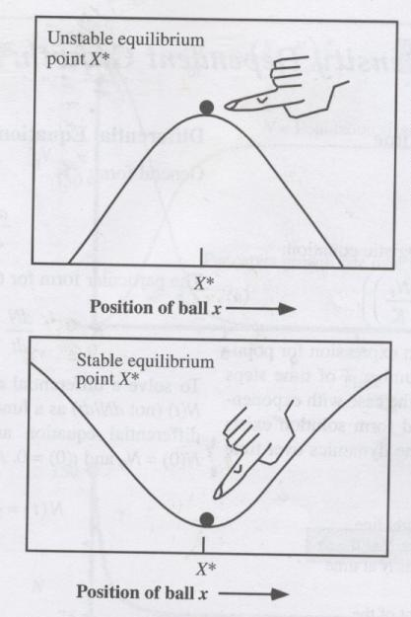
Types of equilibrium
Unstable equilibrium
Stable equilibrium

Slide 9
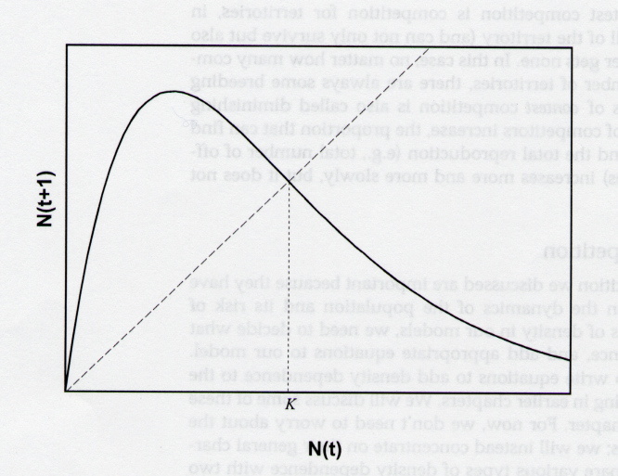
Scramble Competition

Slide 10
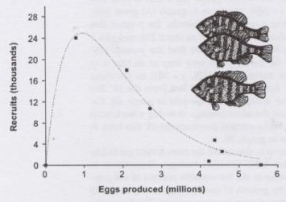
Scramble Competition
Bluegill (Lepomis macrochirus)

Slide 11
Discrete logistic equation

Slide 12
100
100
N_{t+1}=N_{t}
80
80
60
60
N_{t+1}
N_{t}
K
40
40
20
20
0
0
0
20
40
60
80
100
0
1
2
3
4
5
6
7
N_{t}
Time
R = 1.6, N₀=20, K = 50

Slide 13
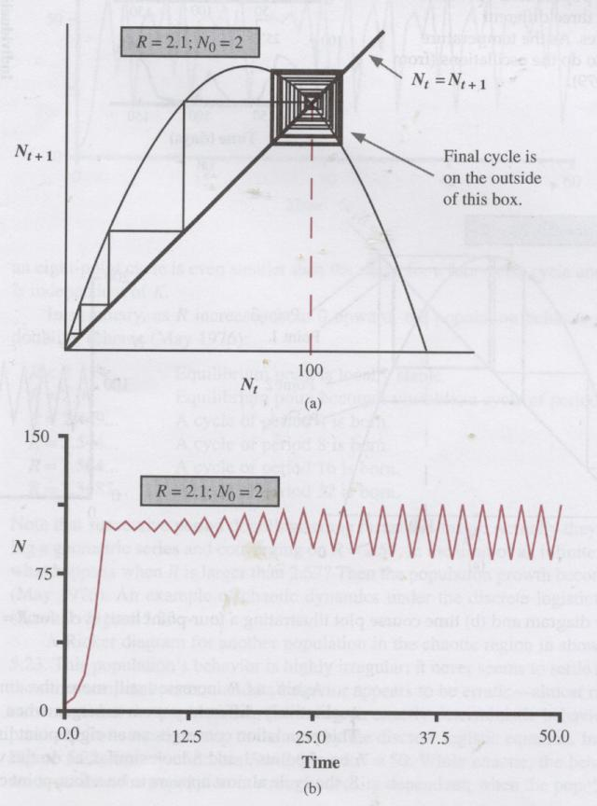
Increase R to 2.1
R = 2.1, N₀ = 2, K = 100
Stable 2-point cycle

Slide 14
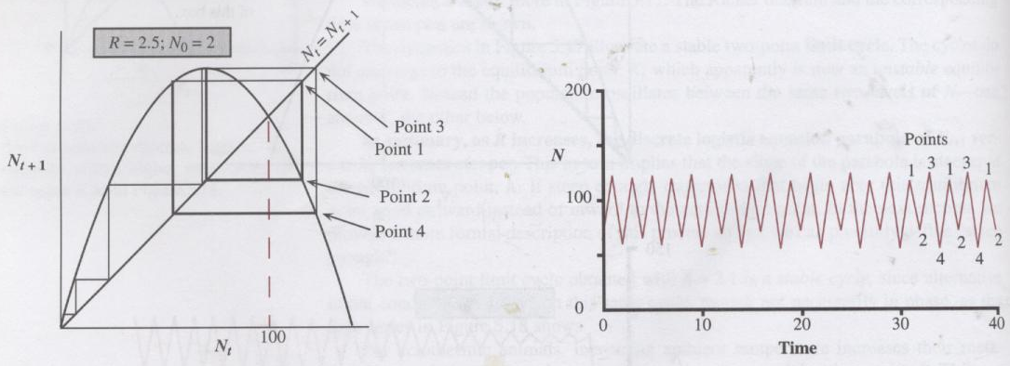
R = 2.5, N₀ = 2, K = 100
Stable 4-point cycle

Slide 15
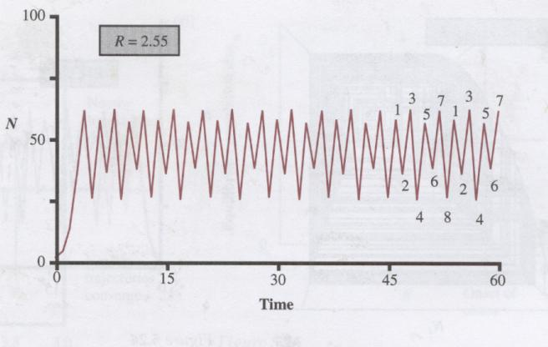
R = 2.55, N₀ = 2, K = 50
Stable 8-point cycle

Slide 16
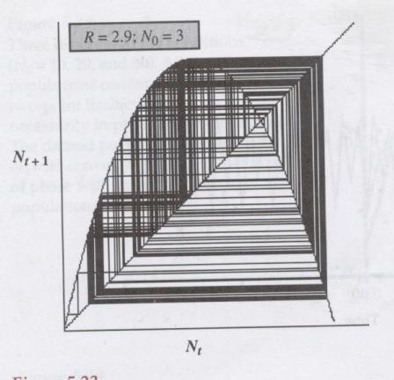
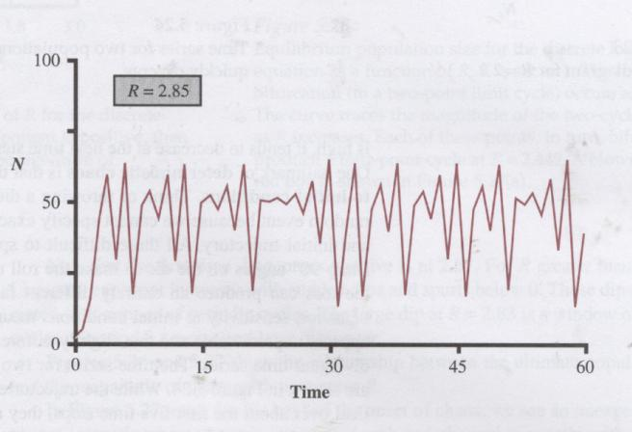
When R > 2.57, population growth becomes chaotic

Slide 17
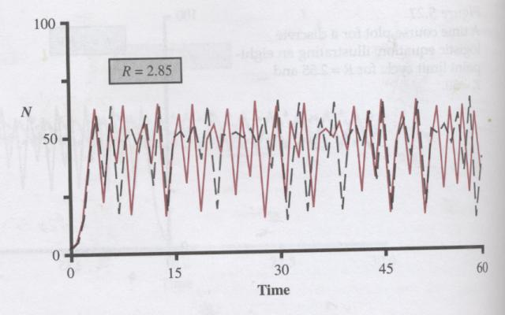

Slide 18
Range of R Dynamic behavior
R < 2.000 Stable equilibrium at K
2.000 < R < 2.449 Stable 2-point cycle
2.449 < R < 2.544 Stable 4-point cycle
2.544 < R < 2.564 Stable 8-point cycle
2.564 < R < 2.570 Larger-point cycles
R > 2.570 Chaos

Slide 19
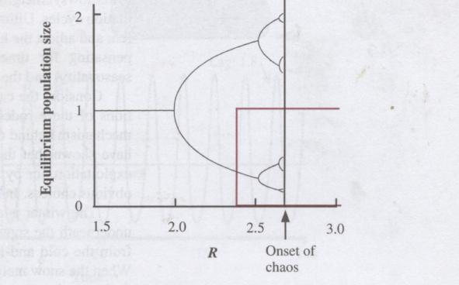
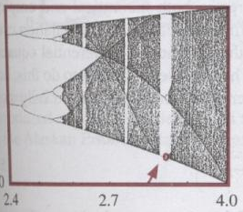
Bifurcation diagram
Equilibrium population size

Slide 20
Scramble
Competition
Exponential
N_{t+1}
N_{t+1}
N_{t}
N_{t}
N_{t+1}
N_{t}
1
N_{t}
N_{t}

Slide 21
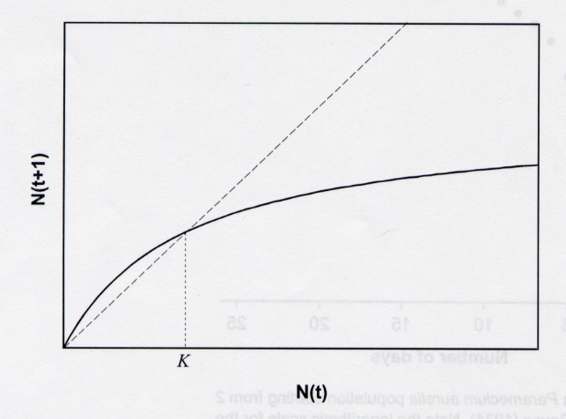
Contest competition

Slide 22
Equation- contest competition
R K N_{t}
N_{t+1} =
K + (R-1) N_{t}

