Slide 2
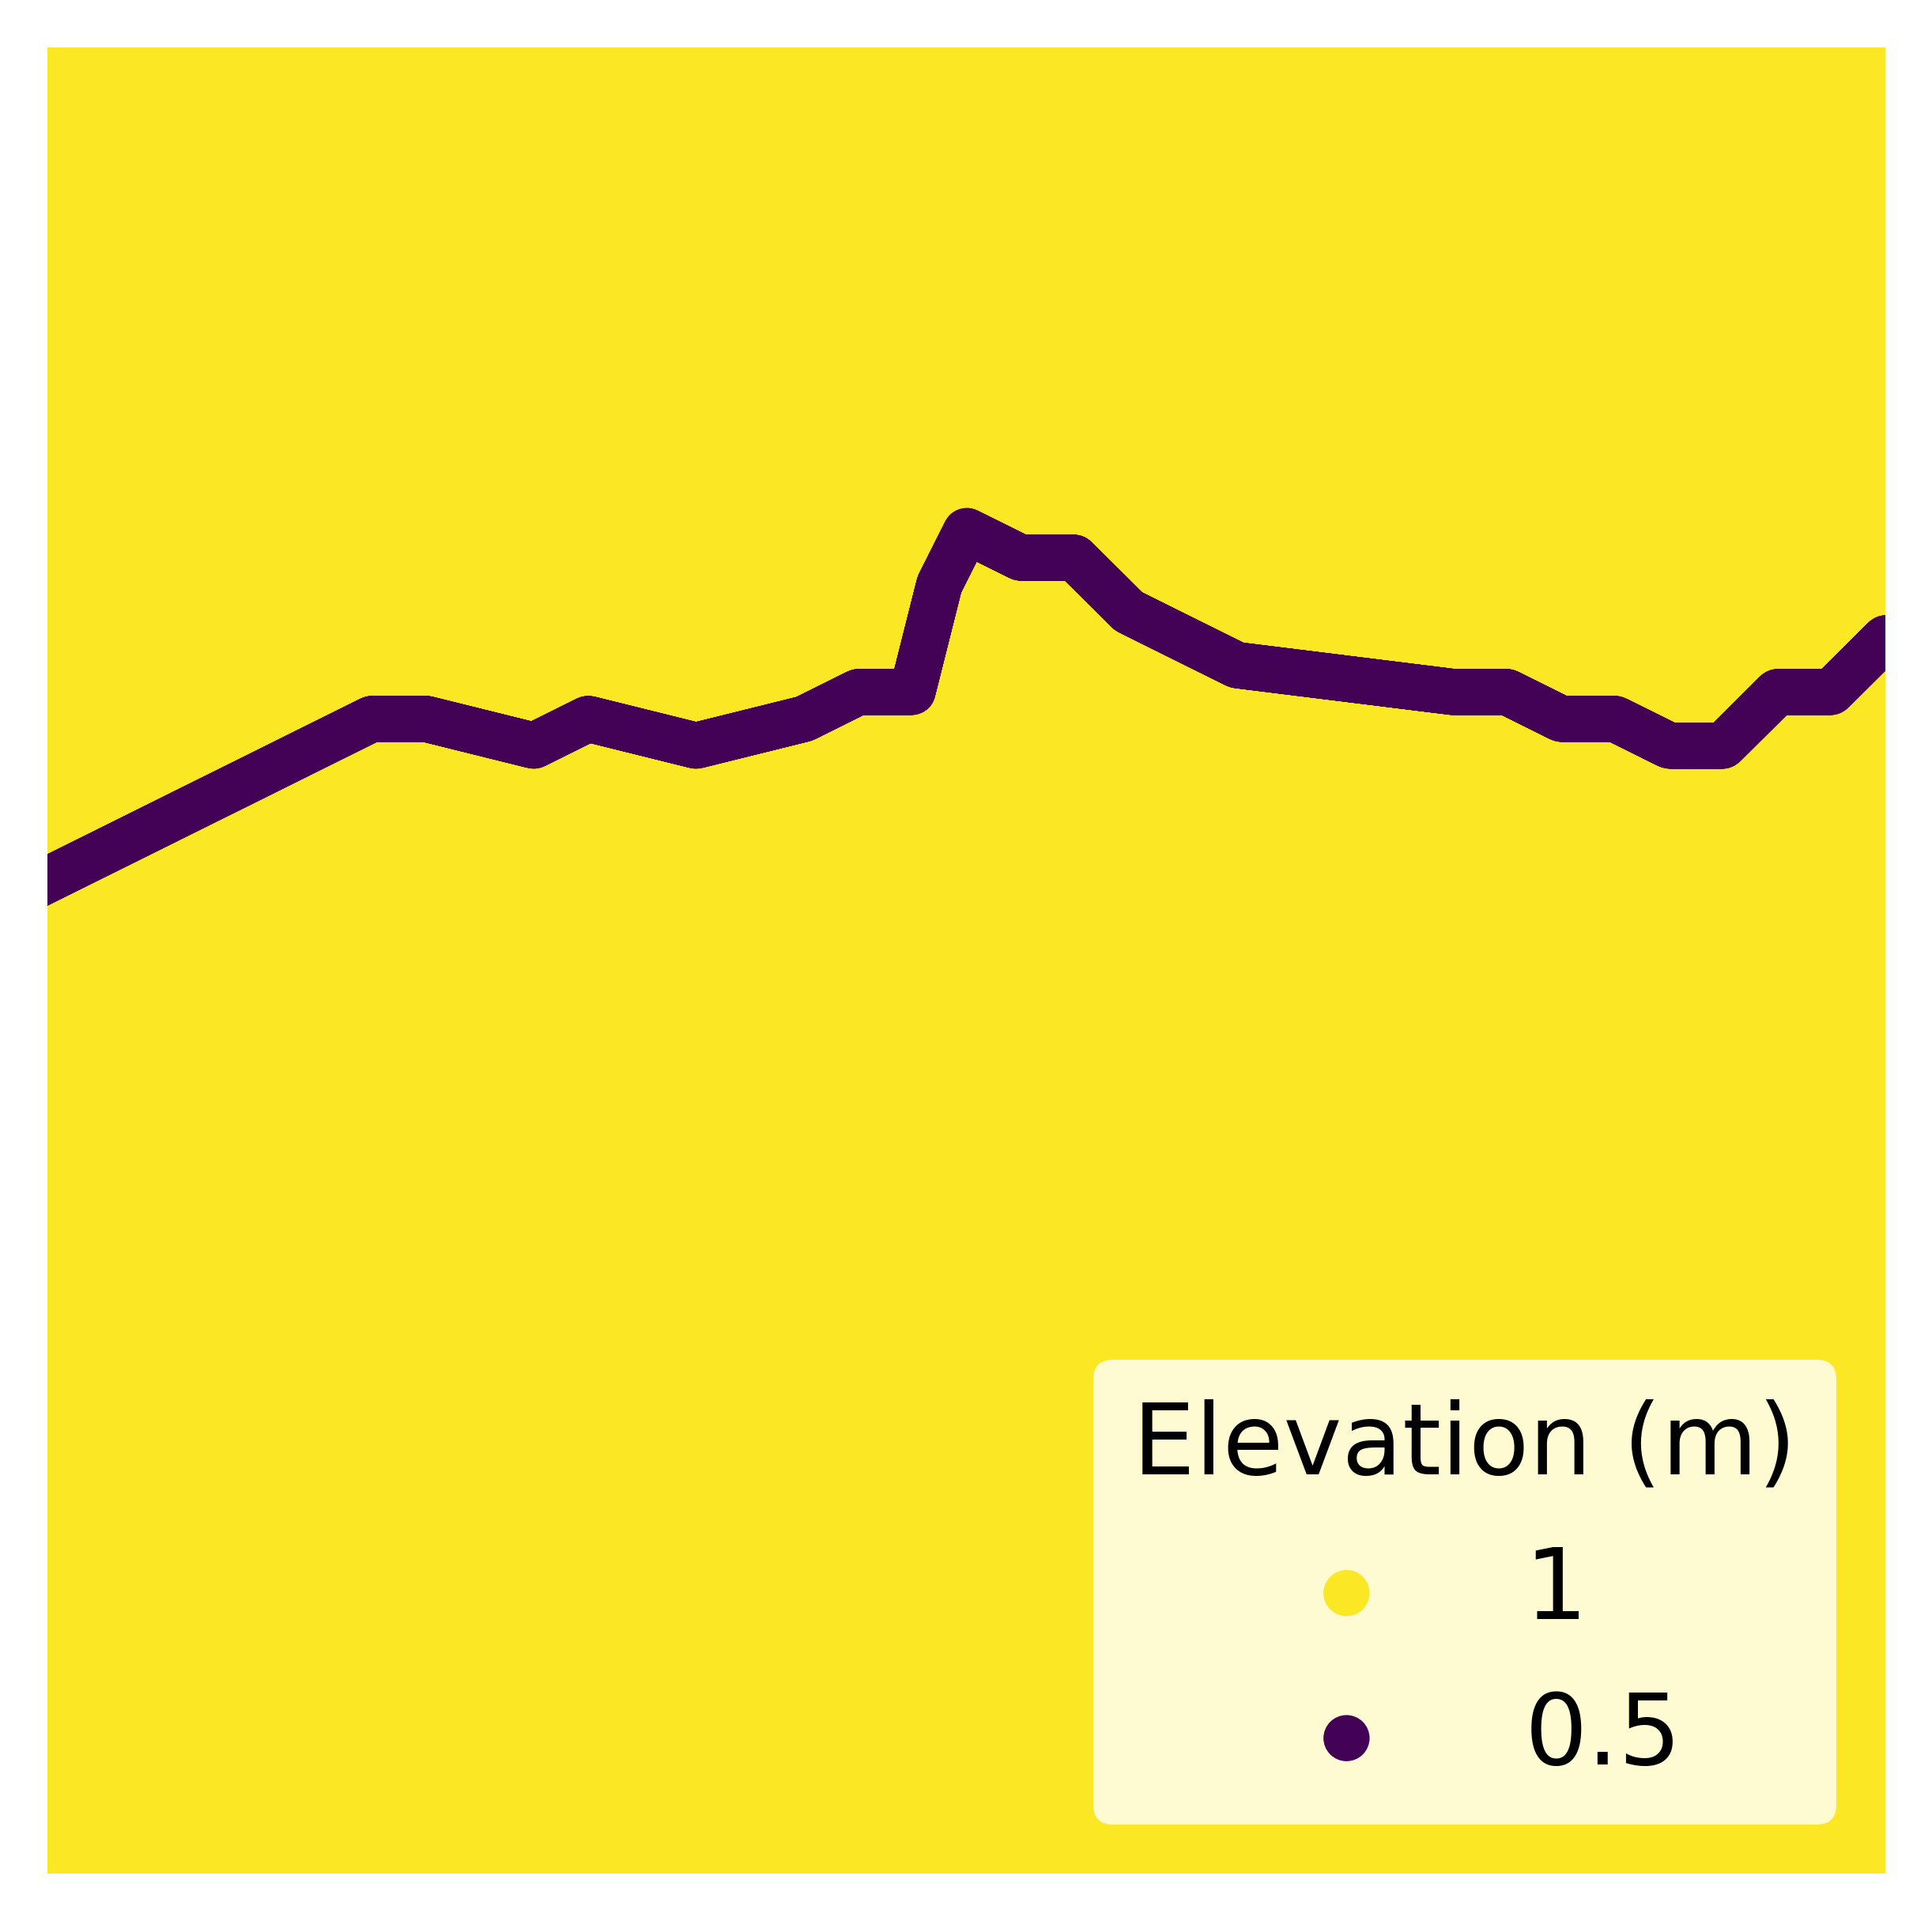
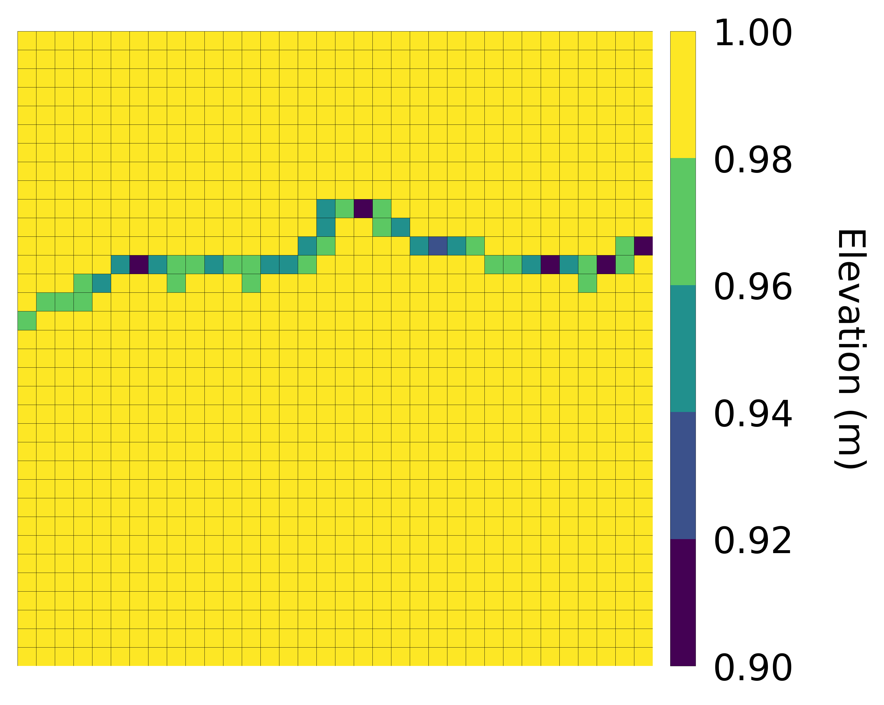
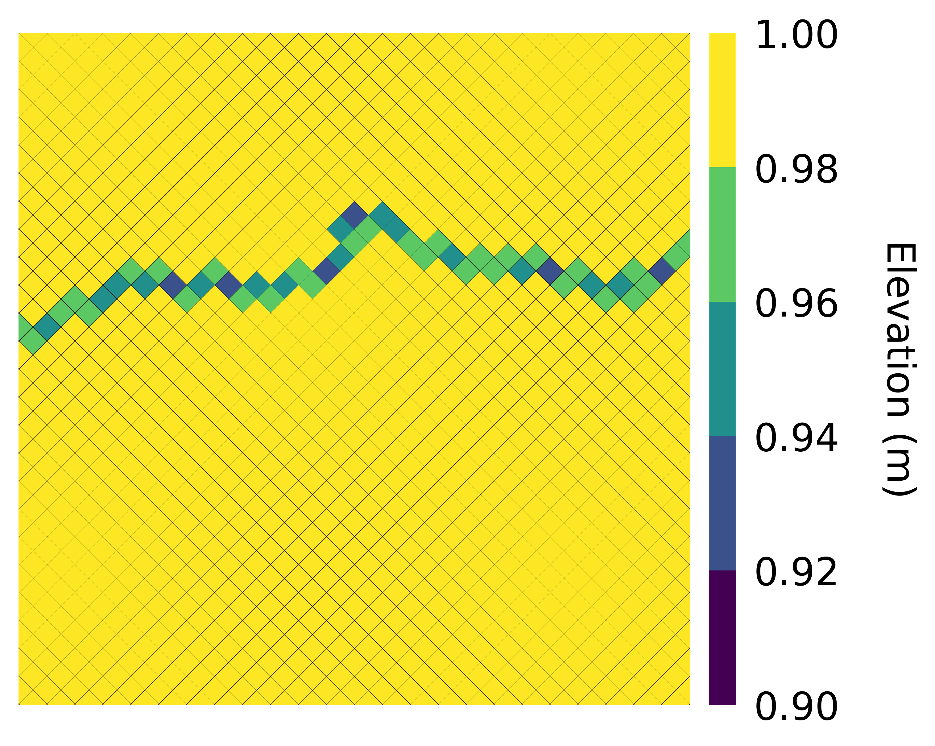
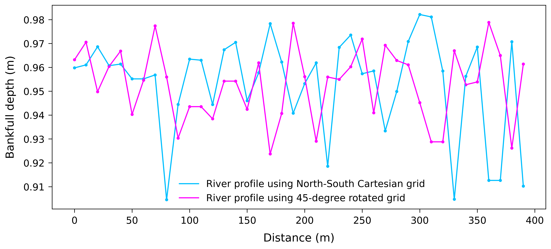
Sample & interpolate on
a North-South Cartesian grid
Sample & interpolate on
a 45-degree rotated grid
LiDAR point cloud
River profiles

Slide 3
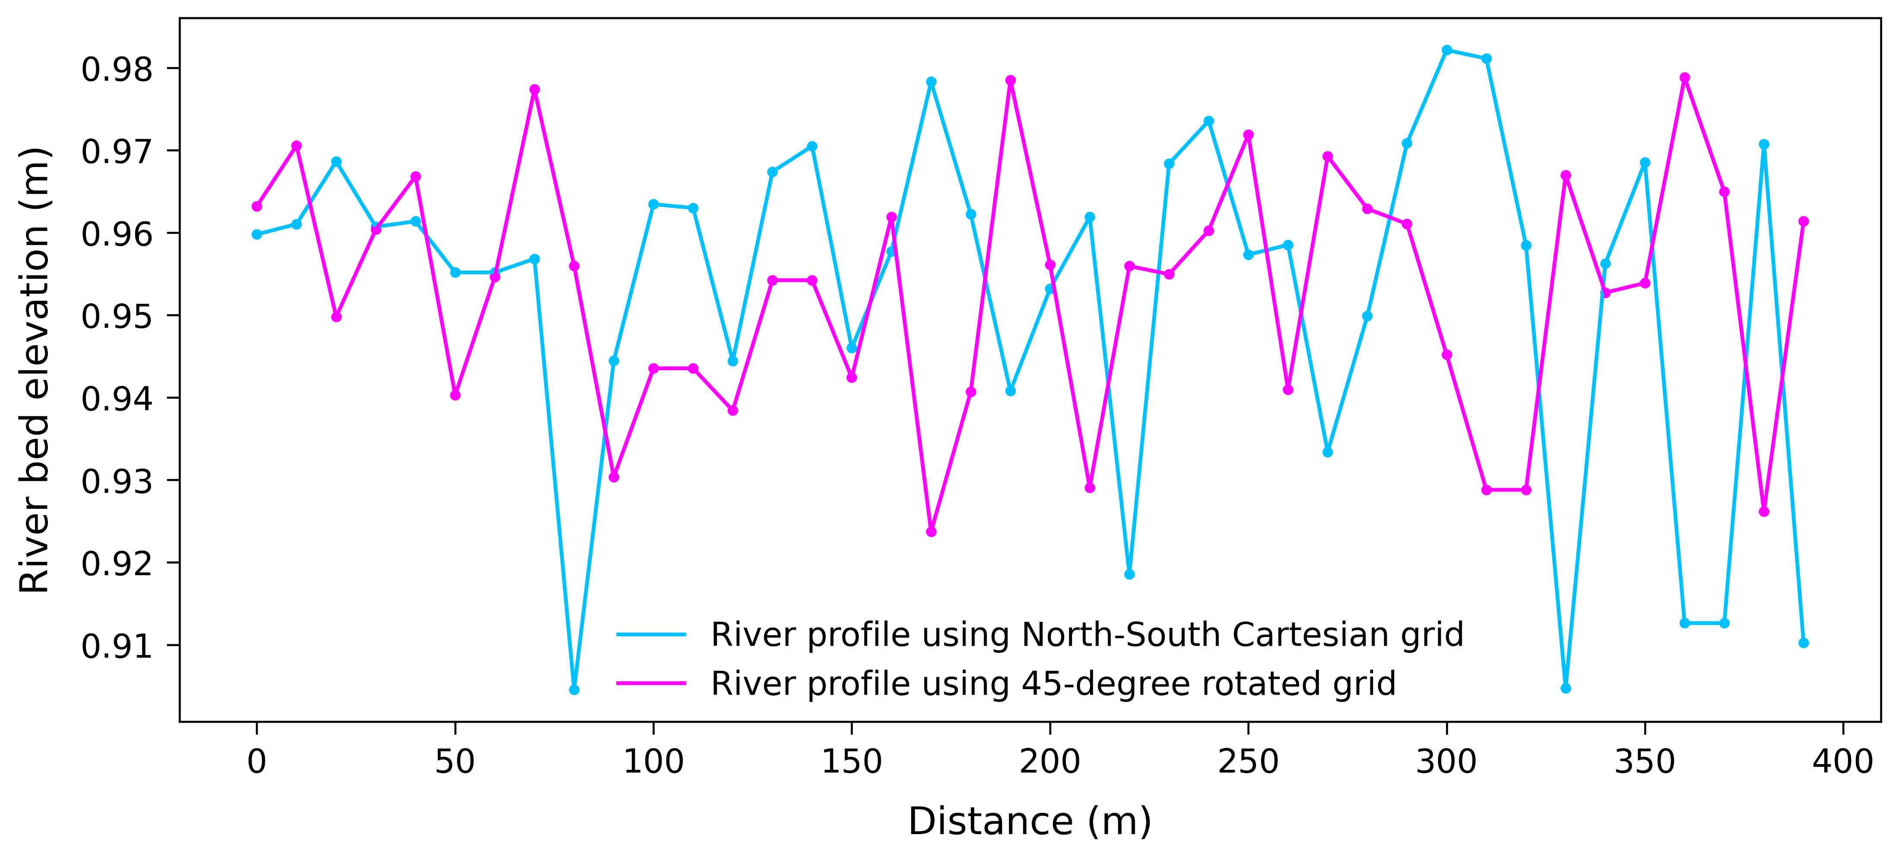
Sample & interpolate on
a North-South Cartesian grid
Sample & interpolate on
a 45-degree rotated grid
LiDAR point cloud
River profiles

Slide 4
Sample & interpolate on
a North-South square grid
Sample & interpolate on
a 45-degree rotated grid
LiDAR point cloud
River profiles

