Slide 1
Social Media based
MBTI Personality Prediction

Slide 2

一
MBTI INTRO
一
FEATURE EXTRACTION
CONTENTS
一
TRAINING ALGORITHM
一
CONCLUSION

Slide 3
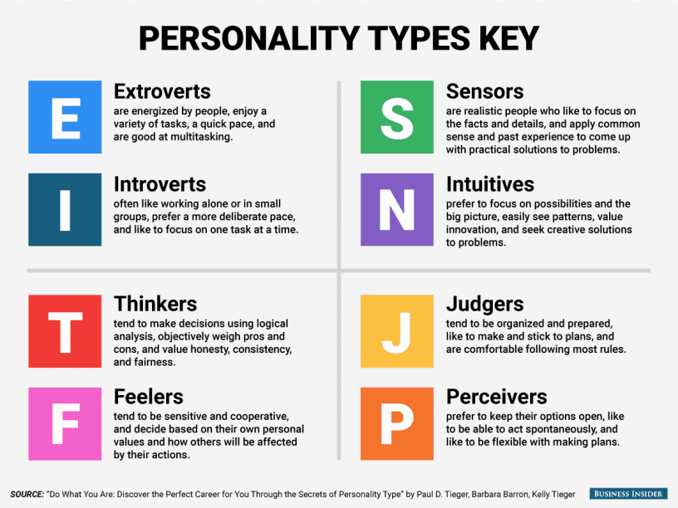
MBTI ( Myers–Briggs Type Indicator )

Slide 4
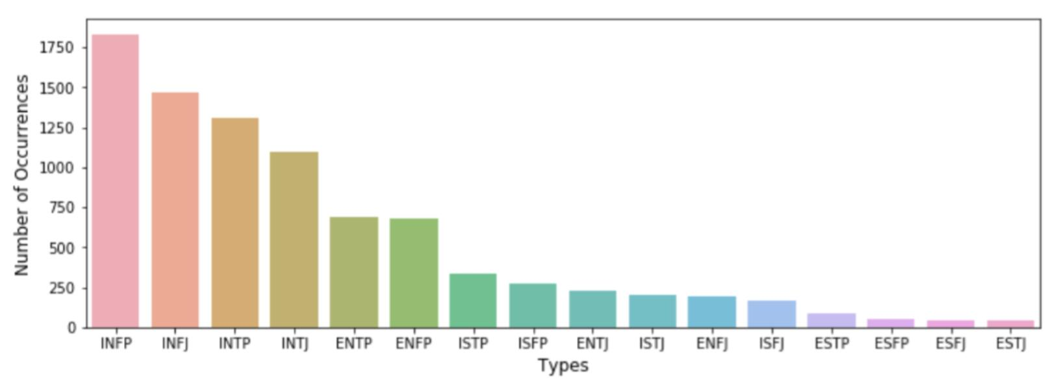
MBTI ( Myers–Briggs Type Indicator )

Slide 5
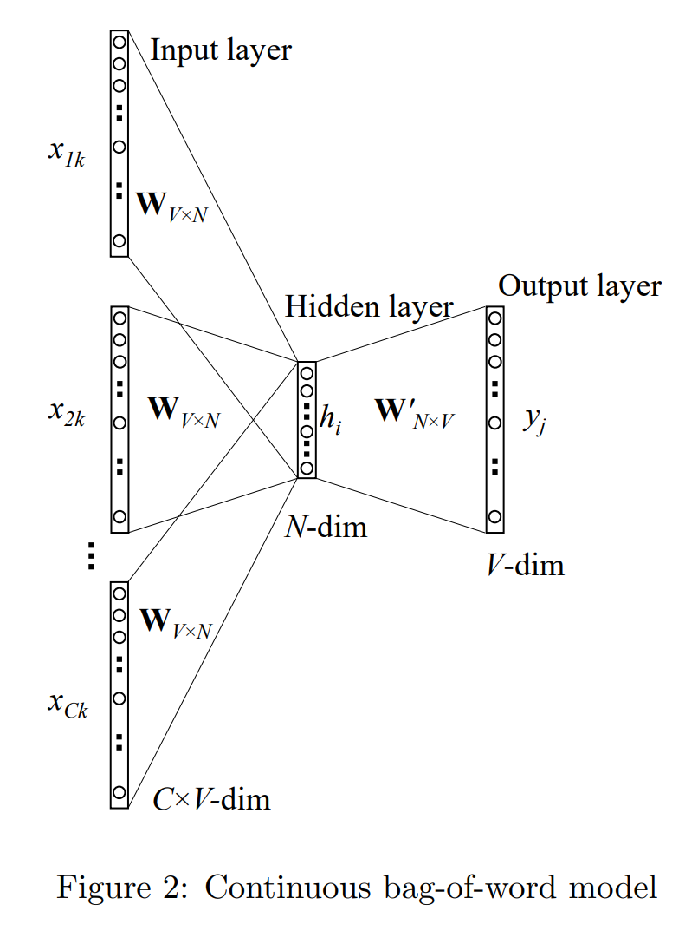
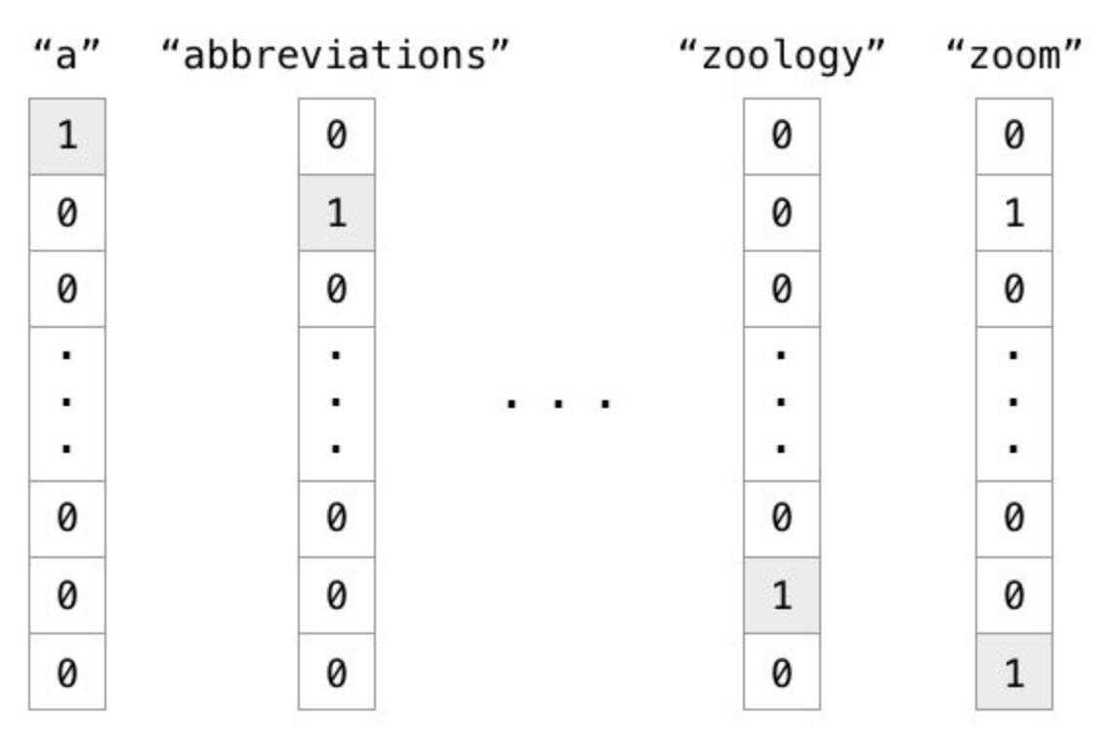
FEATURE EXTRACTION (Word2Vec)
One-Hot Coding
01
CBOW Model
02
N-Gram Model
03

Slide 6
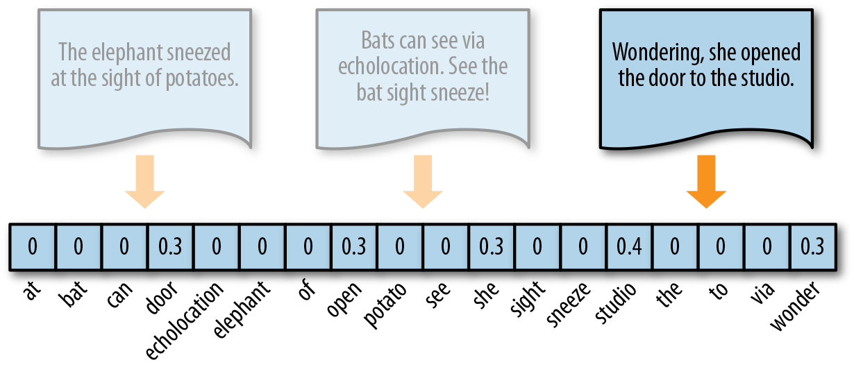
FEATURE EXTRACTION (Paragraph Vectorization)

Slide 7
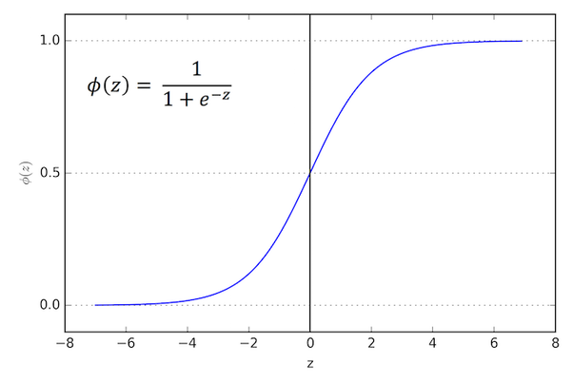
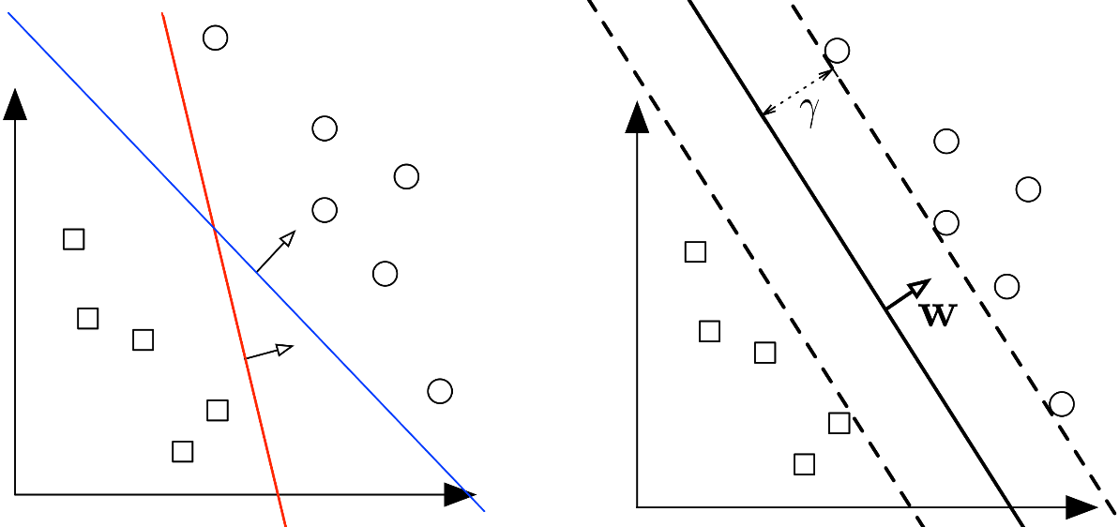
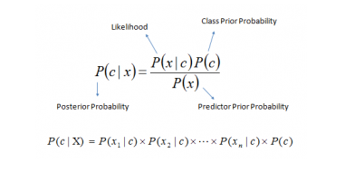
TRAINING ALGORITHM (Basic Algorithm)
SVM
Logistic
Naïve Bayes

Slide 8
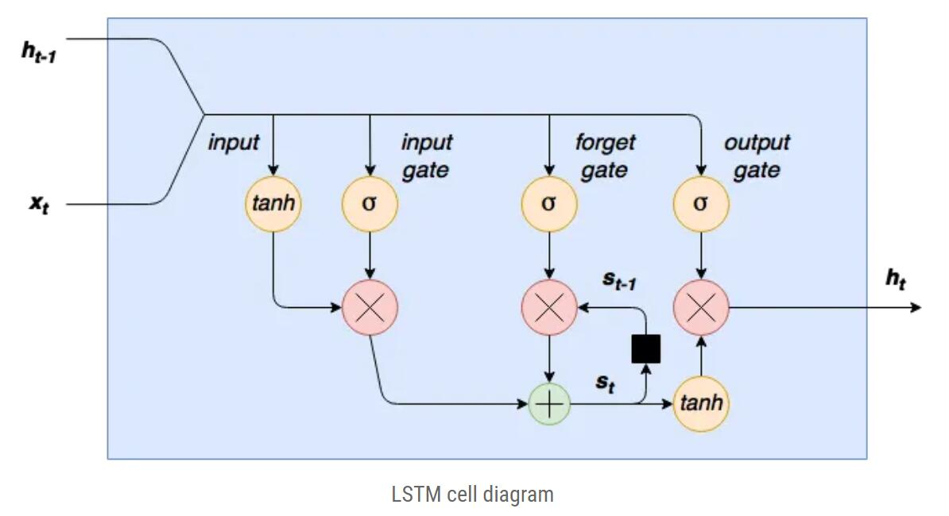
TRAINING ALGORITHM (LSTM)

Slide 9
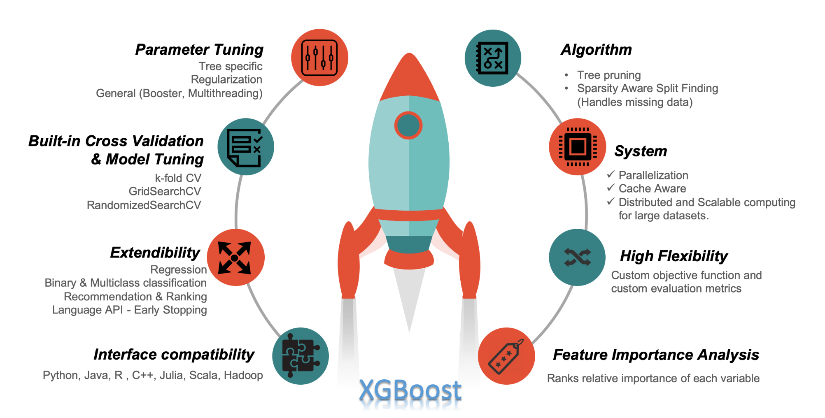
TRAINING ALGORITHM (XGboost)

Slide 10
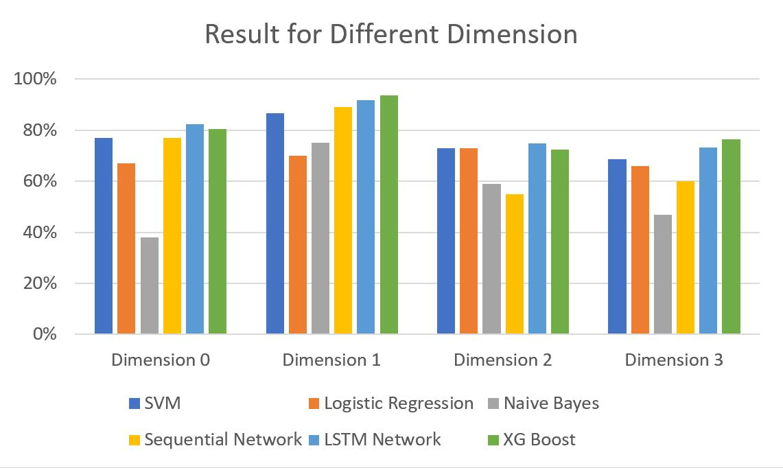
CONCLUSION

Slide 11
THANKS

