Slide 1
v1
Parameter | Conditions
Experiment
Date
Cells
Conditions
Workflow
Oxidation
Coupling
Input
Cleanup
LC-MS

Slide 2
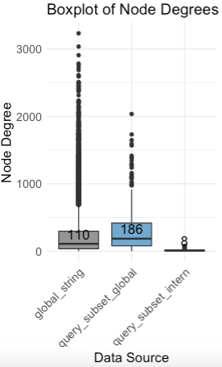
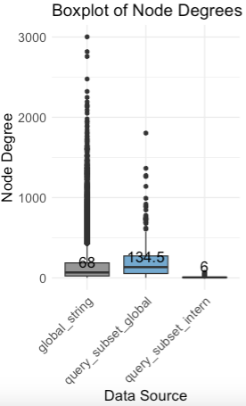
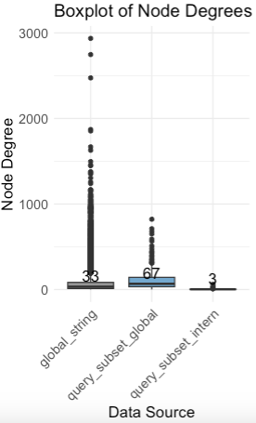
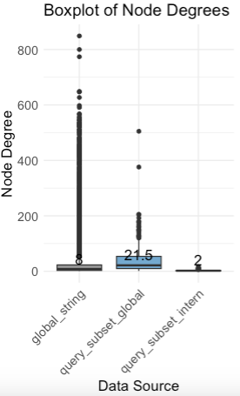

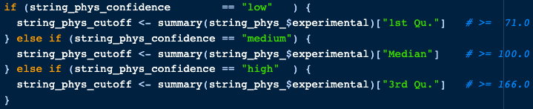
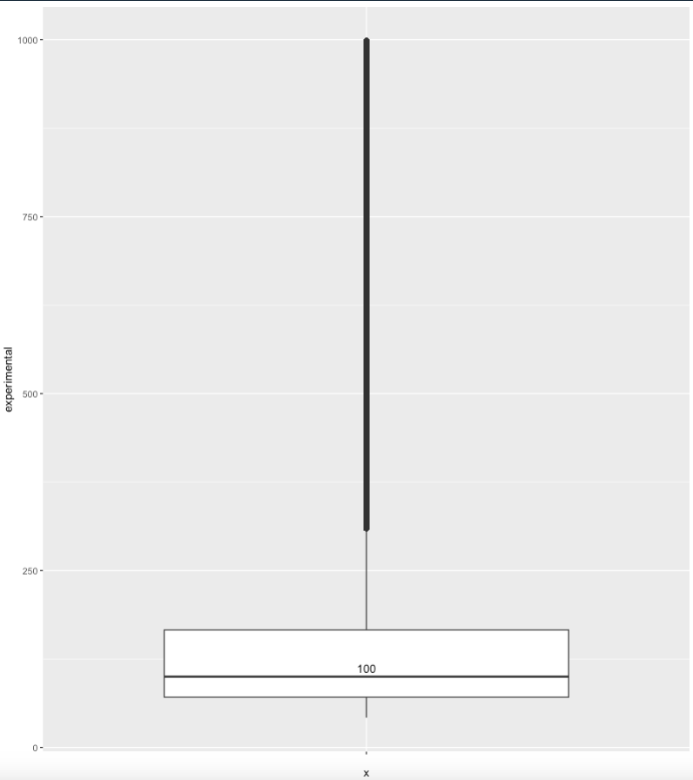
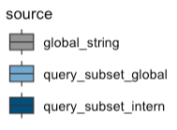
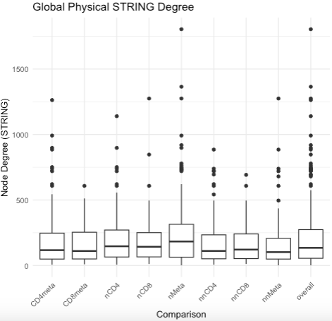
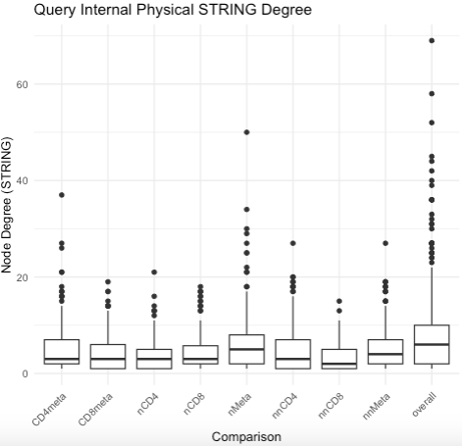
Shs-ds >> ppi_string.R
Test dataset = overall LUX enrichment v31_LUX_4Tss
Noticed suspiciously high physical node degrees of individual proteins
decided to implement experimental evidence score
No STRING recommendation for specific values
Check data distribution
Go for low medium high based on quantiles
Low medium high super high (>=310)
110
68
33
8
Tagging PPIs with experimental STRING score to prioritize discussing them
LUX enriches for proteins with above average degree

Slide 4
section
question

Slide 6
SUMMARY

Slide 7



