Slide 1
Exploring Austin for young professionals and students

Slide 2
Background
Very common for people to move around the world nowadays
Many employers require international experience
Necessary to get information about crime and venues of city of interest

Slide 3
Data acquisition
Crime data from https://data.austintexas.gov/Public-Safety/Crime-Reports-2018/vmn9-3bvu
Data includes year 2018 and offense description, crime occurrence date and time, reported date and time, longitude and latitude.
In total, 102,631 observations with 27 variables
Reduced the data to occurrence date in 2018

Slide 4
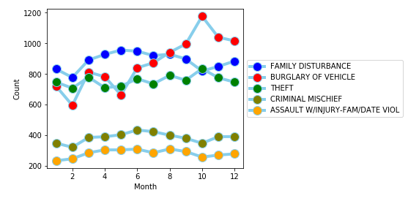
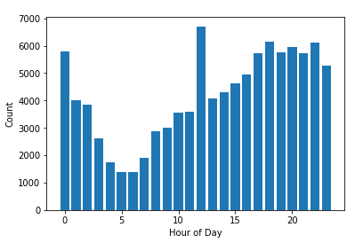
Count of crimes broken down by crime type and month and time
Burglary of Vehicle peaked in October.
Criminal Mishief and Assault with Inujury about 50% less than Theft, Burglary of Vehicles and Family Disturbance
Crimes peaked at 12 pm and hit a minimum at 5 am

Slide 5
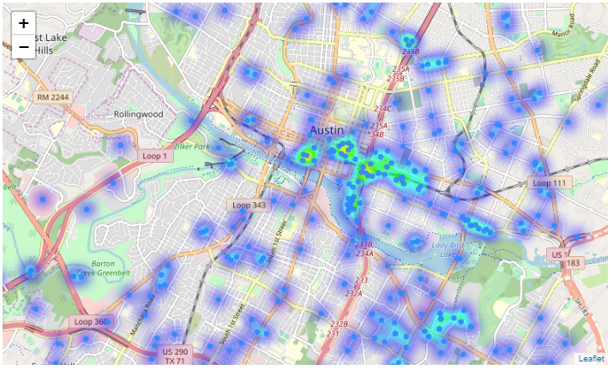
Crime Heat Map of Austin
Map data was limit to 1000 observations due to a lack of computing power.
Crime seems to be high in Downtown Austin
Crime Count by Hour of Day

Slide 6
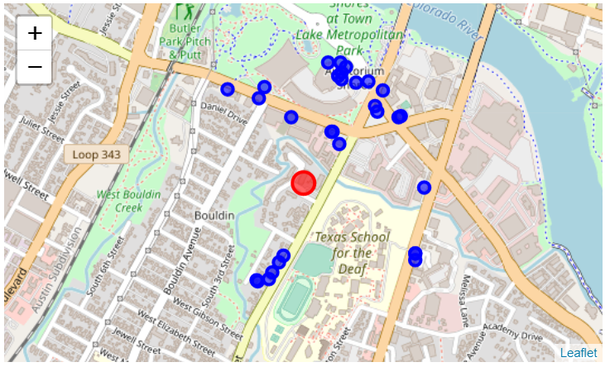
Safe area according to crime heat map with red dot showing apartment with blue dots showing venues of interest

Slide 7
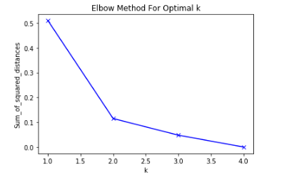
K-means clustering of Austin to find areas of interest
Elbow method revealed k = 2 as
optimal cluster number.
Downtown Austin, South Austin and
North Austin could be labelled as hotel
restaurant area and East Austin as an area
with boutiques and cafes.

Slide 8
Conclusion and Discussion
Used crime data about Austin to find safe neighborhoods.
Created useful maps with Foursquare data to find apartment and venues of interest around it.
Cluster analysis helped to categorize neighborhoods in Austin.
Improvments:
Crime data was limited to 2018
Search for apartment did not take into account financial situation and could be included in further analysis

