Slide 1
Transforming data into insights
Financial data

Slide 2
Raw data: financial stock prices
Daily stock prices from yahoo finance
Manual download of historical data
Lack: 1 day (adj. closing price)
Alternative: integrate with API for live update

Slide 3
Data Lake
Data Lake on AWS Amazon Simple Storage Service (S3)
Pros:
  Cost-effective
  Scalable
  Automatic backup
  Sharing/Access
Cons:
  Lack of total control
...

Slide 4
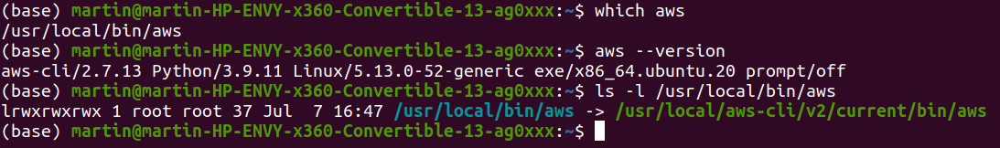
Data Lake: Approach
Setting up AWS (General)
  Create AWS user
  Download Command Line Interface (CLI)
  Create IAM Role (permissions)
  Create IAM user
    - prgrammatic actions
    - attach existing policies
    - AdministratorAccess
  Create Security Group
Setting up AWS S3
  Create S3 Bucket
  Set billing alarm!
  Assign IAM Role permissions
  Upload CSV files
  Assign IAM users (clients)

Slide 5
Data Model
Amazon Redshift
Massively parallel processing (MMP)
  One query process a partined table in parallel (i.e. on multiple CPUs)
Star-schema

Slide 6
Further development
PySpark
EMR or EC2 Cluster Computing
Distributed systems Hadoop
...

