Slide 1
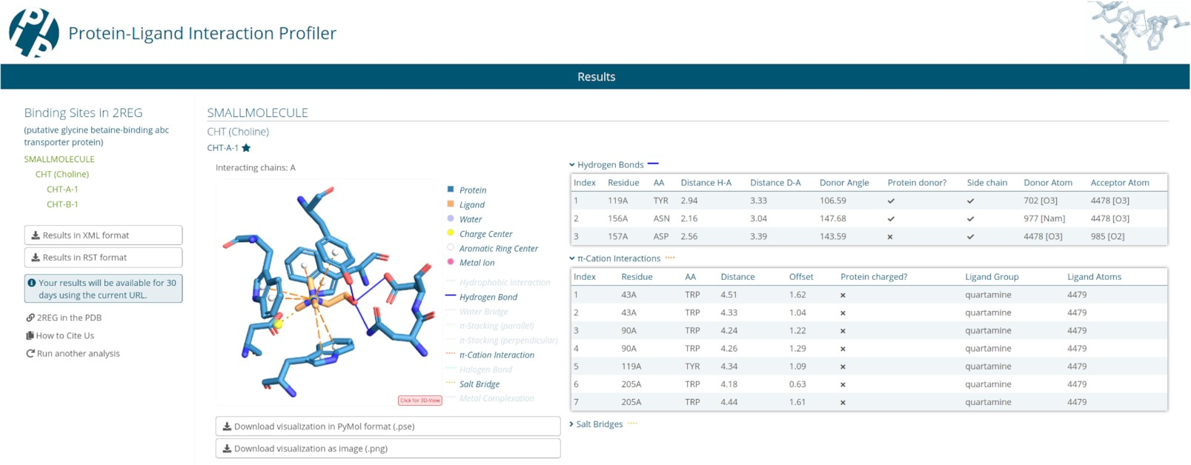

Figure 1. PLIP web tool result page. On the left is a menu for ligands and binding sites, in the middle an image of a ...
Notes:
Figure 1. PLIP web tool result page. On the left is a menu for ligands and binding sites, in the middle an image of a selected binding site and on the right a table with details of the interactions.
Unless provided in the caption above, the following copyright applies to the content of this slide: © The Author(s) 2021. Published by Oxford University Press on behalf of Nucleic Acids Research.This is an Open Access article distributed under the terms of the Creative Commons Attribution License (http://creativecommons.org/licenses/by/4.0/), which permits unrestricted reuse, distribution, and reproduction in any medium, provided the original work is properly cited.

