Slide 1
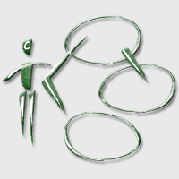
Next Lectures
  October
  23-Oct – 2 pm – Use Case diagrams
  28-Oct – 2 pm – Yannis Velegrakis
  November
  06-Nov – 2 pm – Test: Use case + ER Diagrams
  11-Nov – 2.30 pm – Sequence, State, Activity Diag.
  13-Nov – 2 pm – Class Diagram
  27-Nov – 2 pm – Class Diagram
Notes:
© 2005 Fausto Giunchiglia and Alessandro Tomasi

Slide 2
Exercise:
Reservation System
We want to build a system for the electronic reservation of seats of a group of movie theatres. The users can either buy tickets for a particular show or buy subscriptions, also by phone. Payments can be performed in cash or by credit card. A supervisor can print the list of seats available for a particular show and see the status of sales performed so far.
A secretary updates the list of shows (by adding/deleting/...)

Slide 3
Software Engineering
Reservation System: correction (3 solutions!)
(reserve.pdf)

Slide 4
Software Engineering
Organizing your Requirements

Slide 5
Organizing Your Requirements
To limit the number of Use Cases
  Make it an Iterative Process
  Organize and Classify your Use Cases
UC tends to grow rapidly
Factorize Use Cases and Actors using relationships
Package Diagram or Subsystem
“Strategic” and “System” Use Cases

Slide 6
Revise and Factorize UC/UCD
In the Use Case Diagrams
  Include
  Extend
In the Use Case
  Inclusion
  Extension
  Exceptions
The user executes any of the use cases “Save”, “Load”, …
[extension 1] if The User chooses “Save As”, then he can specify a name for the file.
The user selects a name for the file [exception 1]
[exception 1] If the file name contains “/” an error is reported.

Slide 7
Organize and Classify UC/UCD
Package Diagrams or Subsystem
Packages allows to split diagrams in smaller parts.
Key Ingredients:
  Package or Subsystem
  Dependency
GUI
Core

Slide 8
Organize and Classify UC/UCD
Strategic Use Cases
System Use Cases
High-level use cases. They provide an overview of the system.
Useful to communicate with the stakeholder.
Lower-level use cases. They refine the strategic use cases and provide a more fine grained view of the system.
Use them to decide how to allocate the work.

Slide 9
Organize and Classify UC/UCD
… caveat:
“Strategic” and “System” are just one of the ways (possibly the simplest) to organize your requirements.

Slide 10
Software Engineering
Organizing your Requirements: example

Slide 11
Example: Time Tracker
We have been contacted by a small software firm.
They want us to build a system for letting employees track how they spend their time when working on a computer. The idea is that of a stop-watch: the users of the system can start and stop counting the time spent on different activities; the system logs such activities and can be used to produce reports.
The system can also be integrated with a billing system. The billing system receives all the information about the time spent by programmers on the different projects and computes the cost of projects. This information is then used to charge clients.

Slide 12
Use Case Diagram
Time Tracker
Costs of the Project
Start and stop counting
Produce report
User of the system
Administrator
Billing System
Show the cost of projects

Slide 13
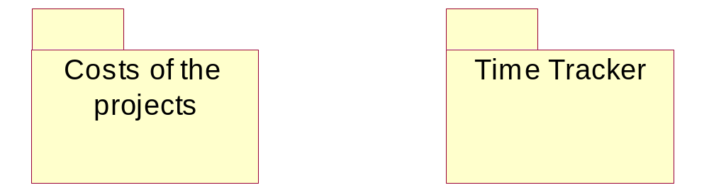
Use Case Diagram with Subsystems

Slide 14
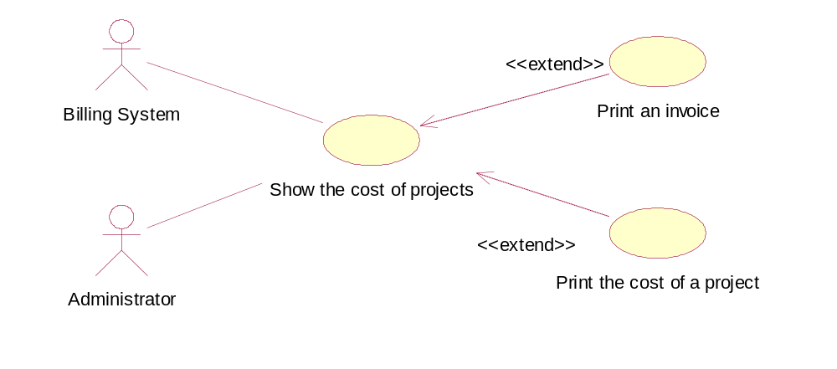
Costs of the Projects

Slide 15
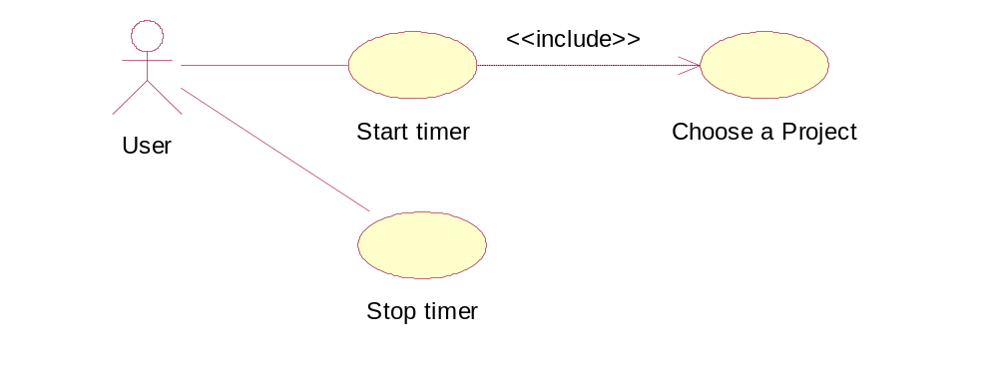
Time Tracker

Slide 16
Home Work
Graph Editor
We want to build a graph editor. The graph editor allows users to build graphs composed of nodes, arcs, and comments. Nodes and arcs may have labels. The user can add, move, and delete nodes and arcs to the diagram. When adding an arc, the user must select a point of the starting node and a point of the ending node. Arcs may be directional. When moving a node, the diagram also moves the arcs connected to the node. Comments can be placed anywhere in the diagram; when the user selects the comment tool, the cursor changes to a I-beam shape.

