Slide 1

Software Engineering
Architectural Design

Slide 2
Architectural Design
Goal
  Define the architecture (structure) of the system
Output
  Architectural Specification Document (possibly containing various UML diagrams)
“Main” Diagram for Architectural Design:
  Class Diagrams

Slide 3
Architectural Design: Perspectives
Architectures can be seen from different perspectives
Logical (class diagrams)
Process (component diagrams)
Physical (deployment diagrams)

Slide 4
UML Diagrams in the Process
...
Requirements
...
Design
...
Implementation
Use Cases
Sequence Diagrams
Activity/State Diagrams
Class Diagrams

Slide 5
Software Engineering
Class Diagrams

Slide 6
Class Diagrams: Perspectives
Conceptual. Diagram that represents the concepts in the domain under study (link between requirements and architectural design)
Specification. Diagram that represents the interfaces of the system under development.
Implementation. Diagram that specifies the implementation of ther system under development.

Slide 7
Class Diagram: Example
Association Ends
Order
Customer
dateReceived
isPrepaid
Number: String
Price: Money
Name
Address
Dispatch()
Close()
creditRating() : String
Association
Class

Slide 8
Class Diagram Elements
Classes
  Name: obvious
  Attributes: identify characteristics of the class
  Operations: list operations (methods) of the class
Association
  Name: association name
Association Ends
  Navigability: allows navigation toward the class pointed by
  Roles: role played by the class attached to the association end
  Multiplicity: range of allowable cardinalities a set may assume

Slide 9
Classes
Attributes:
Visibility Name : Type = Initial_Value
Order
Customer
dateReceived
isPrepaid
Number: String
Price: Money
Name
Address
Dispatch()
Close()
creditRating() : String
Operations:
Visibility Name (arg:Type, …) : Type

Slide 10
Classes
Attributes
  visibility name [multiplicity] : type-expression = initial-value {property string}
Operations
  visibility name (arguments) : type-expression = initial-value {property string}
Visibility
  + public # protected - private

Slide 11
Association
Navigability
  No navigability implies bi-directional or unspecified navigability (try it in Rose)
Association Names vs Roles
  Association Name: Name of the association
  Role Name: Role a class play in the association
Multiplicity
  0..1 or 1 or h..N or N or (:=0..N)
  Multiplicity always refers to a single instance of the class attached to the other end of the association
*

Slide 12
Class Diagram: Example
Polygon
Contains
+points
Point
0..N
3..N

Slide 13
Class Diagram: Example
Association Name
Role Name
Polygon
Contains
+points
Point
0..N
3..N
3..N
Navigability
Multiplicity

Slide 14










Class Diagram: Example
Order
dateReceived
Customer
isPrepaid
name
number : String
address
price : Money
*
*
1
1
creditRating : String()
dispatch()
close()
Corporate Customer
Personal Customer
contactName
creditCardNo
creditRating
creditLimit
*
*
0..1
+salesrep
0..1
+line items
*
Employee
*
OrderLine
quantity : Integer = 0
Product
price : Money = 0
isSatisfied
*
*
1
1

Slide 15
Software Engineering
Class Diagram: example

Slide 16
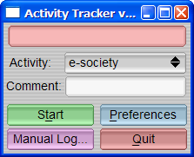
Example: Time Tracker
We have been contacted by a small firm. They want us to build a system for letting employees track how they spend their time when working on a computer. The idea is that of a stop-watch: the users of the system can start and stop counting the time spent on different activities; the system logs such activities and can be used to produce reports.
The system can also be integrated with a billing system. The billing system receives all the information about the time spent by programmers on the different projects and computes the cost of projects. This information is then used to charge clients.

Slide 17
Step 0…
… always start from
the Conceptual Model!

Slide 18
Step 1: Identify Classes
Candidates for classes are objects, concepts, and specific terms that can be found in the Requirement Documents

Slide 19
Step 1:Time Tracker
We have been contacted by a small software firm.
They want us to build a system for letting employees track how they spend their time when working on a computer. The idea is that of a stop-watch: the users of the system can start and stop counting the time spent on different activities; the system logs such activities and can be used to produce reports by an administrator.
The system can also be integrated with a billing system. The billing system receives all the information about the time spent by programmers on the different projects and computes the cost of projects. This information is then used to charge clients.

Slide 20
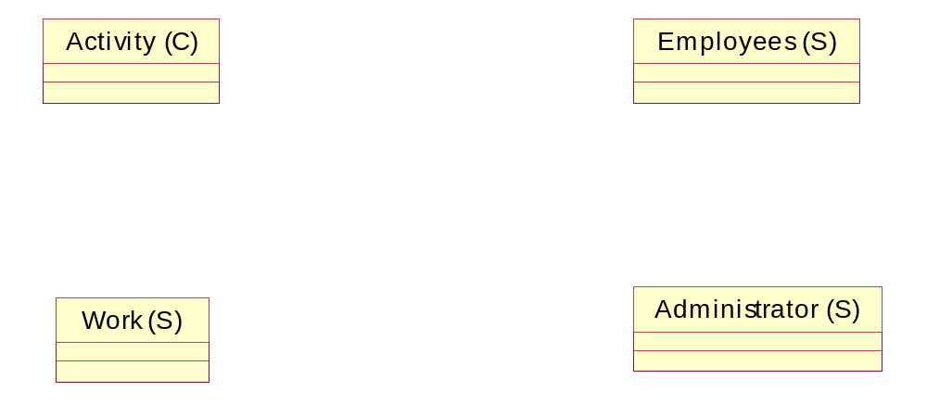
Step 1: Identify Classes

Slide 21
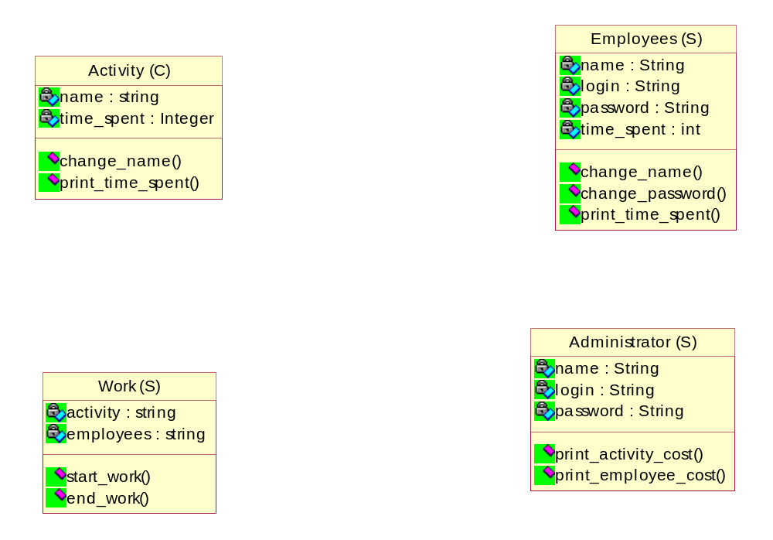
Step 1: Identify Classes (ctd)

Slide 22
Step 2: Establish Associations
Associations are established by looking at the description of objects, concepts, and specific terms found in the Requirement Documents

Slide 23
Step 2: TimeTracker
We have been contacted by a small software firm.
They want us to build a system for letting employees track how they spend their time when working on a computer. The idea is that of a stop-watch: the users of the system can start and stop counting the time spent on different activities; the system logs such activities and can be used to produce reports by an administrator.
The system can also be integrated with a billing system. The billing system receives all the information about the time spent by programmers on the different projects and computes the cost of projects. This information is then used to charge clients.

Slide 24
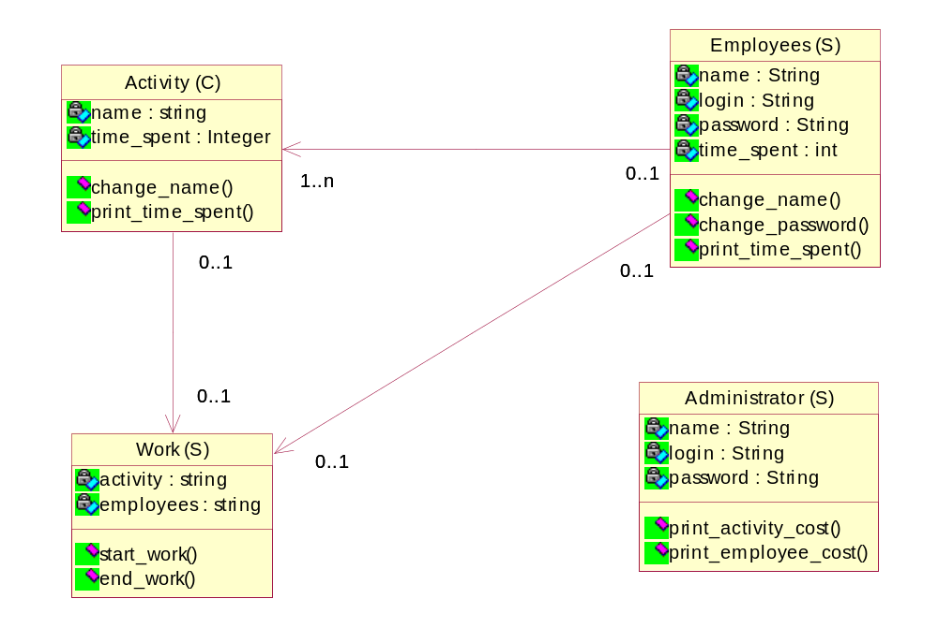
Step 2: Establish Associations
.
n

Slide 25
Homework
La Provincia Autonoma di Trento ci commissiona lo sviluppo di un sistema software in grado di gestire il prestito di materiale audio (cassette audio, CD Musicali) e di materiale video (cassette VHS, DVD) appartenenti al suo archivio audiovisivo. Gli utenti sono suddivisi in due categorie: utenti interni ed esterni. I primi, a differenza degli esterni, possono anche acquistare una copia del materiale presente nell’archivio. Supponendo di sviluppare questo software con un processo a cascata elaborare per questo problema:
Esercizio 1:
uno Use Case Diagram, descrivendo almeno un caso d’uso a piacere
Esercizio 2:
un Class Diagram a livello di specifica

