Slide 1
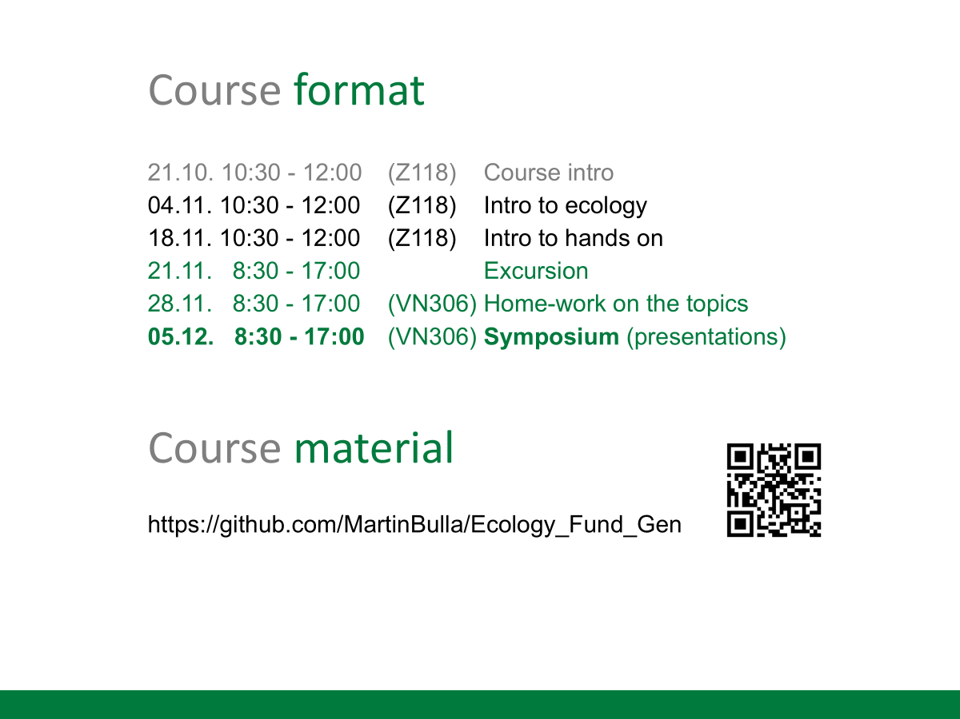

Slide 2
Presentations logistics
15 min talk + 15 min discussion
On key aspects of ecology
Topic
Papers - traditional and current
10 teams of 4-5 people
randomly selected
all member contribute equally & present
work load
1 day – reading the papers and literature search
1 day – preparing the presentation
1 day – homework
1 day – presentation and engagement in the discussion
(your and presentations of others)

Slide 3
Presentations evaluation
TEAM
Conceptual understanding and clarity (ability to synthesize primary literature)
Correctness: arguments grounded in evidence
Connection of classical ideas with modern developments
Engagement: ability to capture audience’s attention
Academic integrity
Structure: logical and easy to follow
Timing (15min)
Ability to discuss & defend your views
Reusability as study material for pears
Notes:
Presentation – a back bone of the course
Read and synthesize primary literature
Learn about basic ecological concepts
Practice scientific thinking and clear communication
Connect classic ideas with modern developments
Create re-usable study material for peers

Slide 4



ATTENDANCE MORNING
Fundamentals of Ecology
(ZEX101E)
Fundamentals of Ecology
(ZEX111E)
General Ecology
(ZEX12E)

Slide 5
What have you taken from todays presenting exercise?
Whose presenting is stuck in your mind?
Tips and tricks for engaging presentation
switching among members a lot makes the presentation engaging
few slides (use them to guid you though what you want to say)
digest the info into essentials
look into the audience
be innovative
show what you know
help each other
try that all works in advance

Slide 6

YOUR FEEDBACK ON THE COURSE

Slide 7
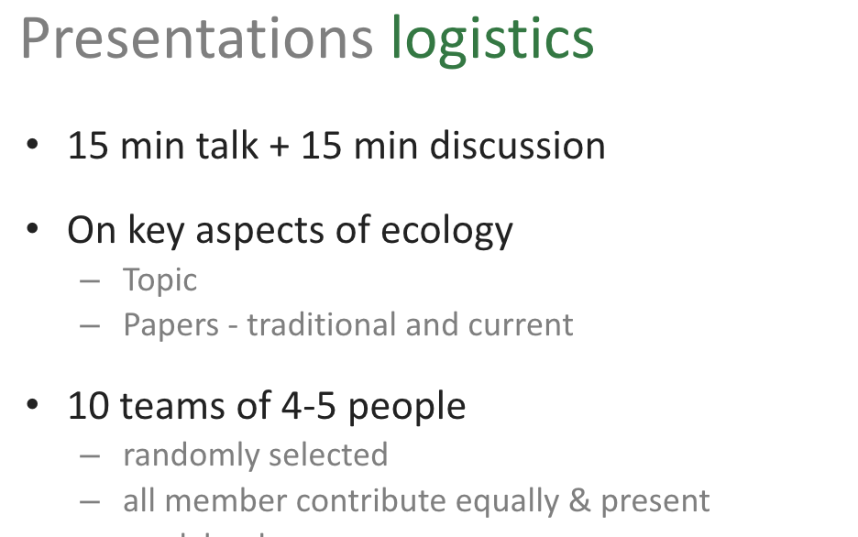
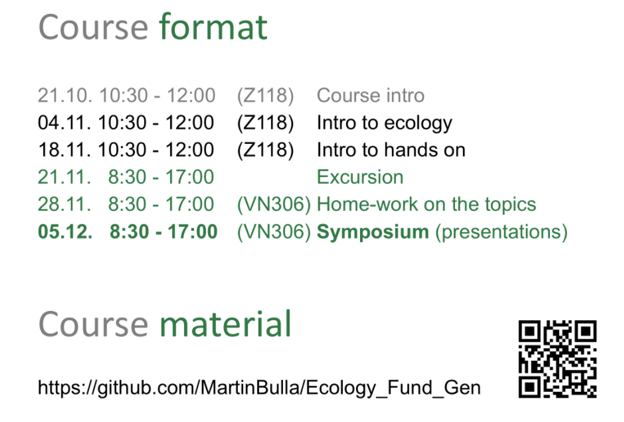
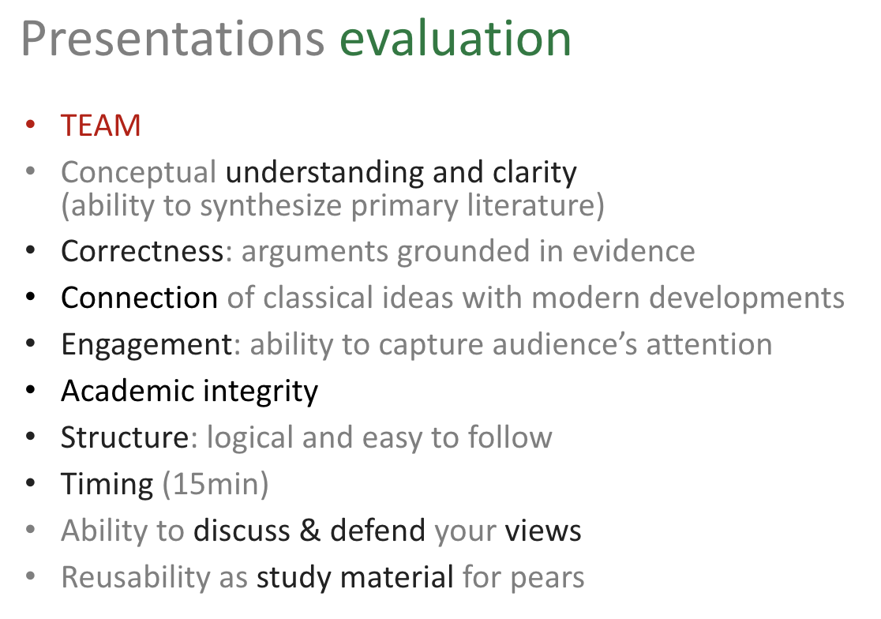

Slide 8
Picture time

Slide 9



ATTENDANCE AFTERNOON
Fundamentals of Ecology
(ZEX101E)
Fundamentals of Ecology
(ZEX111E)
General Ecology
(ZEX12E)

