Slide 1

macroecology and biogeography 2
Azat Aibar, Novruzov Elvin, Choi Inseo, Kindt Zoe

Slide 2
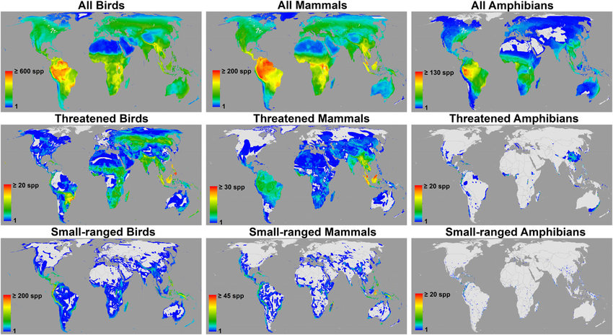

Slide 3
Species concept
Cuvier (1829) defined species as groups descended from common ancestors and resembling each other.
Species represent the most basic units in biological classification that maintain evolutionary independence.
Evolutionary independence occurs when mutation, selection, gene flow, and drift operations populations separately.
Evolution consists of changes in allele frequencies and species from a boundary for a spread of alleles
Types of Species Concepts: Morphological, Biological, Evolutionary, Phylogenetic.

Slide 4

Unveiling Earth's Hidden Biodiversity
Exploring macroecology and biogeography to understand the true scope of life on our planet.

Slide 5



The Challenge of Cryptic Diversity
Cryptic diversity refers to multiple species that are morphologically indistinguishable, often leading to a significant underestimation of true biodiversity. These "hidden" species are genetically distinct but visually identical.
Genetic Distinction
Despite outward similarities, cryptic species exhibit significant genetic differences, revealed through molecular analysis.
Morphological Mimicry
Their identical appearance makes them challenging to identify using traditional taxonomic methods.
Notes:
2

Slide 6


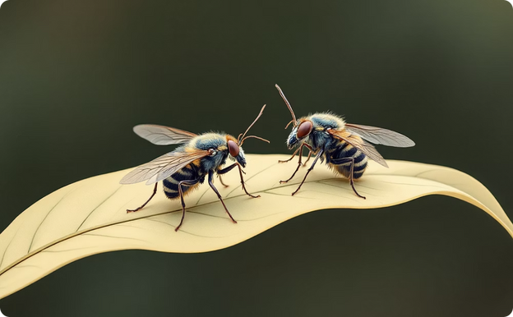
Widespread Examples Across Kingdoms
Cryptic diversity is not confined to a few groups; it's a pervasive phenomenon impacting our understanding of biodiversity across various ecosystems.
Amphibians
Marine Species
Insects
Many frog species, especially in rainforests, exhibit cryptic diversity, with populations looking alike but having distinct calls and genetic signatures.
Coral reef ecosystems are hotbeds for cryptic marine invertebrates, making accurate species counts challenging.
Insect groups like fruit flies (Drosophila) harbor numerous cryptic species, impacting ecological and evolutionary studies.
Notes:
4

Slide 7






Defining Species: A Moving Target
The very concept of a "species" can be ambiguous, leading to challenges in classification and counting.
Evolutionary Fluidity
Species are not static entities; ongoing evolution means boundaries can be fuzzy and constantly shifting.
Species Concepts
Different definitions (e.g., biological, morphological, phylogenetic) can yield varying species counts for the same group.
Hybridization
Interbreeding between closely related species further blurs lines, complicating discrete categorization.

Slide 8
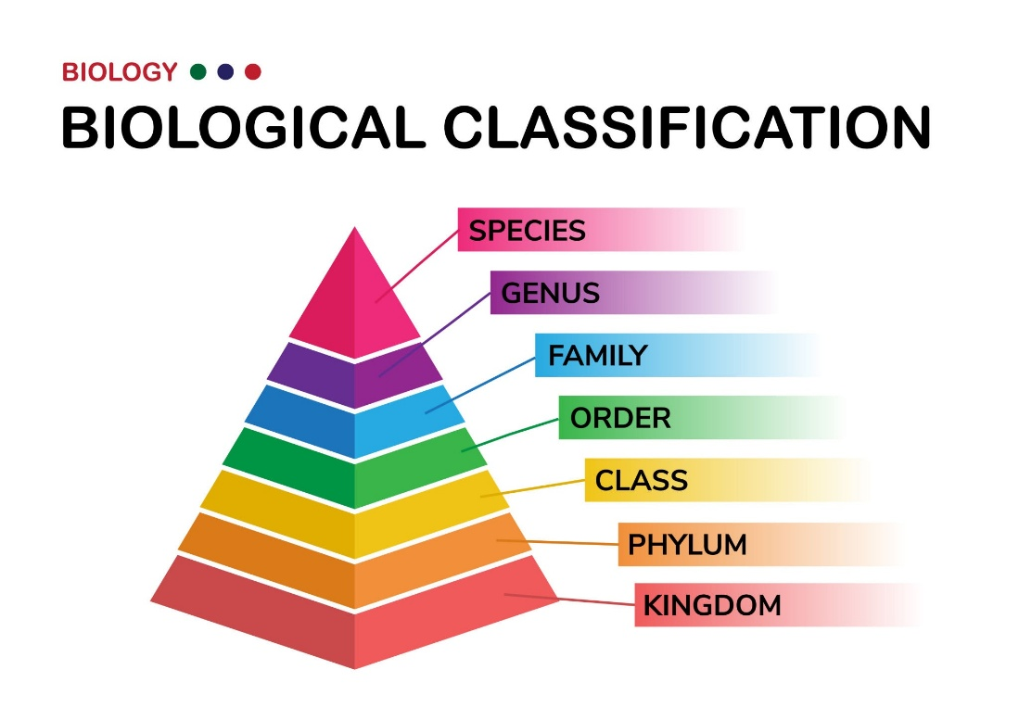
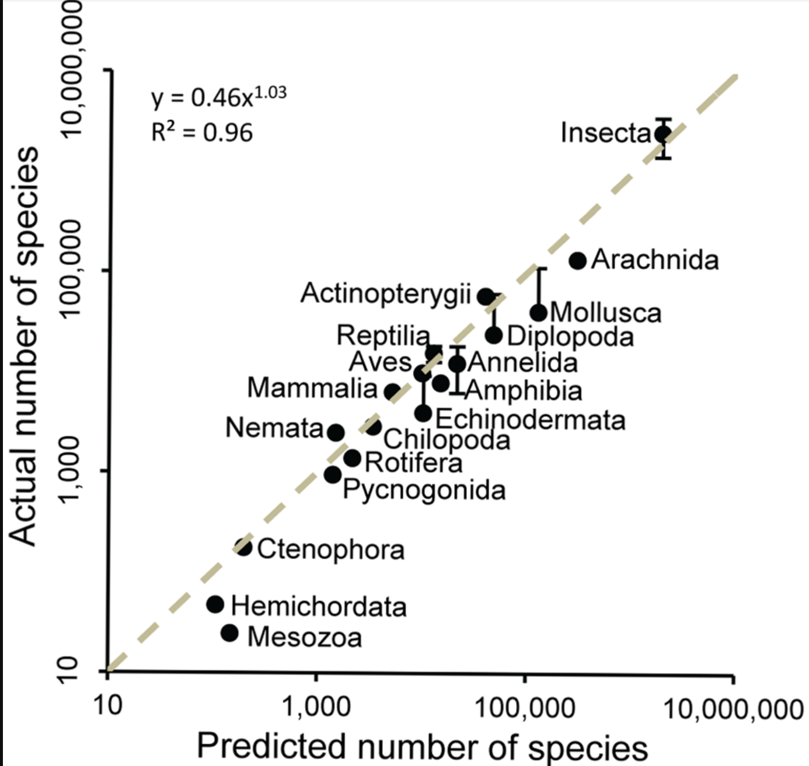
How Many Species on Earth? -Methods: The Taxonomic Pattern
Unknown
(To be predicted)
High Accuracy
Known Patterns
(Discovery Complete)
Used for Prediction

Slide 9
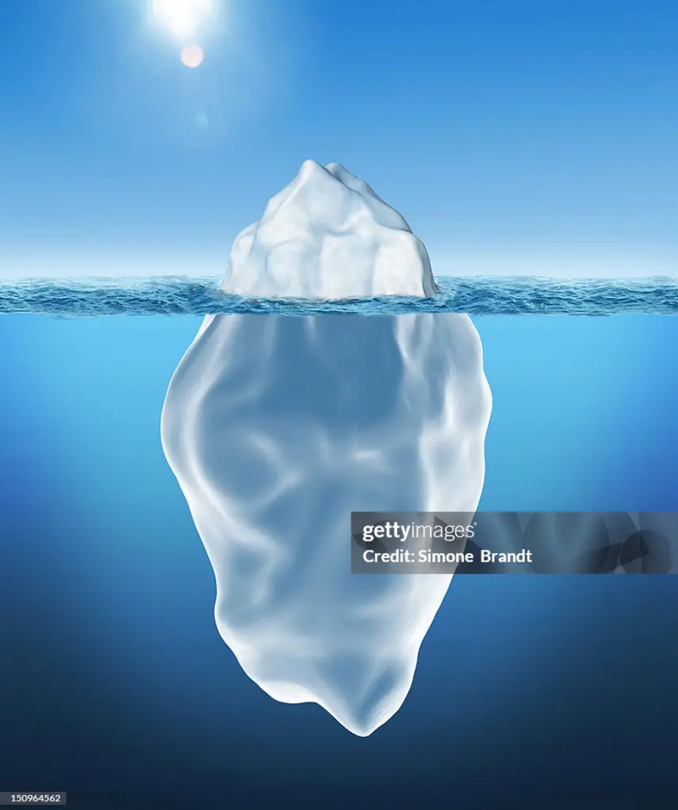
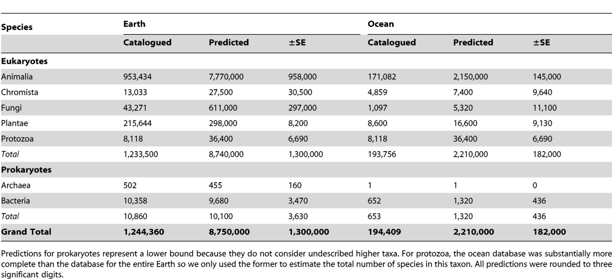
How Many Species on Earth? -Results
~1.2M Described (14%)
~7.5M Undescribed (86%)
Total: ~8.7M Species

Slide 10

Classic View (2011)
-Limitations
✔ First rigorous, data-driven estimation of global biodiversity
✔ Validated against well-known taxa (Mammals, Birds)
✔ Provided a vital baseline for conservation efforts
Excluded Prokaryotes (Bacteria & Archaea), Eukaryotes ONLY
Why? Due to the "Species Concept" challenge
(Hard to apply taxonomic ranks to microbes)
Consequence: Likely underestimates total biodiversity significantly

Slide 11
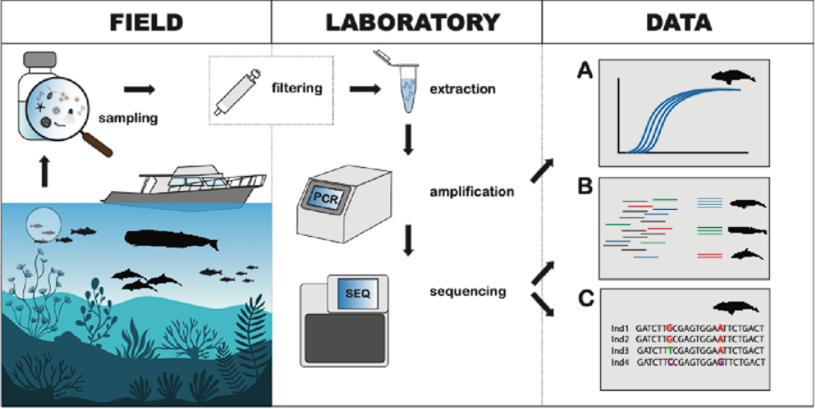
Modern DNA Methods Reveal Hidden Diversity
DNA and eDNA reveal species not detectable by morphology.
This method uncovers cryptic and microbial diversity.
Source: Székely, Cammen & Olsen (2022), Figure 1.
Notes:
This visualization from Székely et al (2022) shows how molecular ecology detects species from DNA in the environment rather than specimens.
DNA methods bypass the need for morphology, enabling detection of cryptic, microscopic, and elusive taxa.
These methods fundamentally expand our biodiversity “visibility,” especially in microbial and symbiotic communities.
This figure is not from Wiens (2023), but it visually represents the modern DNA workflow—sampling, filtering, sequencing, and metabarcoding—that Wiens discusses. These tools detect cryptic, microbial, and microscopic species that classical taxonomy cannot see. Mora et al. (2011) relied mainly on morphology and higher taxonomic patterns, which underestimate species richness. Wiens uses the kinds of DNA-based discoveries shown here to argue that true global biodiversity is far higher—possibly tens of millions or even trillions of species.
Wiens’ main argument depends entirely on modern molecular biology. Without tools like PCR, sequencing, and metabarcoding, the vast hidden diversity he describes would remain invisible.
Classical taxonomy (used by Mora et al., 2011) can only count organisms we can see. It misses cryptic species, microbes, and all species that cannot be distinguished by morphology alone.
This figure visually shows the process that makes Wiens’ conclusions possible:
eDNA sampling in the field
filtration and DNA extraction
PCR amplification of genetic markers
high-throughput sequencing
bioinformatic identification of species from DNA signatures
These technologies opened an entirely new pool of biodiversity data. We are no longer limited to the species that taxonomists can physically collect and describe. We can now detect:
species too small to see
cryptic species hidden within “one” morphological species
microbial communities with enormous diversity
thousands of previously unknown lineages in water, soil, and air
This is why Wiens (2023) reports dramatically higher species richness estimates. His conclusions come directly from molecular datasets made possible by PCR and metabarcoding.
The figure helps the audience instantly understand this shift. It shows, step-by-step, how DNA-based methods uncover hidden organisms that cannot be detected with traditional tools. This makes it the most intuitive and effective way to explain why modern estimates exceed classical ones by orders of magnitude.

Slide 12
Contrasting Species Richness Estimates: Mora et al. (2011) vs. Modern Molecular Projections Wiens (2023)
Modern estimates are dramatically higher due to detection of hidden taxa.
Fold-change calculations and visualization produced using ChatGPT (OpenAI, 2025), based on data from Wiens (2023).
Notes:
Molecular estimates exceed traditional ones by several orders of magnitude (e.g., bacteria from 9,700 → up to 3.2 trillion).
Bacteria, Protists, fungi, and insects show massive underestimation when relying on morphology.
Wiens argues that most biodiversity is invisible to classical methods — this explains why estimates like Mora’s are so much lower.
The graph was created by supplying ChatGPT with species richness values extracted from Table 1 of Wiens (2023). ChatGPT computed proportional fold increases and generated the visualization to highlight biologically relevant differences between classical and molecular estimates.
Why log scale is used
Species estimates span enormous ranges (from thousands → millions → trillions).
A linear scale would make the largest values dominate and flatten the smaller ones.
Log scale compresses the values while still showing proportional differences.
It allows all taxa (bacteria → insects) to fit in one figure without distortion.
How log scale works
Each step equals a 10× increase, not a +1 increase.
Values are plotted by order of magnitude (10³, 10⁴, 10⁵… etc.).
This keeps extremely large numbers (e.g., microbial estimates) visually manageable.
Why the insect gap looks small on the graph
Mora insects ≈ ~5 million; Wiens insects ≈ ~20 million → 4× difference.
A 4× increase is biologically significant but less than one log unit (10×).
Because the scale jumps in powers of 10, differences smaller than 10× look compressed.
So insects appear close together, even though the real increase is substantial.
Why log scale was the most logical choice
Without log scale, Wiens’ bacterial estimate (trillions) would extend off the graph.
Smaller groups (fungi, protists, insects) would become tiny flat lines near zero.
Log scale prevents distortion and allows fair comparison across groups.
It is the standard method in ecology for visualizing data with huge magnitude differences.
Summary on what I was trying to convey:
This slide shows that modern DNA-based methods reveal far more species than classical taxonomy, with massive increases especially for bacteria, protists, and fungi. Molecular data uncovers hidden and cryptic diversity, dramatically raising global species richness estimates.

Slide 13
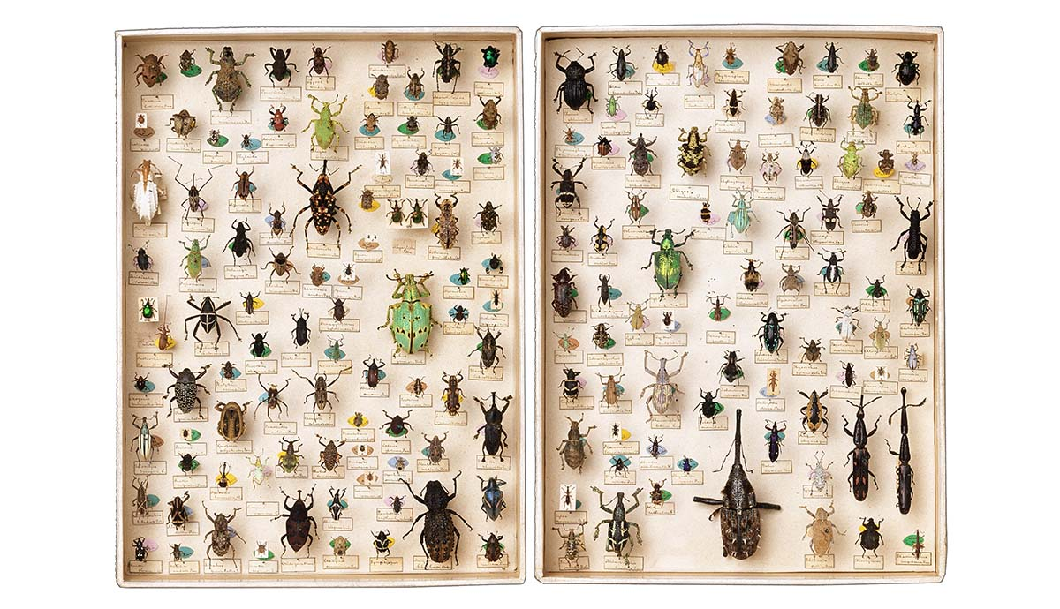
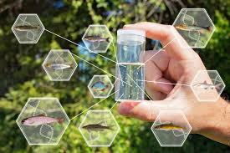
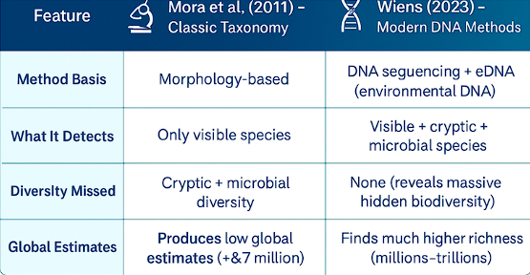
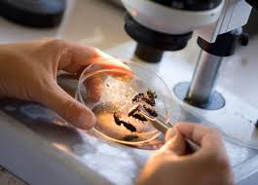
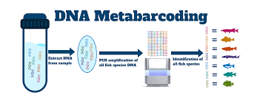
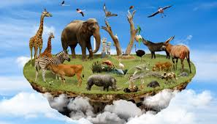
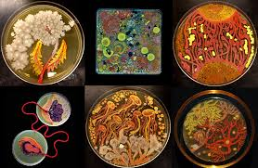
Comparison: Classic vs Modern
Classic
Modern
Classic taxonomy measures visible life; DNA methods reveal the hidden majority.
Notes:
Classic taxonomy (Mora): detects only visible eukaryotic species; misses cryptic + microbial diversity.
Modern DNA (Wiens): detects visible + cryptic + microbial diversity; reveals enormous hidden richness.
Core insight: the two methods are not estimating the same “universe” of life — classic taxonomy covers the tip of the iceberg, DNA reveals the hidden bulk.
Table created by the author using Canva (2025).

Slide 14
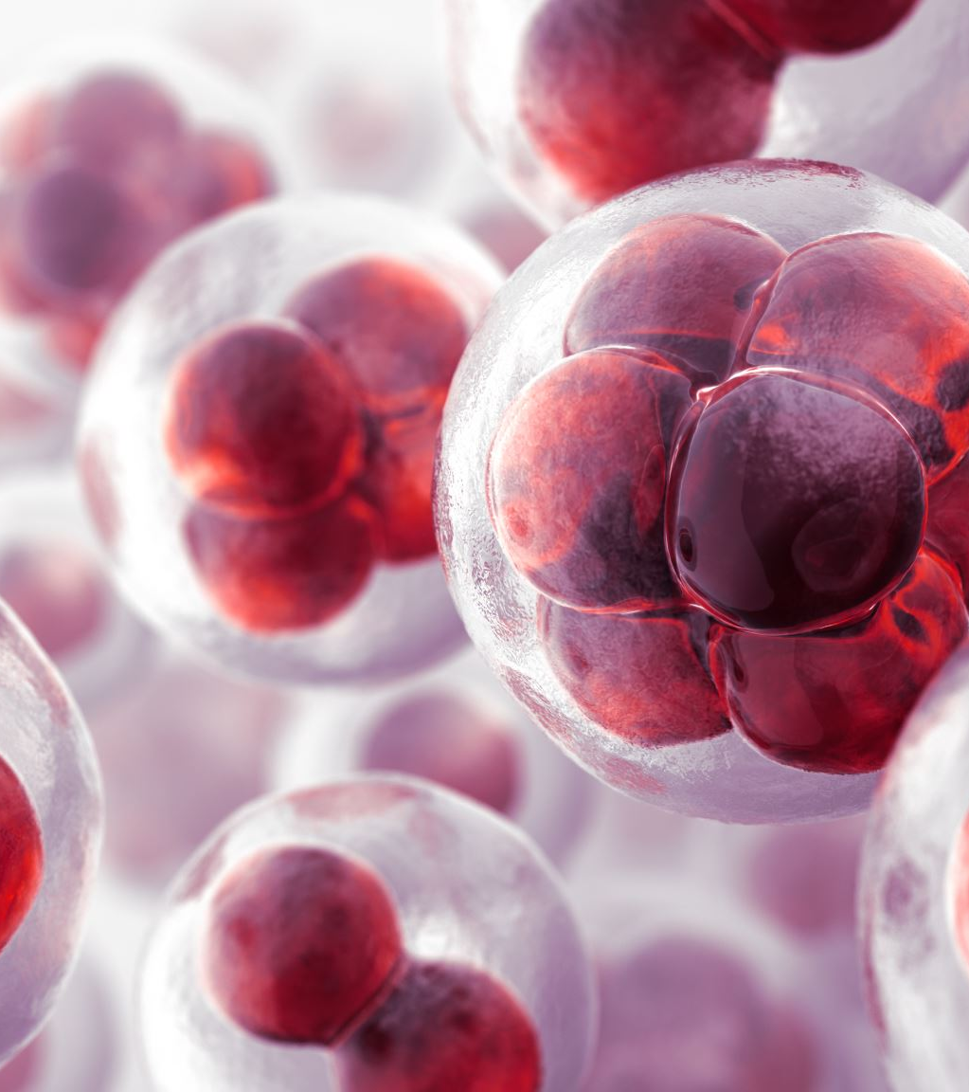
Conclusion
Earth’s true species richness is unknown and likely far higher than early estimates.
Classic taxonomy counts only visible, described species → underestimates diversity.
DNA-based methods (Wiens) detect cryptic, microbial, and hidden species → much higher estimates.
Different methods capture different parts of biodiversity, creating large gaps between estimates.
Most species remain unsampled because they are small, cryptic, or microbial.
Takeaway: Improving methods reveals more life — global richness is far greater than we once thought.
Notes:
Global species richness cannot be represented by one number because methods detect different subsets of life.
Classic estimates provide a visible-life baseline, but DNA methods reveal hidden biodiversity orders of magnitude larger.
Most of Earth’s life remains undescribed due to small size, rarity, habitat inaccessibility, or cryptic morphology.
Overall conclusion: global biodiversity is far greater than early estimates suggested, and advances in detection methods continually revise estimates upward.

Slide 15
Thank you for your attention!

Slide 16
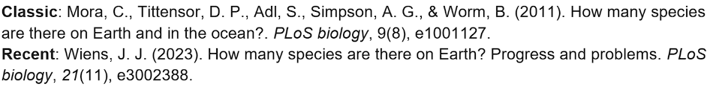
Resources:
Figure (slide 11): Székely, D., Cammen, K., & Olsen, M. T. (2022). Needles in an ocean haystack: Using environmental DNA to study marine mammals in the North Atlantic. NAMMCO Scientific Publications, 12. https://doi.org/10.7557/3.6482
Figure (slide 12):OpenAI. (2025). Fold-change calculations and data visualization generated using ChatGPT (Version GPT-5.1). https://www.openai.com/chatgpt

Slide 17
Who did what?
Aibar Azat 1,2,3
Novruzov Elvin prepared slides 4 ,5,6,7
Inseo Choi 8,9,10
Kindt Zoe prepared slides11,12,13,14,15,16,17

